Slide 2
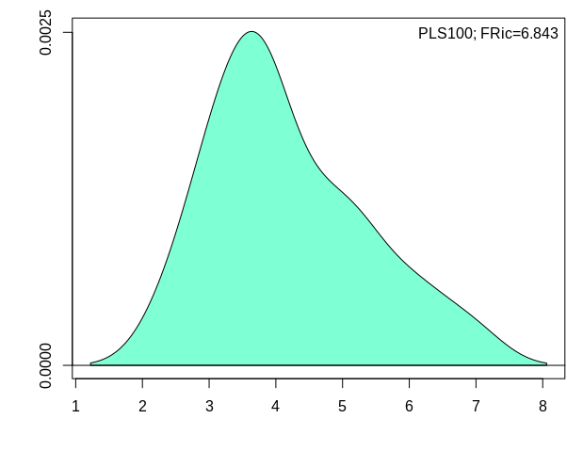
Tleaf 100PLS
Fric=6.843
Feve=0.666
FDiv=0.451

Slide 3
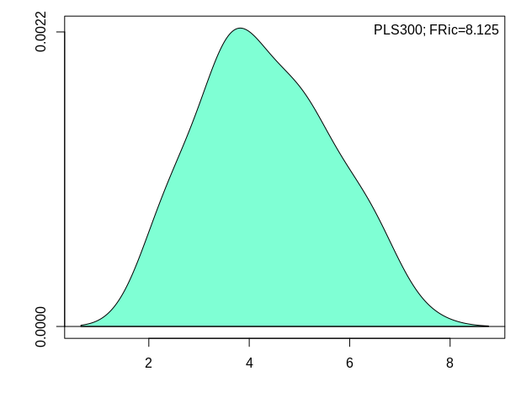
Tleaf 300 PLS
Fric=8.125
Feve=0.655
FDiv=0.395

Slide 4
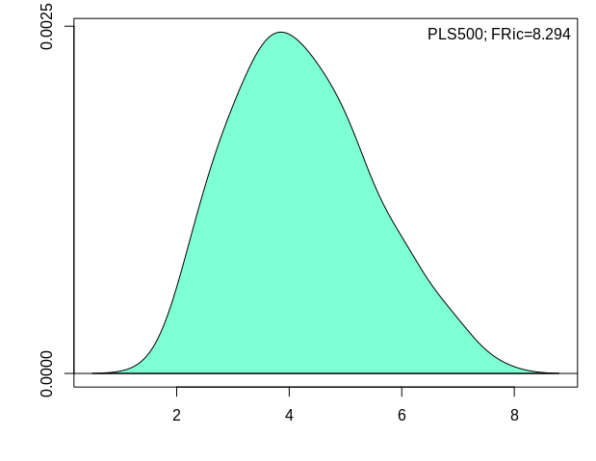
Tleaf 500PLS
Fric=8.294
Feve=0.606
FDiv=0.362

Slide 5
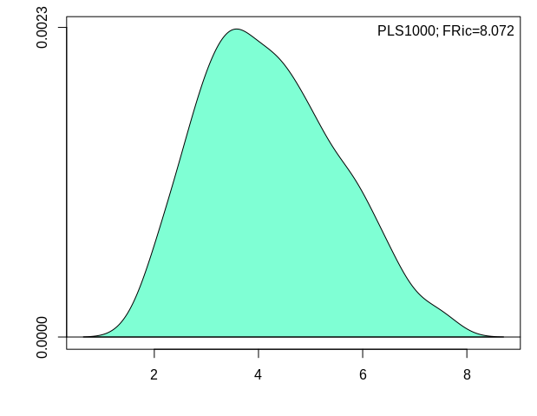
Tleaf 1000PLS
Fric=8.072
Feve=0.633
FDiv=0.394

