Slide 1
SEMESTER PROJECT Rental software system IT1-S16
GROUP #2
Bianca Sgondea
Nicholas Papas
Nikola Sevo
Sergiu Craciunescu
Notes:
Good morning, we are group number two, my name is Sergiu and today we’re going to present our project for this semester which consist in developing a rental software system.

Slide 2
Agenda
Introduction
Analysis
Requirements
Use case
Use case description
Activity diagrams
Class diagram
Implementation
Group work
Demonstration
Notes:
In today’s agenda you can find all the parts we have in our presentation. At the beginning I’m going to make a short introduction about the project and talk about a little part of the analysis, the requirements. Bianca will continue with the rest of the analysis part, use case model, description and activity diagrams followed by Nikola who is going to talk about the class diagram and the implementation part and Nicholas who is going a to speak about our work as a group and about the stages that we’ve been during this project period. At the end we’re going to make a demonstration of the program developed, where we’re going to show our graphical user interface and the functionalities of our system developed by now.

Slide 3
Introduction
Purpose
Notes:
The main purpose of this project it was to create a rental software system for the V-Rent company, a small company located in Horsens, owned by Van Motor so he can upgrade his business helping the employees to manage the rents and the vehicles they have much easier. To understand exactly what the client wants we had an interview with Van Motor were we extract his wishes and transform it in requirements.

Slide 4
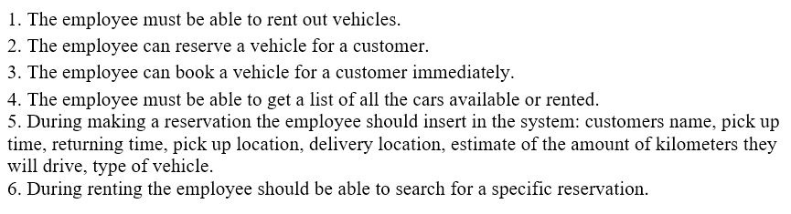
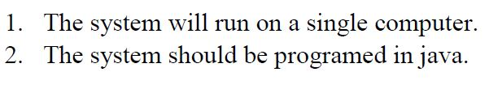
Requirements
Functional requirements
Non-functional requirements
Notes:
Requirements are the client’s demands for the system. We separated the requirements in functional requirements, they describe what the system should do. Here we selected some of our requirements, and this ones are the most important and the ones that are working in our system so far, and non-functional requirements, they describe how the system works and here are the non-functional requirements extracted from the interview.

Slide 5
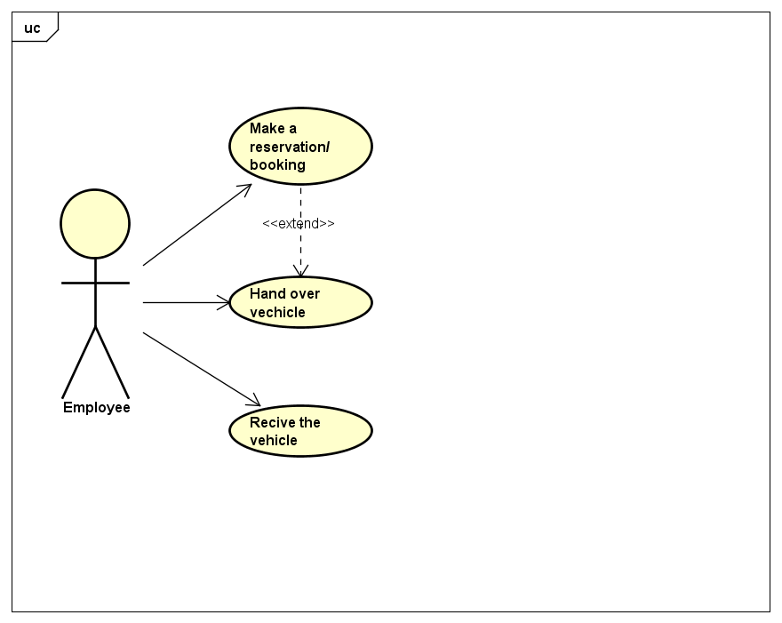
Use case
Represents a number of use case scenarios
Is represented with a use case description and in a use case diagram.
Notes:
Based on the requirements we designed a use case. A use case is a number of use case scenarios. For example we have 3 use cases, each use case is represented with a use case description. Next I will show you a use case description based on the first use case “Make reservation and booking”.

Slide 6
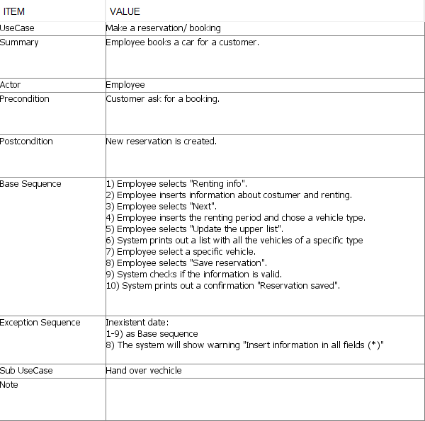
Use case description Make reservation/booking
Summary: action is described
Actor: shows who will do the action
Precondition: condition before the action
Post condition: the result after the action is done
Base sequence: describe the action detailed
Exception sequence: shows which base sequence can be an exception
Sub use case: connection with other action
Notes:
A use case description contains diffrent sections,
Summary: in which the action is described,
actor: shows who will do the action (in our case only employees have access),
precondition: shows the condition before making the action and post condition shows the result after the action is done ,
base sequence describe the action very detailed,
and exception sequence shows which base sequence can be an exception.
A sub use case shows if the use case has a connection with other action.

Slide 7
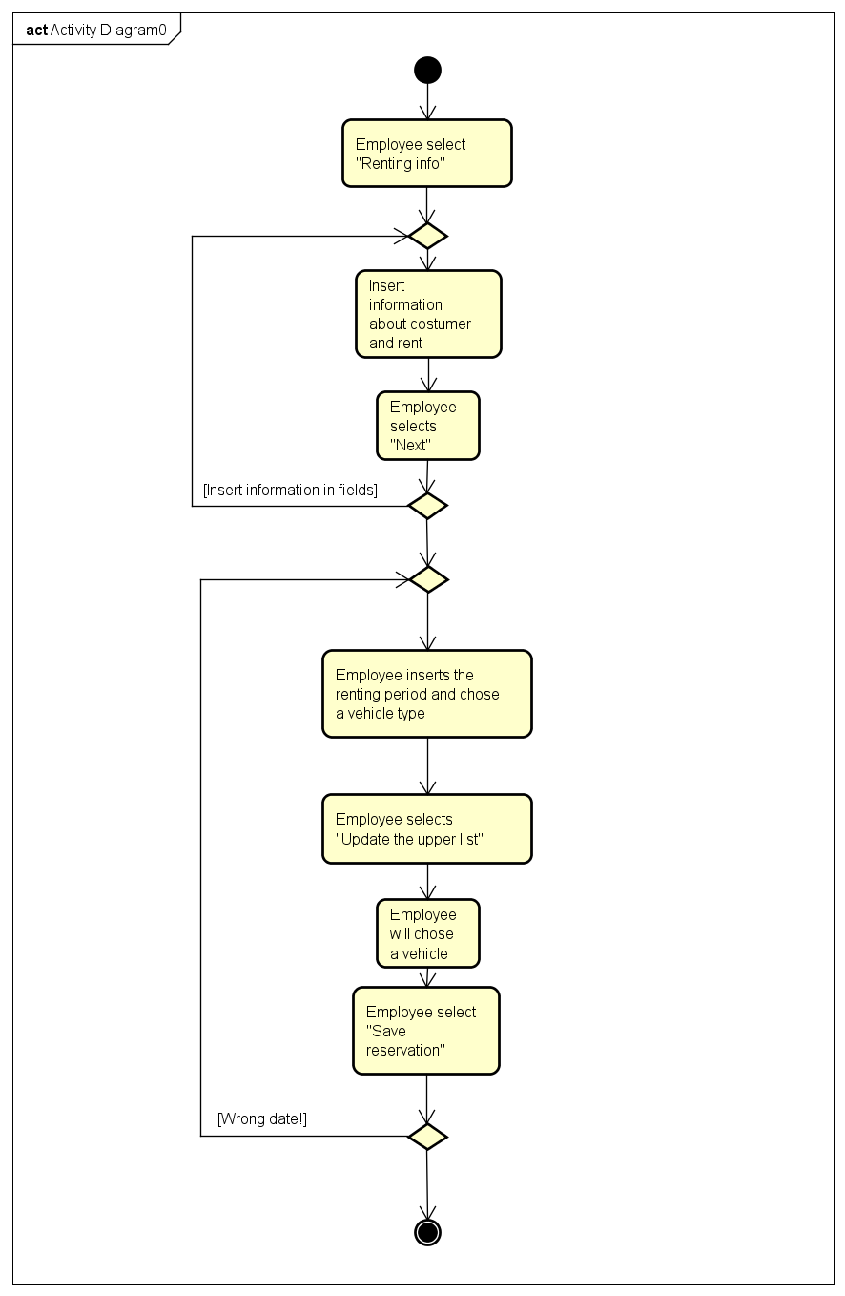
Activity diagram Make reservation/booking
Shows the steps involved in use case description

Slide 8
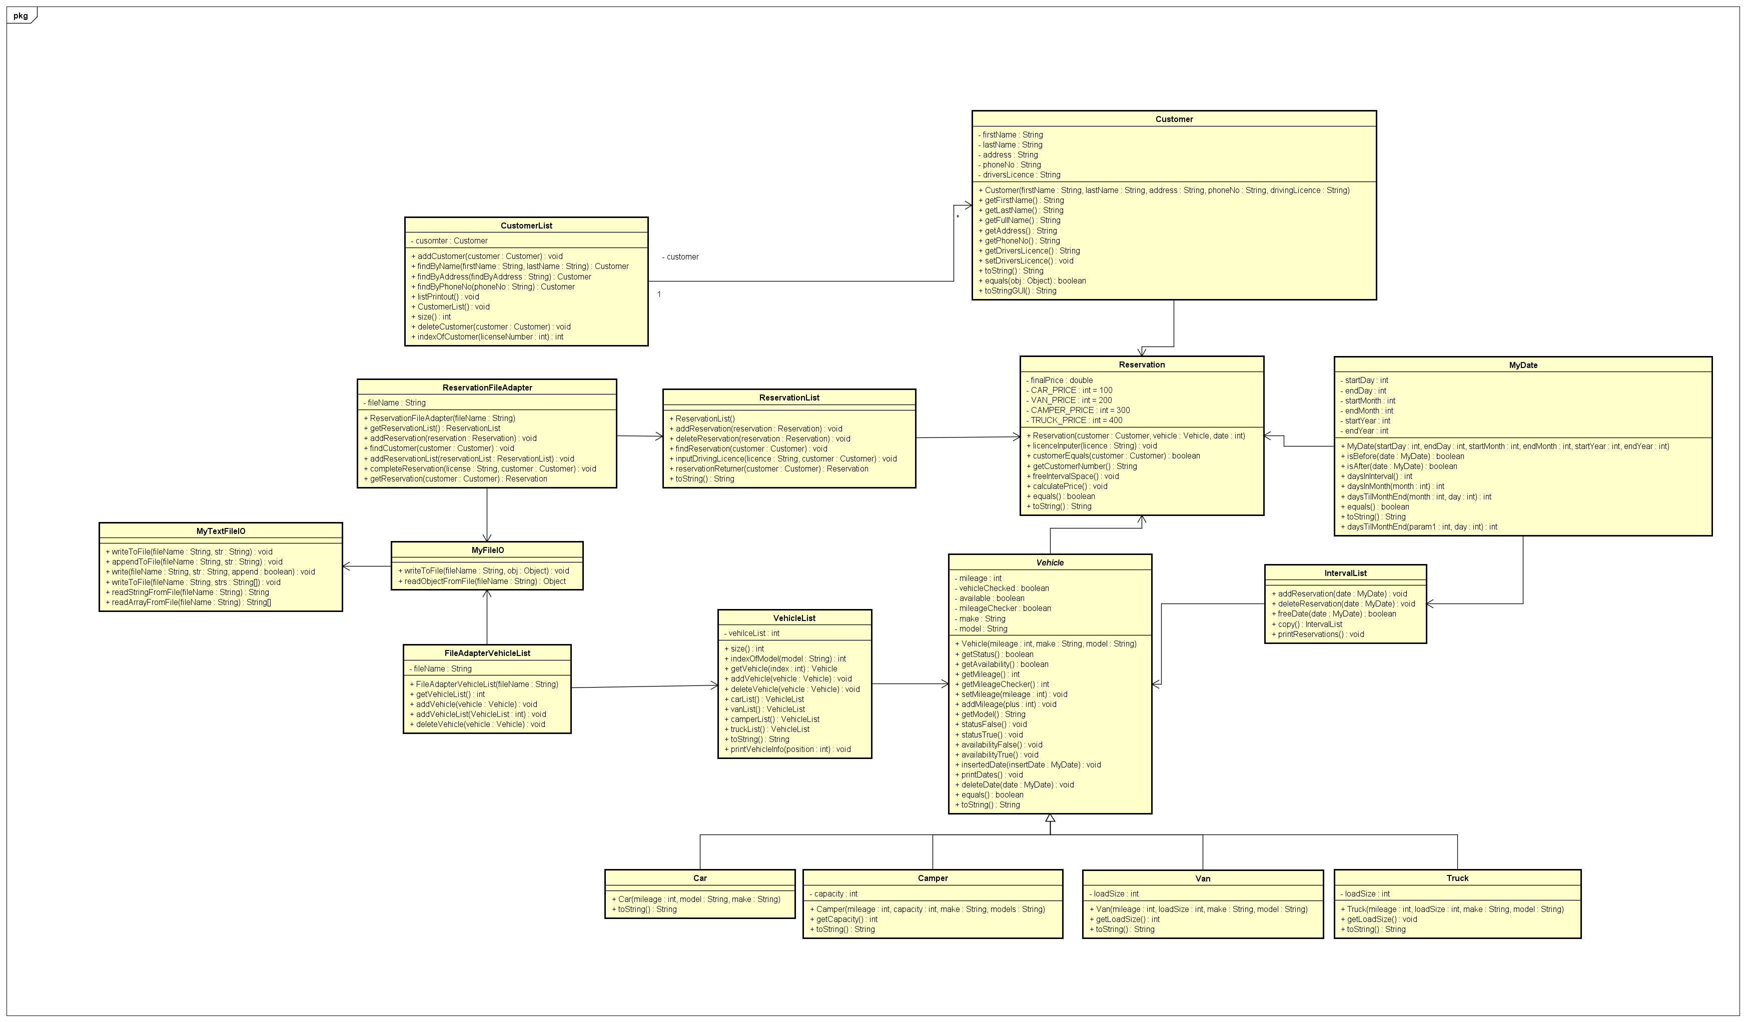
Class diagram
Structure diagram: system’s classes, their attributes, methods and the relationships between objects.
Illustration first, implementation second
Provides an easy overview without diving into code itself

Slide 9
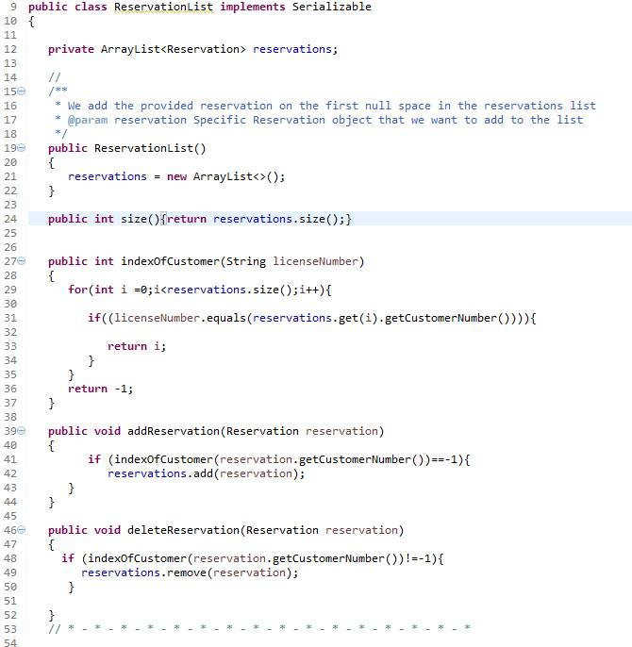
Implementation
After Class Diagram → Actual implementation Testing the functionality Add missing methods and fields Fixing diagrams ( unfortunately ) GUI implementation

Slide 10
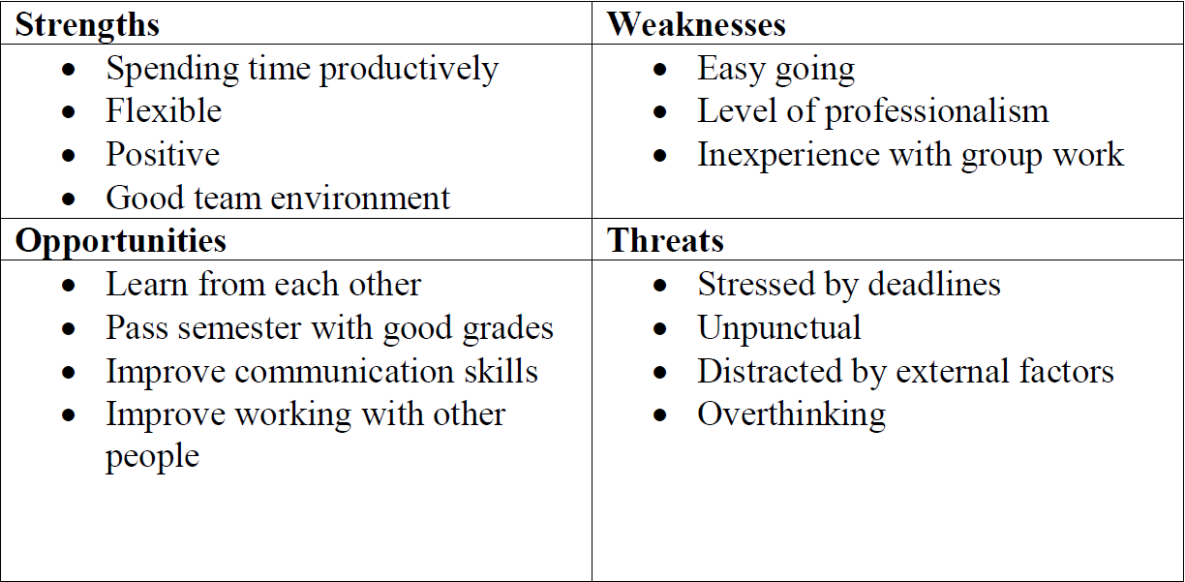
Group work
Group SWOT

Slide 11
Demonstration

Slide 12
Thank you for your attention!

