Slide 1


Honours Project: Automatic device positioning system
Project Students
Biancaa.R ECE SSN 4
Project Guides
Dr. Aasha Nandhini

Slide 2
Outline of the Presentation
Introduction
Objective
System design
Proposed System
Bluetooth Positioning
References

Slide 3
Introduction
Target beneficiaries: Dementia Patients
Devices own reciever and Bluetooth beacons combine to determine if the device is in a particular room.
For the identification of things.
Easy maintenance and transfer of the data due to its digitization.
Data analytics can be performed on the data which will provide useful insights.

Slide 4
Objective
To design a system capable of ensuring the device is within the room, and to narrow down the indoor positioning of the object and to perform data analytics on the stored data.
Problem Statement:
Create a fast and convenient way to locate the device.
Use data analytics to provide insights on details.

Slide 5
System Design
DELIVERABLES
Trying to locate an object
Trying to find the position based on signal strength
Ensuring the signal is from inside the house
Data analytics using the devices positions.
Get the device
+- 5 meters
Identifiaction of room in which the device is in

Slide 6
Literature review
Paper Title | Authors / Source | Year | Key Approach / Features | Summary
Indoor Positioning System Using BLE for Tracking Dynamic Users | Christian Alvin Setiabudi et al. | 2020 | Fingerprinting method with Extended Kalman Filter for tracking | Proposes BLE-based IPS with fingerprinting to handle dynamic users and mitigate multipath effects using weighted sum and EKF for tracking in indoor environments .
A BLE-based Turnkey Indoor Positioning System for Mobility Monitoring | Mokhtari et al. and others | 2025 | Proximity detection and trilateration combined with sensor feedback | Developed an easy-to-integrate IPS requiring minimal setup, focusing on room-level presence detection using BLE RSSI and environmental sensors with exponential filtering for signal smoothing .

Slide 7
Theories and Methods for Indoor Positioning Systems | TG Hailu | 2024 | Reviews BLE alongside Wi-Fi, Zigbee, LoRaWAN; fingerprinting, trilateration, Gaussian filtering | Discusses various measurement techniques including BLE's low power use and cost-effectiveness; hybrid fingerprinting-trilateration improves accuracy; examines BLE performance in typical indoor scenarios .
A Low-Cost Indoor Positioning System Using Bluetooth Low Energy | L Bai et al. | 2020 | BLE beacons, trilateration and fingerprinting with Kalman and particle filters | Develops low-cost system using BLE beacons combined with Raspberry Pi; implements noise reduction with Kalman and Particle filters; targets long-term home monitoring .
Bluetooth Low Energy for Indoor Positioning: Challenges and Applications | M Ghaemifar | 2025 | Comprehensive review of BLE IPS challenges, methods, and applications | Provides an extensive review of BLE IPS techniques, identifying challenges like signal instability, multipath effects, and energy constraints, while reviewing fingerprinting, trilateration, and hybrid approaches .

Slide 8
Peer-to-Peer Verification
DELIVERABLES
First step in student location verification.
The person’s phone scans the vicinity for devices. The phones are matched to the corresponding device by the UUID that is being advertised by the device.
These first set of devices are marked as ‘PP Verified’.
This process cascades until all the beacon are either marked present or a timeout occurs.

Slide 9
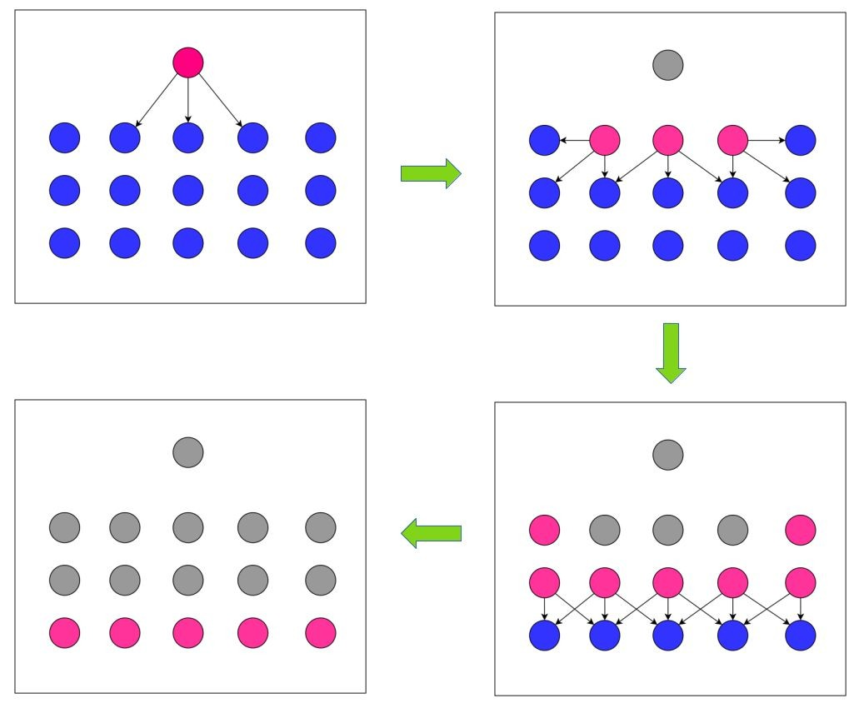
Peer-to-Peer Verification
DELIVERABLES

Slide 10
Bluetooth Beacon Verification
DELIVERABLES
Once this stage is reached, Bluetooth beacons are used to negate the obvious false positives.
The beacons are installed on the outer walls of rooms.
They will be able to detect the signals of devices outside rooms and immediately invalidate their request / inform that the device is outside..

Slide 11

Bluetooth Beacon Verification
DELIVERABLES
Reciever
Becons inside

Slide 12
Needed Hardware:
* BLE Beacons: Devices like Texas Instruments SensorTag CC2650, or ESP32 modules configured as BLE beacons transmitting advertising packets.
* ESP32 Dev Boards: Widely used dual-core microcontrollers with integrated Wi-Fi and BLE, serving as beacons and receivers.
* LED Indicators: For visual status feedback of beacon transmission, reception, or system state.
* Power Supply: Batteries and regulators suitable for low power IoT devices.
* Receivers: ESP32 or Raspberry Pi with BLE radios capable of scanning and collecting BLE signal RSSI.

Slide 13
Workplan:
Setup and Hardware Deployment: Select and deploy BLE beacons, ESP32 modules, and LEDs in the target indoor environment for signal coverage.
BLE Signal Acquisition: Program ESP32 devices to broadcast and scan BLE signals; collect RSSI data for positioning.
Algorithm Development: Implement positioning algorithms (trilateration/fingerprinting) with filtering (Kalman/particle filter) for accuracy.
Testing & Optimization: Test system accuracy in real scenarios, calibrate parameters, and finalize user interface and visualization tools.

Slide 14
THANK YOU

