Slide 1
OPTICAL CHARACTER RECOGNITION
Presented By:
Bandaru Kundana Sri(3122 22 3002 023)
Bharathi K(3122 22 3002 024)
Biancaa(3122 22 3002 025)

Slide 2
Problem Statement
Extracting text from images is a challenging task, especially for handwritten and distorted text.
Traditional OCR methods struggle with irregular text orientations and complex fonts.
There is a need for a robust deep learning-based approach to improve accuracy.

Slide 3
Objectives
Dataset Preparation: Acquire and preprocess handwritten or printed text images.
Model Selection: Implement different ML models such as Linear Regression, SVM, and CRNN with CTC for sequence learning.
Training & Optimization: Train each model with labeled text data.
Performance Evaluation: Compare models based on accuracy and efficiency on benchmark OCR datasets.
Real-world Deployment: Ensure model generalizability for practical OCR applications.

Slide 4
Literature Survey
Related Works:
OCR research dates back to traditional rule-based methods like Tesseract OCR.
Machine learning approaches such as SVM and HMM improved character recognition.
Deep learning models, particularly CNNs and RNNs, revolutionized OCR by improving accuracy in complex scenarios.
Recent advancements include transformer-based models like TrOCR, which further enhance recognition performance.

Slide 5
Block Diagram
Input
Image
Feature Extraction
Preprocessing
OCR Models
Output

Slide 6
Our Progress

Slide 7
Models Implemented
1. Logistic Regression:
Initially used for OCR but found to be unsuitable due to its limitations in handling complex image data.
Confusion matrix results indicate misclassifications.
2. Support Vector Machine (SVM):
Implemented for digit recognition using the MNIST dataset.
Achieved decent accuracy but struggled with complex handwritten text.
3. CRNN with CTC Loss:
Best performing model so far.
Uses convolutional layers for feature extraction and LSTMs for sequence prediction.
Suitable for real-world OCR applications.

Slide 8
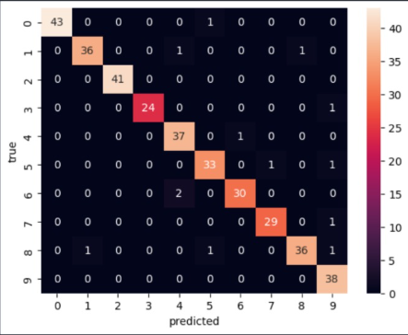
Sample Output from Logistic Regression Model
Below is a confusion matrix from our Logistic Regression model trained on the handwritten digits dataset.
Observation: Misclassification of some digits.

Slide 9
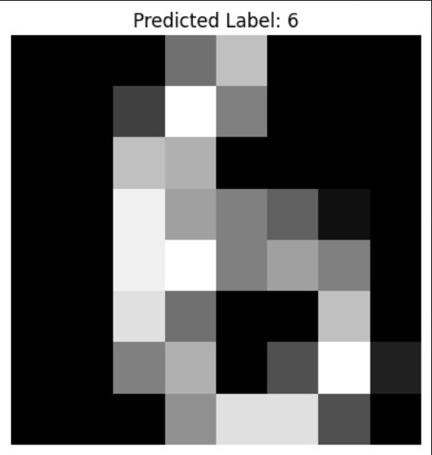
Sample Output from SVM Model
Below is a prediction from our SVM model trained on the handwritten digits dataset.
Predicted Label: 6
Accuracy: Displayed in the results of the SVM model.

Slide 10
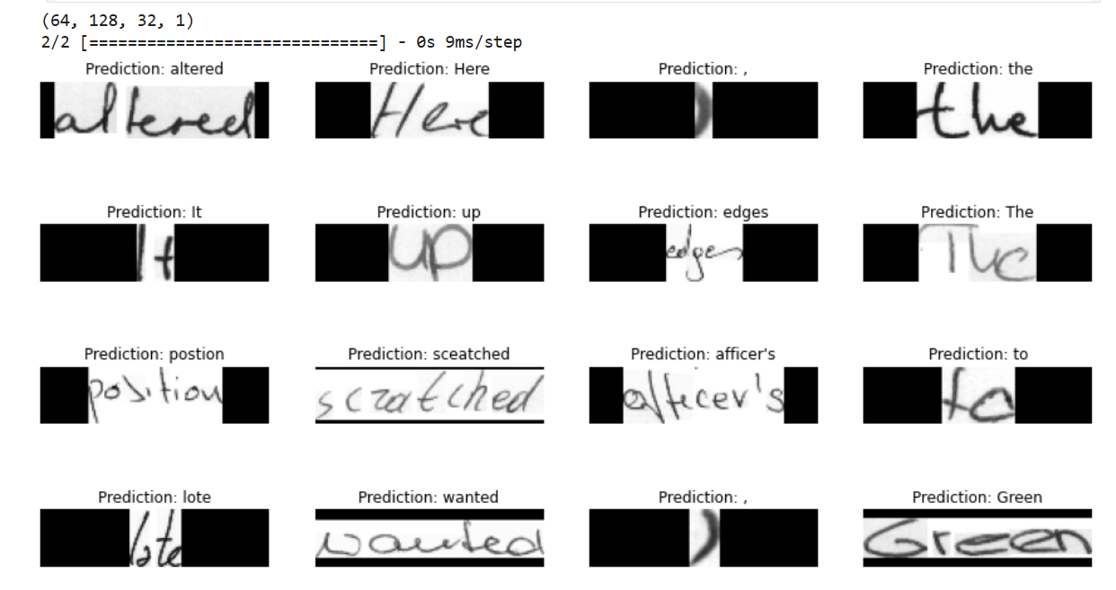
Sample Output from CRNN + CTC Model
Convolutional Neural Network + Connectionist Temporal Classification
CNN layers are used to extract spatial features from images.
These layers identify edges, curves, and shapes in the handwriting.
CTC loss is used because in OCR, the alignment between the input (image) and output (text) is unknown.
It allows the model to learn without needing character-level annotations.

Slide 11
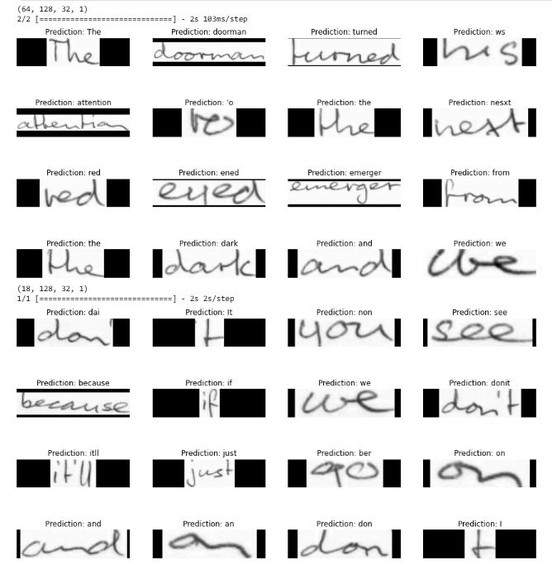
['The', 'doorman', 'turned', 'ws', 'attention', "'o", 'the', 'nesxt', 'red', 'ened', 'emerger', 'from', 'the', 'dark', 'and', 'we', 'went', 'an', 'tosether', 'to', 'the', 'station', 'the', 'children', 'silent', 'because', 'of', 'the', 'cruelty', 'of', 'the', 'world', 'Finally', 'Catherine', 'sand', 'her', 'eyes', 'wet', 'agan', 'think', 'its', 'all', 'abslutely', 'beasthyy', 'and', 'I', 'can', "'f", 'bear', 'tothink', 'about', 'it', 'And', 'D1', 'hikip', 'sand', 'But', 'we', 'we', 'aot', 'to', 'think', 'about', 'it', 'dai', 'It', 'non', 'see', 'because', 'if', 'we', 'donit', 'itll', 'just', 'ber', 'on', 'and', 'an', 'don', 'I', 'non', 'see']

Slide 12
The doorman turned ws attention 'o the nesxt red ened emerger from the dark and we went an tosether to the station the children silent because of the cruelty of the world Finally Catherine sand her eyes wet agan think its all abslutely beasthyy and I can 'f bear tothink about it And D1 hikip sand But we we aot to think about it dai It non see because if we donit itll just ber on and an don I non see

Slide 13
Next Steps
Fine-tune the CRNN model to improve accuracy.
Implement real-time text extraction using an API.
Conduct further comparisons with transformer-based models such as TrOCR,ViT-based OCR models.

Slide 14
References
Smith, R. (2007). "An overview of the Tesseract OCR engine." In Document Analysis and Recognition.
Graves, A., & Schmidhuber, J. (2009). "Offline handwriting recognition with multidimensional recurrent neural networks." In Advances in Neural Information Processing Systems (NIPS).
Baek, J., et al. (2019). "What is wrong with scene text recognition model comparisons?" In International Conference on Computer Vision (ICCV).
Li, Y., et al. (2021). "TrOCR: Transformer-based OCR with pre-trained self-supervised learning." arXiv preprint arXiv:2109.10282.

Slide 15
Thank You!

