Slide 1
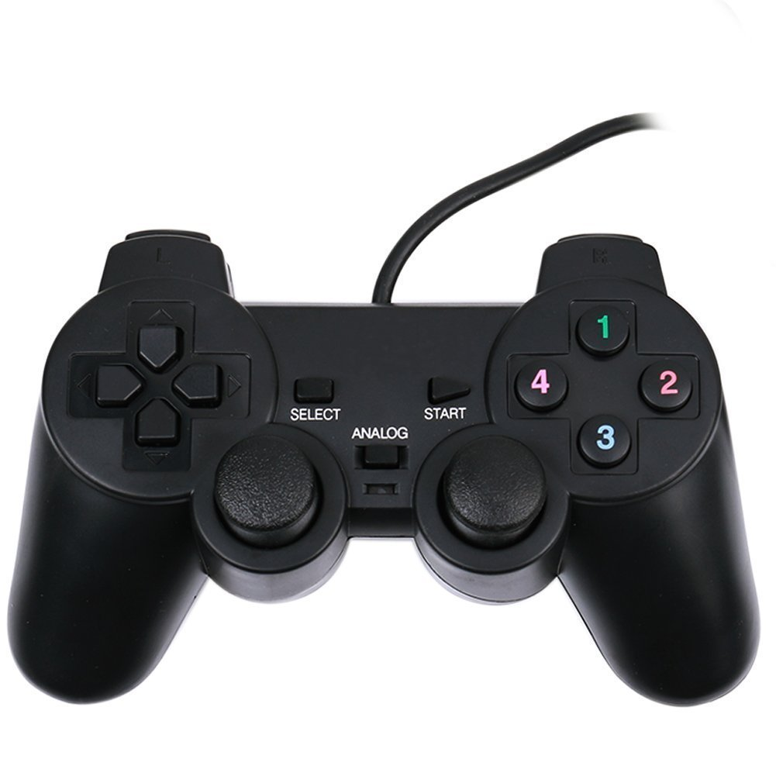
Armar
Retornar
Aterrizar

Slide 2
Info
Joystick

Slide 3
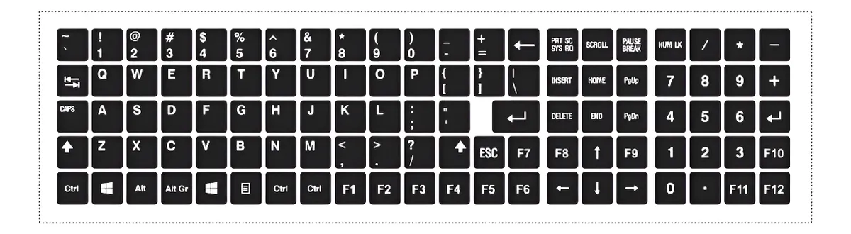
Retornar
Armar
Pitch
Aterrizar
Yaw
Throttle
Roll

