Slide 1
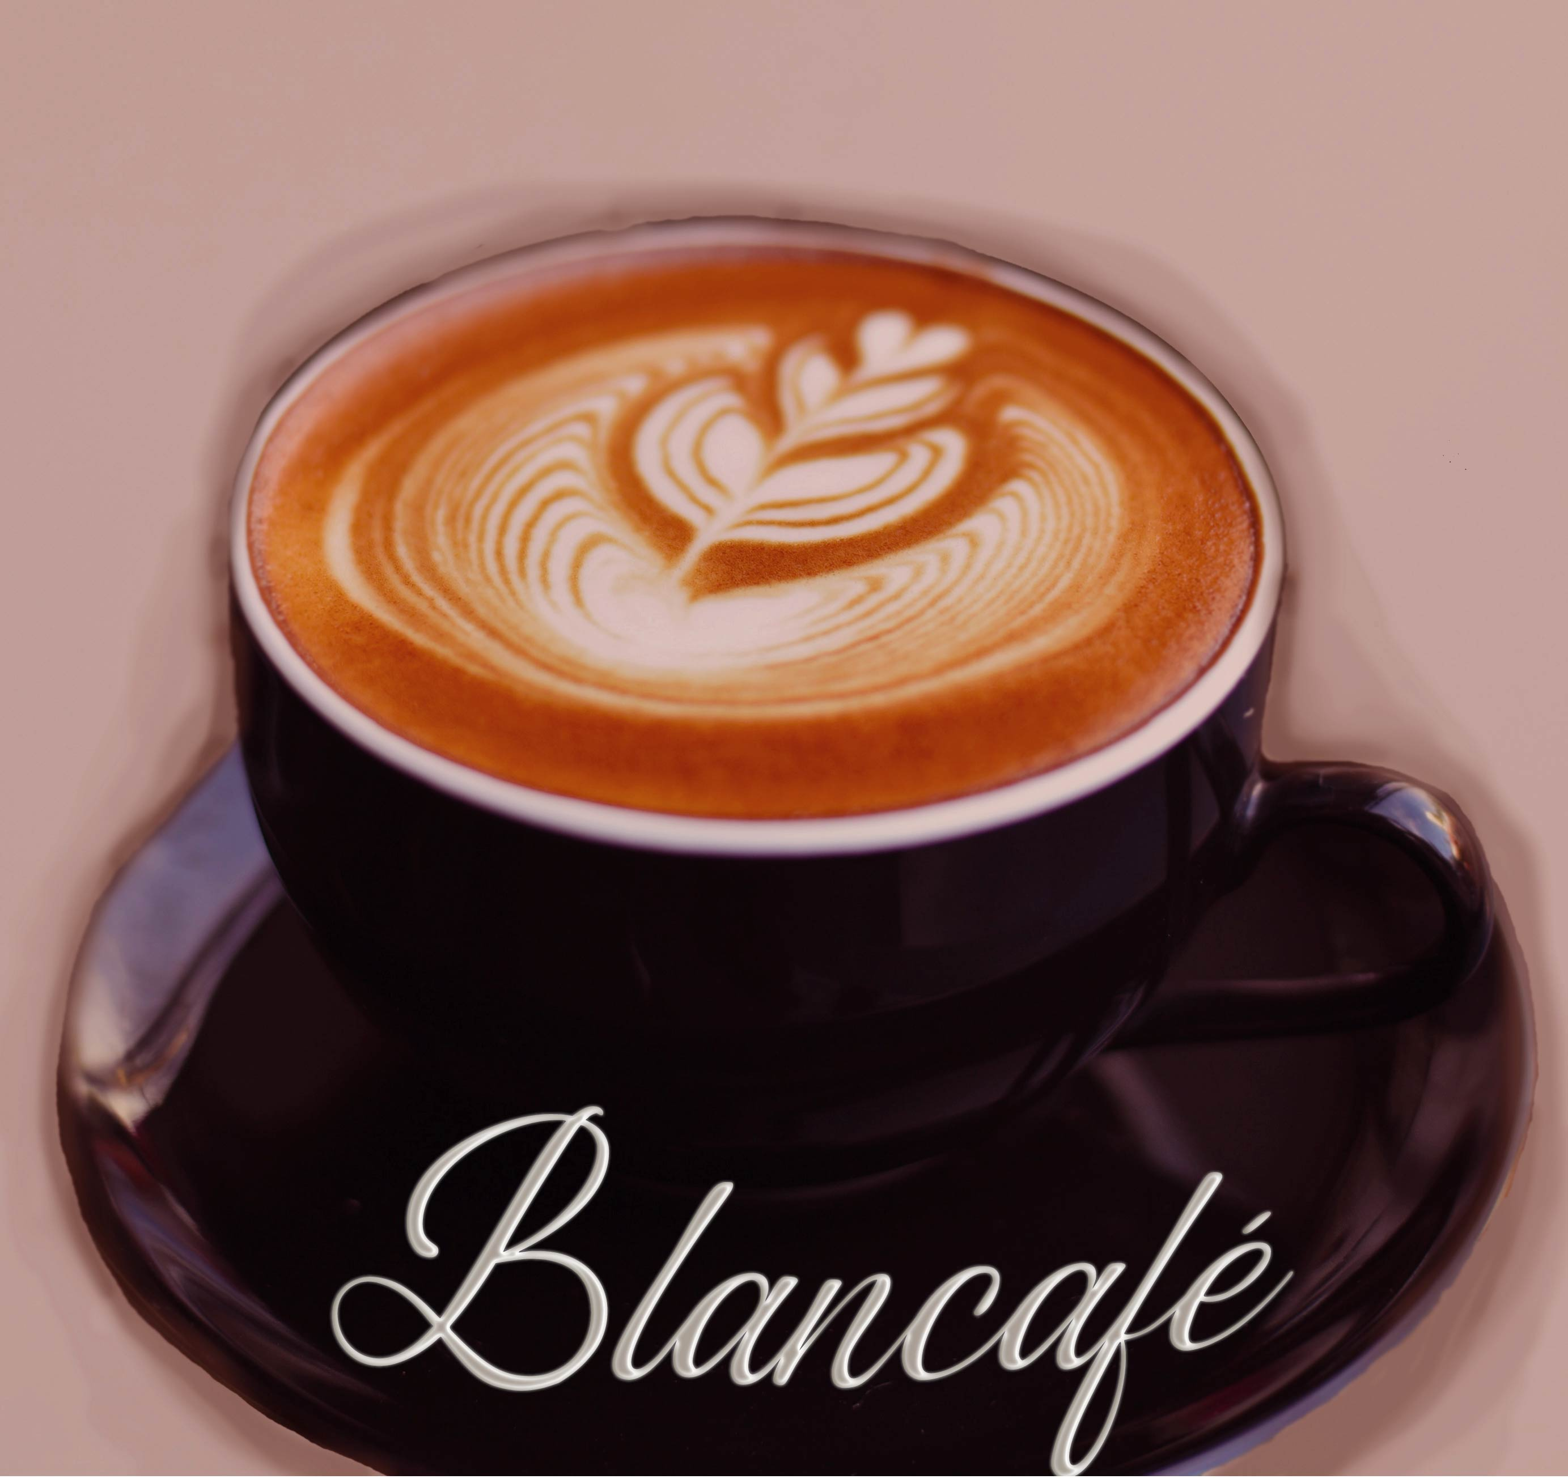
Blancafé
Project created by: Cojocaru Laura
Plamada Bianca
Lipsa Bianca

Slide 2
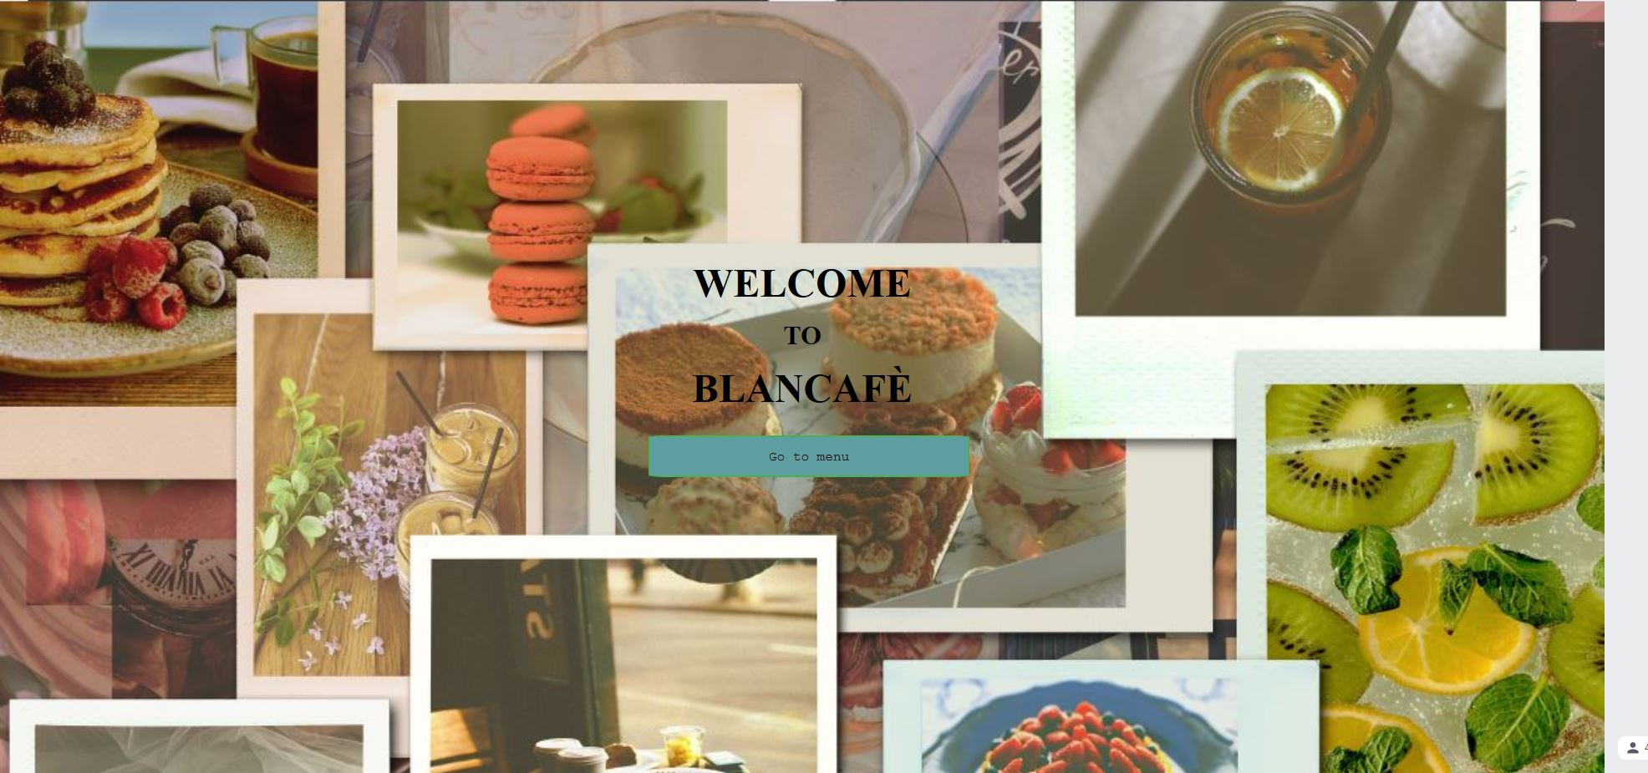
Home page introduction
The “Welcome to Blancafé” was invented by combining our names, resulting in ”Blanca”. After we had the name we added “-fé” to match the name of an elegant café resulting in „Blancafé“.
The “Go to menu” button was designed to redirect the customer to our menu page so they can choose from our variety of products.

Slide 3
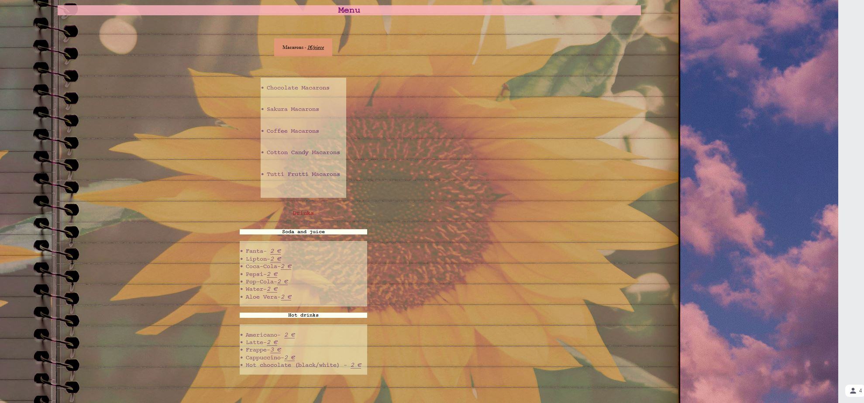
The menu
In the menu you can find two buttons that will redirect you to sites that will describe the macarons and drinks we have available in our shop.
Before you choose to leave the menu you can look at our categories of drinks and macarons. That way you will know where to look further.

Slide 4
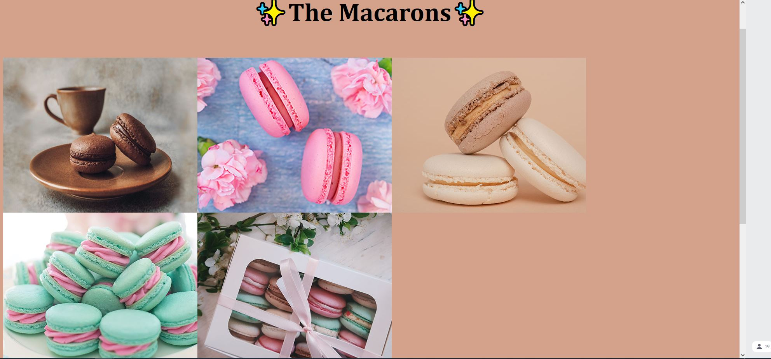
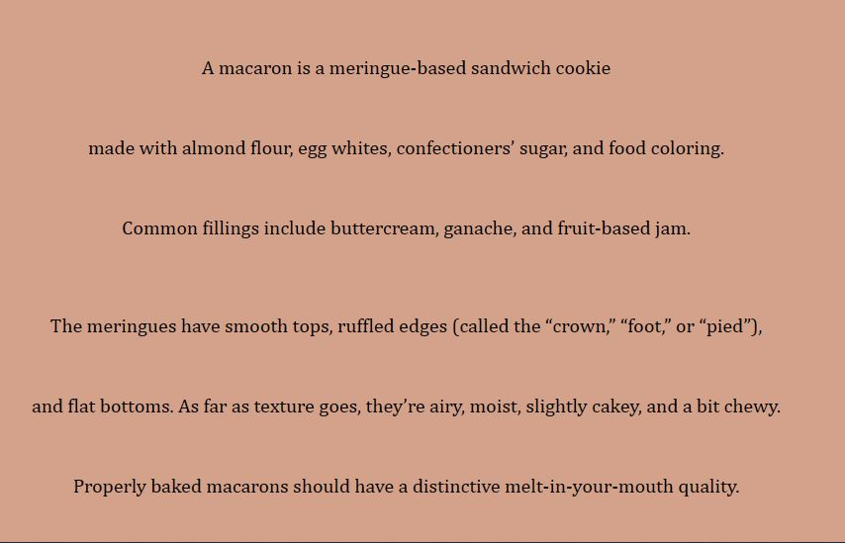
The sweet dish
The “Macarons” button will redirect you to this page, where you can see photos of our sweets .
With the photos comes a little description where it explains what a macaron is, how it is made and with what .

Slide 5
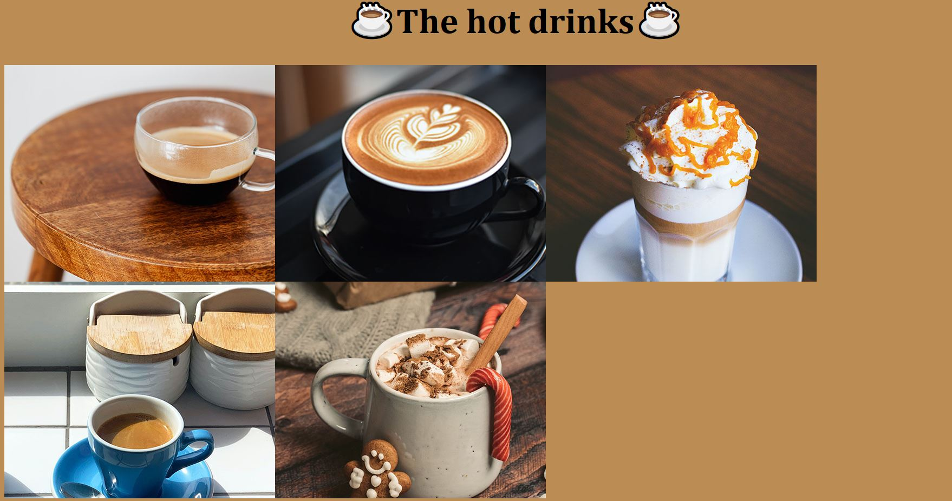
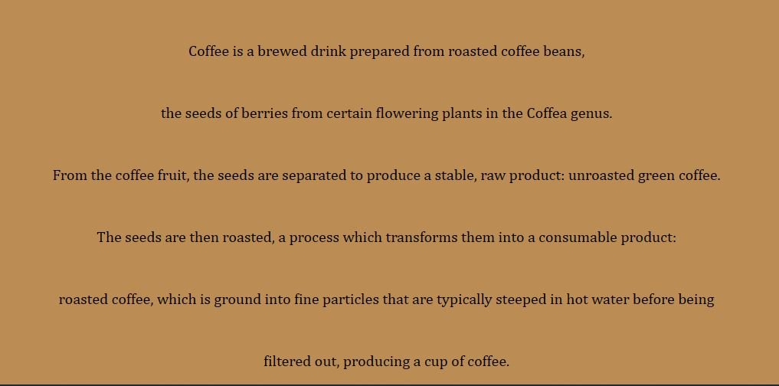
The beverages
The “Hot drinks ” button will redirect you to our drinks page,where you will see our categories of beverages.
Like the macaron page, the drinks page has a description where you can find out a little bit of information on coffee.

Slide 6
Why did you choose this theme?
Firstly, we thought we should do a restaurant but we chose a name that didn’t match a good restaurant. After some thinking, we decided to do a café with macarons as the main sweet dish and a variety of hot and cold drinks.
We didn’t choose to do a café because we were out of ideas, but because we visited a lot of beautiful cafés in Karlsruhe that inspired us and made us want to recreate their beauty .

Slide 7
Thank you for listening to our project!

