Slide 1


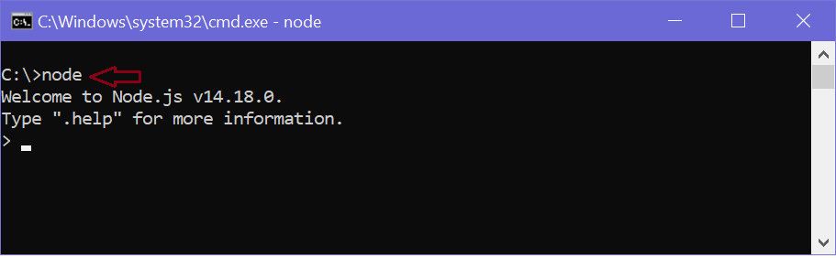
Module 6.3 Node JS Console
The node:console module provides a simple debugging console that is similar to the JavaScript console mechanism provided by web browsers.
The module exports two specific components:
A Console class with methods such as console.log(), console.error(), and console.warn() that can be used to write to any Node.js stream.
A global console instance configured to write to process.stdout and process.stderr. The global console can be used without calling require('node:console').
www.skillaura.com

Slide 2
Example using the global console:
console.log('hello world');
// Prints: hello world, to stdout
console.log('hello %s', 'world');
// Prints: hello world, to stdout
console.error(new Error('Whoops, something bad happened'));const name = 'Ramesh';
console.warn(`Danger ${name}! Danger!`);
// Prints: Danger Ramesh! Danger!, to stderr
www.skillaura.com

Slide 3
Console Class
myConsole.log('hello %s', 'world');
// Prints: hello world, to out
myConsole.error(new Error('Whoops, something bad happened'));
// Prints: [Error: Whoops, something bad happened], to err
const name = 'Will Robinson';
myConsole.warn(`Danger ${name}! Danger!`);
// Prints: Danger Will Robinson! Danger!, to err
Example using the Console class:
const out = getStreamSomehow();
const err = getStreamSomehow();
const myConsole = new console.Console(out, err);
myConsole.log('hello world');
// Prints: hello world, to out
www.skillaura.com

Slide 4
Console.clear()
console.clear()
Added in: v8.3.0
When stdout is a TTY, calling console.clear() will attempt to clear the TTY. When stdout is not a TTY, this method does nothing.
The specific operation of console.clear() can vary across operating systems and terminal types. For most Linux operating systems, console.clear() operates similarly to the clear shell command. On Windows, console.clear() will clear only the output in the current terminal viewport for the Node.js binary.
www.skillaura.com

Slide 5
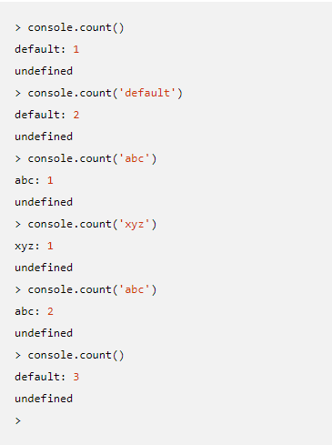
Console.count()
console.count([label])#
Added in: v8.3.0
label <string> The display label for the counter. Default: 'default'.
Maintains an internal counter specific to label and outputs to stdout the number of times console.count() has been called with the given label.
www.skillaura.com

Slide 6
Some other Console Commands:
console.countReset([label])
console.debug(data[, ...args])
console.dir(obj[, options])
console.error([data][, ...args])
const code = 5;
console.error('error #%d', code);
// Prints: error #5, to stderr
console.error('error', code);
// Prints: error 5, to stderr
www.skillaura.com

Slide 7
Console Log()
console.group([...label])#
Added in: v8.5.0
...label <any>Increases indentation of subsequent lines by spaces for groupIndentation length.If one or more labels are provided, those are printed first without the additional indentation.console.groupCollapsed()#
Added in: v8.5.0
An alias for console.group().
conole.groupEnd()#
Added in: v8.5.0
Decreases indentation of subsequent lines by spaces for groupIndentation length.
console.info([data][, ...args])#
Added in: v0.1.100
data <any>
...args <any>
The console.info() function is an alias for console.log()
www.skillaura.com

Slide 8
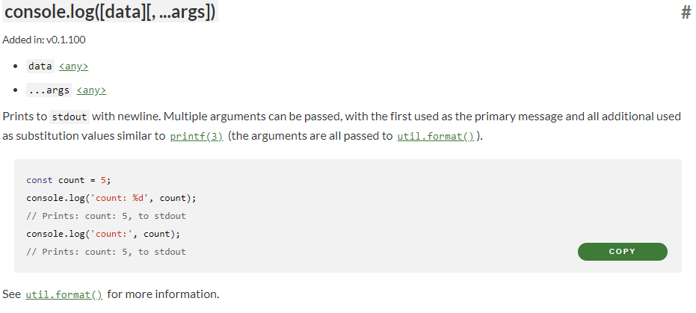
Console Log
Skill Aura
www.skillaura.com

Slide 9
console.profileEnd([label])#
Added in: v8.0.0
label <string>
This method does not display anything unless used in the inspector. Stops the current JavaScript CPU profiling session if one has been started and prints the report to the Profiles panel of the inspector. See console.profile() for an example.
If this method is called without a label, the most recently started profile is stopped.
console.timeStamp([label])#
Added in: v8.0.0
label <string>
This method does not display anything unless used in the inspector. The console.timeStamp() method adds an event with the label 'label' to the Timeline panel of the inspector..
www.skillaura.com

Slide 10
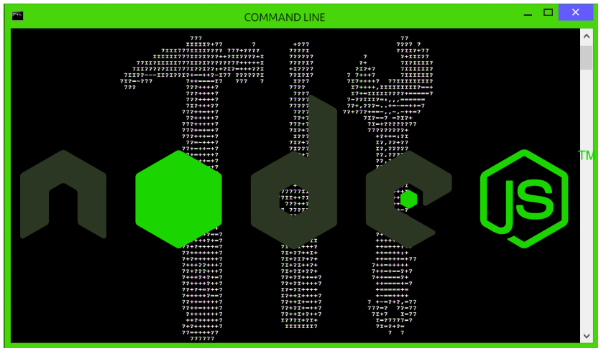
Module 6.4 Node JS Command Line Utilities
The node:console module provides a simple debugging console that is similar to the JavaScript console mechanism provided by web browsers.
The module exports two specific components:
A Console class with methods such as console.log(), console.error(), and console.warn() that can be used to write to any Node.js stream.
A global console instance configured to write to process.stdout and process.stderr. The global console can be used without calling require('node:console').
www.skillaura.com

Slide 11
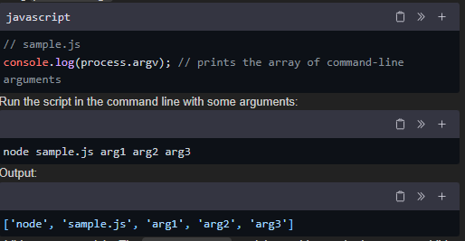
In Node.js, there are several built-in modules and utilities that provide command-line functionalities. These utilities allow you to interact with the command line and perform tasks such as parsing command-line arguments, running external commands, and displaying colored output. Let's explore some of the commonly used command utilities in Node.js:
process.argv: The process.argv property is an array that contains the command-line arguments passed to the Node.js process. The first element (process.argv[0]) is always the path to the Node.js executable, and the second element (process.argv[1]) is the path to the JavaScript file being executed. The subsequent elements in the array are the command-line arguments.
Here's an example of how you can access and parse the command-line arguments using process.argv:
www.skillaura.com

Slide 12
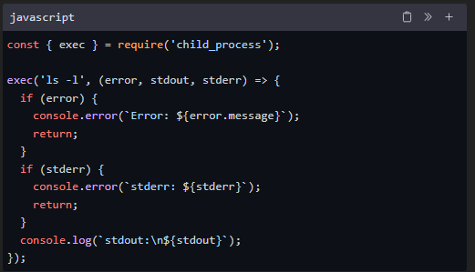
child_process module: The child_process module provides methods to spawn child processes and execute commands in the system's shell. It allows you to run external commands and interact with them programmatically.
Here's an example of how you can use the child_process module to execute an external command:
In the above example, the exec function executes the command ls -l, and the callback function is called when the command finishes executing. Any error or output from the command is handled within the callback.
readline module: The readline module provides an interface for reading input from a readable stream, such as the command line. It allows you to prompt users for input and read their responses.
www.skillaura.com

Slide 13
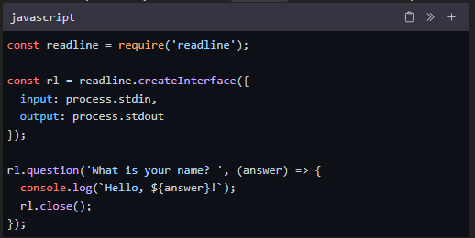
Here's an example of how you can use the readline module to read user input:
In the above example, the createInterface method is used to create an instance of the readline.Interface class. The question method prompts the user with the specified question, and the callback function is called with the user's response.
These are just a few examples of the command utilities available in Node.js. There are many other useful modules and libraries you can explore to enhance your command-line applications.
www.skillaura.com

Slide 14
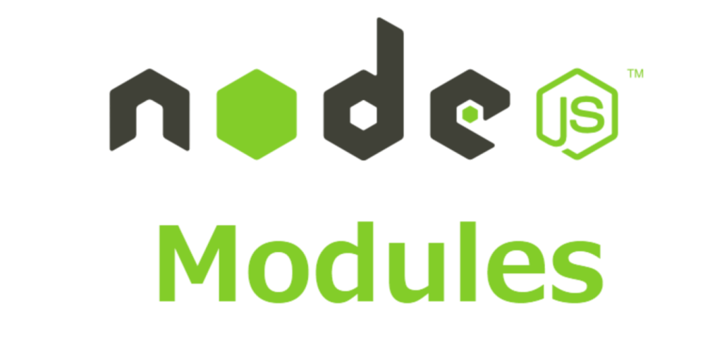
6.5 Node JS Modules
www.skillaura.com

Slide 15

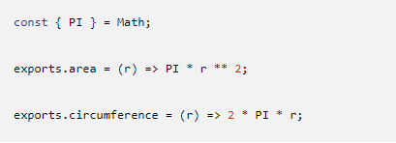
Modules in NodeJS
CommonJS modules are the original way to package JavaScript code for Node.js. Node.js also supports the ECMAScript modules standard used by browsers and other JavaScript runtimes.
In Node.js, each file is treated as a separate module. For example, consider a file named foo.js:
On the first line, foo.js loads the module circle.js that is in the same directory as foo.js.
Here are the contents of circle.js:
www.skillaura.com

Slide 16
Modules in NodeJS
The module circle.js has exported the functions area() and circumference(). Functions and objects are added to the root of a module by specifying additional properties on the special exports object.
Variables local to the module will be private, because the module is wrapped in a function by Node.js (see module wrapper). In this example, the variable PI is private to circle.js.
The module.exports property can be assigned a new value (such as a function or object).
www.skillaura.com

Slide 17
Types of Modules in NodeJS
There are three main types of Node modules that you will work with as a Node.js developer. They include the following.
Built-in modules
Local modules
Third-party modules
www.skillaura.com

Slide 18
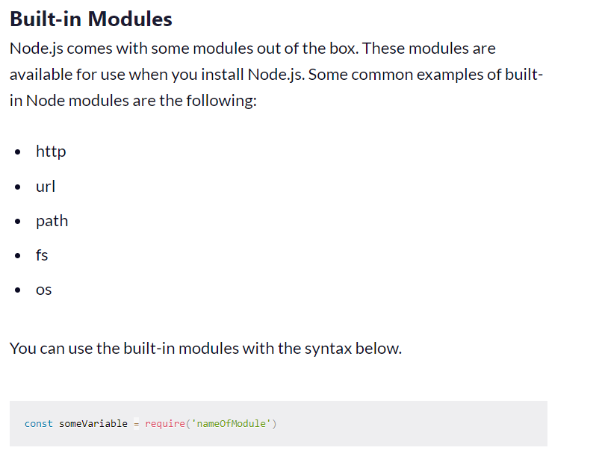
You load the module with the require function. You need to pass the name of the module you're loading as an argument to the require function.
Note: The name of the module must be in quotation marks. Also, using const to declare the variable ensures that you do not overwrite the value when calling it.
You also need to save the returned value from the require function in someVariable. You can name that variable anything you want. But often, you will see programmers give the same to the variable as the name of the module (see example below).
www.skillaura.com

Slide 19
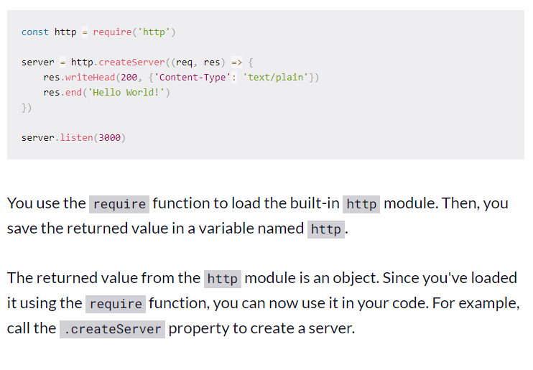
Built-in Module Example
www.skillaura.com

Slide 20
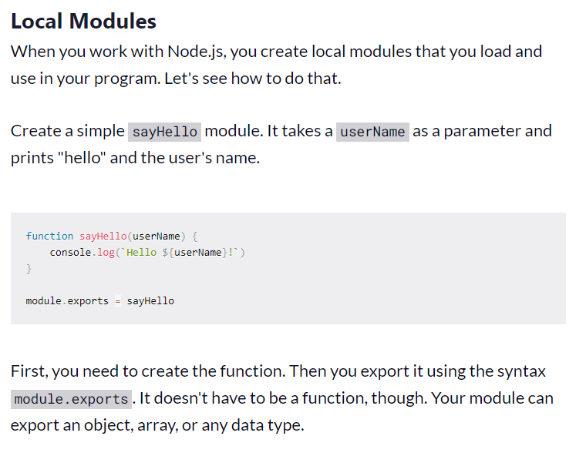
www.skillaura.com

Slide 21
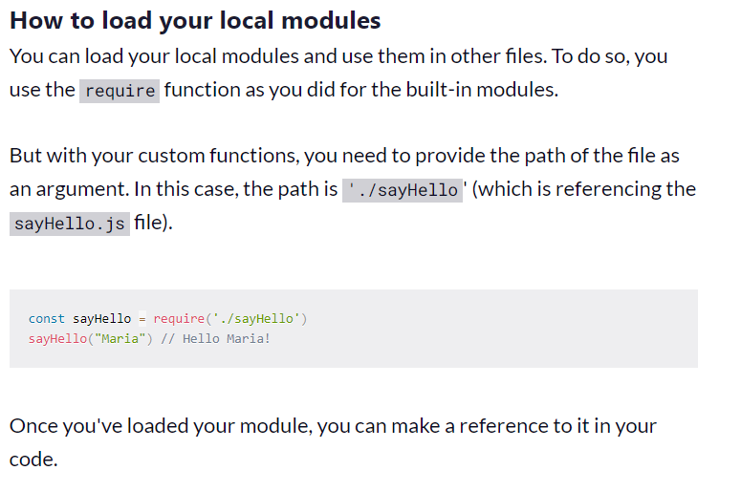
www.skillaura.com

Slide 22
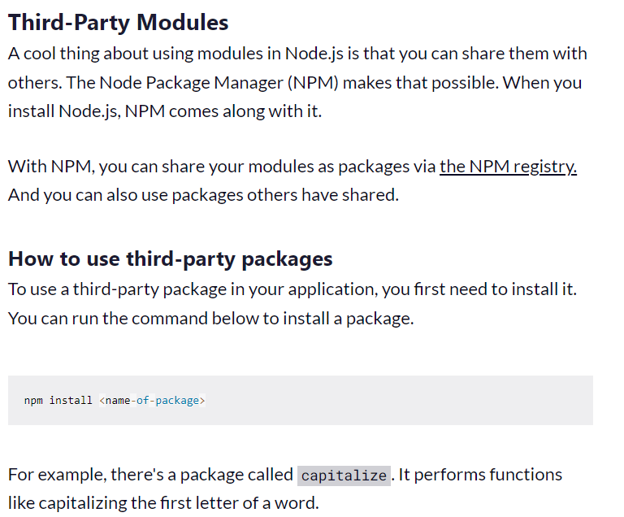
www.skillaura.com

Slide 23
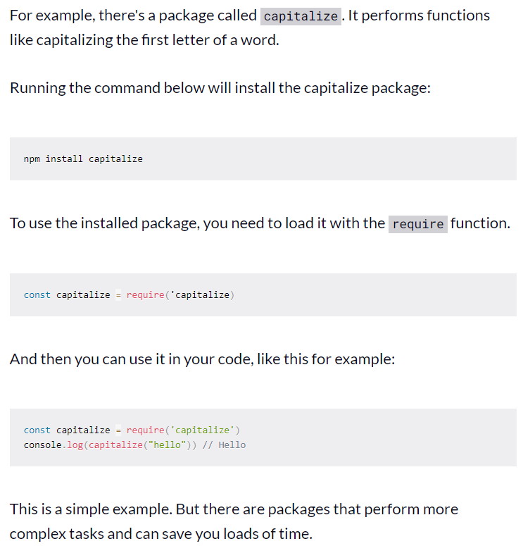
www.skillaura.com

Slide 24
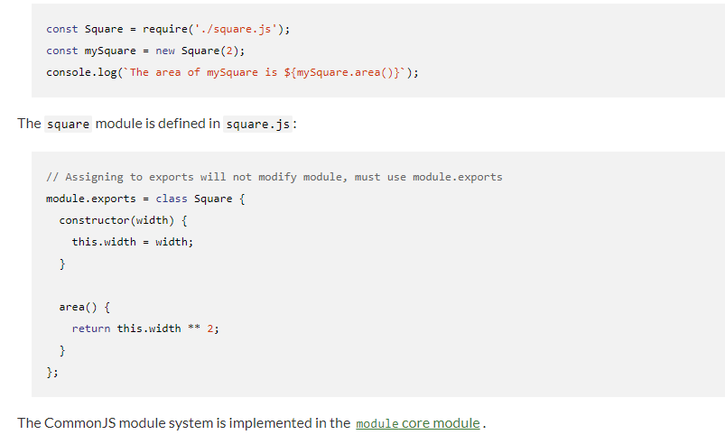
Some more Examples of Modules in NodeJS
The module.exports property can be assigned a new value (such as a function or object).
Below, bar.js makes use of the square module, which exports a Square class:
www.skillaura.com

Slide 25
Examples Contd… Modules in NodeJS
Enabling#
Node.js has two module systems: CommonJS modules and ECMAScript modules.
By default, Node.js will treat the following as CommonJS modules:
Files with a .cjs extension;
Files with a .js extension when the nearest parent package.json file contains a top-level field "type" with a value of "commonjs".
Files with a .js extension or without an extension, when the nearest parent package.json file doesn't contain a top-level field "type" or there is no package.json in any parent folder; unless the file contains syntax that errors unless it is evaluated as an ES module. Package authors should include the "type" field, even in packages where all sources are CommonJS. Being explicit about the type of the package will make things easier for build tools and loaders to determine how the files in the package should be interpreted.
Files with an extension that is not .mjs, .cjs, .json, .node, or .js (when the nearest parent package.json file contains a top-level field "type" with a value of "module", those files will be recognized as CommonJS modules only if they are being included via require(), not when used as the command-line entry point of the program).
See Determining module system for more details.
Calling require() always use the CommonJS module loader. Calling import() always use the ECMAScript module loader.
www.skillaura.com

Slide 26
Conclusion
In this article, you learned about what Node modules are and the three types of node modules. You also learned about how to use the different types in your application.
www.skillaura.com

Slide 27
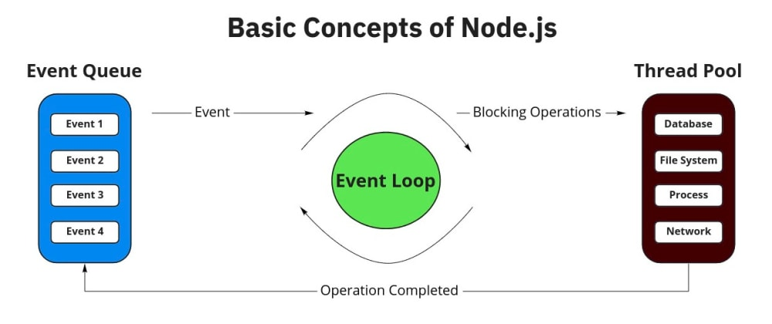
Module 6.6 NodeJS Concepts
www.skillaura.com

Slide 28
Module 6.6 NodeJS Concepts
In NodeJS, Core Concepts are basically divided into three categories:
The Node.js Event Loop
Node.js Timers
Node.js process.nextTick()
www.skillaura.com

Slide 29
Module 6.6 NodeJS Concepts
What is the Event Loop?
The event loop is what allows Node.js to perform non-blocking I/O operations — despite the fact that JavaScript is single-threaded — by offloading operations to the system kernel whenever possible.
Since most modern kernels are multi-threaded, they can handle multiple operations executing in the background. When one of these operations completes, the kernel tells Node.js so that the appropriate callback may be added to the poll queue to eventually be executed. We'll explain this in further detail later in this topic.
Event Loop Explained
When Node.js starts, it initializes the event loop, processes the provided input script (or drops into the REPL, which is not covered in this document) which may make async API calls, schedule timers, or call process.nextTick(), then begins processing the event loop.
www.skillaura.com

Slide 30
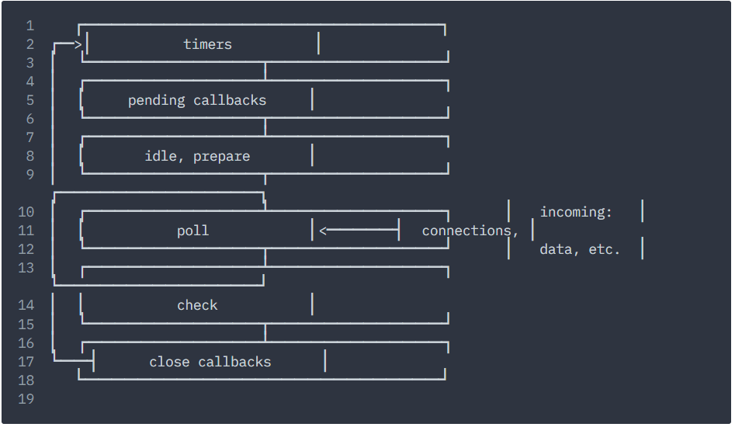
Module 6.6 NodeJS Concepts
The following diagram shows a simplified overview of the event loop's order of operations.
www.skillaura.com

Slide 31
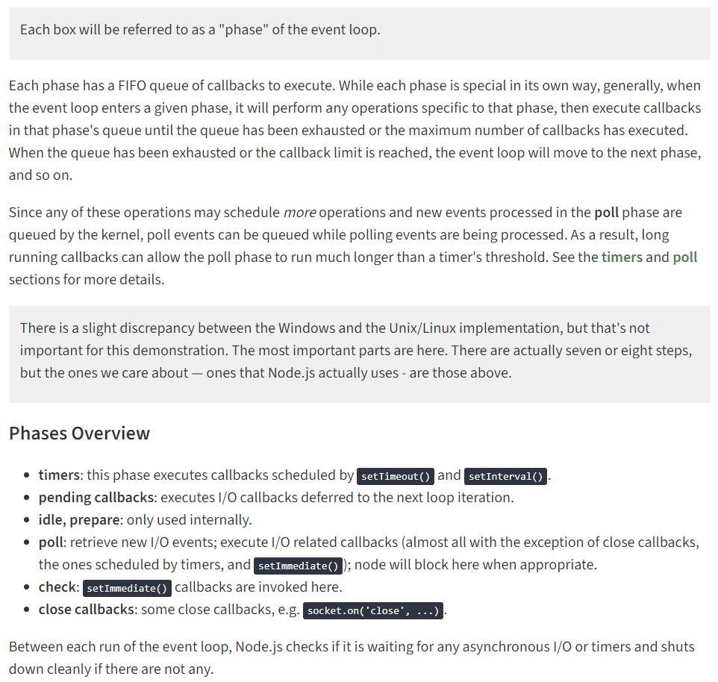
Module 6.6 NodeJS Concepts
www.skillaura.com

Slide 32
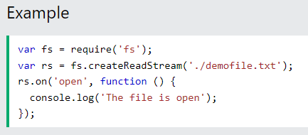
Module 6.7 NodeJS Events
Events in Node.js
Every action on a computer is an event. Like when a connection is made or a file is opened.
Objects in Node.js can fire events, like the readStream object fires events when opening and closing a file:
www.skillaura.com

Slide 33

Module 6.7 NodeJS Events
Events Module
Node.js has a built-in module, called "Events", where you can create-, fire-, and listen for- your own events.
To include the built-in Events module use the require() method. In addition, all event properties and methods are an instance of an EventEmitter object. To be able to access these properties and methods, create an EventEmitter object:
www.skillaura.com

Slide 34
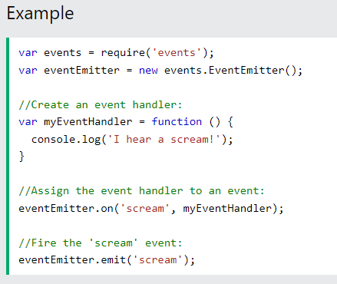
Module 6.7 NodeJS Events
The EventEmitter Object
You can assign event handlers to your own events with the EventEmitter object.
In the example below we have created a function that will be executed when a "scream" event is fired.
To fire an event, use the emit() method.
www.skillaura.com

Slide 35
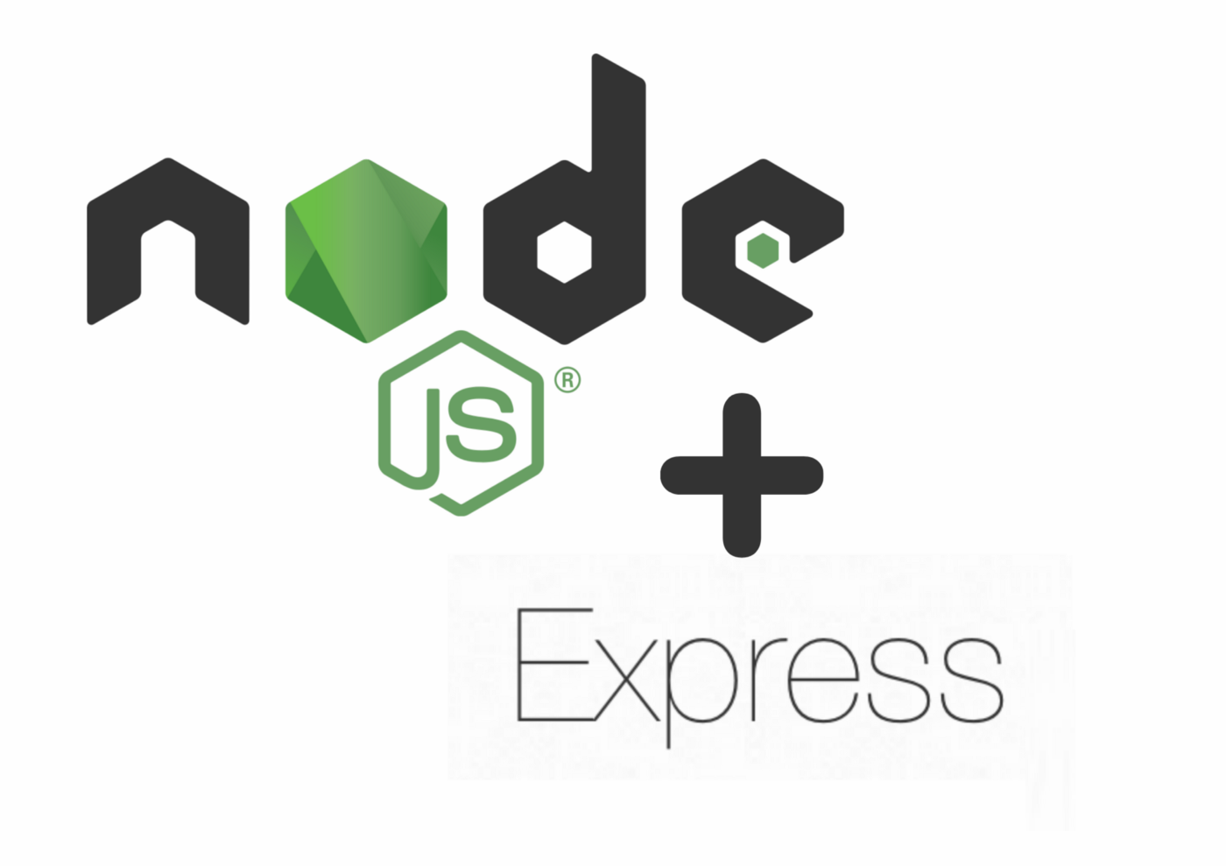
Module 6.8 NodeJS with ExpressJS
www.skillaura.com

Slide 36
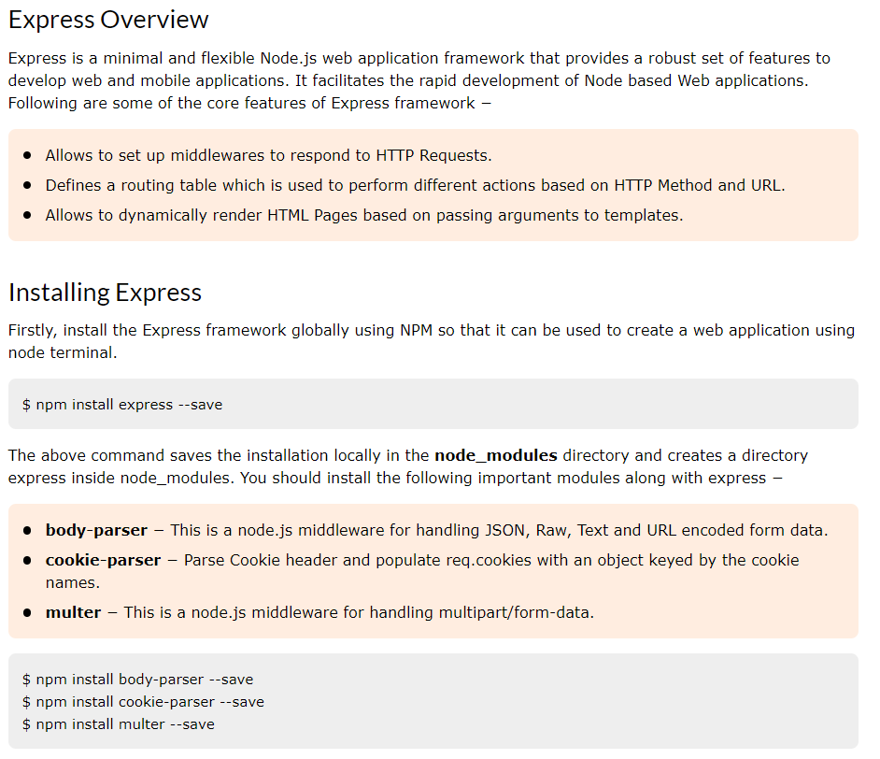
Module 6.8 NodeJS with ExpressJS
www.skillaura.com

Slide 37
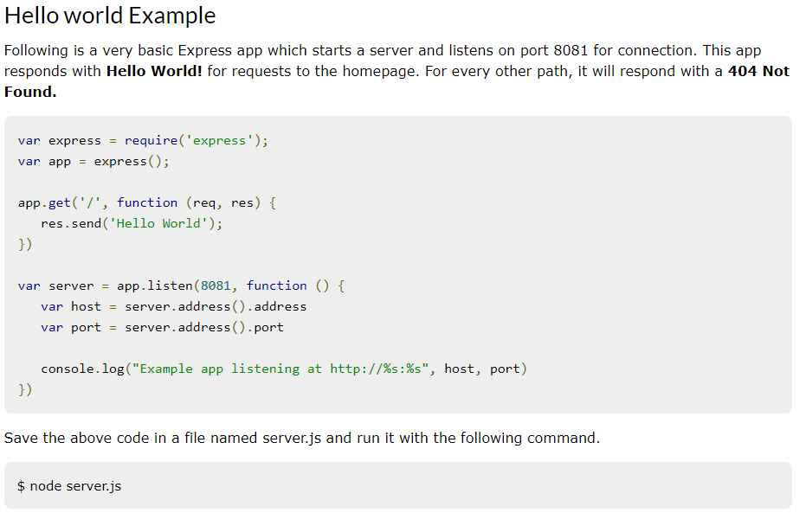
Module 6.8 NodeJS with ExpressJS
www.skillaura.com

Slide 38
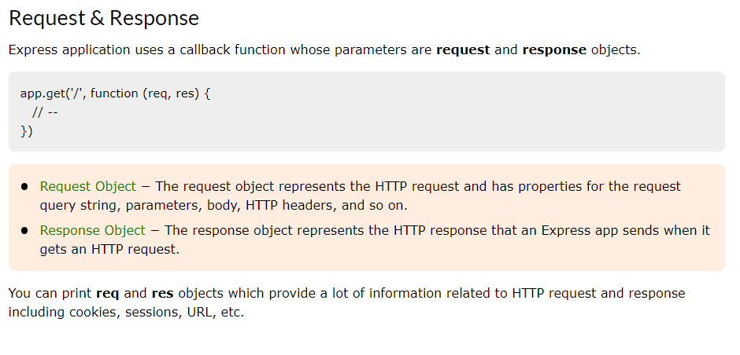
Module 6.8 NodeJS with ExpressJS
www.skillaura.com

Slide 39
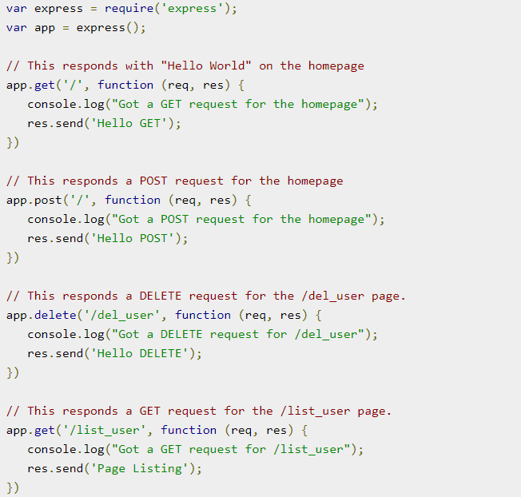
Module 6.8 NodeJS with ExpressJS
Basic Routing
We have seen a basic application which serves HTTP request for the homepage. Routing refers to determining how an application responds to a client request to a particular endpoint, which is a URI (or path) and a specific HTTP request method (GET, POST, and so on).
We will extend our Hello World program to handle more types of HTTP requests.
www.skillaura.com

Slide 40
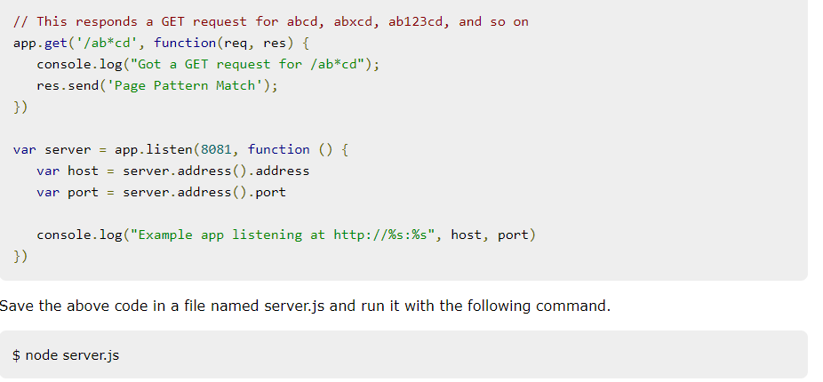
Module 6.8 NodeJS with ExpressJS
Now you can try different requests at http://127.0.0.1:8081 to see the output generated by server.js. Following are a few screens shots showing different responses for different URLs.
Screen showing again http://127.0.0.1:8081/list_user
Screen showing again http://127.0.0.1:8081/abcd
Screen showing again http://127.0.0.1:8081/abcdefg
www.skillaura.com

Slide 41
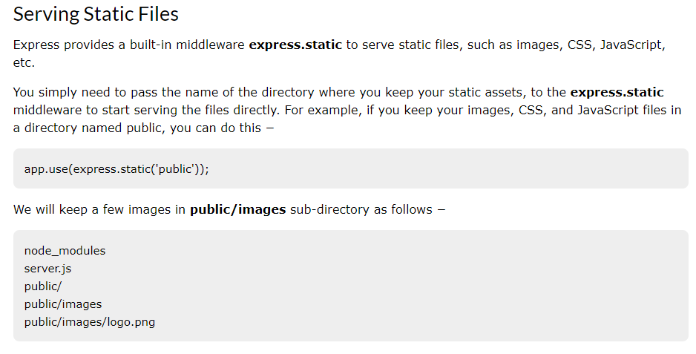
Module 6.8 NodeJS with ExpressJS
www.skillaura.com

Slide 42
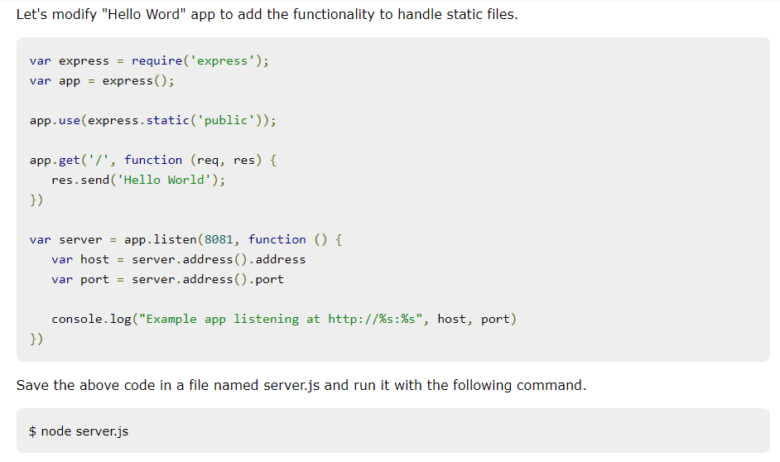
Module 6.8 NodeJS with ExpressJS
www.skillaura.com

Slide 43
Module 6.8 NodeJS with ExpressJS
There are much more things we can do with the NodeJS + ExpressJS.
We can have get and post methods to get and post the data to our backend/ Database.
We will be covering these things later on the Project Demonstration Side.
www.skillaura.com

Slide 44
Module 6.9 NodeJS Database Access
In this Module, we are going to see both the ways to connect:
NodeJS with MongoDB
NodeJS with MySQL
www.skillaura.com

Slide 45
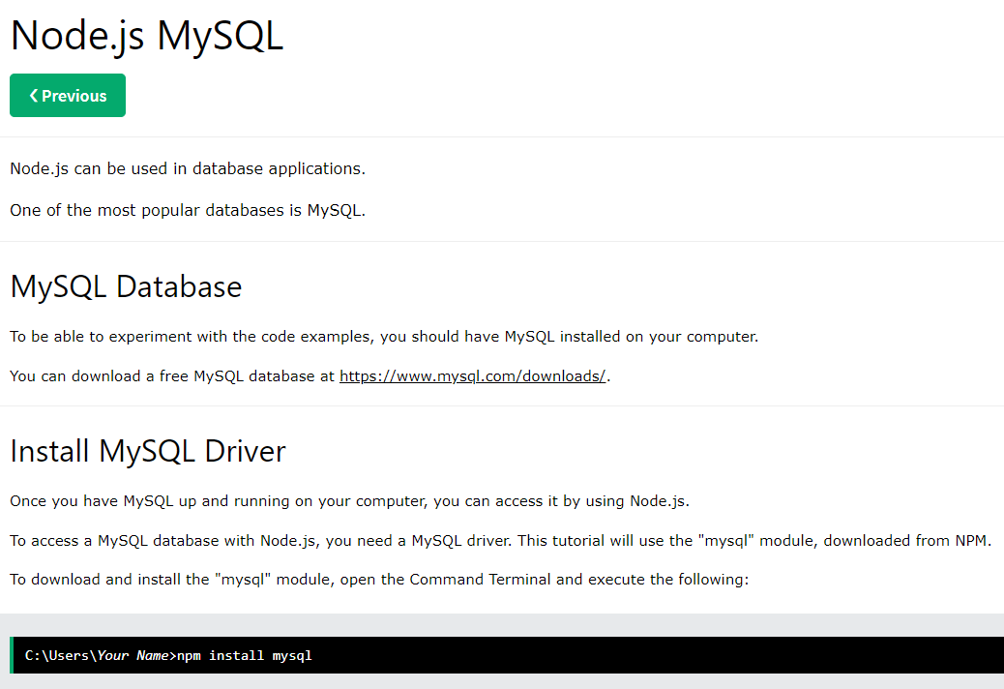
Module 6.9 NodeJS Database Access
www.skillaura.com

Slide 46
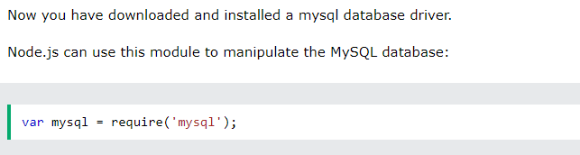
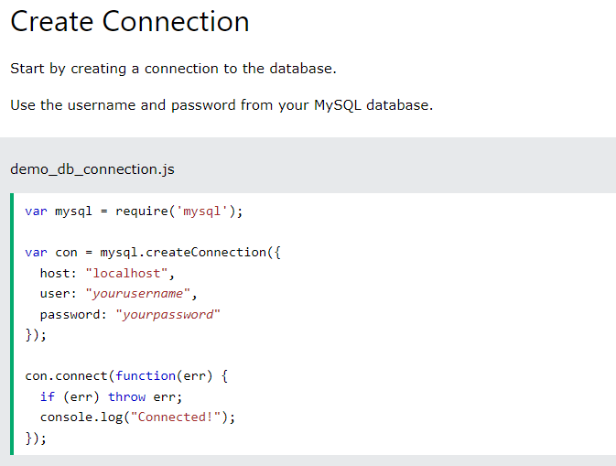
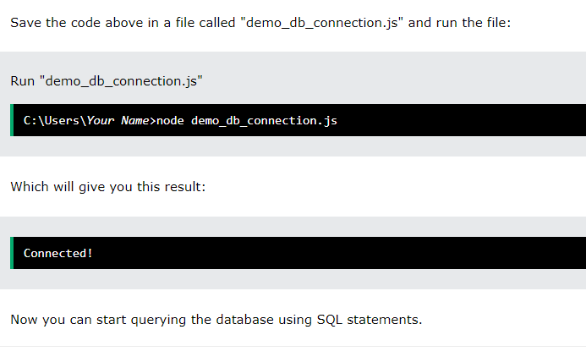
Module 6.9 NodeJS Database Access
www.skillaura.com

Slide 47
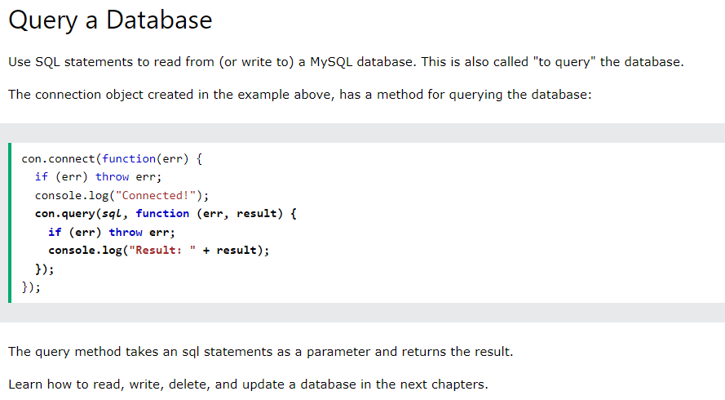
Module 6.9 NodeJS Database Access
www.skillaura.com

Slide 48
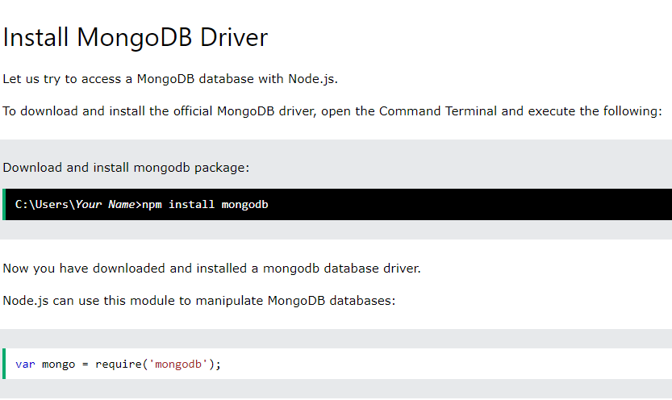
Module 6.9 NodeJS Database Access
www.skillaura.com

Slide 49
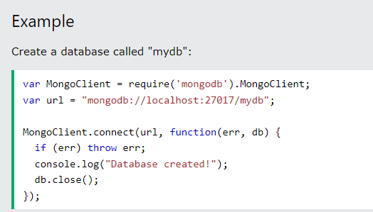
Module 6.9 NodeJS Database Access
Creating a Database
To create a database in MongoDB, start by creating a MongoClient object, then specify a connection URL with the correct ip address and the name of the database you want to create.
MongoDB will create the database if it does not exist, and make a connection to it.
www.skillaura.com

Slide 50
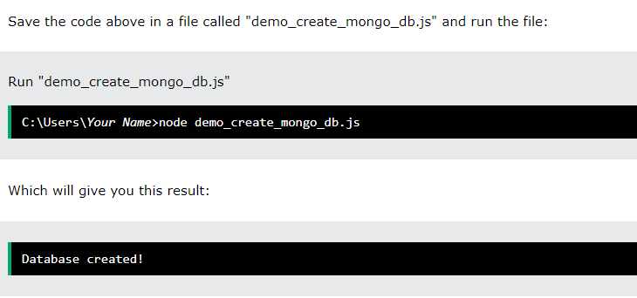
Module 6.9 NodeJS Database Access
So, In this way we can connect out NodeJS with both the SQL and NoSQL Databases.
www.skillaura.com

Slide 51
Practical Demonstration of a User form using MySQL Database
In this practical demonstration, we are going to create a HTML form and render it in the browser and then we will be going to post the data to our MySQL Database and then we will also fetch all the details from the database using Get Request.
www.skillaura.com

Slide 52


Thank you
www.skillaura.com
+91 9743-60-68-69
info@skillaura.com
www.skillaura.com

