Slide 1


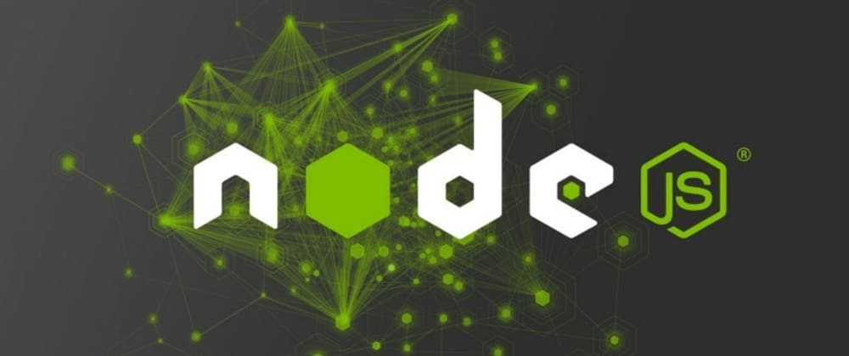
Node JS
www.skillaura.com

Slide 2


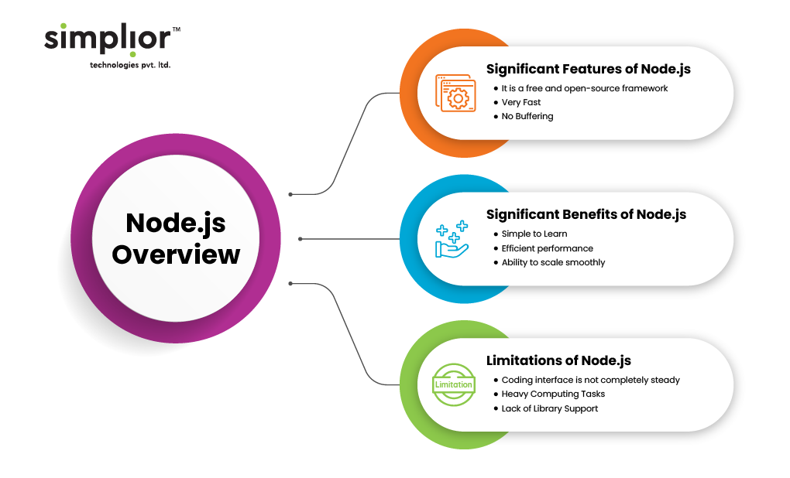
Contents:
Node js overview
Node js - basics and setup
Node js console
Node js command utilities
Node js modules
Node js concepts
Node js events
Node js with express js
Node js database access
www.skillaura.com

Slide 3
Module 6.1 Node js overview
Introduction to Node.js
Definition of Node.js: Node.js is an open-source, cross-platform JavaScript runtime environment that executes JavaScript code outside a web browser. It allows developers to use JavaScript for server-side scripting, enabling the development of scalable and high-performance network applications.
Brief history and development: Node.js was created by Ryan Dahl in 2009. It is built on the V8 JavaScript runtime engine from Google Chrome, providing a fast and efficient environment for executing JavaScript code.
Emphasis on JavaScript runtime: Node.js extends the use of JavaScript beyond the browser, allowing developers to use a single language for both client-side and server-side development.
www.skillaura.com

Slide 4
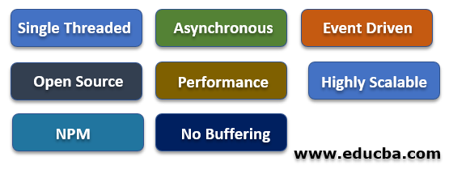
Key Features of Node.js
Non-blocking I/O: Node.js uses an event-driven, non-blocking I/O model, making it highly efficient and capable of handling concurrent requests without blocking the execution of other tasks.
Event-driven architecture: Node.js is designed to be event-driven, meaning it utilizes an event loop to handle asynchronous operations. This architecture enhances scalability and responsiveness.
Single-threaded model: Node.js operates on a single-threaded event loop, but it can handle many concurrent connections. This is achieved through the use of non-blocking I/O operations.
Package management with npm: Node Package Manager (npm) is a powerful tool for managing and sharing Node.js modules. It simplifies dependency management and makes it easy to integrate third-party packages into projects.
www.skillaura.com

Slide 5
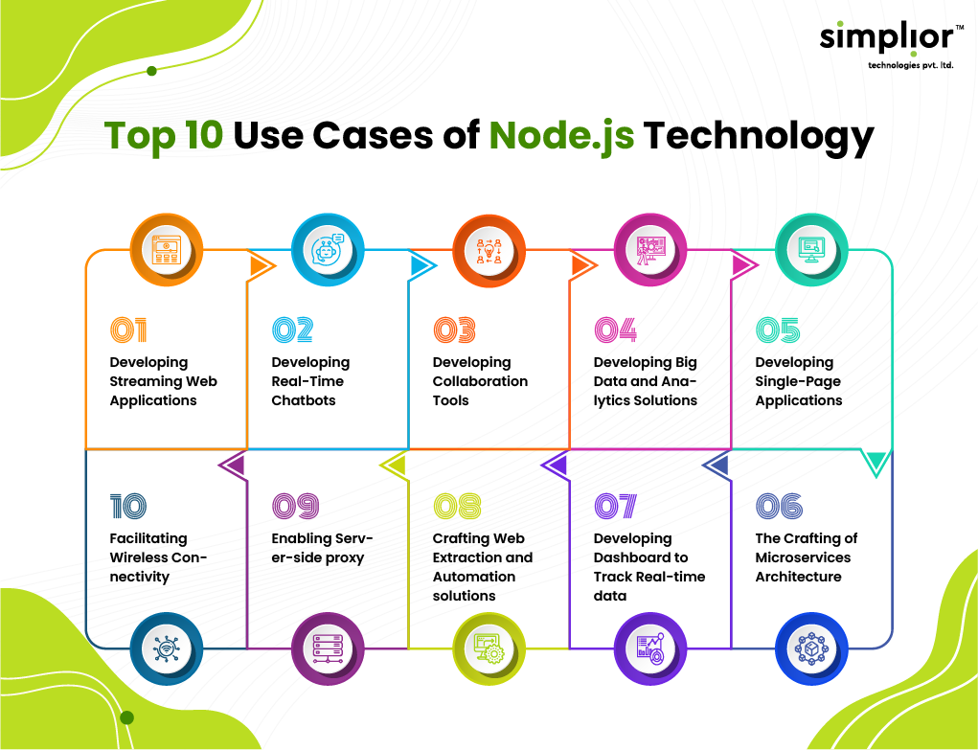
Use Cases of Node.js
Backend development: Node.js is widely used for building server-side applications, providing a robust and scalable environment for backend development.
Real-time applications: Node.js is well-suited for real-time applications such as chat applications, online gaming, and collaborative tools due to its event-driven and non-blocking nature.
APIs and microservices: Node.js is commonly used to build RESTful APIs and microservices, offering a lightweight and efficient solution for communication between services.
Server-side scripting: Node.js enables server-side scripting, allowing developers to use JavaScript for server-side logic and handle server-side tasks.
www.skillaura.com

Slide 6
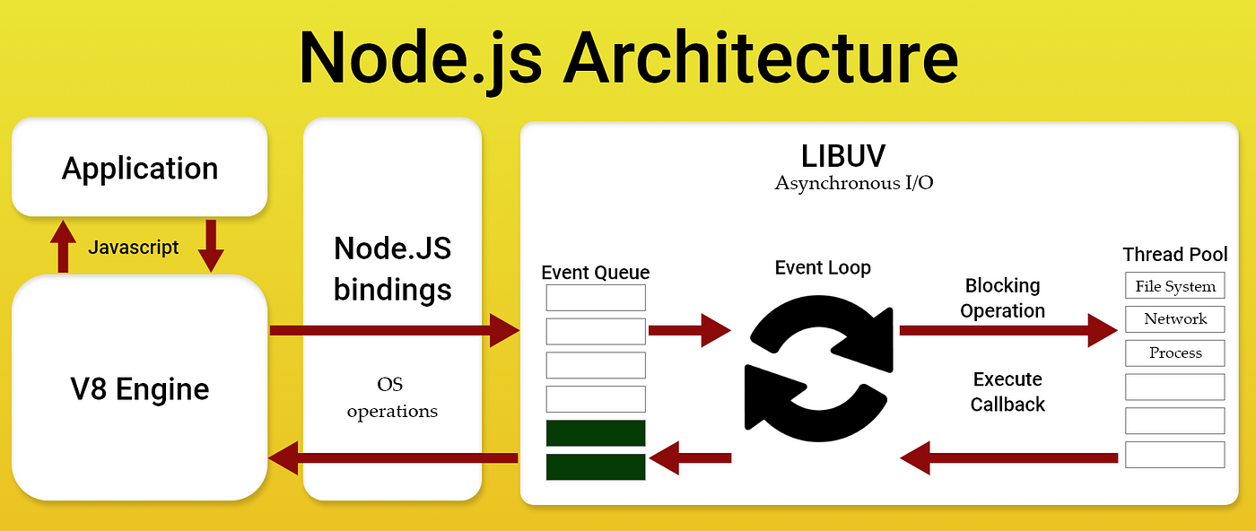
Architecture of Node.js
Overview of the event loop: The event loop is a fundamental concept in Node.js, managing asynchronous operations and ensuring that the application remains responsive. It continuously checks for events and executes corresponding callback functions.
Explanation of the V8 JavaScript engine: Node.js leverages the V8 JavaScript engine, which compiles JavaScript code into machine code for faster execution. V8 is known for its speed and efficiency.
How Node.js handles concurrent requests: Node.js uses a single-threaded, event-driven model to handle concurrent requests. This allows for efficient utilization of system resources and improved performance.
www.skillaura.com

Slide 7
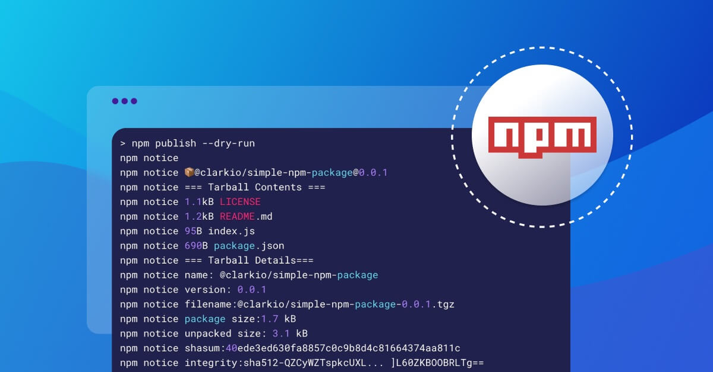
Node Package Manager (npm)
Introduction to npm: npm is the default package manager for Node.js, providing a vast ecosystem of reusable packages and modules. It simplifies the process of managing project dependencies and packages.
Package.json file and its significance: The package.json file is a configuration file that contains metadata about the project, including dependencies, scripts, and other settings. It is crucial for defining the project's structure and managing dependencies.
Dependency management with npm: npm allows developers to easily install, update, and uninstall project dependencies. This ensures that projects are consistent across different environments and makes it simple to share code with others.
www.skillaura.com

Slide 8
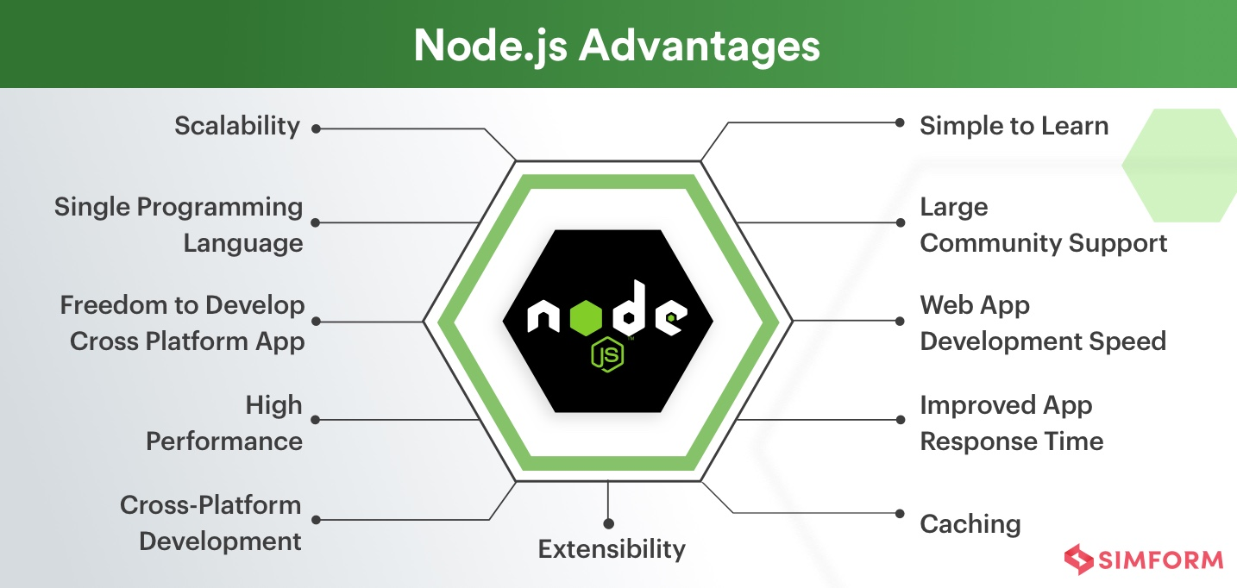
Advantages of Node.js
High performance: Node.js is known for its high performance and efficiency, especially in handling concurrent connections. The non-blocking I/O model and event-driven architecture contribute to its speed.
Scalability: Node.js is highly scalable due to its ability to handle a large number of concurrent connections efficiently. This makes it suitable for building scalable and responsive applications.
Large and active community: Node.js has a vibrant and active community of developers, contributing to the ecosystem with a wide range of libraries, frameworks, and tools.
JavaScript as a universal language: Using JavaScript for both client-side and server-side development streamlines the development process, allowing developers to use a single language across the entire stack.
www.skillaura.com

Slide 9

Challenges and Considerations
Callback hell: Asynchronous operations in Node.js often involve the use of callbacks, which can lead to nested and complex code structures known as "callback hell." This can be mitigated using techniques like promises or async/await.
Limited support for multi-core processors: Node.js is inherently single-threaded, and while it can handle concurrent connections, it may not fully utilize multi-core processors. Additional tools or approaches, such as clustering, may be needed for optimal utilization.
Learning curve for beginners: Some developers may find the event-driven and asynchronous nature of Node.js challenging to grasp initially. However, with practice and understanding, developers can harness the power of Node.js effectively.
www.skillaura.com

Slide 10
Case Studies
Examples of companies using Node.js successfully: Showcase well-known companies that have adopted Node.js for their projects. This could include companies like Netflix, LinkedIn, or PayPal.
Highlight specific projects or applications: Discuss specific projects or applications within those companies where Node.js played a crucial role in achieving success.
www.skillaura.com

Slide 11
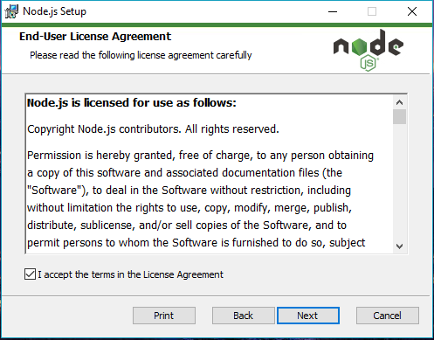
"Module 6.2: Node.js - Basics and Setup"
Introduction to Node.js
Brief recap of Node.js:
Explain that Node.js is a JavaScript runtime built on the V8 JavaScript engine.
Mention its server-side capabilities, allowing developers to use JavaScript for both client and server-side scripting.
Emphasis on using JavaScript on the server side:
Highlight the significance of using a single language (JavaScript) for both frontend and backend development.
Advantages of Node.js for server-side development:
Mention non-blocking I/O, event-driven architecture, and scalability as key advantages.
www.skillaura.com

Slide 12
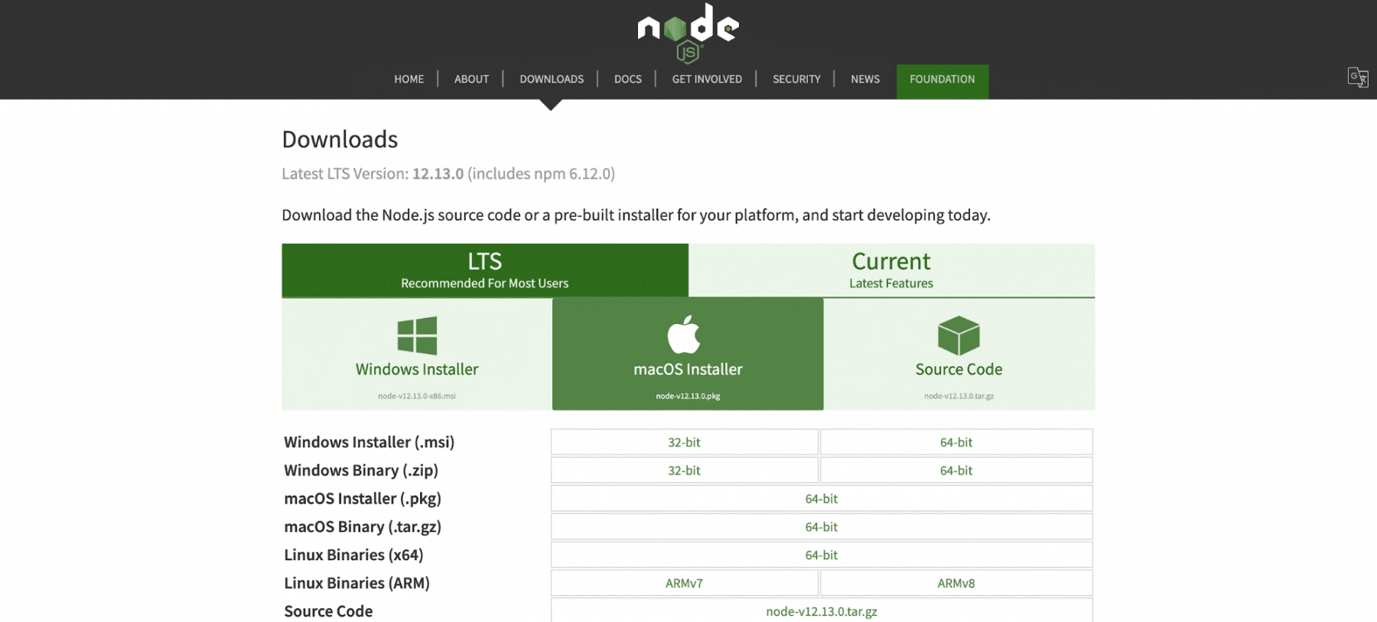
Installing Node.js
Downloading Node.js from the official website:
Provide the URL for the official Node.js website.
Walk through the process of downloading the installer for different operating systems.
Installation process for different operating systems:
Provide step-by-step instructions for installing Node.js on Windows, macOS, and Linux.
Verifying the installation using terminal or command prompt:
Demonstrate how to check if Node.js is installed by running simple commands like node -v and npm -v.
www.skillaura.com

Slide 13
Node.js Architecture Overview
Overview of the event-driven, non-blocking architecture:
event loop and how it handles asynchronous operations efficiently.
Emphasize the non-blocking nature of Node.js, allowing it to handle multiple concurrent connections without blocking the execution of other tasks.
Role of the event loop in managing asynchronous operations:
Illustrate the concept of the event loop with a diagram.
The relationship between Node.js and the V8 JavaScript engine:
how Node.js leverages the V8 engine for executing JavaScript code.
www.skillaura.com

Slide 14
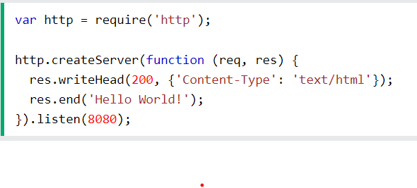
Your First Node.js Program
Creating a simple "Hello World" program in Node.js:
Provide a basic code snippet for a "Hello World" program in Node.js.
Explain the basic structure and syntax of a Node.js program.
Explanation of the basic structure and syntax:
Briefly discuss key components such as require statements and the usage of the console.log function.
Running the program in the terminal or command prompt:
Demonstrate how to execute the program using the terminal or command prompt.
www.skillaura.com

Slide 15
Node Package Manager (npm)
Introduction to npm as the package manager for Node.js:
Explain the role of npm in managing project dependencies.
Emphasize the vast ecosystem of packages available through npm.
Common npm commands (e.g., npm init, npm install):
Walk through essential npm commands, such as initializing a new project (npm init) and installing dependencies (npm install).
Managing project dependencies using package.json:
Discuss the significance of the package.json file and how it manages project metadata and dependencies.
www.skillaura.com

Slide 16
Basic Node.js Modules
Explanation of built-in modules (e.g., fs, http):
built-in modules in Node.js, such as the 'fs' (File System) and 'http' modules.
purpose of these modules in simplifying tasks like file operations and creating an HTTP server.
How to use modules in Node.js:
examples of how to use built-in modules in a Node.js application.
Creating a simple example using a built-in module:
a basic example that involves using a built-in module to perform a specific task.
www.skillaura.com

Slide 17
Setting Up a Basic Node.js Project
Structuring a Node.js project:
Discuss best practices for organizing files and directories in a Node.js project.
Emphasize the importance of a well-structured project for maintainability.
Creating and organizing files and directories:
Walk through the process of setting up a basic project structure, including directories for source code, tests, and configuration.
Best practices for project organization:
Highlight common best practices for naming conventions and organizing code.
Brief overview of popular Node.js frameworks (e.g., Express):
Mention popular frameworks like Express for building web applications.
www.skillaura.com

Slide 18
Debugging and Tools
Overview of debugging tools for Node.js (e.g., built-in debugger, VSCode):
Briefly introduce built-in debugging tools in Node.js and popular integrated development environments (IDEs) like Visual Studio Code.
Common debugging techniques:
Discuss common debugging techniques, such as setting breakpoints and inspecting variables.
The importance of testing in Node.js development:
Stress the significance of testing methodologies, including unit testing and integration testing.
www.skillaura.com

Slide 19
Module 6.3 Node js console
Sub heading
www.skillaura.com

Slide 20
Heading
Sub heading
www.skillaura.com

Slide 21
Heading
Sub heading
www.skillaura.com

Slide 22
Heading
Sub heading
www.skillaura.com

Slide 23
Heading
Sub heading
www.skillaura.com

Slide 24
Heading
Sub heading
www.skillaura.com

Slide 25
Thank you
www.skillaura.com
+91 9743-60-68-69
info@skillaura.com
www.skillaura.com

