Slide 1

BENCHMARKING MLIPS & FORCE FIELDS
A Comprehensive Study on Silicon and Germanium

Slide 2

INTRODUCTION: THE CHALLENGE OF INTERATOMIC POTENTIALS
Molecular Dynamics (MD) is essential for modeling material behavior at the atomistic level. However, its accuracy is fundamentally limited by the interatomic potential used.
FEATURE
CLASSICAL
MLIPS
Efficiency
Very High
Moderate
Accuracy
Limited
Near-DFT
Transferability
Poor
Excellent
We benchmark four Machine Learning Interatomic Potentials (MLIPs) and two classical potentials for Silicon and Germanium.
Formulation
Fixed Analytical
Data-Driven

Slide 3

METHODOLOGY: REFERENCE DATA & MODELS
REFERENCE DATA
EVALUATED POTENTIALS
Ground-truth values from DFT (GGA-PBE) and Experimental measurements.
MACE-MP-0 Pre-trained foundation model, ACE-based descriptors.
Element
a (DFT)
E (DFT)
CHGNet Pre-trained, incorporates magnetic moments for charge modeling.
Silicon (Si)
5.469 Å
-5.43 eV
DPA-3 SemiCond Pre-trained specifically for semiconductor materials.
Germanium (Ge)
5.763 Å
-4.62 eV
DeepMD (Fine-tuned) Trained on MACE-teacher data with Optuna HPO.
Classical (Tersoff, SW) Traditional analytical bond-order and angular potentials.

Slide 4

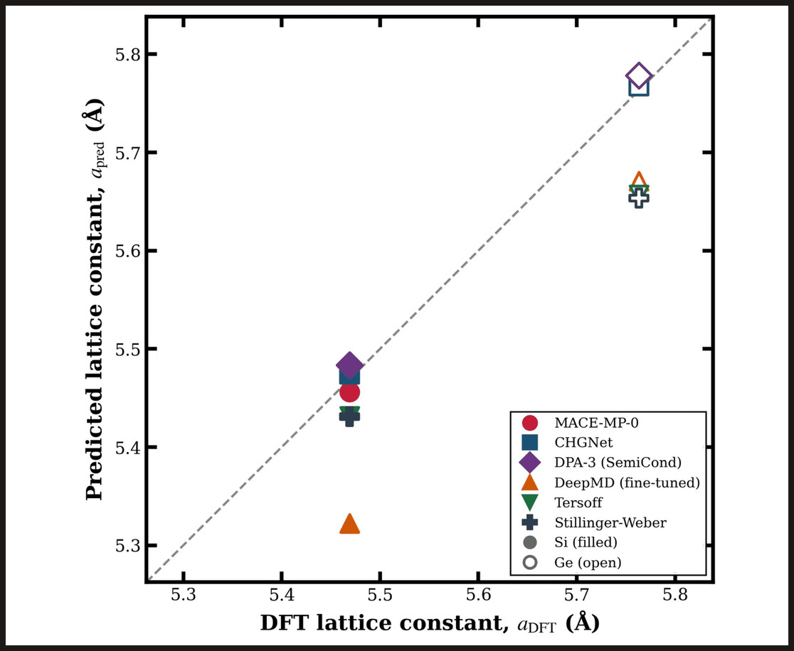
RESULTS: LATTICE CONSTANT PARITY
The parity plot compares predicted equilibrium lattice constants against DFT reference values for both Silicon and Germanium.
Model
Si Error (%)
Ge Error (%)
CHGNet
0.09%
0.08%
MACE-MP-0
0.23%
0.12%
Classical (Avg)
~0.70%
~1.87%
Key Finding
CHGNet and MACE-MP-0 demonstrate exceptional structural accuracy, outperforming classical potentials by an order of magnitude.

Slide 5

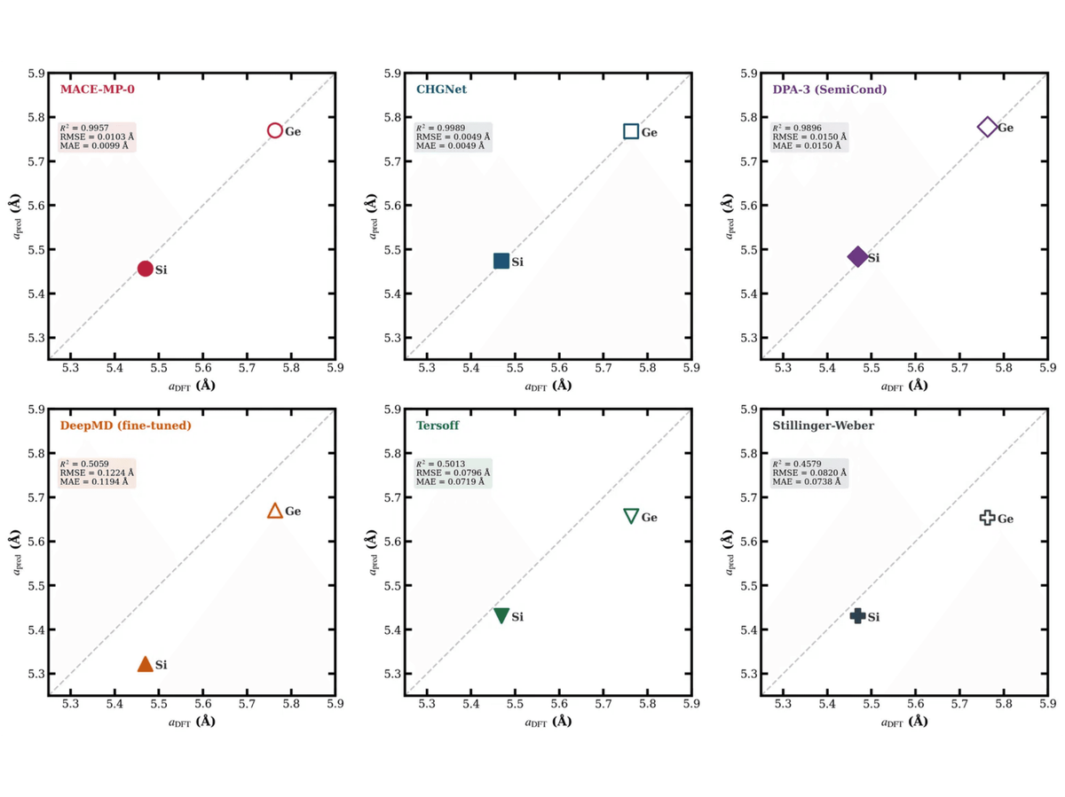
RESULTS: PER-MODEL LATTICE ACCURACY
STATISTICAL PERFORMANCE
MODEL
MAE (Å)
RMSE (Å)
R²
CHGNet
0.0049
0.0051
0.999
MACE-MP-0
0.0097
0.0102
0.998
DPA-3
0.0154
0.0155
0.996
Tersoff
0.0689
0.0732
0.912
SW
0.0708
0.0751
0.908
DeepMD
0.1214
0.1342
0.795

Slide 6

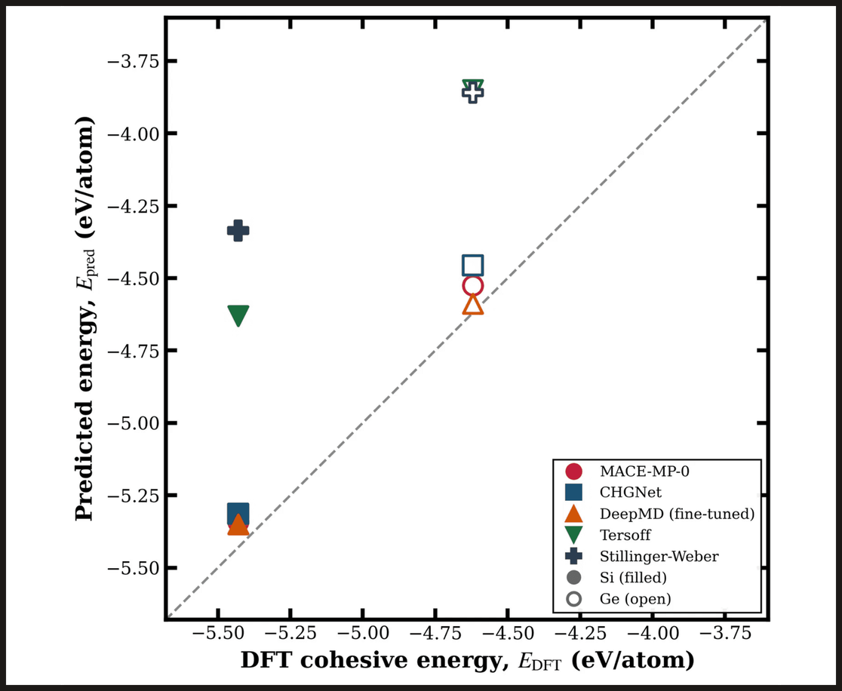
RESULTS: COHESIVE ENERGY PREDICTIONS
MACE-MP-0 demonstrates superior accuracy for cohesive energy, achieving errors as low as 1.6% for Silicon and 2.0% for Germanium.
Model
Si (eV/at)
Ge (eV/at)
DFT Reference
-5.430
-4.620
MACE-MP-0
-5.342
-4.526
Tersoff
-4.630
-3.851
CLASSICAL POTENTIALS UNDERPREDICT ENERGY BY 14-20%.
*DPA-3 excluded due to atomic reference differences (~ -107 eV/atom).

Slide 7

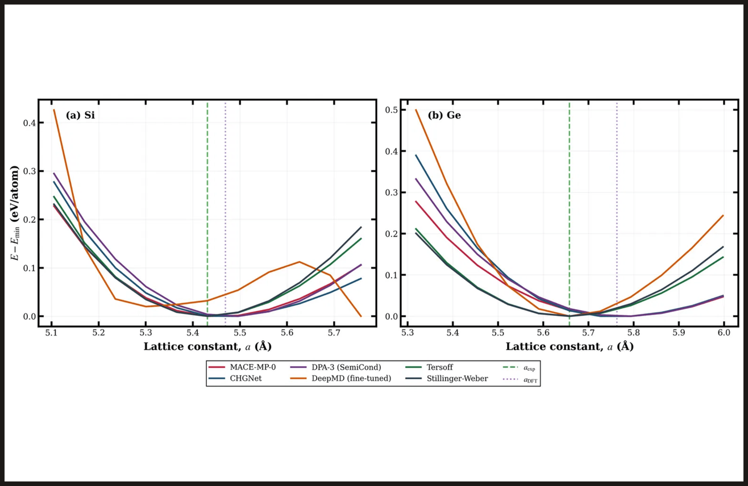
RESULTS: EQUATION OF STATE (EOS)
The Equation of State (EOS) curves describe the energy response to volume changes, critical for predicting mechanical properties.
Pre-trained MLIPs: Produce smooth, symmetric parabolic wells centered near the DFT lattice constant.
DeepMD: Exhibits an asymmetric well for Si and an anomalous 8 eV/atom spike under high compression.
Classical: Tersoff and SW show broader, shallower wells compared to the DFT reference.
MLIPS CAPTURE THE CURVATURE OF THE PES WITH SUPERIOR FIDELITY.

Slide 8

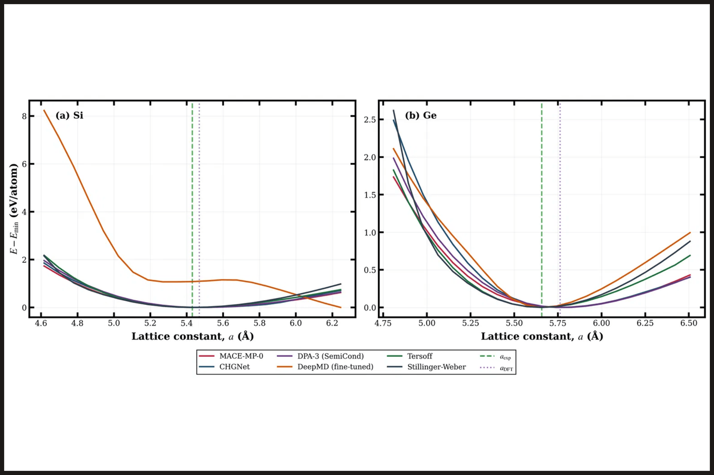
RESULTS: WIDE-RANGE ENERGY-STRAIN CURVES
This analysis examines the energy behavior over a broad range of lattice constants, spanning 85% to 115% of the experimental value.
While classical potentials often struggle with extreme deformations, MLIPs demonstrate remarkable stability and physical consistency across the entire strain range.
MLIPS MAINTAIN STRUCTURAL INTEGRITY EVEN UNDER HIGH COMPRESSION AND EXPANSION.
Fig 4: Energy-strain curves for Si and Ge across a wide range of lattice constants.

Slide 9
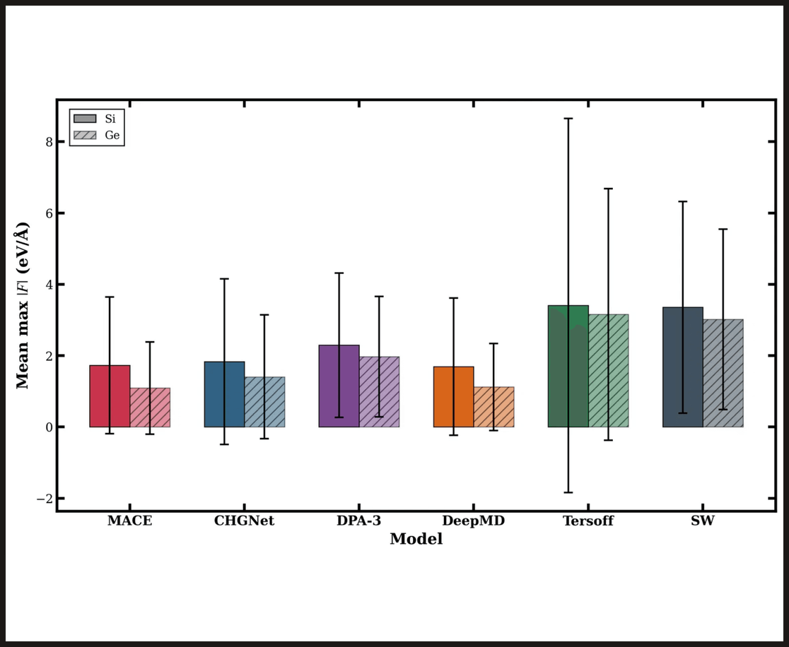
RESULTS: FORCE STABILITY
Force stability is measured by the mean maximum atomic force magnitude over 30 random displacements.
MLIPs: < 2.3 eV/Å (Smoother landscapes)
DeepMD: 1.69 eV/Å (Si), 1.12 eV/Å (Ge)
Classical: 2-3x higher force magnitudes
NEURAL NETWORK POTENTIALS PRODUCE SIGNIFICANTLY SMOOTHER FORCE LANDSCAPES, ESSENTIAL FOR STABLE MD.

Slide 10

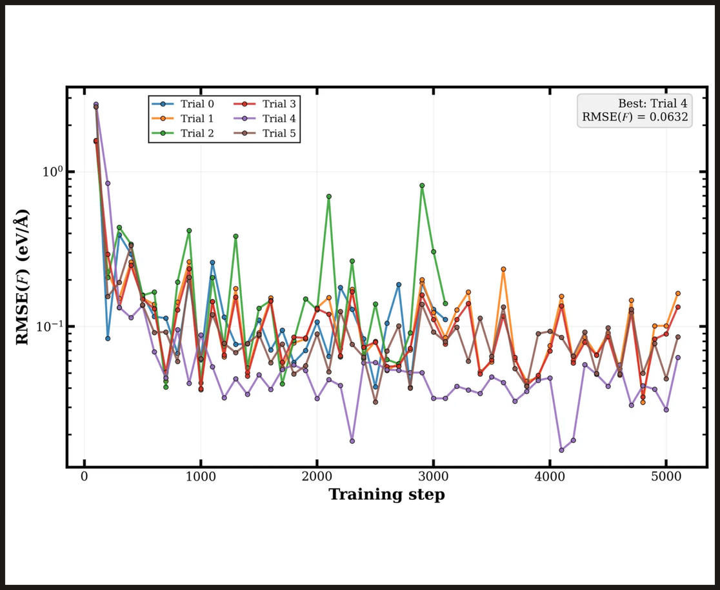


DEEPMD OPTIMIZATION: OPTUNA HPO
BEST HYPERPARAMETERS (TRIAL 4)
PARAMETER
VALUE
Cutoff Radius ($r_{cut}$)
6.0 Å
Descriptor Neurons
[25, 50, 100]
Initial Learning Rate ($η_{0}$)
3.34 × 10⁻³
Total Training Steps
5000
Final RMSE(F)
0.0632 eV/Å

Slide 11

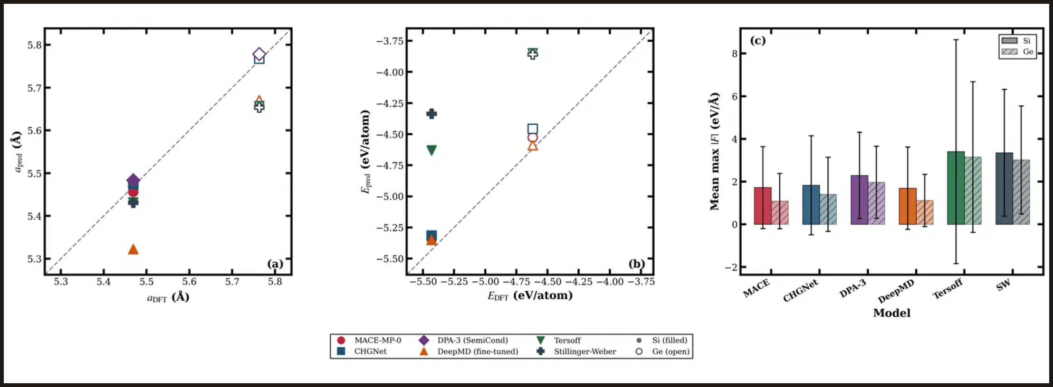
SUMMARY DASHBOARD: PERFORMANCE OVERVIEW
LATTICE PARITY: MLIPS > 99% ACCURACY
ENERGY PARITY: MACE-MP-0 LEADS
FORCE STABILITY: 3X SMOOTHER PES

Slide 12

DISCUSSION, RANKING, AND CONCLUSION
RANK
MODEL
AVG LATTICE ERROR
FORCE STABILITY
TYPE
1
CHGNet
0.088%
1.62 eV/Å
MLIP (Pre-trained)
2
MACE-MP-0
0.178%
1.41 eV/Å
MLIP (Pre-trained)
3
DPA-3 SemiCond
0.267%
2.13 eV/Å
MLIP (Pre-trained)
4
Tersoff / SW
~1.28%
~3.23 eV/Å
Classical
MODEL VERDICTS
KEY TAKEAWAYS
Best Overall: CHGNet for structural precision. Best for MD: MACE-MP-0 for smoothest PES. Classical: Tersoff for accuracy; SW for stability.
Pre-trained MLIP foundation models achieve near-DFT accuracy without system-specific training, outperforming classical potentials by an order of magnitude in structural and energy predictions.
MLIPS ARE THE NEW STANDARD FOR HIGH-ACCURACY ATOMISTIC SIMULATIONS.

