Slide 1

By Aaditya Bhusal

Slide 2

Introduction
Virtualization is the process of creating a virtual version of
Computer Hardware Platforms
Storage Devices
Computer Network Resources

Slide 3
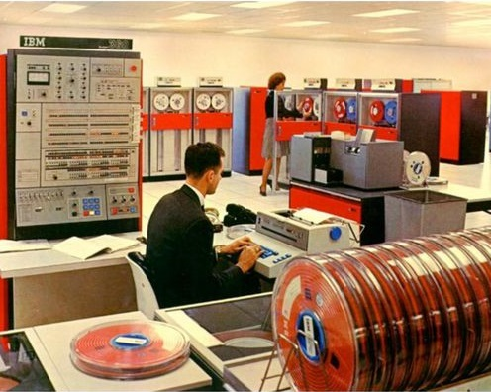
History
The development of virtualization began in 1960s by IBM
In 1963, MIT announced Project MAC.
In 1964, IBM started to work on CP-40 mainframe.
IBM CP–40 Mainframe

Slide 4
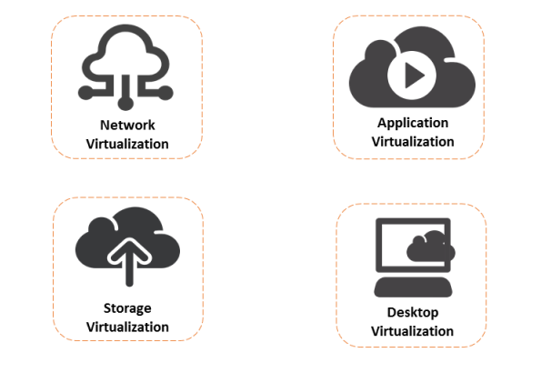
Types of Virtualization
Hardware Virtualization

Slide 5
Advantages
Cheaper
Less Work Load
Provides Energy Savings
Better Uptime
Promotes Digital Entrepreneurship.

Slide 6
Disadvantages
High Cost of Implementation
Security Risk
Time Consuming
Lack of availability of resources.

Slide 7
Thank you

