Slide 1
Databases 1
SQL | Introduction
Topic Aim | To introduce the client server structure, Oracle and SQL

Slide 2
SQL |Objectives
Structured Query Language
  Data Definition
    Data Control
  Data Manipulation
    Data Query
Datatypes
Getting started with Oracle

Slide 3
SQL
A declarative standard programming language
  ANSI (American National Standards Institute)
Designed to manage data in relational databases
Define and manipulate data
  Oracle, MySQL, SQL Server, Access, Sybase, DB2
Originally called SEQUEL
  (Structured English QUery Language)
Designed by IBM research centre in 1974/75
First introduced commercially 1979 by Oracle

Slide 4
Language Structure
SQL is one language
Grouped into commands to achieve tasks
  Data Definition
    Data Control
  Data Manipulation
    Data Query

Slide 5
DDL
Data Definition Language
Part of SQL
Allows users to create and restructure objects
  CREATE TABLE
  ALTER TABLE
  DROP TABLE
Focus for this module

Slide 6
DCL
Data Control Language
Part of SQL, DDL
Controls access to database
Controls distribution of privileges to users
  ALTER, CREATE USER, PASSWORD
  ROLE
  GRANT .., TO
  REVOKE

Slide 7
DML
Data Manipulation Language
Part of SQL
Allows users to manipulate data within objects
  INSERT
  UPDATE
  DELETE
Includes querying

Slide 8
DQL
Data Query Language
Part of SQL, DML
Comprised of only one command
  SELECT
  From simple to complex
Most concentrated focus of SQL in RDB
Accompanied by many options and clauses
  WHERE
  JOIN
  ORDER BY

Slide 9
Datatypes
Characteristic of an attribute
Classifications of a type of information
Determines what kind of data an attribute holds
  Datatypes must match type of data
Specifies the implicit operations for that data
  ie Numbers can be + * / -
    Characters can be concatenated

Slide 10
Datatypes
The following data types usually exist:
  character, number, date
Datatypes vary dependent on the software eg
  text, string, VARCHAR2
  integer, float, double, NUMBER
  ANSI SQL (relational only) uses
    NUMBER, VARCHAR2, CHAR and DATE
Notes:
Not MS Access! No autonumber, text, notes

Slide 11
NUMBER
Used to store fixed or floating-point numbers
Syntax
  NUMBER(precision,scale)
Precision
  Total number of significant digits
  Optional
  Defaults to maximum supported by operating systems
Scale
  Number of digits to the right of the decimal point
  Can range from -84 to 127
  Optional
  Defaults to zero

Slide 12
NUMBER Example
NUMBER
  Maximum digits allowed by the system
    Before or after the decimal place
NUMBER(2)
  Two digits before decimal place, zero digits after
NUMBER(3,2)
  One digit before decimal place, two digits after

Slide 13
Character Types
Two types for storing text in Oracle
CHAR
  Fixed length character
VARCHAR2()
  Variable length characters
Good Practise:
  All data stored in character types should be upper case

Slide 14
CHAR
CHAR stores fixed length character data
Effective for quick processing
Syntax
  CHAR (length)
Length
  Maximum 2,000 bytes
  Optional
  Defaults to 1
  Padded with blanks to the maximum length

Slide 15
CHAR Example
CHAR
  stores one character
CHAR(10)
  Stores 10 characters for a value of any length
  Inserting ‘MANDY’ in CHAR would store ‘MANDY’+5 blanks
    ‘MANDY[][][][][]’

Slide 16
VARCHAR2
Used to store variable length data
Efficient for storage
  Syntax
    VARCHAR2(length)
Length
  Maximums 4,000 bytes
  Mandatory
  Values are trimmed
  Only length of string is stored

Slide 17
VARCHAR2 Example
VARCHAR2(10)
  Stores up to 10 characters based on actual string
  Entering ‘MANDY’ in VARCHAR2 would store MANDY only
  Extra characters are not stored

Slide 18
VARCHAR
VARCHAR is synonymous with VARCHAR2
  VARCHAR is defined in the ANSI standards
  VARCHAR2 is an oracle defined datatype
VARCHAR may be phased out in a future
May store variable-length character strings compared with different comparison semantics
Avoid VARCHAR for future compatibility
Notes:
CHAR is more efficient to access. VARCHAR2 is better for storage

Slide 19
DATE
Used to store date and time
  To the precision of seconds
Stores date values from
  Jan 1 4712 BC, to Dec 31 9999 AD
Each DATE includes
  Year, Month, Day, Hour, Minute, Second
  Sub second granularity not supported by DATE
Time portion of DATE defaults to midnights
  (12:00:00 am)

Slide 20
DATE Example
DATE
  Stores date in pre set format
    ‘10-JAN-2000’
    Not set to record time on site
Stored internally as a number
  Uses a seven bytes default mask
Retrieved and updated based on a default mask
  Default format mask is ‘DD-MON-YYYY’
Changed by setting format parameter
  NLS_DATE_FORMAT
Notes:
Can’t use smart quotes

Slide 21
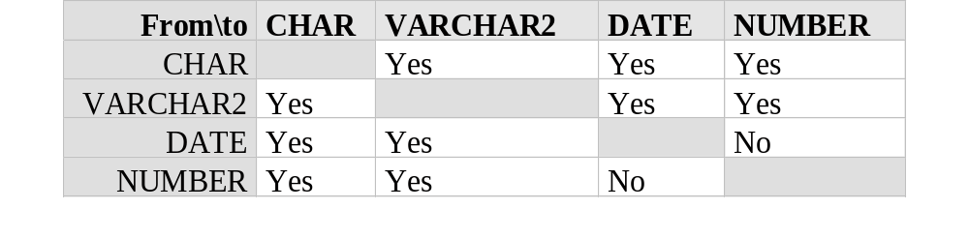
Implicit Datatype Conversion
Implicit conversion to dates requires that the string be in the default date format

Slide 22
Databases Software
Database Software for this module
  Teach transferable skills not software
  We use industry standards
    DBMS Oracle
    Query language SQL *Plus
Why not MS Access
  Not a DMBS, therefore not comparable
  No concurrency, transaction control or scalability
  Small scale business tool 20 users or less
Microsofts
comparable to Oracle
is SQLServer
not Access
Notes:
ANSI SQL is a transferable skill
Once learnt the tool can be applied to other Database eg
Sysbase, Dbase SQLServer – Current market standards
MySQL, ProgreSQL – freeware
BDW in-house database build based on SQL

Slide 23
Commitment and Attitude
You wont understand if you’ve been:
  Chatting, Twittering, on Facebook, surfing,
  not read the activity
  not working outside class
  not prepared
Like programming
  Its not like using your phone its like making it
  It takes time and work
Time for a change of attitude
  Form school child to university student
  Not just in this module but in everything

Slide 24
Practicals
You work through workbooks at your own pace
  Step by step guide
  Must complete activities
  Easy?
Keep up
  One model developed throughout
  Each week builds on the last
  Complete in your own time if you don’t finish
Practicals cover all skills for your assignment
Notes:
It isn’t difficult but it is fussy
It is structure, and step by steps, so do all the steps.

Slide 25
LOGGING INTO ORACLE
Double click the file e:\Oracle12c\sqlplus.exe
  not the one in programs
Open SQL* Plus on your (client) computer
Connect your client-based SQL*Plus program to the Oracle server by typing in your details:
username@student/password
Usernames
  List of practical logins on blackboard
  The original password is the same as the login
Coursework Logins
  your assignment login is the same as your usual login but plus 200
    eg: practical login CSY1026_1
    assignment login CSY1026_201
Notes:
Can’t accept number for first character of password
Therefore must use quotes
Be carful of copying from word the formatting upsets it.

Slide 26
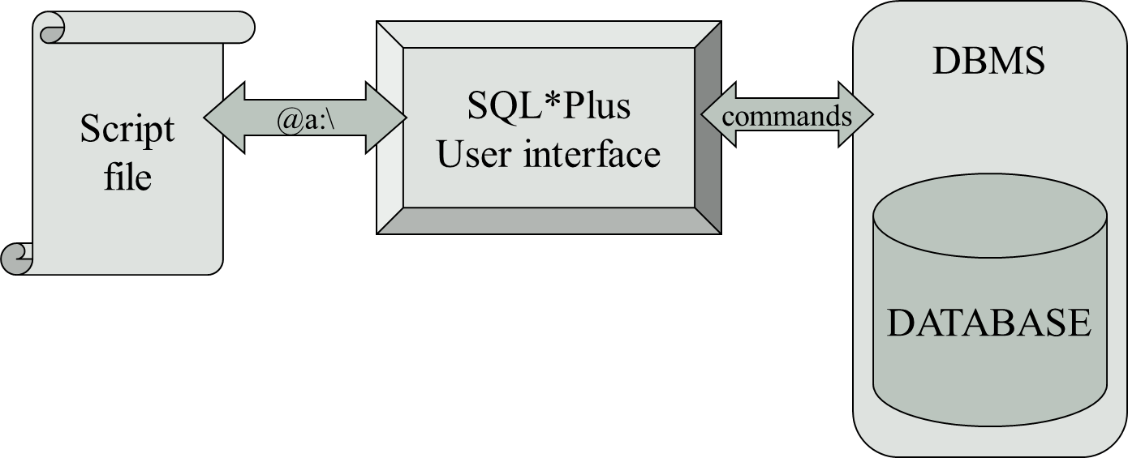
PRACTICALS
What are we doing?

Slide 27
Script Files
A simple program file
Written in utility or application proprietary language
Use a script file (notepad++) to
  Create and manipulate your database
    command to change the database
  Keep a back up of your work
  Keep a reference of your work
The command must be accurate
Include correct syntax (grammar)
NOT DIFFICULT!

Slide 28
Adding Comments
Two methods to apply comments
  2 dashes and a space at the start of a single line of text
    -- comment
  Slash-asterisk at start and a asterisk-slash at end of text
    /* comment */
Examples
  /*
  Inserts into each table must maintain entity, referential and domain integrity
  */
  DROP table student; -- delete the student table
Notes:
Note the spaces after the comment notation but before the comment, it can be fussy

Slide 29
Running a file
Using START or @ command
  Syntax
  START path\file_name.extension
  @path\file_name.extension
  Example
  START F:\csy1026\createTest.txt
  @F:\csy1026\dropTest.txt
Note there is a space after START and not after @
Notes:
Note: NO spaces in files names or paths

Slide 30
Alter user
ALTER USER your_user_id
IDENTIFIED BY your_new_password;
  ALTER USER csy1026_56
  IDENTIFIED BY “2001234”;
Notes:
It isn’t case specific but it is good practice to have reserved words in UPPER CASE
Be ware of formatting eg smart quotes

Slide 31
Review Questions
What does SQL stand for?
What is SQL?
Which database tools use SQL
What does DDL stand for?
What is DDL?
What does DML stand for?
What is DML?
What does ANSI stand for?
Name 4 datatypes in SQL Oracle
What is NULL?
Ask me a question
10

Slide 32
Summary…
Structure Query Language
  Data Definition Language
  Data Manipulation Language
Datatypes
  NUMBER
  CHAR
  VARCHAR2
  DATE
Next Week: Introduction to DDL..

Slide 33
