Slide 1


Department of ICT
A project(minor) proposal defense on:
“DiGiWallet: Digital Academic Credential Verification System”
Project Members:
Submitted to:
Bibek Ghimire 230309
Department of ICT Cosmos College of Management and Technology
Maheshwar Pant 230322
Manisha Oli 230347
Date : May, 2026
1
Department of ICT, Cosmos College of Management and Technology

Slide 2


Introduction
• Academic credentials include certificates, transcripts and degree documents.
• Used for employment, higher education, scholarships and professional registration.
• Traditional verification is slow, repetitive and vulnerable to fraud.
• DiGiWallet issues, stores, shares and verifies credentials digitally.
• Digital signatures confirm authenticity; QR codes enable quick verification.
• Reduces fake documents, manual effort and verification delay.
Department of ICT, Cosmos College of Management and Technology
2

Slide 3
Problem Statement
Academic credential verification is still slow, repetitive and dependent on manual checking. DiGiWallet addresses this by enabling reusable digitally signed academic credentials.
Students carry duplicate photocopies or scanned copies for different applications
Employers spend time contacting institutions to confirm document authenticity.
No simple reusable digital platform exists for instant QR-based verification.
Department of ICT, Cosmos College of Management and Technology
3

Slide 4

Problem Context in Nepal
Repeated Document Submission
Students submit the same certificates repeatedly for jobs, internships, higher studies, KYC and official verification.
Slow Manual Verification
Employers often contact colleges or universities manually through email, phone or official correspondence.
Fake / Tampered Risk
Scanned or physical certificates can be altered or misused, creating trust issues for employers and institutions.
Department of ICT, Cosmos College of Management and Technology
4

Slide 5
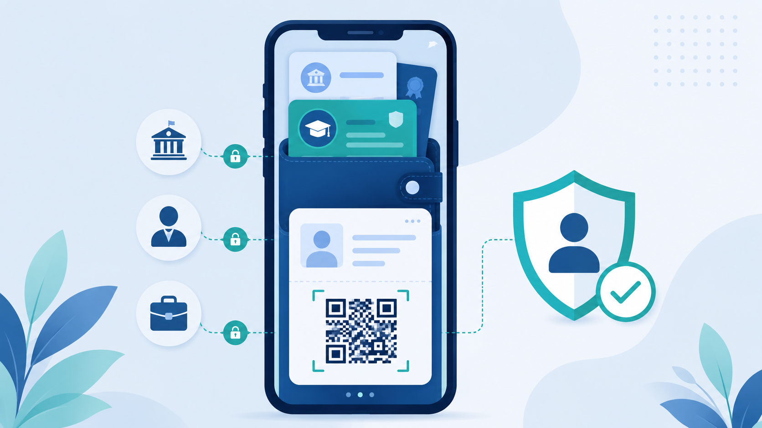
Proposed Solution: DiGiWallet
DiGiWallet provides a secure digital wallet where students receive, store
and share academic credentials issued by verified colleges.
College issues
verified academic credential
Student stores
credential in digital wallet
Verifier checks
authenticity using QR/link
Main Value: one trusted credential, reusable verification, less paperwork.
Department of ICT, Cosmos College of Management and Technology
5

Slide 6
Objectives
The major objectives of DiGiWallet Project are:
• To develop a secure web-based system for issuing digitally signed academic credentials.
• To provide students with a digital wallet for storing and sharing credentials through QR codes
or verification links.
• To enable employers and institutions to verify credentials instantly.
• To reduce repeated document submission, manual verification delays, and fake certificate risks.
• To demonstrate a reliable prototype using web and cryptographic technologies
Department of ICT, Cosmos College of Management and Technology
6

Slide 7
Literature Review
➢ Background
• Academic credential fraud affects trust between students, institutions and employers.
• Paper certificates and scanned copies can be forged, damaged, lost or reused.
• Manual verification through email, phone or official letters is slow and costly.
• Digital identity guidelines emphasize secure identity proofing, authentication and trust [1].
➢ Related Standards
• Decentralized Identifiers (DIDs) support verifiable digital identity without relying on one central authority [2].
• Verifiable Credentials define a standard way to issue, hold and verify digital records [3].
DepartmDepartment of ICT, Cosmos College of Management and Technology
ent of ICT, Cosmos College of Management and Technology
Department of ICT, Cosmos College of Management and Technology
7

Slide 8
➢ Existing Research
• SSI research gives users control over credentials and reduces dependency on central intermediaries [4].
• Blockchain-based SSI has been proposed for secure academic credential management [5].
• Rustemi et al. found that blockchain improves transparency, security, traceability and trust [6].
• Cerberus showed that blockchain can reduce verification time and third-party dependency [7].
• Blockcerts introduced an open standard for blockchain-based certificates [8].
➢ Challenges and Research Gap
• Existing systems can be costly, complex, hard to scale and difficult to standardize.
• DiGiWallet focuses on a feasible academic prototype using digital signatures and QR-based verification.
8

Slide 9
Project Methodology
Research & Observation
System Analysis
Study current manual verification practices and existing digital credential systems.
Identify actors, requirements, data flow, modules and security checkpoints.
Prototype Development
Testing & Evaluation
Build web-based MVP using MERN stack and cryptographic libraries.
Test valid, tampered, revoked and not-found credential cases.
Approach: iterative sprint-based development with regular review, testing and documentation.
Department of ICT, Cosmos College of Management and Technology
9

Slide 10
System Architecture
Frontend Layer
Backend API Layer
React.js dashboards Admin | Issuer | Student | Verifier
Node.js + Express.js Auth, credential, wallet and verification APIs
Database Layer
Security Service
MongoDB Users, colleges, credentials, public keys, logs
Hashing, signing, signature verification, access control
Design focus: clear separation of UI, API, security logic and data storage.
Department of ICT, Cosmos College of Management and Technology
10

Slide 11
System Users and Modules
1. Admin Panel
2. College / Issuer Portal
Manage colleges, users, public keys and system records
Enter verified student data and issue digitally signed credentials
3. Student Wallet
4. Verifier Portal
View, store and share credentials using QR code or verification link
Check credential authenticity and status instantly
Together, these modules create the complete credential lifecycle: issue → store → share → verify.
Department of ICT, Cosmos College of Management and Technology
11

Slide 12
Technical Workflow
Create credential JSON
Generate SHA-256 hash
Sign hash using private key
Issuer enters data
Store signed credential
Share QR / verify link
Verify using public key
Student Wallet QR / Verification Link
Verification API recreates hash + checks signature
Result Valid / Invalid / Revoked
Security Principle: Any change in credential data changes the hash, causing signature verification to fail.
Department of ICT, Cosmos College of Management and Technology
12

Slide 13

Cryptographic Security Model
Hashing
Credential data is converted into a fixed fingerprint using SHA-256.
Digital Signature
Issuer signs the hash using its private key.
Public Key Verification
Verifier confirms authenticity using issuer public key.
Revocation Check
System checks whether the credential is still valid.
Department of ICT, Cosmos College of Management and Technology
13

Slide 14
Expected Outcomes
Working web-based prototype
Admin and college issuer portal
Student digital wallet
QR-based verifier portal
Valid / invalid / tampered / revoked result
Project report and defense demo
The final system will demonstrate secure issuing, storing, sharing and verifying of academic credentials.
Department of ICT, Cosmos College of Management and Technology
14

Slide 15
Work Plan / Sprint Overview
S1
S2
S3
S4
S5
S6
S7
S8
S9
S10
Proposal Defense
System Design
Auth + Roles
Issuer Module
Crypto Issuance
Student Wallet
Verifier Portal
Security + Revocation
Testing + Deployment
Final Defense
Current Phase
Requirement analysis, proposal creation, presentation preparation and proposal defense.
Final Phase
Testing, deployment, final documentation, demo preparation and final project defense.
Department of ICT, Cosmos College of Management and Technology
15

Slide 16
Scope and Limitations
MVP Scope
Initial Limitations
Web-based prototype with admin, issuer, student wallet and verifier portal. Uses controlled academic data for demonstration.
No real government integration, national ID integration, actual university database access or legal production deployment.
Future Enhancements
Blockchain registry, decentralized identity, employer API, mobile wallet, biometric identity binding and national-level adoption.
NOTE : The project is intentionally scoped as a feasible academic
prototype, not a full national credential platform.
Department of ICT, Cosmos College of Management and Technology
16

Slide 17
References
[1] P. A. Grassi, M. E. Garcia, and J. L. Fenton, “Digital identity guidelines,”
NIST(National Institute of Standards and Technology), Tech. Rep., 2017.
[2] “Decentralized identifiers(dids)v1.0,” 2022.
[Online]. Available: https://www.w3. org/TR/did-core/
[3] W3C, “Verifiable credentials data model 1.1,” 2022.
[Online]. Available: https: //www.w3.org/TR/vc-data-model/
[4] S. Cucko and M. Turkanović, “Decentralized and self-sovereign identity in the
era of blockchain: a survey,” IEEE Access, vol. 9, pp. 139009–139027, 2021
[5] R. R. S, “Secure academic credential management using blockchain-based self
sovereign identity,” International Journal for Research in Applied Science and
Engineering Technology, vol. 13, pp. 2238–2244, 9 2025
[6] A. Rustemi and et al., “Blockchain-based systems for academic certificate verification: a systematic
review,” ResearchGate/IEEE Access, 2023.
[7] M. Tariq and et al, “Cerberus: A blockchain-based credential verification system,” 2019
[8] M. M. Lab, “Blockcerts: Open standard for blockchain certificates,” 2016.
[Online]. Available: https://www.blockcerts.org/
17

Slide 18
DiGiWallet: Digital Academic Credential Verification System
Thank You!
Any Questions or Suggestions?!
Department of ICT, Cosmos College of Management and Technology
18

