Slide 1

E-Library LMS
Arpan Pokharel (075 BCT 015) Bibek Basyal (075 BCT 097) Chirag Lamsal (075 BCT 032)
Notes:
NOTE:
To change the image on this slide, select the picture and delete it. Then click the Pictures icon in the placeholder to insert your own image.

Slide 2
OBJECTIVES
To understand Data Structure and Algorithm concept using C++.
To develop creativity and individuality in problem solving, performing tasks and teamwork.
To make us able to work in major projects in coming future.

Slide 3
INTRODUCTION
E-Library LMS is an application, a Library Management System which manages the Library database.
It manages the library using a computerized system where users can record various transactions like addition of students, edit students ,issue books, return books, add new book, etc.
Books and student maintenance modules are also included in this system which would keep track of the students using the library and also a detailed description about the books a library contains.
With this computerized system there will be no loss of book record or member record which generally happens when a non computerized system is used.
The Admin is able to generate different kinds of reports like lists of students registered, list of books, issue and return reports. All these modules are able to help librarian to manage the library with more convenience and in a more efficient way as compared to library systems which are not computerized.

Slide 4
PROPOSED SYSTEM
The application can search for all the books by title, author or subject, preview their contents.
The proposed systems aims to overcome drawbacks of existing system and:
Reduce time and effort required to find books.
Make the use of library user friendly and efficient.
Improve efficiency and quality of service.

Slide 5
FEATURES
Create, Read, Update, Delete(CRUD) operations for students and book records.
Book issue.
Sort and preview books.
Student login page where student can find books.
A search column to search availability of books.
View student/book records via Digital Library System.

Slide 6
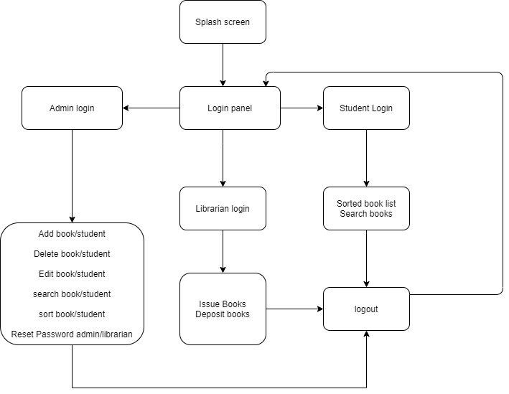
FLOWCHART

Slide 7
IMPLEMENTATION
Our application allows three modules:
Administrator
Add Student/Book
Issue Book
Student
Search book
Librarian
Modify Student/Book
Delete Student/Book
Search Student/Book
Sort Student/Book
List Student/Book
Reset Admin/librarian password
Sorted Book list
Deposit Book

Slide 8
ALGORITHM
Our application uses below algorithms
Sorting
Linear Search
Searching
Selection Sort
Insertion Sort
Merge Sort
Heap Sort
Quick Sort
Bogo Sort
Binary Search
Bubble Sort

Slide 9
SORTING ALGORITHMS
Bubble Sort
Selection Sort
Insertion Sort
Bogo Sort
Merge Sort
Heap Sort
Quick Sort

Slide 10
SEARCHING ALGORITHMS
Linear Search
Binary Search

Slide 11
Some Screenshots
Splash Screen
Main Menu

Slide 12
Some Screenshots
Student Menu
Admin Menu

Slide 13
Some Screenshots
login Menu
Librarian Menu

Slide 14
Some Screenshots
Sorting Menu
Search Menu

Slide 15
CONCLUSION
The project has been successfully completed and tested.
In the long term, this project will make the use of library more efficient, user friendly, easier and effective.
It is a real improvement over the existing manual system as it effectively overcome all the drawbacks of the existing system.

Slide 16
E-Library LMS
Thank You!!!
Notes:
NOTE:
To change the image on this slide, select the picture and delete it. Then click the Pictures icon in the placeholder to insert your own image.

