Slide 1
Career Guide App
Presented by :
Vivek Santosh Mandal (2401010091)

Slide 2
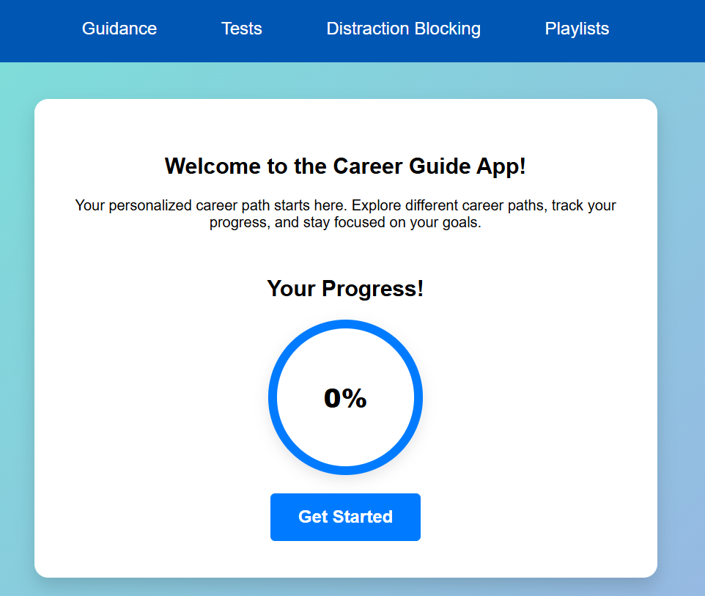
Introduction
A smart learning platform for guided career development.
Users select a career and receive structured video guidance.
Includes tests, progress tracking, and distraction blocking.

Slide 3

Problem Statement
Students often lack a clear path to pursue technical careers.
Distractions from social media lower learning efficiency.
Lack of collaborative opportunities for real-world projects.

Slide 4
Methodology & Approach
Choose a career and follow stepwise learning content.
Unlock new topics by passing tests.
Use profile dashboard to track progress with circular indicators.
Find partners based on strengths and weaknesses.
Block social media distractions during study sessions.

Slide 5
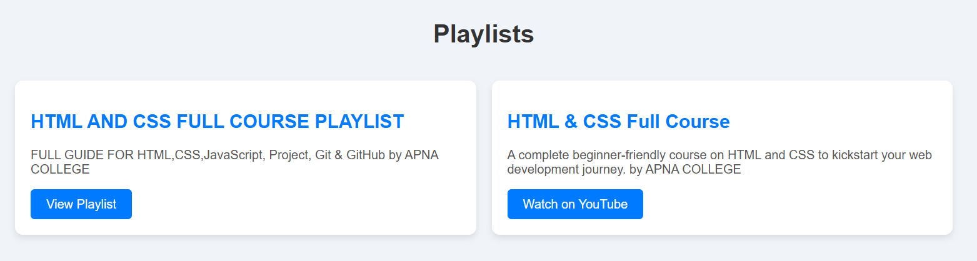
Demonstration Features
Career selection interface
Video playlist access per topic
Topic-wise MCQ tests
Progress dashboard with circular progress
Partner match-making & idea sharing

Slide 6
Technologies Used
Frontend: HTML5, CSS3, JavaScript
Backend: Python (Django)
Database: Json
Tools: VS Code, Git, GitHub

Slide 7

Conclusion
Guided and distraction-free learning environment.
Structured progression toward any career path.
Collaborative ecosystem for student developers.

Slide 8
Thank you

