Slide 1
ESP32 LECTURE SERIES
Introduction to
ESP32-DevKitC
Board Overview · Pinout · Power Options · Custom PCB Design
Espressif Systems | ESP32-DevKitC V4

Slide 2
What is ESP32-DevKitC?
ESP32-DevKitC is a small, versatile development board by Espressif based on the ESP32 chip. It exposes most I/O pins via header connectors, making it ideal for prototyping, teaching, and custom PCB reference design.
Wi-Fi + BT
Dual-Core CPU
Rich Peripherals
Dual-mode 2.4 GHz Wi-Fi (802.11 b/g/n) & Bluetooth/ BLE 4.2
Xtensa LX6 @ up to 240 MHz with 520 KB SRAM on-chip
34 GPIO · ADC · DAC · PWM · I²C · I²S · SPI · UART · Touch
Available Modules (V4):
ESP32-WROOM-32E · ESP32-WROOM-32UE · ESP32-WROVER-E · ESP32-WROVER-IE · ESP32-WROOM-32D · ESP32-SOLO-1
Headers available in male or female pin variants — check ESP Product Selector for current availability.

Slide 3
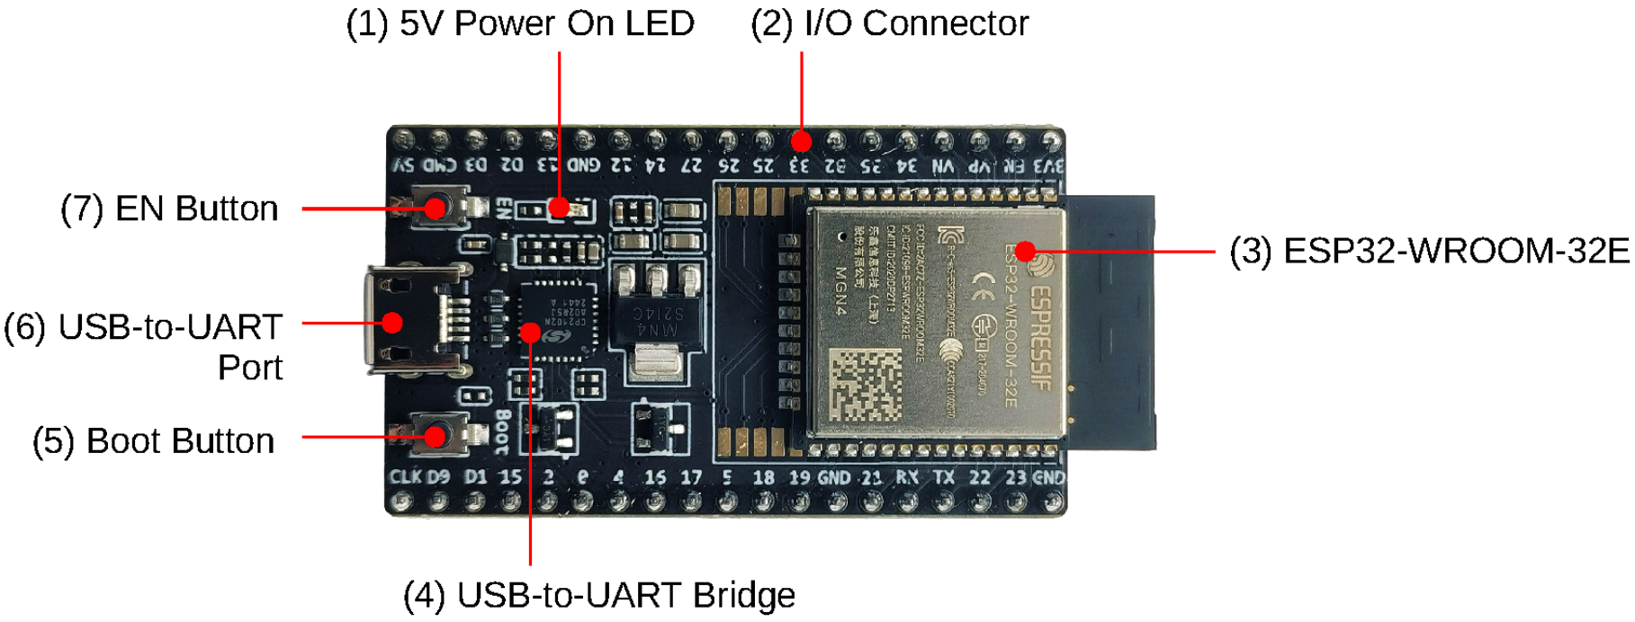
Board Functional Description — ESP32-DevKitC V4

Slide 4
Power Supply Options
01
DEFAULT
Micro USB Port
The easiest and recommended method. Connect the board to a PC or 5V USB charger via Micro-USB cable. Provides power and serial communication.
📌 No external wiring needed
02
EXTERNAL
5V + GND Header Pins
Feed 5 V directly to the 5V and GND header pins from a regulated external supply (e.g., lab bench supply or a battery regulator circuit).
📌 J2 Pin 19 (5V) → J3 Pin 1 (GND)
03
ADVANCED
3V3 + GND Header Pins
Supply 3.3 V directly to the 3V3 and GND pins. Useful when your custom PCB already has a 3.3 V regulator. Bypasses the on-board LDO.
📌 J2 Pin 1 (3V3) → J3 Pin 1/7 (GND)
⚠ WARNING: Use ONLY one power source at a time. Using multiple simultaneously can damage the board or the power supply.

Slide 5
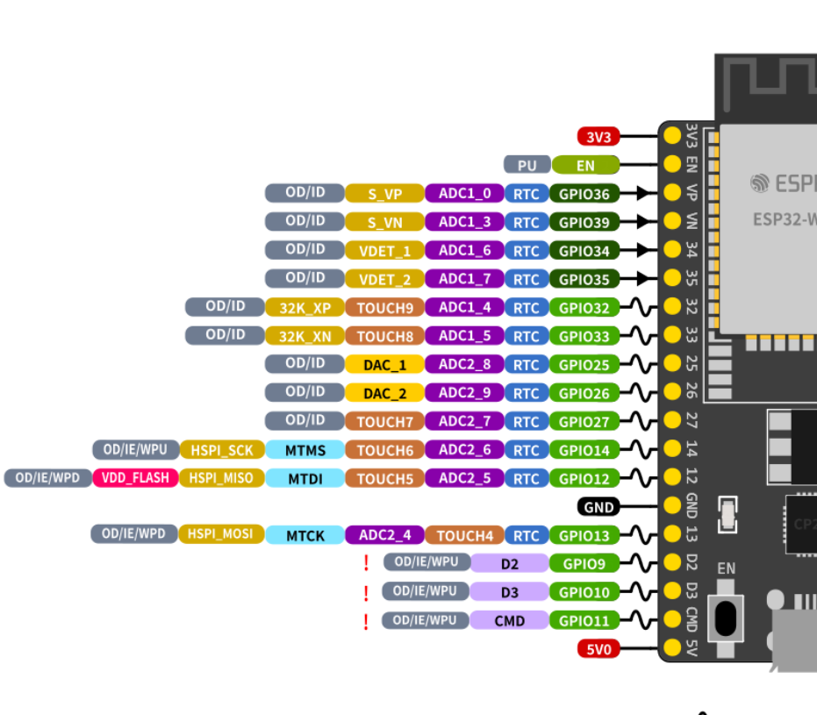
Header Pinout — J2 (Left Side)
No.
Name
Type
Function
1
3V3
P
3.3 V power supply
2
EN
I
CHIP_PU — Reset
3
VP
I
GPIO36, ADC1_CH0, S_VP (input only)
4
VN
I
GPIO39, ADC1_CH3, S_VN (input only)
5
IO34
I
GPIO34, ADC1_CH6, VDET_1 (input only)
6
IO35
I
GPIO35, ADC1_CH7, VDET_2 (input only)
7
IO32
I/O
GPIO32, ADC1_CH4, TOUCH9, XTAL_32K_P
8
IO33
I/O
GPIO33, ADC1_CH5, TOUCH8, XTAL_32K_N
9
IO25
I/O
GPIO25, ADC2_CH8, DAC_1
10
IO26
I/O
GPIO26, ADC2_CH9, DAC_2
11
IO27
I/O
GPIO27, ADC2_CH7, TOUCH7
12
IO14
I/O
GPIO14, ADC2_CH6, TOUCH6, MTMS
13
IO12
I/O
GPIO12, ADC2_CH5, TOUCH5, MTDI
14
GND
G
Ground
15
IO13
I/O
GPIO13, ADC2_CH4, TOUCH4, MTCK
16
D2*
I/O
GPIO9, D2 — ⚠ Reserved for SPI flash
17
D3*
I/O
GPIO10, D3 — ⚠ Reserved for SPI flash
18
CMD*
I/O
GPIO11, CMD — ⚠ Reserved for SPI flash
19
5V
P
5 V power supply
* Pins D0–D3, CMD, CLK are reserved for internal SPI flash. Avoid using them in user designs.

Slide 6
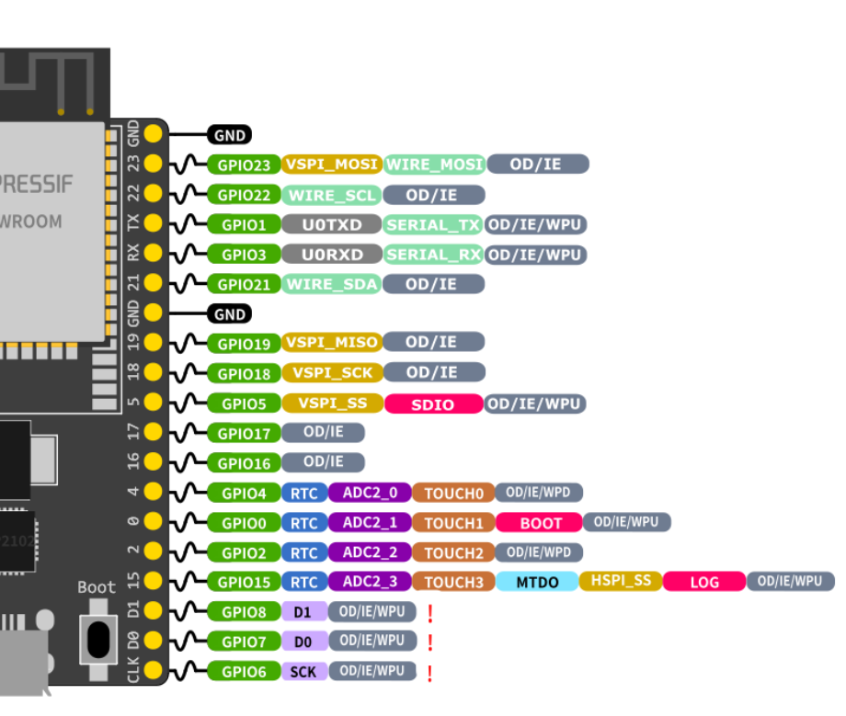
Header Pinout — J3 (Right Side)
No.
Name
Type
Function
1
GND
G
Ground
2
IO23
I/O
GPIO23
3
IO22
I/O
GPIO22
4
TX
I/O
GPIO1, U0TXD — UART0 Transmit
5
RX
I/O
GPIO3, U0RXD — UART0 Receive
6
IO21
I/O
GPIO21
7
GND
G
Ground
8
IO19
I/O
GPIO19
9
IO18
I/O
GPIO18
10
IO5
I/O
GPIO5
11
IO17†
I/O
GPIO17 — Not available on WROVER modules
12
IO16†
I/O
GPIO16 — Not available on WROVER modules
13
IO4
I/O
GPIO4, ADC2_CH0, TOUCH0
14
IO0
I/O
GPIO0, ADC2_CH1, TOUCH1, Boot strapping pin
15
IO2
I/O
GPIO2, ADC2_CH2, TOUCH2, Boot strapping pin
16
IO15
I/O
GPIO15, ADC2_CH3, TOUCH3, MTDO
17
D1*
I/O
GPIO8, D1 — ⚠ Reserved for SPI flash
18
D0*
I/O
GPIO7, D0 — ⚠ Reserved for SPI flash
19
CLK*
I/O
GPIO6, CLK — ⚠ Reserved for SPI flash
* SPI flash reserved pins | † GPIO16/17 reserved on WROVER-E/IE — available on WROOM and SOLO-1 modules only.

Slide 7
GPIO Functional Map — Key Peripherals
ADC (Analog Input)
DAC (Analog Output)
Touch Sensor
ADC1: GPIO32,33,34,35,36,39
ADC2: GPIO0,2,4,12,13,14,15,25,26,27
⚠ ADC2 unavailable when Wi-Fi is active
DAC_1: GPIO25
DAC_2: GPIO26
8-bit resolution (0–3.3 V output)
GPIO0,2,4,12,13,14,15,27,32,33
10 capacitive touch channels
Useful for touchpad UI
UART
SPI
I²C
UART0 TX: GPIO1 | RX: GPIO3
UART1 TX: GPIO10 | RX: GPIO9
UART2: assignable to any GPIO via Matrix
HSPI: GPIO14(CLK),12(MISO),13(MOSI),15(CS)
VSPI: GPIO18(CLK),19(MISO),23(MOSI),5(CS)
SPI0/1 reserved for internal flash
Default: SDA=GPIO21 SCL=GPIO22
Remappable via GPIO Matrix
Supports up to 400 kHz fast mode

Slide 8
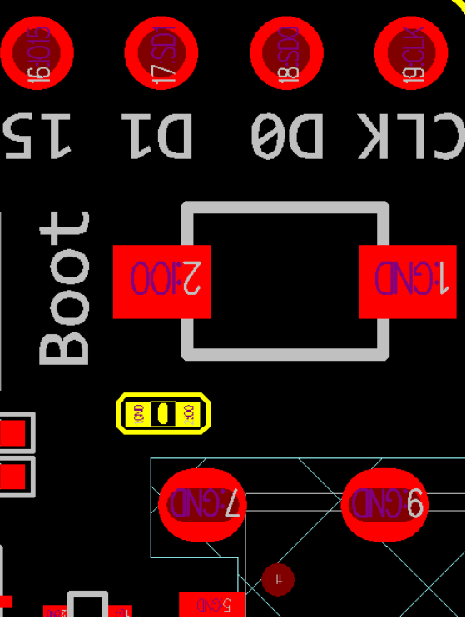
Important Hardware Notes
⚠ Note on Component C15 (Early Boards)
Issue 1: Board may boot into Download mode unexpectedly.
Issue 2: Clock signal on GPIO0 may be affected by C15's parasitic capacitance.
Fix: Remove C15 (located near GPIO0 on the PCB). Marked in yellow on the board layout diagram.
⚡ Strapping Pins — Critical for Boot Mode
●
GPIO0 (IO0):
HIGH = Normal boot / LOW = Download mode (BOOT button)
●
GPIO2 (IO2):
Must be LOW or floating during download; HIGH for normal boot
●
GPIO5 (IO5):
Controls SDIO timing; keep HIGH (pull-up) for normal operation
●
GPIO12 (MTDI):
Flash voltage select — LOW for 3.3 V; HIGH for 1.8 V flash (WROVER)
●
GPIO15 (MTDO):
UART log output enable — LOW disables U0TXD boot log
PCB Design Tip: Always add pull-up/pull-down resistors on strapping pins to guarantee correct boot behavior in your custom board.

Slide 9
Start Application Development
01
Inspect the Board
Before powering up, visually inspect the ESP32-DevKitC V4 for any physical damage. Check solder joints, components, and the USB port.
02
Install ESP-IDF
Download and install the Espressif IoT Development Framework (ESP-IDF). Follow the official Get Started guide at docs.espressif.com for Windows, Linux, or macOS.
03
Connect via USB
Connect the board to your PC using a Micro-USB cable. The 5V LED will illuminate. Your OS will detect a new serial port (COMx / /dev/ttyUSBx).
04
Flash & Monitor
Use idf.py build flash monitor to compile, flash, and open the serial monitor. Hold BOOT then press EN to enter download mode if needed.
Reference: ESP-IDF Get Started → https://docs.espressif.com/projects/esp-idf/en/latest/

Slide 10
Related Documents & Summary
📄 Reference Documents
✅ Lecture Summary
› ESP32 Datasheet (PDF)
Board:
ESP32-DevKitC V4 — small, breadboard-friendly
› ESP32-DevKitC V4 Schematics (PDF)
Core:
ESP32 (Xtensa LX6 dual-core, up to 240 MHz)
› ESP32-DevKitC V4 PCB Layout (PDF)
Wireless:
Wi-Fi 802.11 b/g/n + Bluetooth 4.2/BLE
› ESP32-DevKitC V4 Dimensions (PDF)
Memory:
520 KB SRAM + 4 MB Flash (module)
› ESP32-DevKitC V4 Dimensions Source (DXF)
GPIO:
38 pins total, 34 usable for user GPIO
› ESP32-WROOM-32E Datasheet (PDF)
Peripherals:
ADC, DAC, Touch, SPI, I²C, UART, PWM
› ESP Product Selector
Programming:
Micro-USB → CP210x → UART → ESP32
› ESP-IDF Get Started Guide
Power:
Micro-USB (default), 5V pin, or 3V3 pin
› ESP32 Hardware Design Guidelines
PCB Use:
Module footprint: ESP32-WROOM-32E
All documents available at: docs.espressif.com
For board design docs, contact: sales@espressif.com

