Slide 1

EASYSQL
Presented by
Bibhas Das, Bikram Lohar, Sarthak Ghosh Sayak Mondal, Avijit Mondal
Under Guidance of Dr. Sayani Mondal
Assistant Professor
Department of computer science
Sister Nivedita University
Date: 30 April, 2025

Slide 2
AGENDA
Introduction
Objectives
Literature Review
Research Gap
Methodology
Dataset Preparation
Technical Specification
Result and Discussion
Conclusion and Future Scope

Slide 3
EASYSQL: A Smart SQL Query Suggestion Tool

Slide 4

Introduction
EASYSQL is a terminal-based tool that helps beginners write correct SQL queries by offering real-time, schema-based suggestions and corrections to enhance learning and reduce errors.
Writing SQL queries is challenging for both beginners and experienced users due to syntax errors, missing semicolons, and unclear table or column names, while existing AI tools lack live database validation during typing.
EASYSQL bridges the gap by providing a simple, real-time, terminal-based tool that guides users with live schema-based suggestions and instant corrections, making SQL learning faster and error-free.

Slide 5
Objectives
Develop an intelligent SQL suggestion system that helps beginners write correct queries by offering real-time, context-aware guidance using schema-aware patterns, addressing syntax, structure, and promoting step-by-step learning.
Query Suggestion Generation: EASYSQL provides real-time, context-aware recommendations based on user input and live database schema, assisting users in constructing accurate SQL queries.
Query Correction: The system identifies and corrects common SQL errors, such as syntax mistakes, missing clauses, and misused keywords, ensuring users write error-free queries.

Slide 6
Literature Review
Existing Features
Various systems assist users, especially beginners, in writing SQL queries. Tools like SnipSuggest [1] simplify query creation by suggesting snippets or converting keywords into full SQL using templates. QueRIE[2] and DialSQL[3] use query history and schema to offer personalized, adaptive suggestions. Agrawal’s system[4] leverages RDFS templates to guide SQL generation from metadata.
AI-based methods further enhance automation. RNNs and Q-Learning[5] predict queries via sequence patterns, boosting accuracy and speed. NLP-based systems[6] allow query building through natural language or visuals, using techniques like token reuse and incremental refinement for faster results. SQLSketch[7] support cross-domain applications and translate natural language into SQL via semantic parsing and neural models.
In addition to intelligent systems, several web and desktop tools simplify SQL query writing. SQL Fiddle[8] is a browser-based tool that supports MySQL, PostgreSQL, and SQL Server, allowing users to set up schemas and run queries online without installation.
PopSQL[9] is a collaborative SQL editor with autocomplete, version control, and built-in charting, enabling teams to write, share, and visualize queries together.
Dbeaver [10] is a robust database tool for developers, offering smart autocomplete, schema browsing, and support for databases like MySQL, PostgreSQL, and MongoDB, available in both free and enterprise editions.

Slide 7
Research gap
Traditional SQL tools like MySQL Workbench show errors only after query execution.
These tools are more suitable for experienced users due to features like data visualization and schema browsing.
NLP-based SQL generators automatically produce full queries from natural language input.
These tools skip the learning process by not explaining how the queries are constructed.
Most popular SQL editors and platforms focus more on query execution than on teaching users how to write them.
They lack interactive, educational support to help users improve their SQL skills.

Slide 8
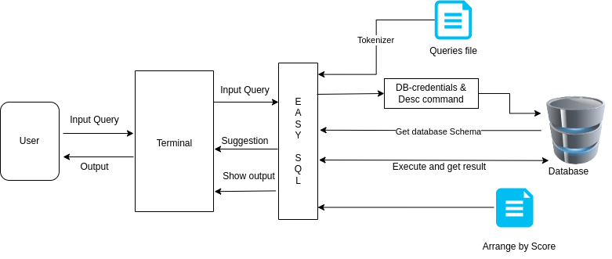
Methodology
System Overview
The above diagram represents the high-level architecture of the EASYSQL system. It shows how the user, EASYSQL engine, and the connected database interact to support real-time SQL query suggestions, validation, and execution.

Slide 9
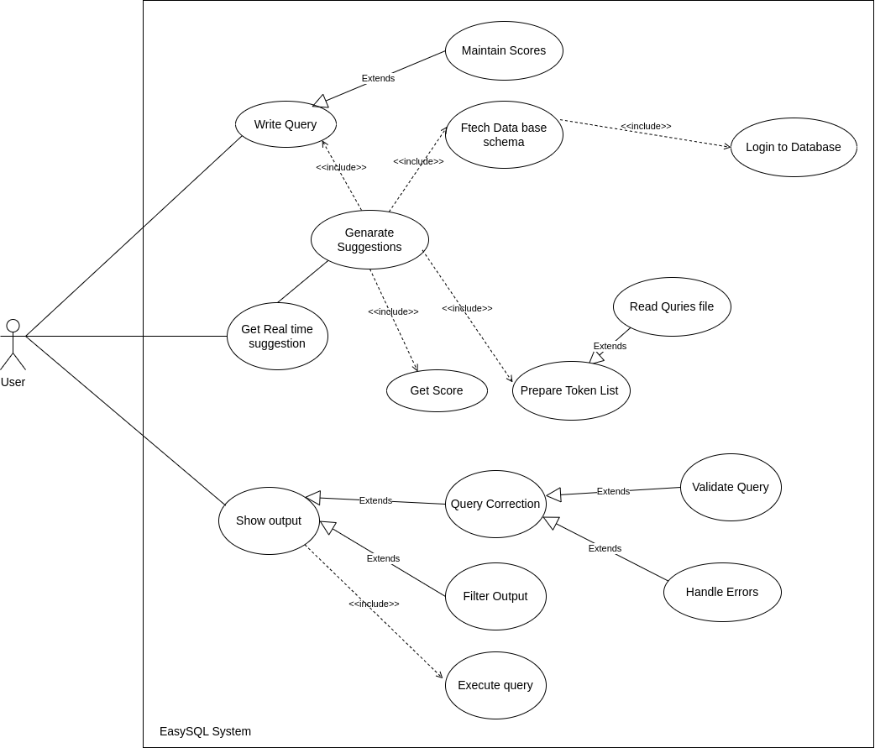
Use case Diagram

Slide 10

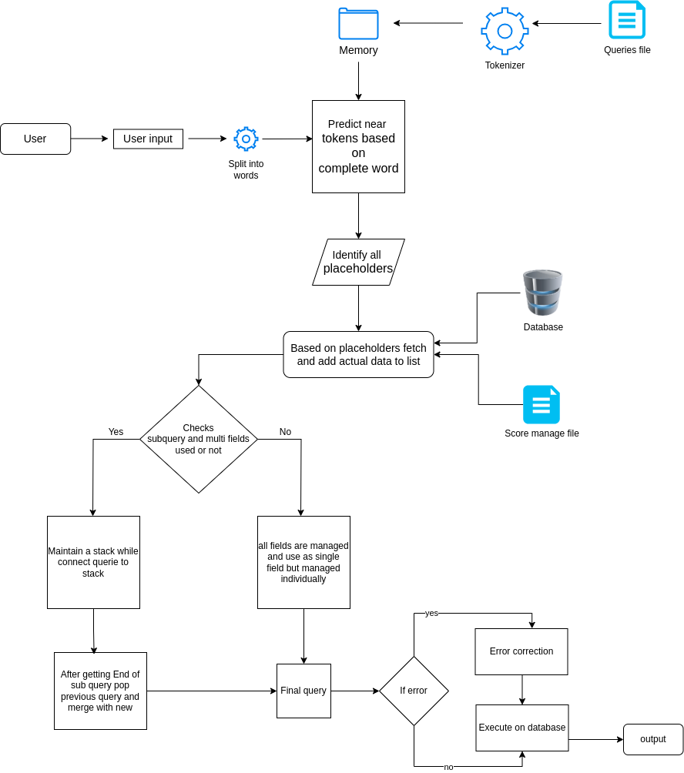
Work Flow of the Back-end

Slide 11

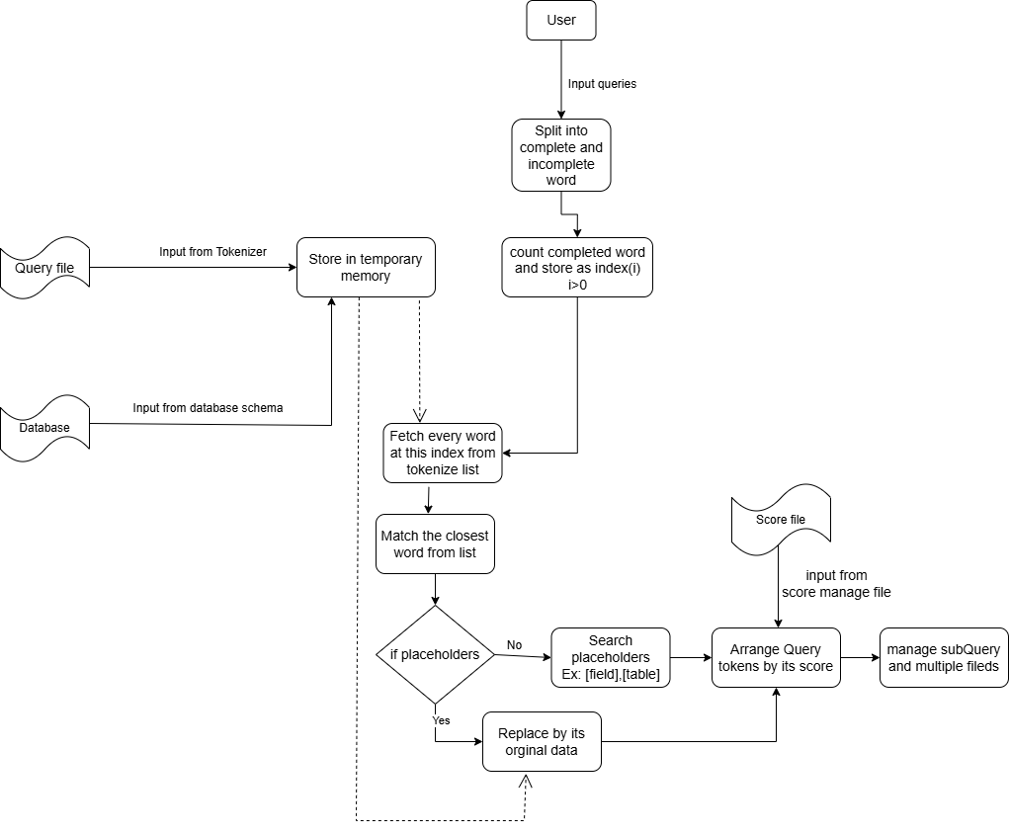
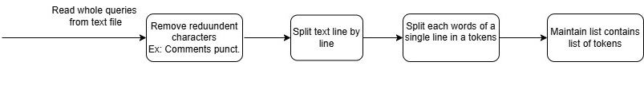
Suggestion Process
EASYSQL provides real-time query suggestions based on token matching and database schema awareness. As users type, the system predicts the next possible keywords, fields, or clauses and displays dynamic suggestions to assist query construction.

Slide 12
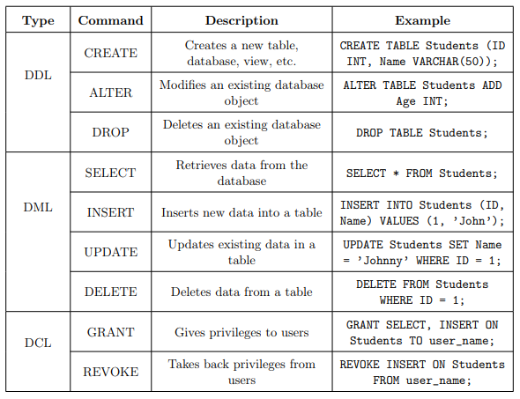
Knowledge Graph
The Knowledge Graph shows how SQL operations (DDL, DML, DCL) and their commands are related. It was dynamically expanded during the project by creating ontologies, inserting new queries, and updating patterns. Additional ontologies such as Create, Insert, Update, and Delete were also developed.

Slide 13
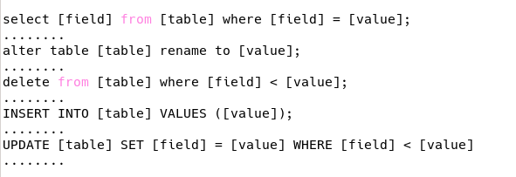
Dataset and Preparation
EASYSQL used a structured ontology to map SQL keywords and clauses. General SQL queries were manually created by following these graphs to maintain correct syntax flow.
Tools like ChatGPT and Protégé supported visualization, while actual query preparation was done manually to ensure standardized and dynamic suggestions.
A total of approximately 1400+ SQL queries were prepared during the development.
These queries covered various SQL operation types for broad and realistic suggestions
300+ queries related to SELECT (DQL) operations.
150+ queries for INSERT (DML) operations.
110+ queries for UPDATE (DML) operations.
120+ queries for DELETE (DML) operations.

Slide 14
Technical Specification
Windows 10, Windows 11, Ubuntu (versions 20.04 LTS and 22.04 LTS), and Manjaro Linux 25.0.0.
The application is compatible with Python versions 3.6 and above 2, and was successfully tested in environments running Python 3.6, 3.10, and 3.13.2.
The project primarily uses the Pythonlibrary prompt_toolkit (version 3.0.51)3, along with standard libraries such as os, re, and pytest-shutil 1.8.1 4, rich 14.0.0 5.
EASYSQL operates through terminal environments like Windows Command Prompt and Linux Terminals like ZSH, BASH.
Database connections were tested with both MySQL 6 and 11.7.2-MariaDB 7 servers . Minimum recommended system requirements include at least 2 GB RAM.

Slide 15
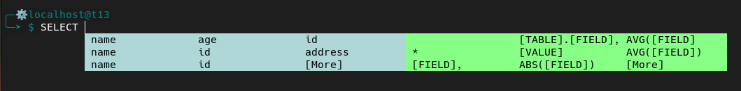
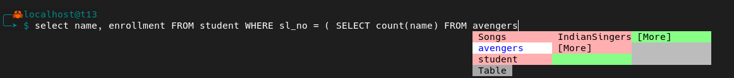
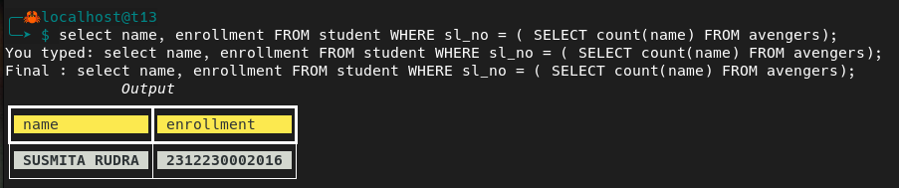
Suggestion and Output
The first output screenshot shows how EASYSQL provides live suggestions while the user is typing a query in the terminal environment. Partial words are matched and possible completions are suggested dynamically.
The second screenshot demonstrates how all probable keywords and actual field names retrieved from the connected database are shown, helping the user complete their query accurately and quickly.
Finally, the executed SQL query's output is displayed directly on the terminal through a clean and simple interface, ensuring an easy-to-understand user experience

Slide 16
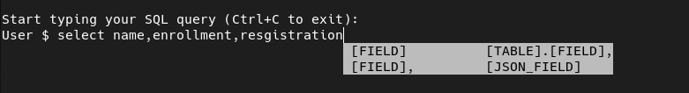
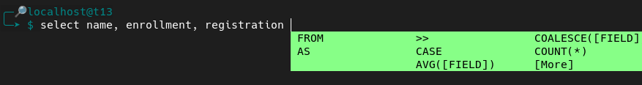
Challenges Faced
Subquery Issue: Could not manage deeper nested subqueries beyond predefined examples.
Solution:
Used stack-based logic to manage subqueries dynamically.
Space Issue in Multiple Fields: Multiple fields without spaces were treated as a single token, breaking suggestions.
Solution:
Inserted spaces after commas and internally merged fields after suggestion.

Slide 17


Correction
EASYSQL includes an automatic Query Corrector module that detects and fixes minor syntax errors during query writing.
It handles missing semicolons, incomplete keywords, misplaced clauses, and ensures that the final query is valid before execution.
When the user forgets to add a semicolon ; at the end of the query, EASYSQL automatically detects and corrects it before executing the query.
When a subquery is incomplete, missing a closing bracket ), EASYSQL identifies the mistake and automatically adds the missing ) and the final ; to correct the query.

Slide 18
Conclusion & Future Work
EASYSQL helps students and beginners write correct SQL queries in real-time with suggestions and corrections.
It supports query building, error correction (missing semicolons, wrong keywords, unmatched parentheses), and schema validation.
The system works efficiently in a terminal environment and is lightweight.
Limitations include support only for MySQL databases and dependency on predefined query sets.
Future improvements include adding support for other databases (PostgreSQL, Oracle), introducing natural language query conversion, improving the suggestion engine with machine learning, and building a GUI version for easier access.

Slide 19
References
1) Nodira Khoussainova et al. “SnipSuggest: Context-aware autocompletion for SQL”. In: Proceedings of the VLDB Endowment 4.1 (2010), pp. 22–33.
2) Javad Akbarnejad et al. “SQL QueRIE recommendations”. In: Proceedings of the VLDB Endowment 3.1-2 (2010), pp. 1597–1600.
3) Izzeddin Gür et al. “Dialsql: Dialogue based structured query generation”. In: Proceedings of the 56th Annual Meeting of the Association for Computational Linguistics (Volume 1: Long Papers). 2018, pp. 1339–1349.
4) Quan Do et al. “Automatic generation of SQL queries”. In: 2014 ASEE Annual Conference& Exposition. 2014, pp. 24–221.
5) Venkata Vamsikrishna Meduri, Kanchan Chowdhury, and Mohamed Sarwat. “Evaluation
of machine learning algorithms in predicting the next SQL query from the future”. In: ACM Transactions on Database Systems (TODS) 46.1 (2021), pp. 1–46.
6) https://anishdoshi.com/assets/pdf/HCI_Final_Report_nl2sql.pdf
7) Karam Ahkouk et al. “SQLSketch: Generating SQL Queries using a sketch-based ap
proach”. In: Journal of Intelligent & Fuzzy Systems 40.6 (2021), pp. 12253–12263
8) https://sqlfiddle.com/
9) https://popsql.com/
10) https://dbeaver.io/

Slide 20
Acknowledgement
We sincerely thank our respected guide, Dr. Sayani Mondal, Assistant Professor, for her constant support, valuable suggestions, and guidance throughout this project.
We are grateful to the Department of Computer Science, the Project Committee, our HOD, and all faculty members of Sister Nivedita University for their academic support and encouragement.
We extend heartfelt thanks to our family members and friends for their motivation and belief in us throughout this journey.
Finally, we appreciate the contributions of our peers, juniors, and seniors, whose collaboration and suggestions enriched our learning experience.

Slide 21
Thank you!

