Slide 1

EASYSQL: A Smart SQL Query Suggestion Tool
Presented by
Bibhas Das, Bikram Lohar, Sarthak Ghosh Sayak Mondal, Avijit Mondal
Under Guidance of Dr. Sayani Mondal
Assistant Professor
Department of computer science
Sister Nivedita University
Date: 30 April, 2025

Slide 2
Introduction
EASYSQL is a terminal-based tool that helps beginners write correct SQL queries by offering real-time, schema-based suggestions and corrections to enhance learning and reduce errors.
Writing SQL queries is challenging for both beginners and experienced users due to syntax errors, missing semicolons, and unclear table or column names, while existing AI tools lack live database validation during typing.
EASYSQL bridges the gap by providing a simple, real-time, terminal-based tool that guides users with live schema-based suggestions and instant corrections, making SQL learning faster and error-free.

Slide 3
Objectives
Develop an intelligent SQL suggestion system that helps beginners write correct queries by offering real-time, context-aware guidance using schema-aware patterns, addressing syntax, structure, and promoting step-by-step learning.
Query Suggestion Generation: EASYSQL provides real-time, context-aware recommendations based on user input and live database schema, assisting users in constructing accurate SQL queries.
Query Correction: The system identifies and corrects common SQL errors, such as syntax mistakes, missing clauses, and misused keywords, ensuring users write error-free queries.

Slide 4
Literature Review
Source
This overview is based on a survey of academic literature obtained via Google Scholar. In particular, we synthesized information from research papers and reviews on SQL query assistance and natural-language interfaces to databases.
Existing Features
Various systems have been developed to assist users especially beginners in writing SQL queries. Tools like SnipSuggest simplify query creation by offering snippet suggestions based on past query logs, while SQLSUGG enables users to input keywords and converts them into full SQL statements using predefined templates [1]. QueRIE monitors user activity and query logs to provide personalized suggestions based on query history [2]. DialSQL offers real-time, adaptive completions by combining schema structure with previous queries [3]. Agrawal’s system uses RDFS templates to generate SQL queries from structured metadata, helping users understand SQL logic through guided patterns [4].

Slide 5
Existing Features
Modern AI-based approaches enhance SQL automation further. Techniques like RNNs and Q-Learning predict user queries based on sequence patterns, improving accuracy and execution speed [5]. NLP-based systems enable natural language or visual interactions, allowing users to build queries through simple text or graphical inputs. Methods like token reuse and incremental refinement optimize query generation with faster response times [6]. SQLSketch enables users to outline queries that the system completes, supporting cross-domain applications, while NLIDB systems convert natural language into SQL using semantic parsing and neural models [7].
In addition to these, there are also some widely-used web and desktop tools that streamline query writing. SQL Fiddle is a browser-based tool that lets users quickly set up schemas and run SQL queries online, supporting MySQL, PostgreSQL, and SQL Server—no installation needed [8]. PopSQL is a collaborative SQL editor where teams can write, share, and visualize queries together, with features like autocomplete, version control, and built-in charting [9]. DBeaver is a powerful database tool for developers, offering smart autocomplete, schema browsing, and support for many databases like MySQL, PostgreSQL, and MongoDB, available in both free and enterprise versions [10] .

Slide 6
Research gap
Existing SQL learning tools often fall short when it comes to helping beginners. Traditional tools like MySQL Workbench provide limited support while writing queries, showing errors only after execution and offering little guidance on what to type next. While it’s useful for experienced users with features like data visualization and schema browsing, it's not ideal for learning. Newer tools that translate natural language into SQL such as NLP-based generators can automatically produce queries, but they skip the learning process by not explaining how those queries are formed. Similarly, many popular editors and platforms focus more on execution than education. EASYSQL fills this gap by providing real-time, intelligent suggestions as users type, helping them learn SQL step by step while improving accuracy and confidence.

Slide 7
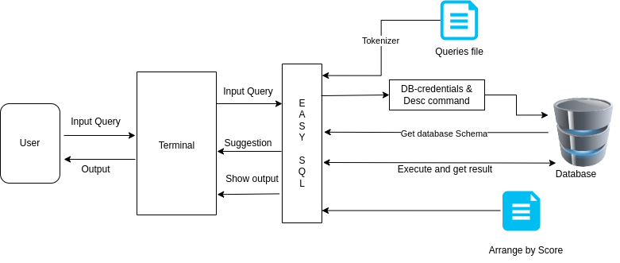
Methodology
System Overview
Overall Diagram
The above dirgram represents the high-level architecture of the EASYSQL system. It shows how the user, EASYSQL engine, and the connected database interact to support real-time SQL query suggestions, validation, and execution. The system flow highlights the core components and their coordination to assist users throughout the query writing and correction process.

Slide 8
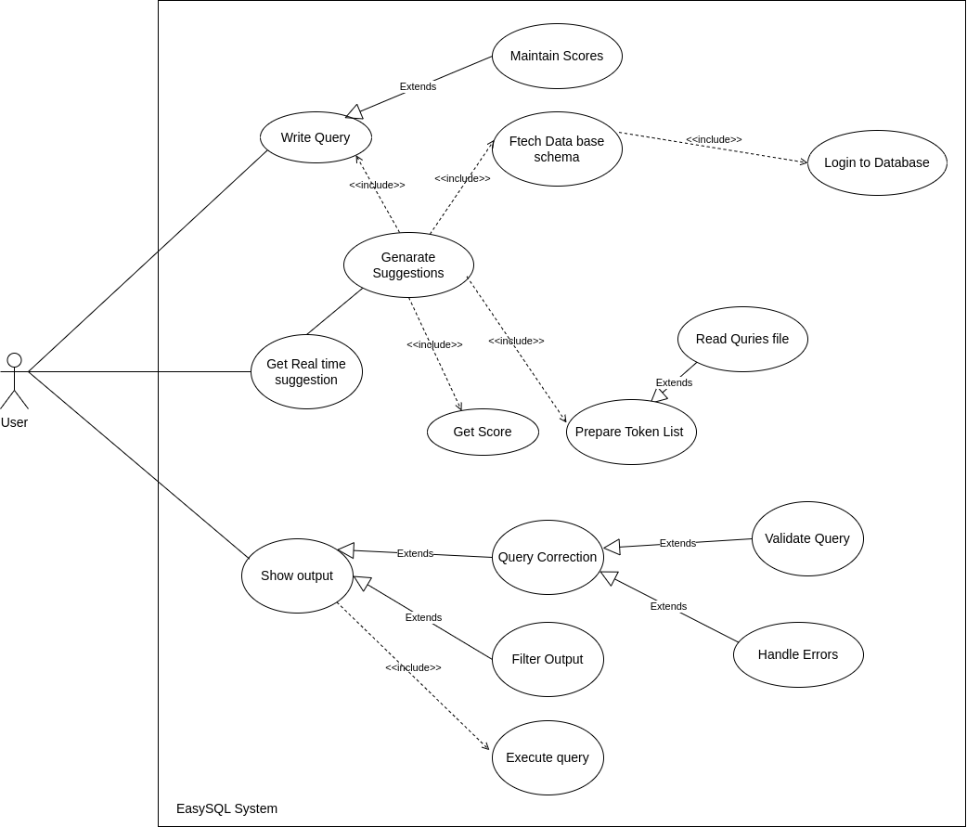
Use case Diagram
The Use Case Diagram shows how the user, the EASYSQL program, and the database interact. It highlights key activities such as writing queries, fetching schema, suggesting corrections, handling errors, and executing queries.
The diagram follows UML standards and clearly represents all system activities, dependencies, and flows needed for the EASYSQL system to work properly.

Slide 9
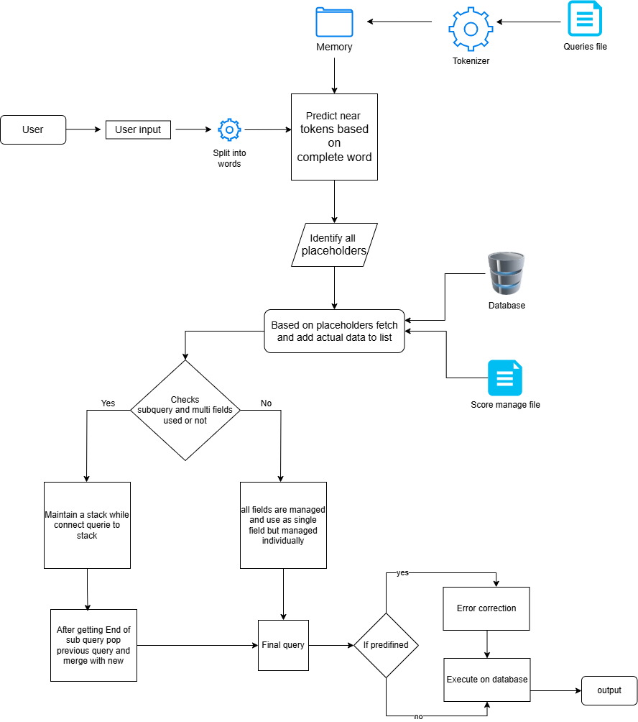
Implementation
The diagram shows the complete flow of the EASYSQL system, from user input to query execution. Each module : tokenizer, suggestion engine, schema fetcher, error correction, and executor—works together to help users write correct SQL queries efficiently.
Overall Steps

Slide 10
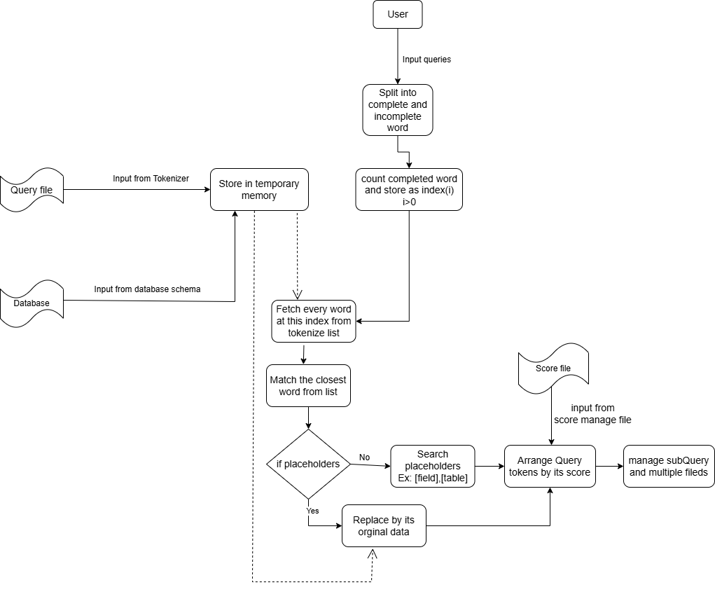
Suggestion Process
EASYSQL provides real-time query suggestions based on token matching and database schema awareness. As users type, the system predicts the next possible keywords, fields, or clauses and displays dynamic suggestions to assist query construction.
Suggestion steps

Slide 11
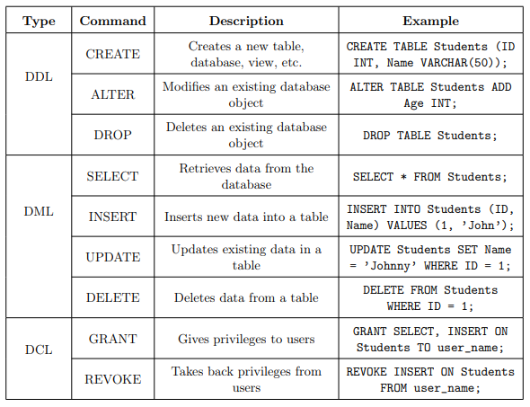
Knowledge Graph
The Knowledge Graph shows how SQL operations (DDL, DML, DCL) and their commands are related. It was dynamically expanded during the project by creating ontologies, inserting new queries, and updating patterns.
Additional ontologies such as Create, Insert, Update, and Delete were also developed.
Knowledge Graph

Slide 12
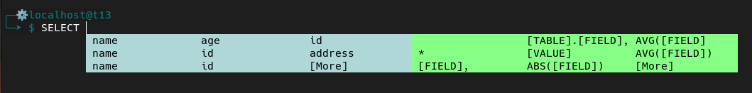
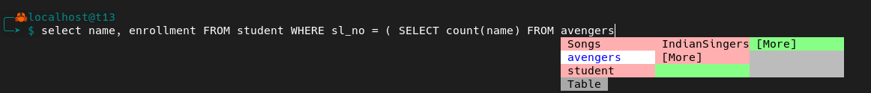
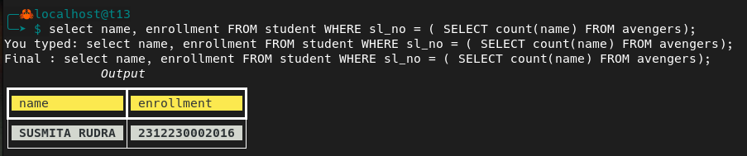
Suggestion and Output
The first output screenshot shows how EASYSQL provides live suggestions while the user is typing a query in the terminal environment. Partial words are matched and possible completions are suggested dynamically.
The second screenshot demonstrates how all probable keywords and actual field names retrieved from the connected database are shown, helping the user complete their query accurately and quickly.
Finally, the executed SQL query's output is displayed directly on the terminal through a clean and simple interface, ensuring an easy-to-understand user experience

Slide 13
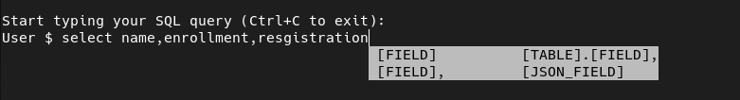
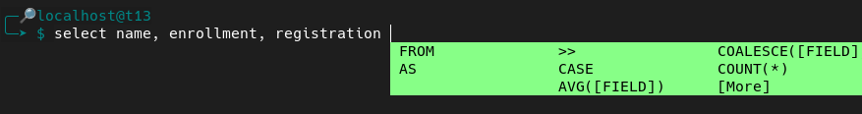
Challenges Faced
Subquery Issue: Could not manage deeper nested subqueries beyond predefined examples.
Solution:
Used stack-based logic to manage subqueries dynamically.
Space Issue in Multiple Fields: Multiple fields without spaces were treated as a single token, breaking suggestions.
Solution:
Inserted spaces after commas and internally merged fields after suggestion.

Slide 14


Correction
EASYSQL includes an automatic Query Corrector module that detects and fixes minor syntax errors during query writing.
It handles missing semicolons, incomplete keywords, misplaced clauses, and ensures that the final query is valid before execution.
When the user forgets to add a semicolon ; at the end of the query, EASYSQL automatically detects and corrects it before executing the query.
When a subquery is incomplete, missing a closing bracket ), EASYSQL identifies the mistake and automatically adds the missing ) and the final ; to correct the query.

Slide 15
Conclusion & Future Work
EASYSQL helps students and beginners write correct SQL queries in real-time with suggestions and corrections.
It supports query building, error correction (missing semicolons, wrong keywords, unmatched parentheses), and schema validation.
The system works efficiently in a terminal environment and is lightweight.
Limitations include support only for MySQL databases and dependency on predefined query sets.
Future improvements include adding support for other databases (PostgreSQL, Oracle), introducing natural language query conversion, improving the suggestion engine with machine learning, and building a GUI version for easier access.

Slide 16
References
1) https://dl.acm.org/doi/abs/10.14778/1880172.1880175
2) https://dl.acm.org/doi/abs/10.14778/1920841.1921048
3) https://aclanthology.org/P18-1124/
4) https://peer.asee.org/automatic-generation-of-sql-queries
5) https://dl.acm.org/doi/abs/10.1145/3442338
6) https://anishdoshi.com/assets/pdf/HCI_Final_Report_nl2sql.pdf
7) https://journals.sagepub.com/doi/abs/10.3233/JIFS-210359
8) https://sqlfiddle.com/
9) https://popsql.com/
10) https://dbeaver.io/

Slide 17
Acknowledgement
We sincerely thank our respected guide, Dr. Sayani Mondal, Assistant Professor, for her constant support, valuable suggestions, and guidance throughout this project.
We are grateful to the Department of Computer Science, the Project Committee, our HOD, and all faculty members of Sister Nivedita University for their academic support and encouragement.
We extend heartfelt thanks to our family members and friends for their motivation and belief in us throughout this journey.
Finally, we appreciate the contributions of our peers, juniors, and seniors, whose collaboration and suggestions enriched our learning experience.

Slide 18
Thank you!

