Slide 1
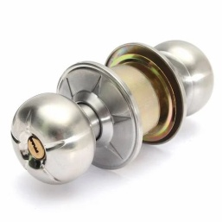
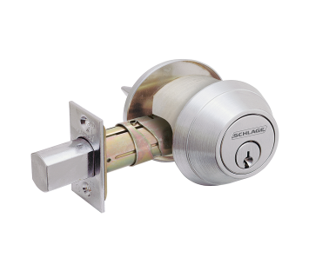
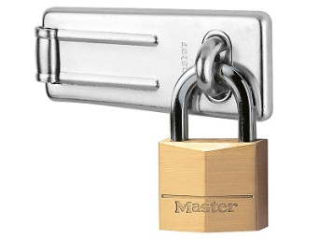
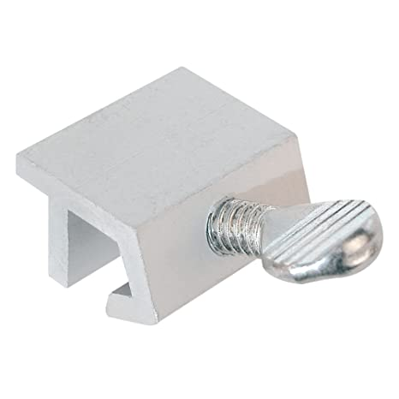
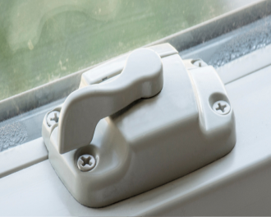
Types of Locks
Knob Lock: A door lock with a spring bolt operated by a knob.
Deadbolt: A door lock with a spring bolt operated by a key.
Padlock&Hasp: A padlock is a portable locking mechanism and a hasp is a metal plate used to secure it to a door or gate.
Slider Lock: A slider lock is a type of lock that uses a sliding bolt or latch mechanism to secure a door or window.
Window Lock: A window lock is a type of lock that is specifically designed to secure a window.

Slide 2
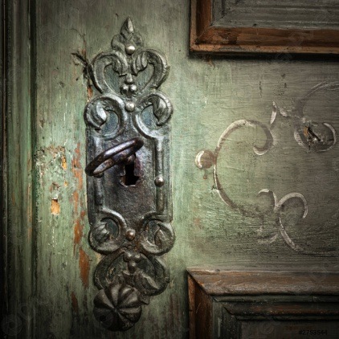
Antique Lock
An antique lock is a type of lock that is old and no longer produced or commonly used
If the property has a antique lock then it will not be removed. Instead we will put a padlock and hasp on the door.
And the same work order we will bid a locksmith to disable the lock. And Finnaly attached a lockset.
Lockset: Lockset is the set of a Knob Lock and Deadbolt.

Slide 3
Key Codes and Box codes
The key code is determined by the last digit of the loan number.
And the Box code is the last 4 digits of the loan number.
Lone number ending with | Key code
0, 1, 2 | 67767
3, 4, 5 , 6 | 35241
7, 8, 9 | 44535
Example: Lone number : *****6289
then the Key code 44535 because the last digit is 9
and the box code is : 6289 (The last 4 digits)

Slide 4
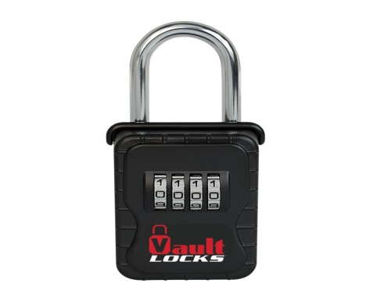
Some rules during the lock change
The old lock must be kept in the kichen drawer not thrown away.
The lock that is changed that is not a normal lock. It is property preservation lock. Those kind of lockes are avilable from MFS supply.
If there is a situation that there is an shed. We shoould be ensure that it is resecure or need to install one if it missing.

