Slide 1

Capstone Project Final Presentation
(Group 4)
MENTOR: Ankush Bansal
Members:
Anushka Arora
Bibhash Dutta
Gaurav Rai
Sachin Verma
Supriya Raturi
T. Shalem

Slide 2

AIRBNB HOTEL PRICE PREDICTION
Problem Statement:
We acquired Airbnb 2021 dataset for 28 prominent cities of USA.
With this dataset we aim to develop a reliable price prediction model using machine learning and data processing techniques to aid new property owners with pricing of their property with aim to make the pricing both competitive profitable for the new owner.

Slide 3
Problem Definition
What Is The Importance Of This Problem We Aim To Solve?
Let us assume we have a new host who wants to start in the business of renting his property out using Airbnb.
How does he/ she know what prices to charge for each room?
Location
Popularity (Tourist Attractions/ Landscape/ Seasonal or Perennial)
Customer Base
Competitive Pricing
Kind of Amenities provided by each of the rooms.

Slide 4
Problem Definition Continued…
Q) How does he/ she know what prices to charge for each room?
This question can be tackled through the following two methods:
Solution 1: Going from property to property to know the listings they have provided
Solution 2: Refer to a system where all he/she has to provide is the location where his/her property is at and the system computes the most competitive pricing for that location in an instant.

Slide 5
Problem Definition Continued…
This is where our Project came in.
We aimed to analyse Airbnb's publicly available listing information for this year to predict their room/flat/villa prices based on location, amenities provided and various other features.
Thus, providing Airbnb Hosts with undeniable advantages of marketing strategy planning, revenue forecasting, purchase decision, action plan for near future and much more.

Slide 6





Methodology
Data Acquisition
Data Cleaning
Exploring the Data
Model Building
Model Analysis
The data was acquired from the source http://insideairbnb.com/
The dataset was cleaned with removal of unwanted features and columns with null values
Analyzing the Data through the EDA process and gaining Inferences of the data in order to form the model.
From the Inferences gained from the data, we move onto Basic Model Building.
The created model is then tested for accuracy scores and ways of improving the model are then learnt.

Slide 7
Data Acquisition
ACQUIRING THE DATA
Source: http://insideairbnb.com/
We have merged the data of 28 unique cities of USA to form one chunk of data consisting 201709 records and 75 features.
DATA MERGING
This main dataset was created by merging the Airbnb datasets of 28 different cities in USA with common features, compiling them into one large dataset.

Slide 8
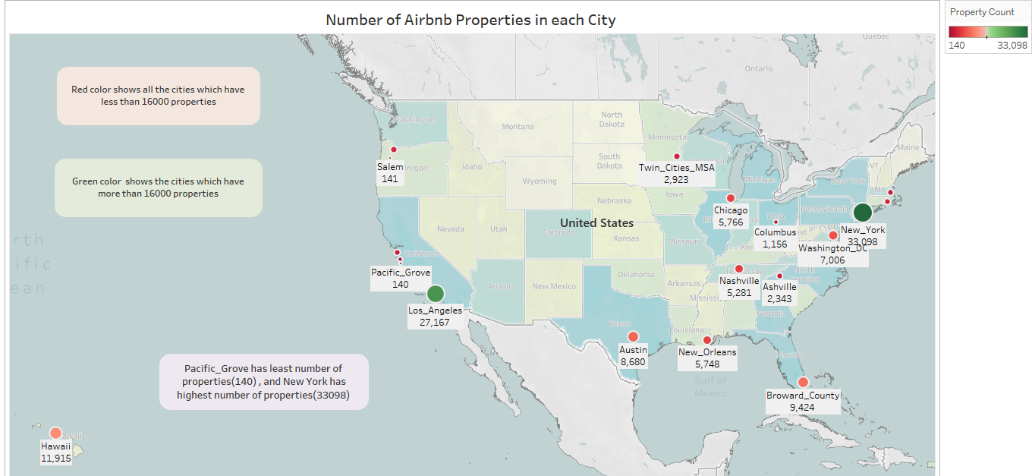

Slide 9
Cleaning the Data
Records and features containing more than 30% nulls are removed which left us with 199331 records and 68 features.
Out of these 68 features some features contained no useful information for our purposes viz. (Host_url, host_picture_url etc) where as some contained redundant information which were dropped after performing correlation between similar features.
After cleaning the data, we are left with 199331 records and 39 features.

Slide 10
Null Imputations
Features | Description
Host since | Imputed with initial date present in the dataset (mode)
Review columns | Imputed with mean scores of each city
Host_response_time | Imputed considering host_id, if host_id has multiple listings and one of the listings has response time but other listing doesn’t have that then we impute it with the response time of the available listing else we impute it with the mode of listing.
Others | Majority of features are imputed with mean/median/mode.
In this data we have dealt with huge number of null values.
Records and features containing more than 30% nulls were dropped.
Other Data which had nulls less than 30% were imputed.

Slide 11
Feature Engineering
Features | Description
Host_experience | Feature is based on the date since when host (host_since) is listed with AirBnb. This is the difference between the host_since to date the dataset is scripted in months.
Population | Population of the city. This is data extracted from census.gov
Geography | describes the geographically structure of city/state.
Landscape | describes landscape of that city / state.
Weather | describes throughout weather condition of that city/ state
city_tier | classifies cities based on their population count. Tier 1 being highly populated and tier 4 being least populated.
park_view | 1 for neighbourhood containing park and 0 for not. Feature is extracted from neighburhood_text.
water_view | 1 for neighbourhood containing water bodies and 0 for not. Feature is extracted from neighburhood_text.
hill_view | 1 for neighbourhood containing hilly terrain and 0 for not. Feature is extracted from neighburhood_text.
Some feature additions were made to add more relevant and value adding information which can be used to determine the pricing of a particular property such as population, host experience index, and natural features like geography and landscape.

Slide 12
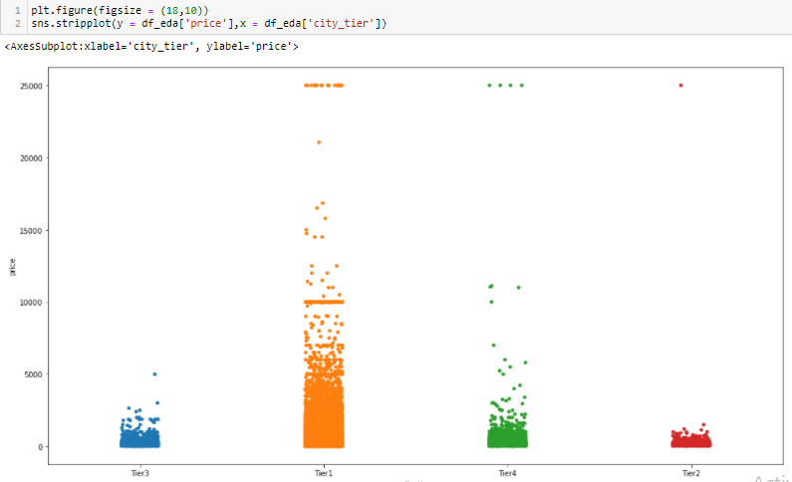
Exploratory Data Analysis
PRICE VARIATION WITH CITY TIERS
It is found that Tier 1 cities have more price when compared to other tier cities, also since it has more dense strips, it shows that most of the listings are of Tier 1 cities.
Another inference from the Data which can be taken is that even though Tier 4 cities are smaller cities, they still have higher prices which could be due to reasons like them being Scenic Spots with more natural attractions than larger cities or are more popular destinations for being quite and pristine or more for adventure seekers.

Slide 13
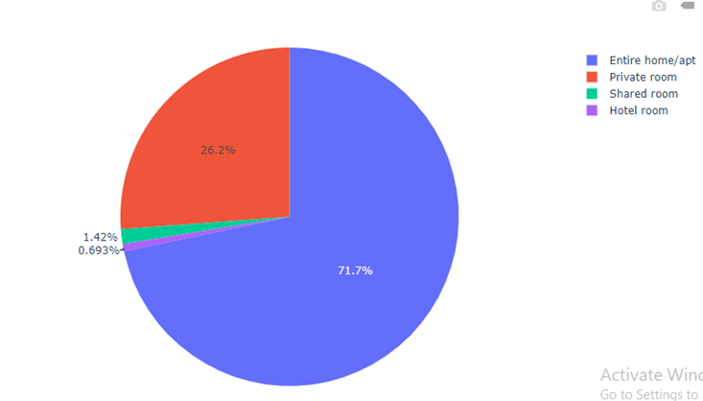
Exploratory Data Analysis Continued…
NUMBER OF LISTINGS FOR ROOM TYPE
It is observed that 71.7% of host have provided their entire home/apartment to Airbnb followed by private room at 26.2%.

Slide 14
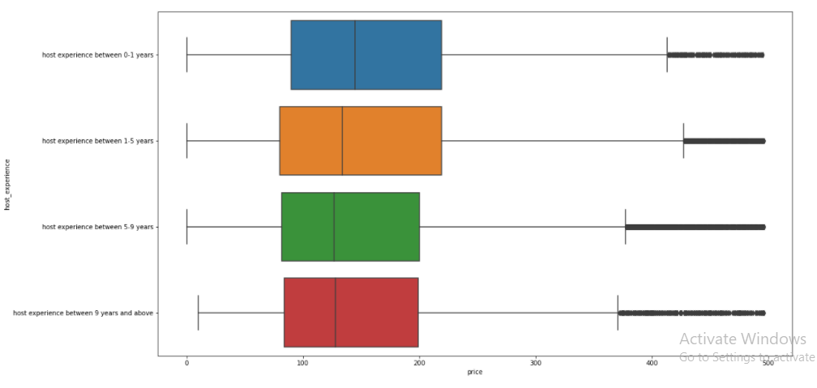
Exploratory Data Analysis Continued…
PRICE V/S HOST EXPERIENCE
Host experience is divided into 4 bins: 0-1 year, 2-5 years, 5-9 years, 9 and above.
From the boxplot is it observed that the mean the median values of prices for new properties is higher compared to those properties which have been in Airbnb listing for a longer time.
In other words, we can infer that new owners demand a higher price for their property compared to older owners or hosts.

Slide 15
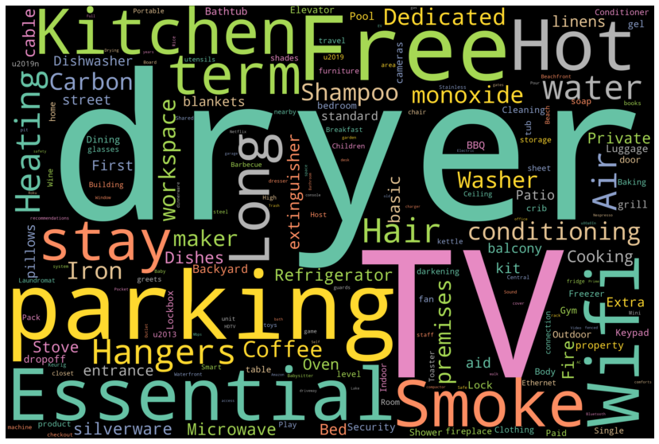
Exploratory Data Analysis Continued…
WORD CLOUD:
Inferences:
The larger the name of the amenities, the more the amenity is common among the properties.
From the word cloud, we can infer that the most common amenities listed in the dataset are dryer, TV, parking, Kitchen, Essentials and Wi-Fi.
We can assume from the word cloud that these amenities are the most often demanded amenities by the customers and provision of these amenities is a must for a property.
The term Free is a very popular term in Amenities, which indicates customers are attracted to free amenities and facilities like Free Parking, Free Wi-Fi.

Slide 16
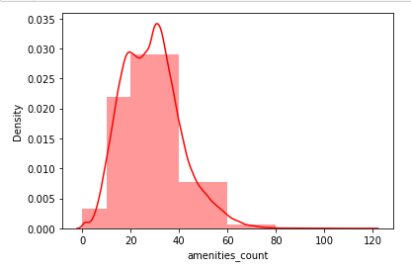
Exploratory Data Analysis Continued…
COUNT OF THE NUMBER OF AMENITIES PROVIDED:
Inferences:
From the distribution plot we can infer that a majority of the properties in our dataset provide between 20-40 amenities in their listing and property.
9-10% of the properties provide more than 40 amenities while the remaining properties provide amenities ranging from 10-20 amenities.

Slide 17
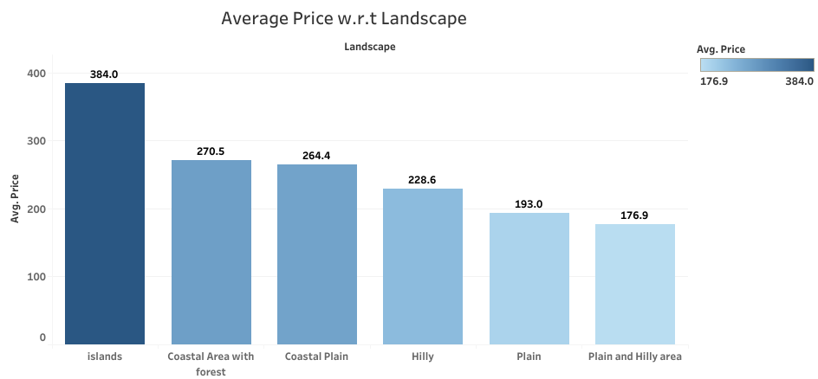
Exploratory Data Analysis Continued…
AVERAGE PRICE OF PROPERTY VS LANDSCAPE
From this figure, we can infer that the priciest properties are located on the islands. This could be due to the exotic nature of a property on an island, or tourist demand to such a property which could increase the pricing by a lot.
We can also infer those properties with not much geographical attractions like plains and plains with forests tend to have cheaper properties while properties which are hilly or are next to a coast tend to have higher prices for properties.
Higher prices for properties are more beneficial for the hosts and hence shown in a darker shade.

Slide 18
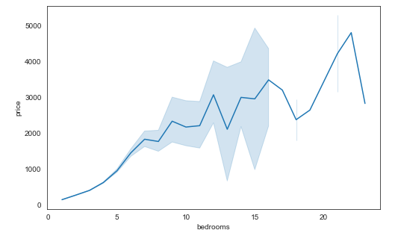
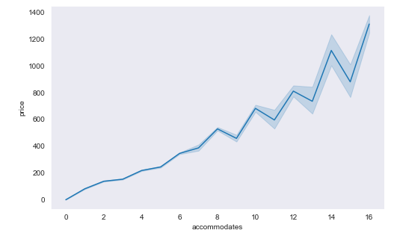
Exploratory Data Analysis Continued…
PRICE CORRELATION WITH FEATURES
It was found that the target column – price is not much correlated to other features. The top 2 features in correlation are accommodates, bedrooms
Price – Bedrooms: 0.371 correlation coefficient. As the number of bedrooms increases the price is also increases.
Price – Accommodates : 0.346 correlation coefficient. As the number of accommodates increases the price of property also increase.

Slide 19
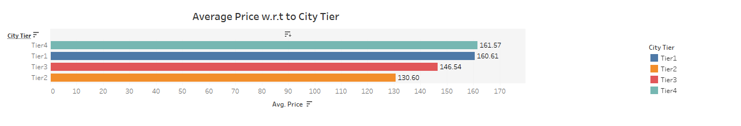
Exploratory Data Analysis Continued…
AVERAGE PRICE V/S CITY TIER
Inferences:
The below plot shows the average price of property in different city tiers.
City tiers were formed based on city population with Tier1 having highest population and Tier-4 having least.
It was found that average price of Tier 4 cities is highest with Tier-1 cities coming at second place.
Tier-2 cities have least average price of all 4.

Slide 20
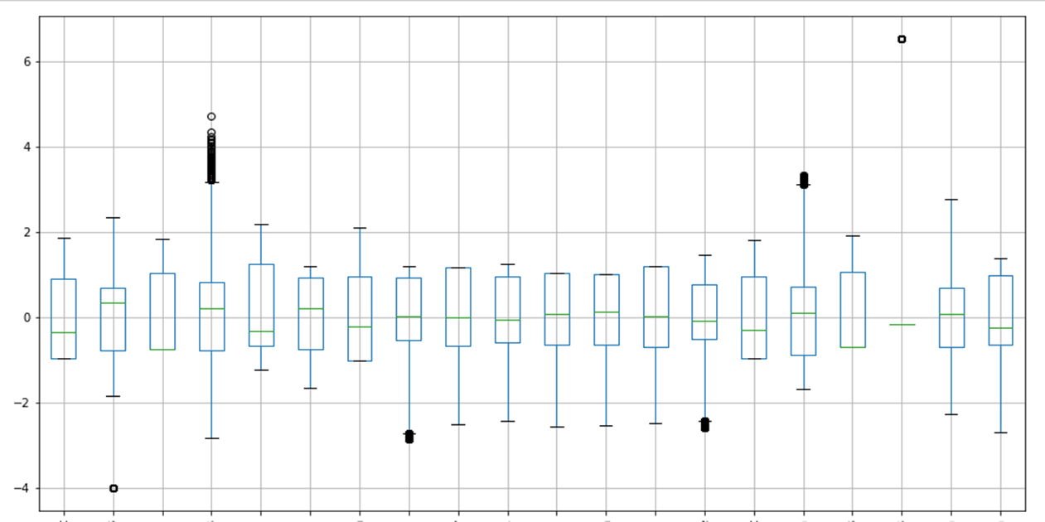
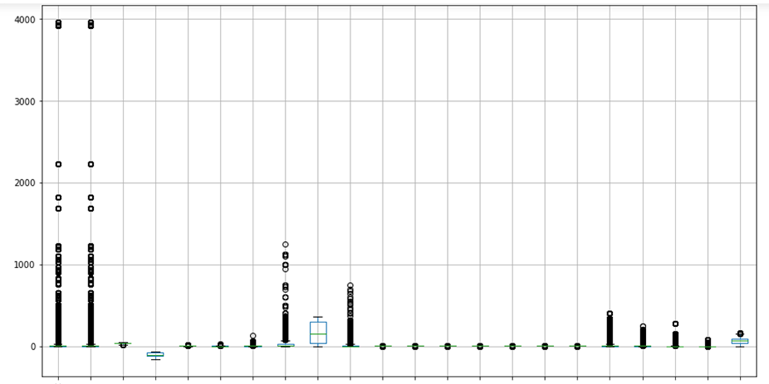
Exploratory Data Analysis Continued…
POWER TRANSFORMING THE DATA
Our original dataset was heavily skewed and contained huge number of outliers.
The image shows outliers in the data before transformation
Outliers after power transformation.

Slide 21
Exploratory Data Analysis Continued…
OUTLIERS REMOVAL
We have removed outliers using IQR technique.
After the removal of outliers, the shape of our data remains 168751 records and 46 features.
ENCODING CATEGORICAL DATA
We have 22 categorical columns out of 46 total features, which have been dummy encoded.

Slide 22
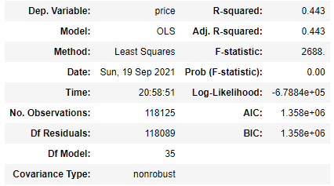
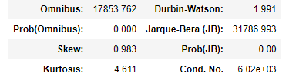
Model Building
We used OLS (ordinary least square) method for our base model building. Following were the results obtained:
Test R2 is obtained to be 0.443 which means independent variable are unable to explain the variation in dependent variable properly.
The condition number is large, means strong multicollinearity between the variable exists.
Prob (JB) is less than 0.05 indicating that error is not normally distributed.
Skew value is 0.983 indicating that data is positively skewed.
review_scores_accuracy, host_response_time_within_a_day, host_response_time_within_an_hour have pvalue > 0.05 hence these variables are not significant in price prediction.

Slide 23
Approaches for Model Building
APPROACH 1
We applied various different algorithm on the prepared data to see if any algorithm is giving us better results. But all algorithms we used gave us a test R2 value of around 0.45 which was not promising at all.
APPROACH 2
From the base model we discovered that our data was a victim of multicollinearity. Hence, we calculated VIF score of each feature and dropped the ones which were contributing the most. We then built the regression model on the same. Again, we saw an average of 0.45 test R2.

Slide 24
Approaches for Model Building Continued…
APPROACH 3
Since we were dealing with huge set of features which showed high amount of multicollinearity hence, we performed dimensionality reduction using PCA. We built model using 80% variance (10 features) as well as using 90% variance (15 features). With PCA indeed we were able to get rid of multicollinearity but the max R2 we could reach was 0.57 using Gradient Boosting.
APPROACH 4
Finally, we decided to take log of the target column ‘price’ and again built the model using all algorithms. Since our model was not overfitted hence the regularization algorithms – Ridge, Lasso and Elastic Net were not performing well.

Slide 25
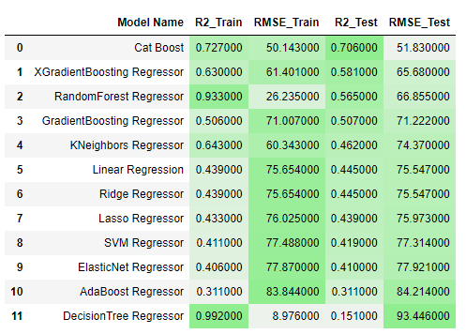
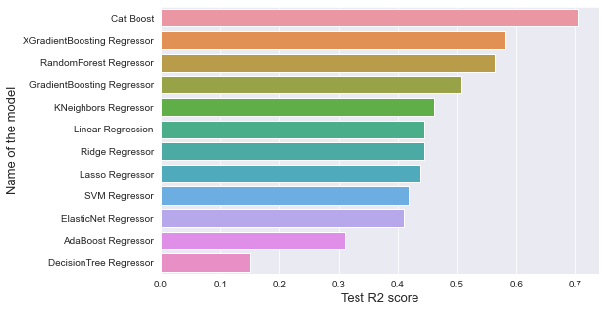
Model Building Continued…
Following are the results obtained (arranged in accordance of best to worst performance):

Slide 26

Best Fit Model
It could be seen that all the ensemble techniques specially boosting algorithms are performing well. Out of 11 different algorithms used, CatBoost gave the best result with test R2 score of 0.706
Comparison of Base Model and Best Fit Model:
Model Name | Base Model (OLS) | CatBoost Model
R2 | 0.434 | 0.705
RMSE | 75 | 51.83

Slide 27
Best Fit Continued…
Last slide suggest that CatBoost indeed is working well for our problem. Hence making it our best fit model.
Following bar graph shows the features with their importance score. Higher bar suggests that the feature plays more part in predicting the target price. Top 5 features are -
1. ‘accommodates'
2. ‘bedrooms’
3. ‘population’
4. 'room_type_Private room'
5. 'minimum_nights'

Slide 28
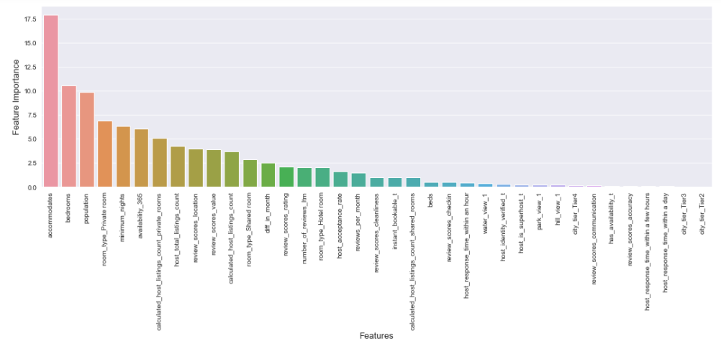
Best Fit Continued…

Slide 29
Conclusion
CHANGES THAT AFFECTED MOST IN-MODEL BUILDING:
Ordinary least square model was unable to learn well.
It was seen that ensemble algorithms were performing exceptionally well compared to OLS and other algorithms.
After removing the multi-collinearity using VIF model started to improve.
By talking log of the dependent variable, we saw significant improvement in the machine.

Slide 30
Conclusion Continued…
KEY RISK AND INTERPRETATION OF OUR MODEL:
Although we were able to increase R2 score from 0.454 to 0.705 but going beyond that became a hassle.
There were presence of high multicollinearity therefor we applied PCA technique yet we saw no improvement.
Feature selection and hyperparameter tuning also failed to increase the accuracy.
This could mean that we might need to go back on the EDA stage and see what more feature engineering we could do to make model learn better.

Slide 31
Bibliography
[1] Airbnb public dataset.” http://insideairbnb.com/get-the-data.html’ Accessed: 2021-10-25.
[2] H. Yu and J. Wu, “Real estate price prediction with regression and classification,” CS229 (Machine Learning) Final Project Reports, 2016
[3] Y. Yang, N. J. Mueller, and R. R. Croes, “Market accessibility and hotel prices in the caribbean: The moderating effect of quality-signaling factors”, Tourism Management, vol. 56, pp. 40–51, 2016.
[4] Tang, E. “Neighborhood and Price Prediction for San Francisco Airbnb Listings.” (2015).
[5]https://www.analyticsvidhya.com/blog/2021/05/5-regression-algorithms-you-should-know-introductory-guide/
[6]https://vitalflux.com/gradient-boosting-regression-python-examples/
[7]https://www.geeksforgeeks.org/xgboost-for-regression/
[8]https://towardsdatascience.com/catboost-regression-in-6-minutes-3487f3e5b329
[9]https://michael-fuchs-python.netlify.app/2019/11/11/introduction-to-sgd-classifier/

Slide 32
THANK YOU
Team 4:
Anushka Arora
Bibhash Dutta
Gaurav Rai
Sachin Verma
Supriya Raturi
T. Shalem

