Slide 1

SI-2025
Analog IC Design
Dr. Saroj Rout & Er. Prasant Swain
Summer Internship
June 02, 2025

Slide 2
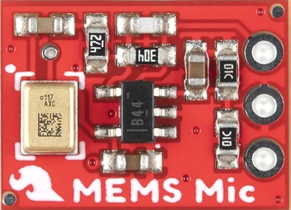
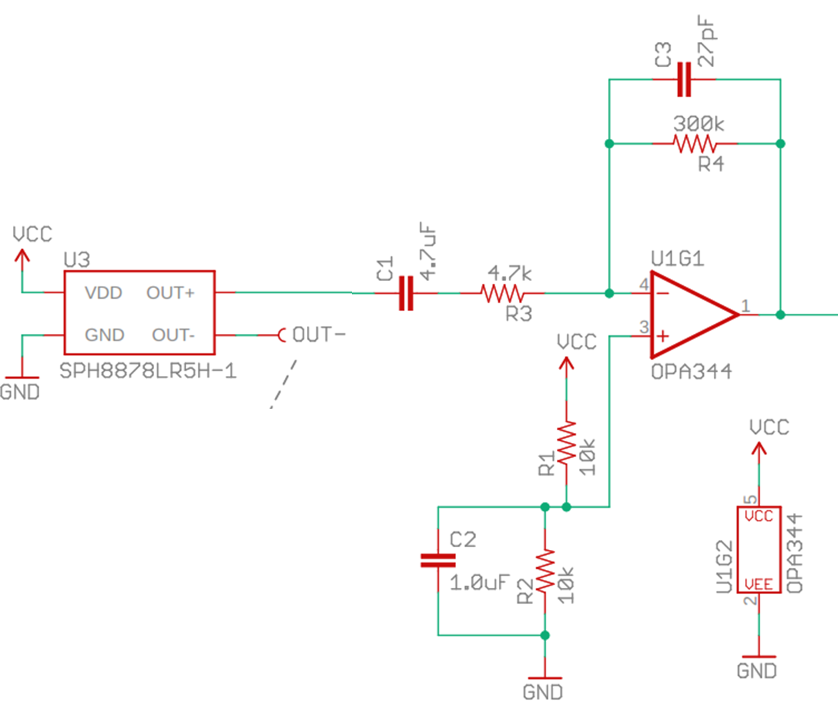

USB Microphone System
USB-MIDI Controller
(Arduino microcontroller)
A/D Converter
Processor
10b
USB-MIDI

Slide 3
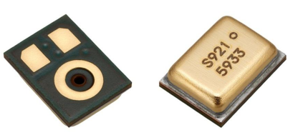
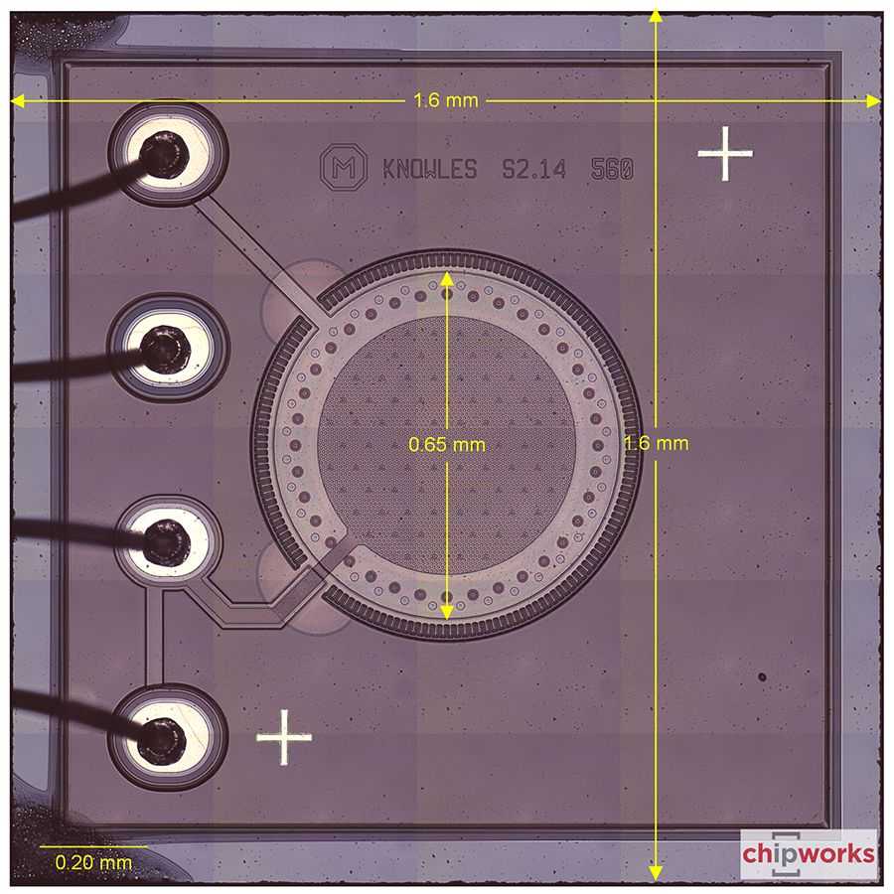
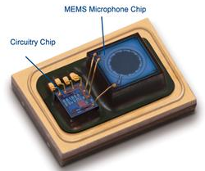
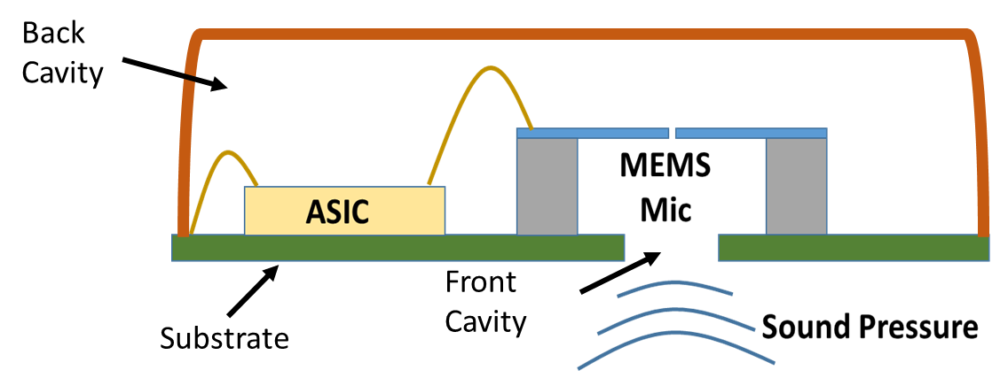
Microphone Teardown
14 mm
1.6 mm
10 mm
1.6 mm

