Slide 1
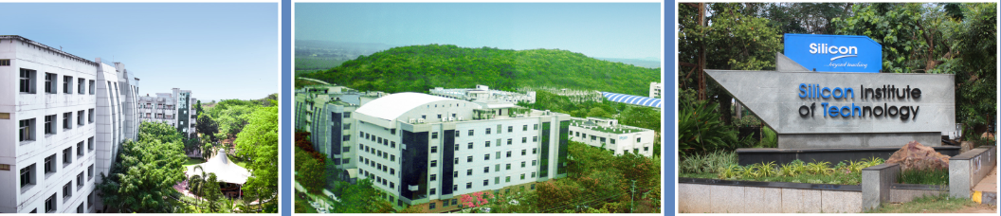
SI-2025
Analog IC Design
Dr. Saroj Rout & Er. Prasant Swain
Summer Internship
June 02, 2025

Slide 2
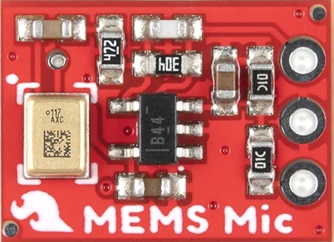
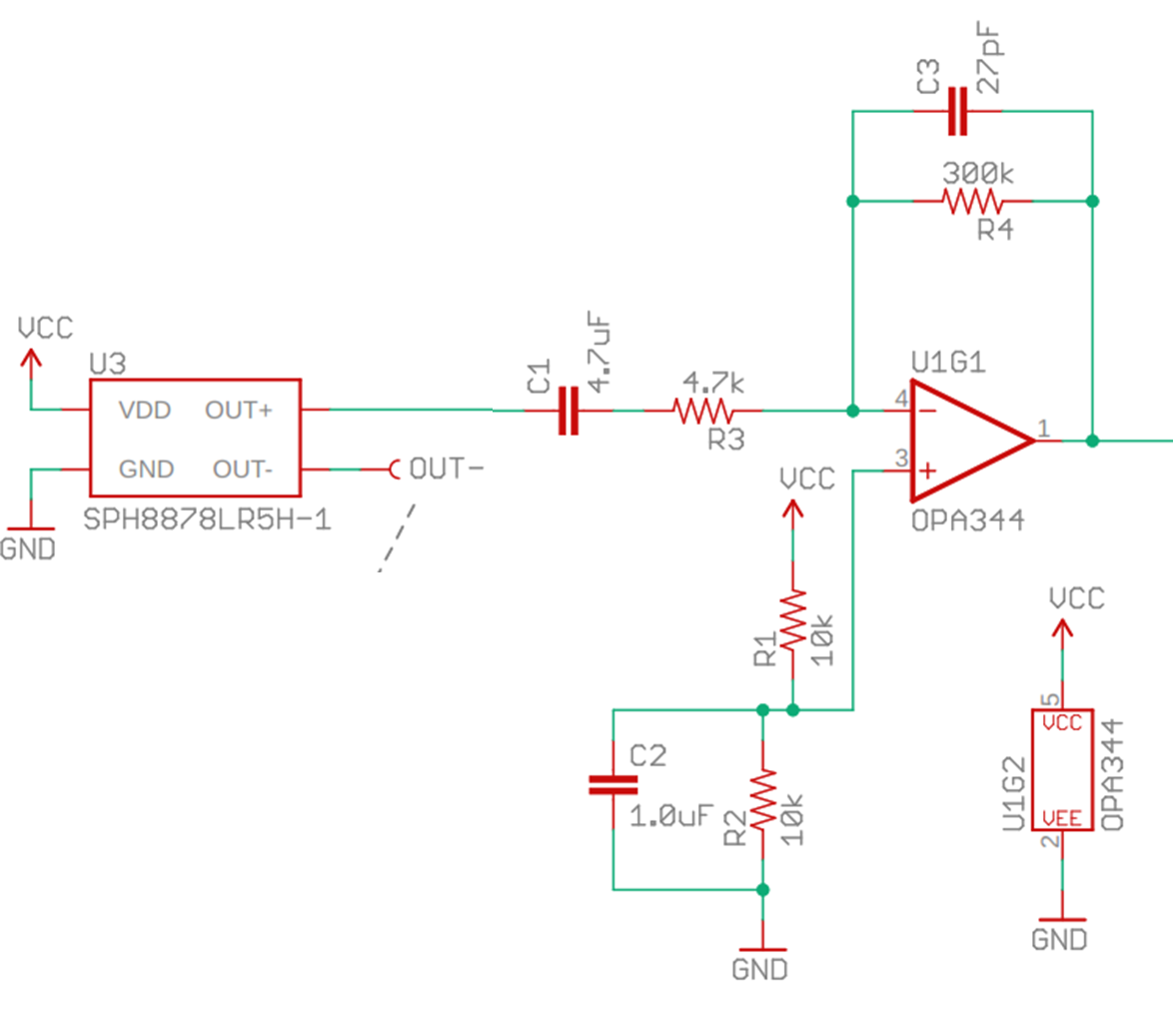

USB Microphone System
USB-MIDI Controller
(Arduino microcontroller)
A/D Converter
Processor
10b
USB-MIDI

Slide 3
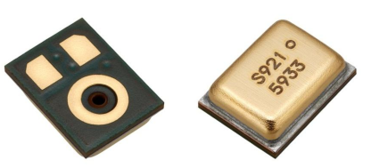
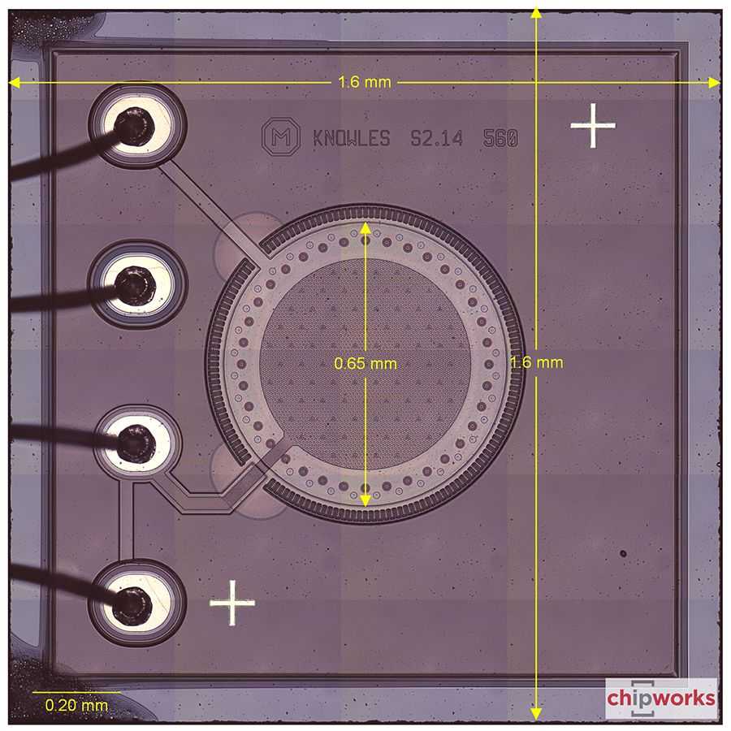
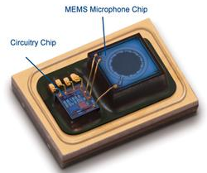
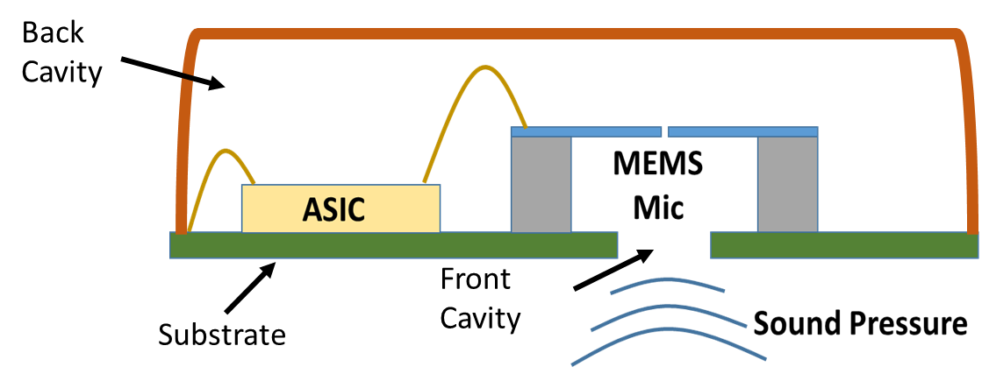
Microphone Teardown
14 mm
1.6 mm
10 mm
1.6 mm

Slide 4
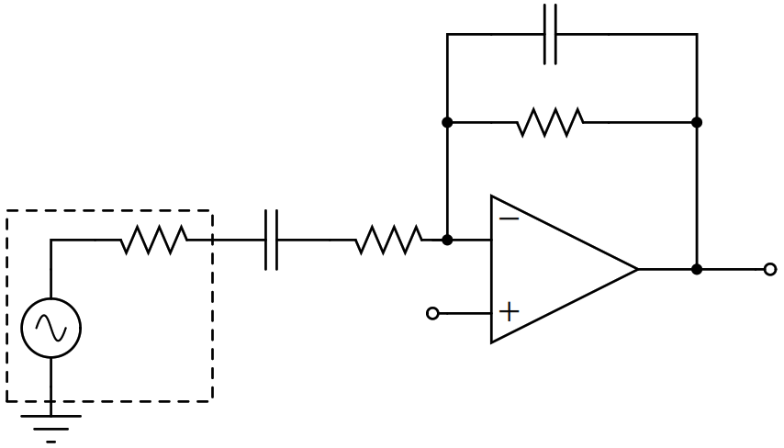

















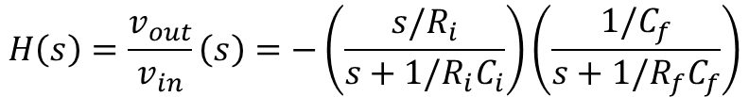




$$C_{f}$$
$$R_{i}=R_{in}+R_{mic}$$
$$R_{f}$$
$$27 pF$$
$$R_{mic}$$
$$C_{i}$$
$$300 kΩ$$
$$R_{in}$$
$$v_{out}$$
$$380 Ω$$
$$4.7 μF$$
$$4.7kΩ$$
$$V_{cm}$$
$$v_{mic}$$
$$H\left(s\right)=\frac{v_{out}}{v_{in}}\left(s\right)=−\left(\frac{s/R_{i}}{s+1/R_{i}C_{i}}\right)\left(\frac{1/C_{f}}{s+1/R_{f}C_{f}}\right)$$
$$HPF$$
$$LPF$$
$$s=0 : H\left(s\right)=0$$
$f_{zero}=\frac{1}{2πR_{i}C_{i}}≈6.66 Hz$
$$s=∞ : H\left(s\right)=0$$
$f_{pole}=\frac{1}{2πR_{f}C_{f}}≈19.6 kHz$
$$s≫\frac{1}{R_{i}C_{i}} \& s≪\frac{1}{R_{f}C_{f}}: H\left(s\right)=−\frac{R_{f}}{R_{i}}=−60$$

Slide 5
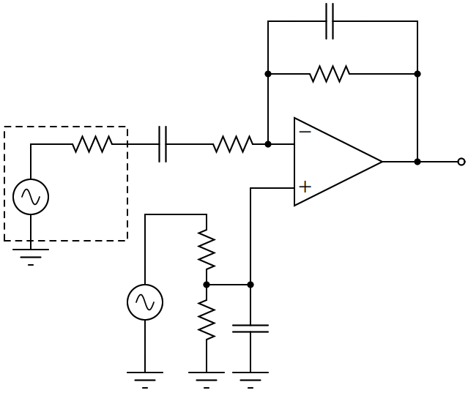





















$$C_{f}$$
$$R_{i}=R_{in}+R_{mic}$$
$$R_{f}$$
$$27 pF$$
$$R_{mic}$$
$$C_{i}$$
$$300 kΩ$$
$$R_{in}$$
$$v_{out}$$
$$380 Ω$$
$$4.7 μF$$
$$4.7kΩ$$
$$v_{mic}$$
$$R_{s1}$$
$$10 kΩ$$
$$V_{cm}$$
$$v_{sn}$$
$$C_{s}$$
$$R_{s2}$$
$$1 μF$$
$$10 kΩ$$

Slide 6
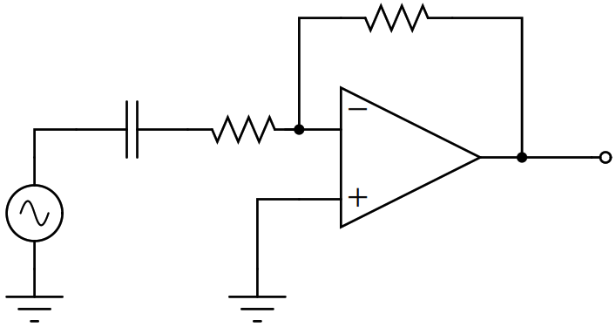








$$R_{f}$$
$$5 kΩ$$
$$C_{i}$$
$$R_{i}$$
$$v_{out}$$
$$4.7 μF$$
$$5 kΩ$$
$$v_{in}$$

Slide 7
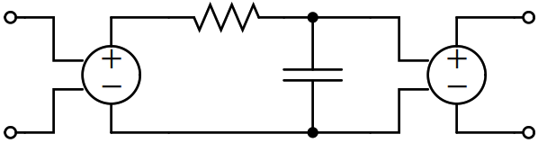














(a
$$R$$
$$v_{ip}$$
$$v_{op}$$
-
$$v_{im}$$
$$1000$$
$$1$$
$$v_{op}$$
+
$$C$$
$$v_{ip}$$
$$vcvs_{1}$$
$$vcvs_{2}$$
$$v_{im}$$
$$v_{om}$$
$$v_{om}$$
(a) Schematic of the Op-Amp model
(a) Symbol of the Op-Amp model

