Slide 1
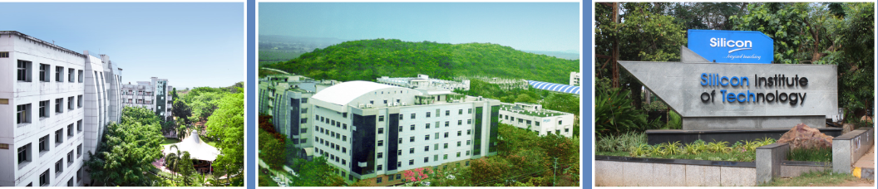
SI-2025
Analog IC Design
Introduction to IC Fabrication
Saroj Rout
Summer Internship
10 June 2025

Slide 2
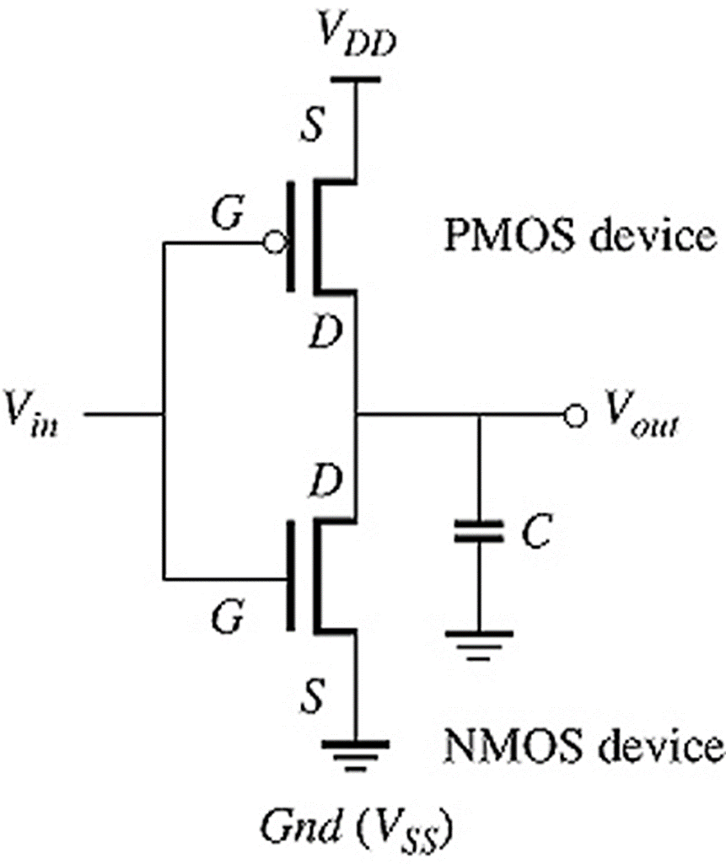

Schematic to Physical Devices

Slide 3
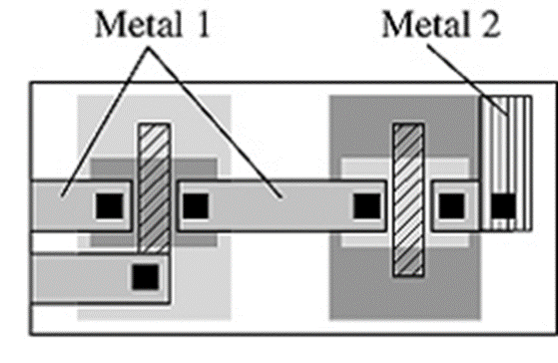
Circuit to Foundry Masks (Layout)

Slide 4

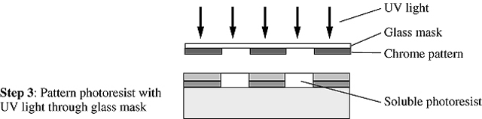
Material Patterning Steps (1)

Slide 5


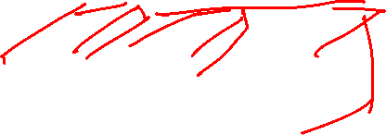
Material Patterning Steps (2)

Slide 6
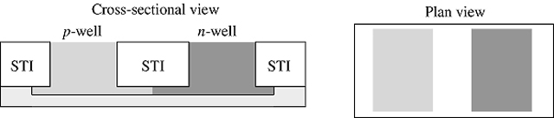
Foundry Masks (Layout) to Physical Devices

Slide 7
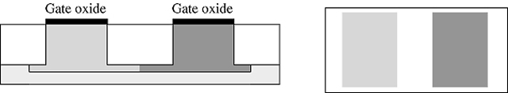
Foundry Masks (Layout) to Physical Devices (2)

Slide 8
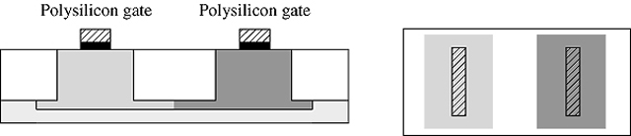
Foundry Masks (Layout) to Physical Devices (3)

Slide 9
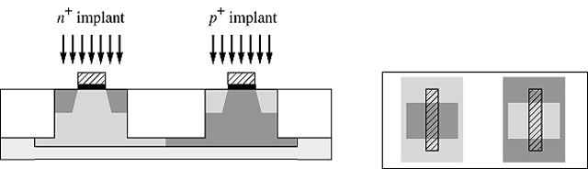

Foundry Masks (Layout) to Physical Devices (4)

Slide 10
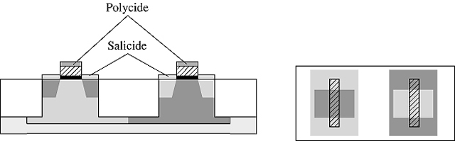
Foundry Masks (Layout) to Physical Devices (5)

Slide 11
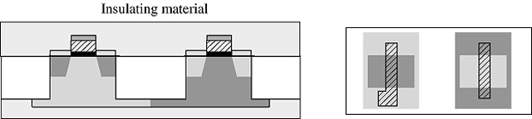
Foundry Masks (Layout) to Physical Devices (6)

Slide 12
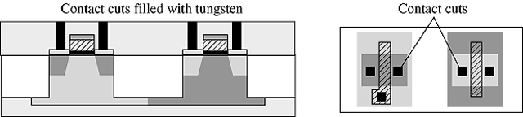
Foundry Masks (Layout) to Physical Devices (7)

Slide 13
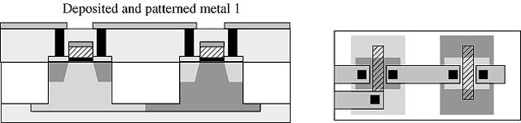
Foundry Masks (Layout) to Physical Devices (8)

Slide 14

Foundry Masks (Layout) to Physical Devices (9)

Slide 15
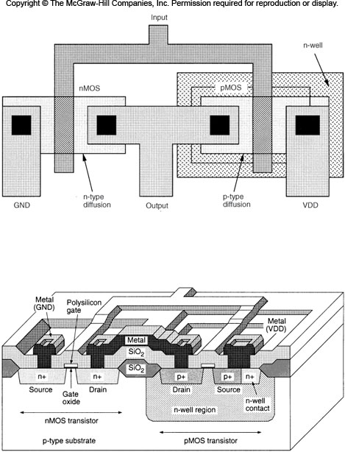
An Older Fabrication Technique: LOCOS

