Slide 1
Review: Circuits
05 June 2025

Slide 2
Active Circuits

Slide 3
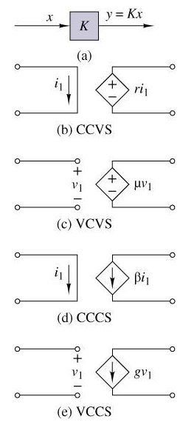

Linear Dependent Sources

Slide 4
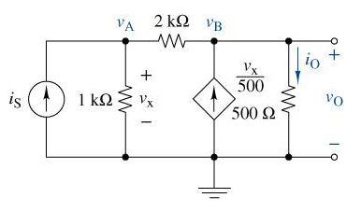
Analysis using Dependent Sources

Slide 5
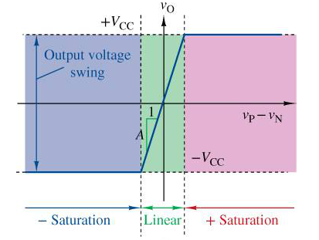
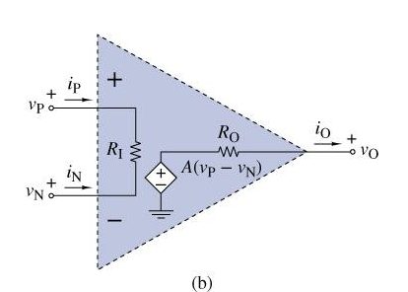
Operational Amplifier Model

Slide 6
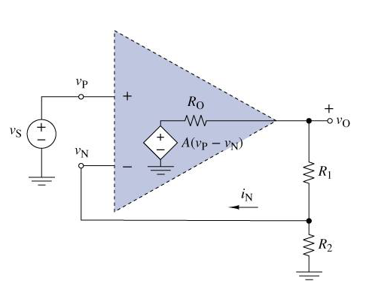

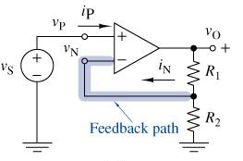
Operational Amplifier Analysis

Slide 7
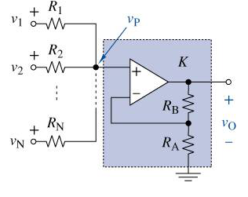
Operational Amplifier Analysis

Slide 8
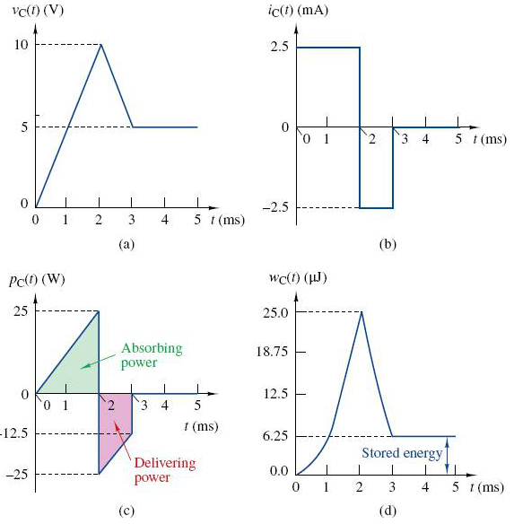
Capacitance

Slide 9
Capacitance

Slide 10
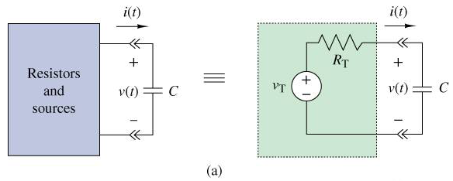
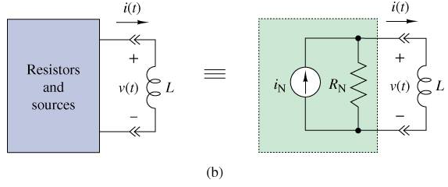
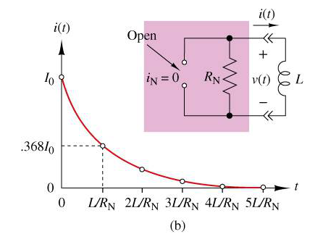
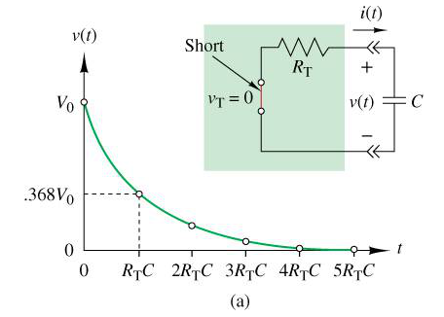
First-Order Circuits

Slide 11
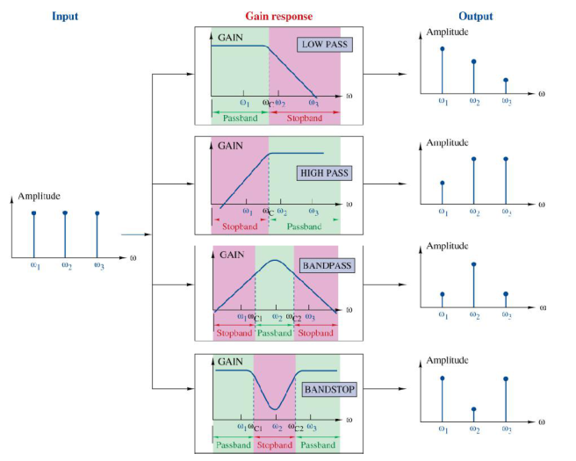
Frequency Response (Four Basic Gain Responses)

Slide 12
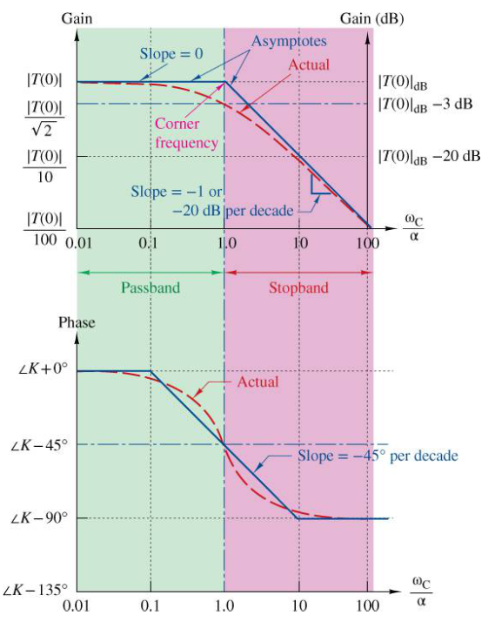
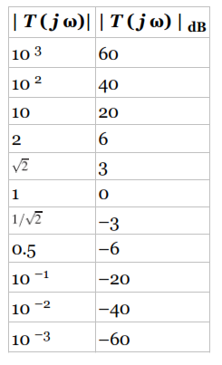

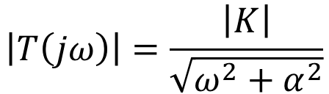
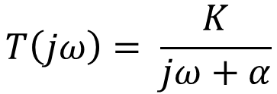
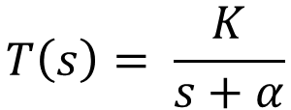
First-Order Low-Pass Response
$$T\left(s\right)= \frac{K}{s+α}$$
$$T\left(jω\right)= \frac{K}{jω+α}$$
$$\left|T\left(jω\right)\right|=\frac{\left|K\right|}{\sqrt{ω^{2}+α^{2}}}$$
$$θ\left(ω\right)=angle\left(K\right)− \tan^{−1}\left(ω/α\right)$$

Slide 13
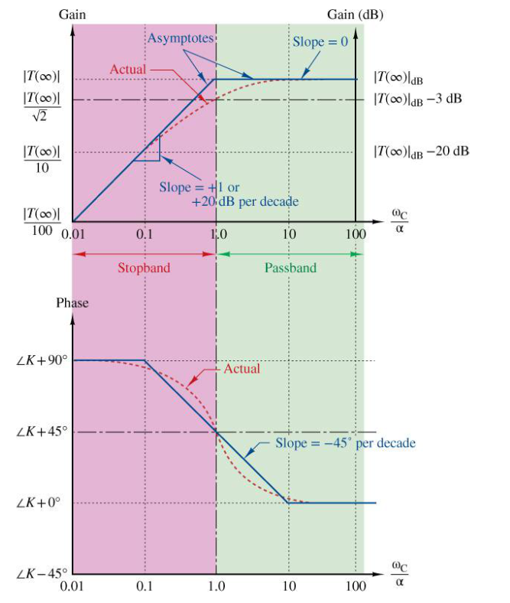
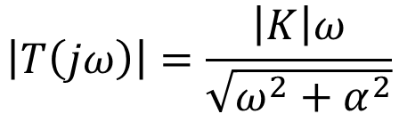
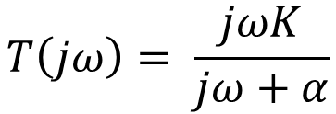
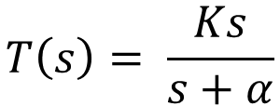
First-Order High-Pass Response
$$T\left(s\right)= \frac{Ks}{s+α}$$
$$T\left(jω\right)= \frac{jωK}{jω+α}$$
$$\left|T\left(jω\right)\right|=\frac{\left|K\right|ω}{\sqrt{ω^{2}+α^{2}}}$$
$$θ\left(ω\right)=angle\left(K\right)+{90}^{∘}− \tan^{−1}\left(ω/α\right)$$

Slide 14
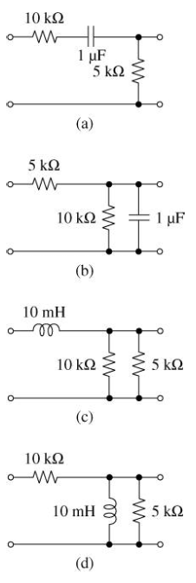

Slide 15
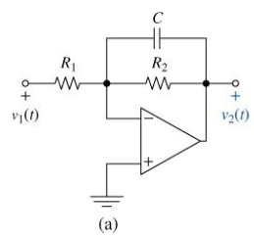
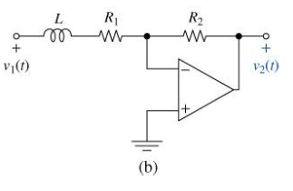

Slide 16
First-Order Band-Pass Response

