Slide 1
Review: Circuits
05 June 2025

Slide 2
Linear Circuits

Slide 3
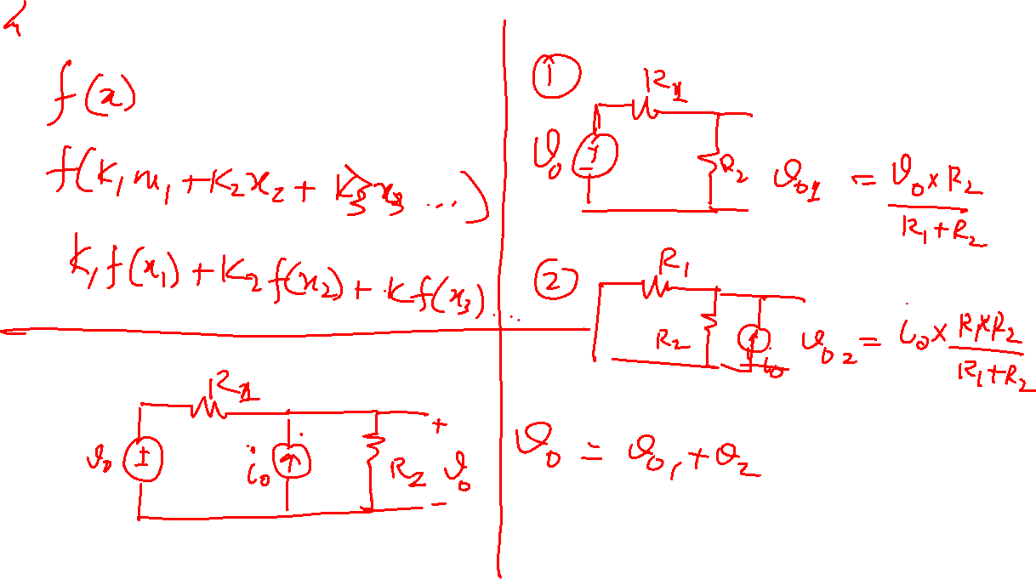

Slide 4
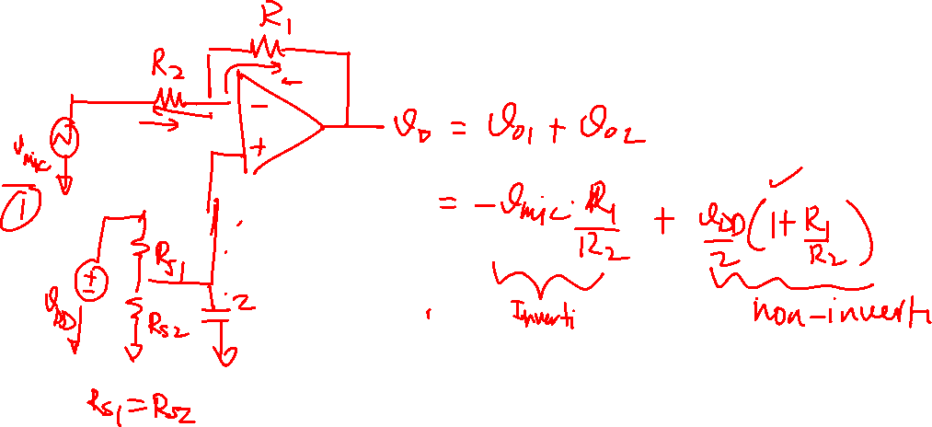

Slide 5
Active Circuits

Slide 6
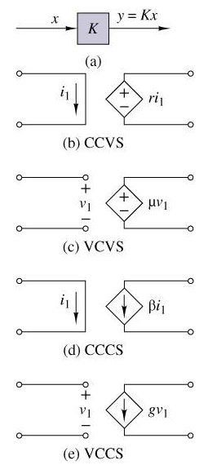

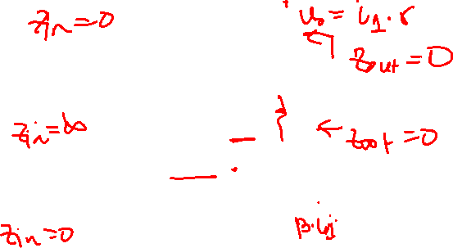
Linear Dependent Sources

Slide 7
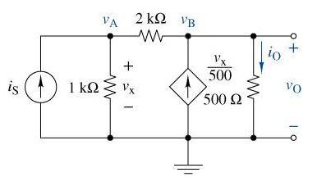
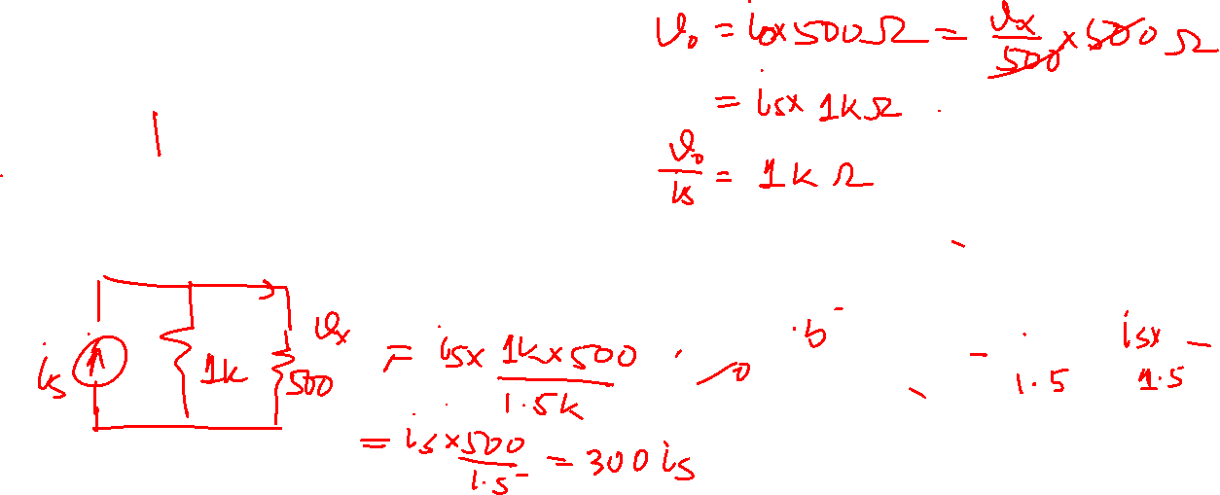
Analysis using Dependent Sources

Slide 8
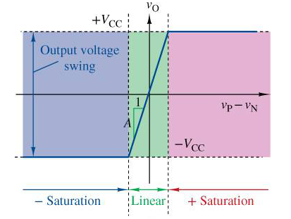
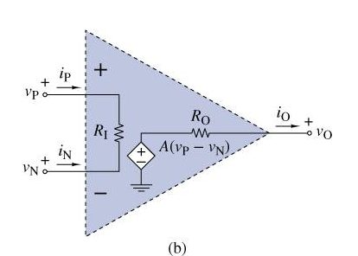
Operational Amplifier Model

Slide 9
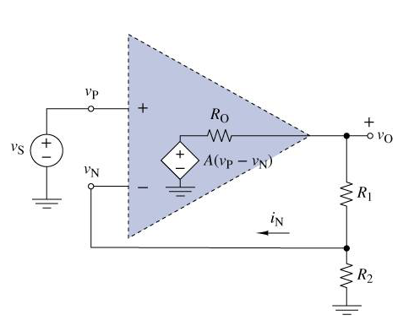

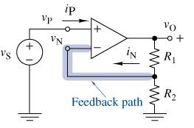
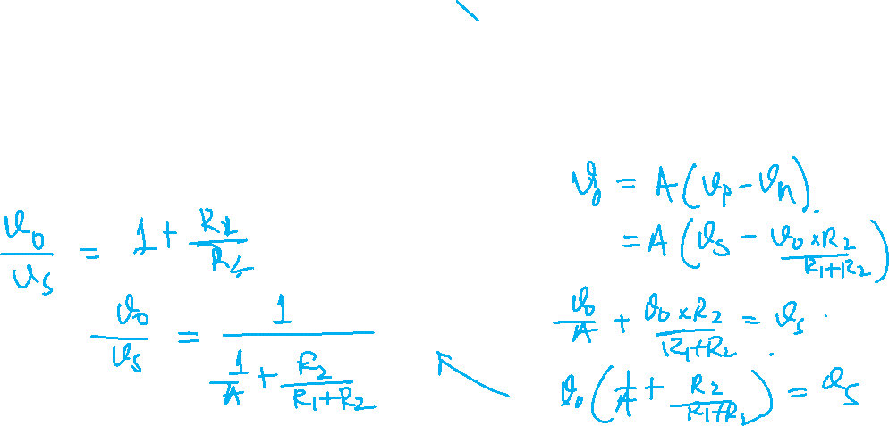
Operational Amplifier Analysis

Slide 10
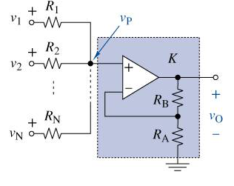
Operational Amplifier Analysis

Slide 11
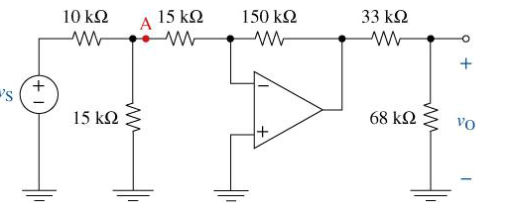
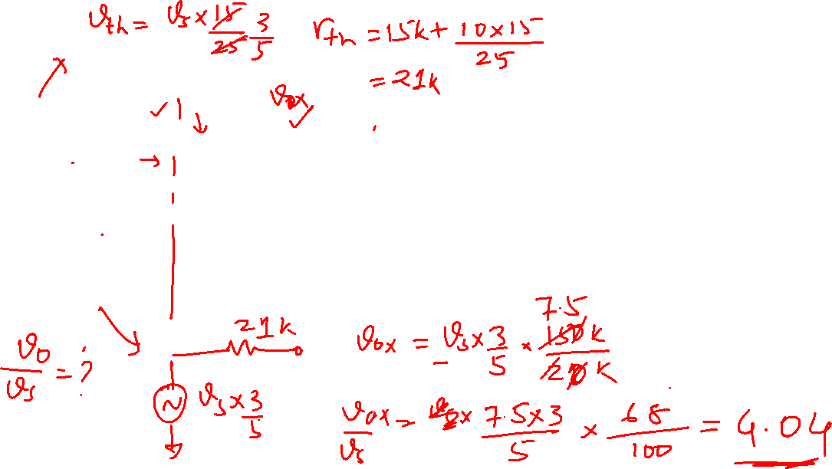

Slide 12
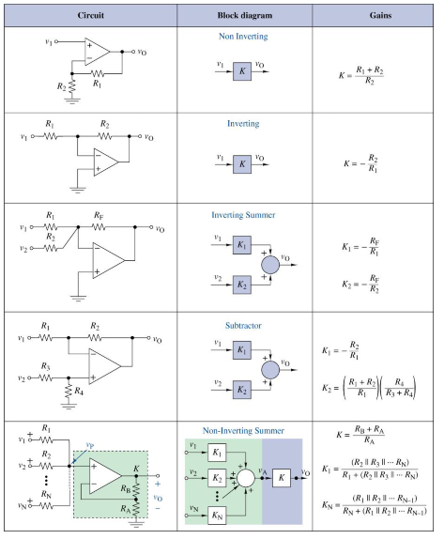
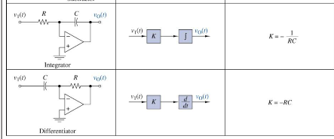

Slide 13
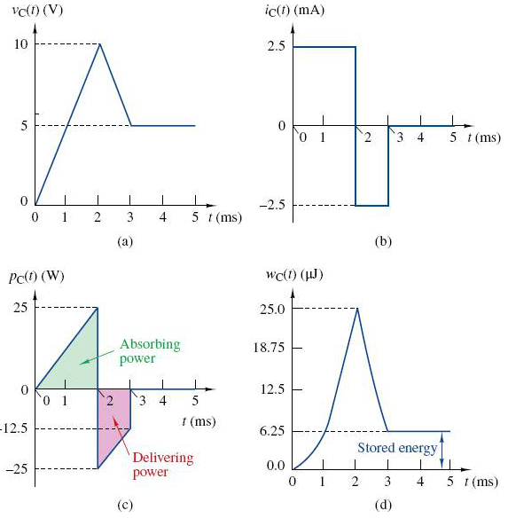
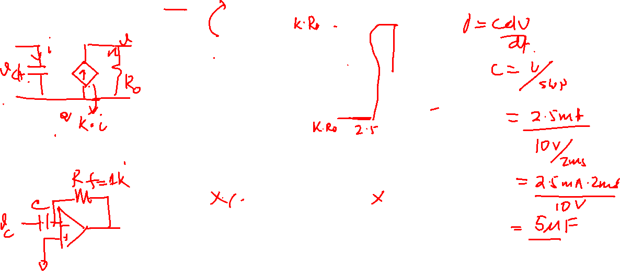
Capacitance

Slide 14
Capacitance

Slide 15
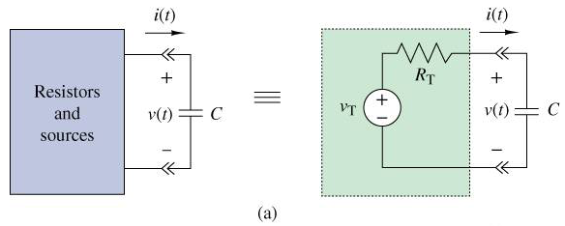
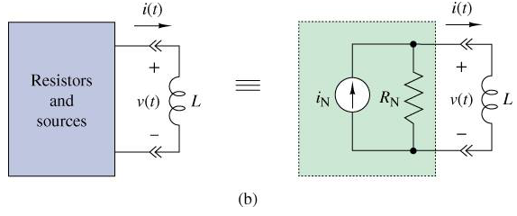
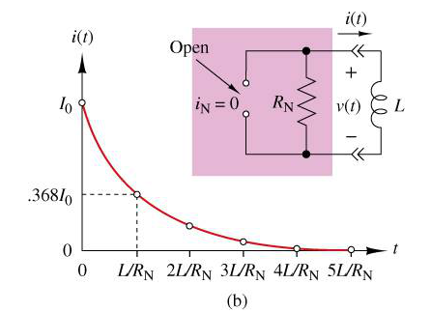
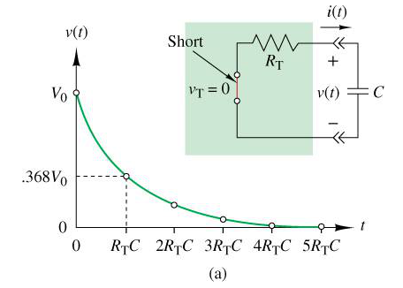
First-Order Circuits

Slide 16
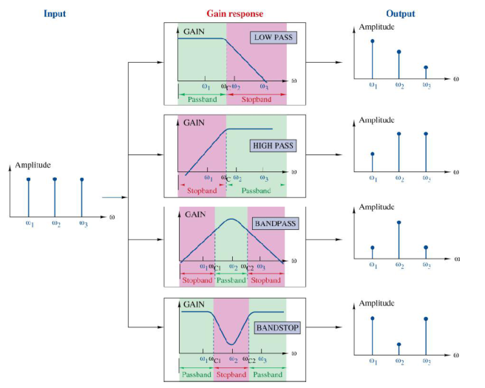
Frequency Response (Four Basic Gain Responses)

Slide 17
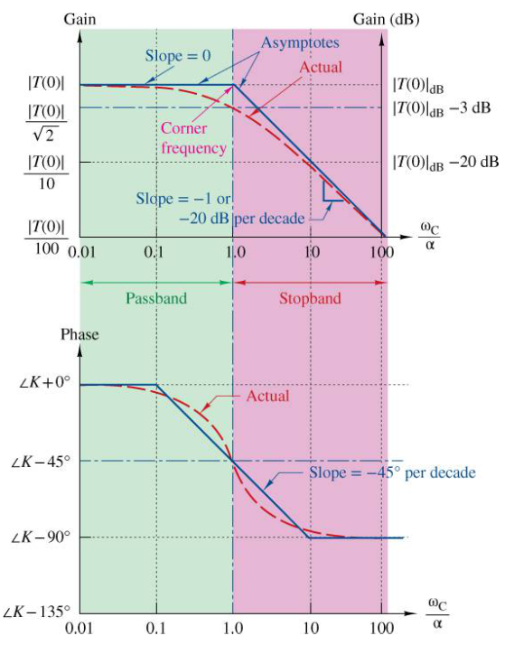
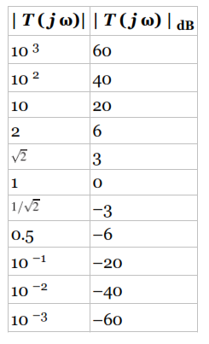


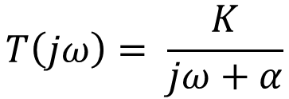
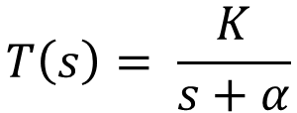
First-Order Low-Pass Response
$$T\left(s\right)= \frac{K}{s+α}$$
$$T\left(jω\right)= \frac{K}{jω+α}$$
$$\left|T\left(jω\right)\right|=\frac{\left|K\right|}{\sqrt{ω^{2}+α^{2}}}$$
$$θ\left(ω\right)=angle\left(K\right)− \tan^{−1}\left(ω/α\right)$$

Slide 18
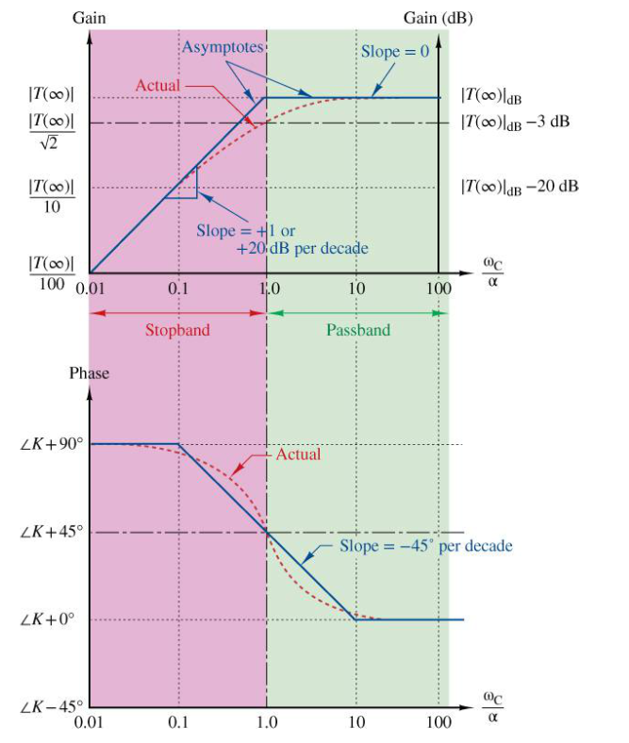

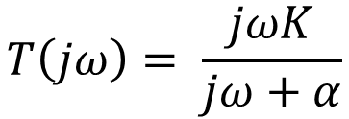
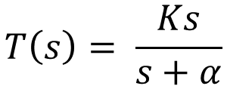
First-Order High-Pass Response
$$T\left(s\right)= \frac{Ks}{s+α}$$
$$T\left(jω\right)= \frac{jωK}{jω+α}$$
$$\left|T\left(jω\right)\right|=\frac{\left|K\right|ω}{\sqrt{ω^{2}+α^{2}}}$$
$$θ\left(ω\right)=angle\left(K\right)+{90}^{∘}− \tan^{−1}\left(ω/α\right)$$

Slide 19
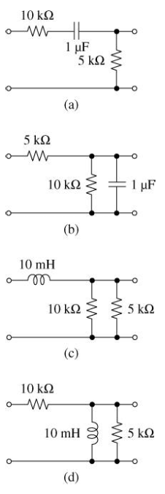
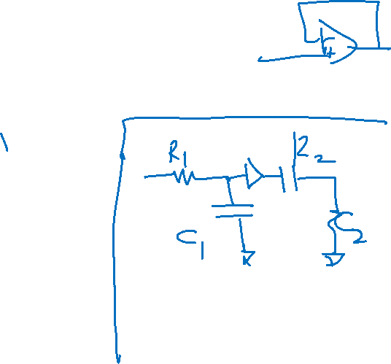
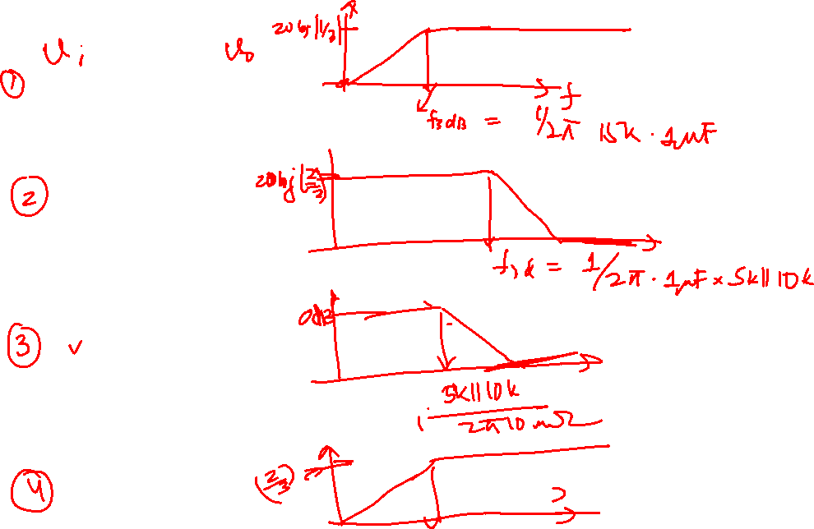

Slide 20
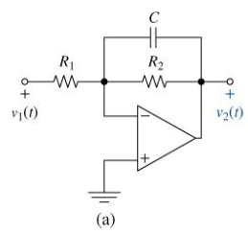
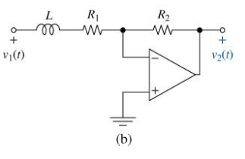
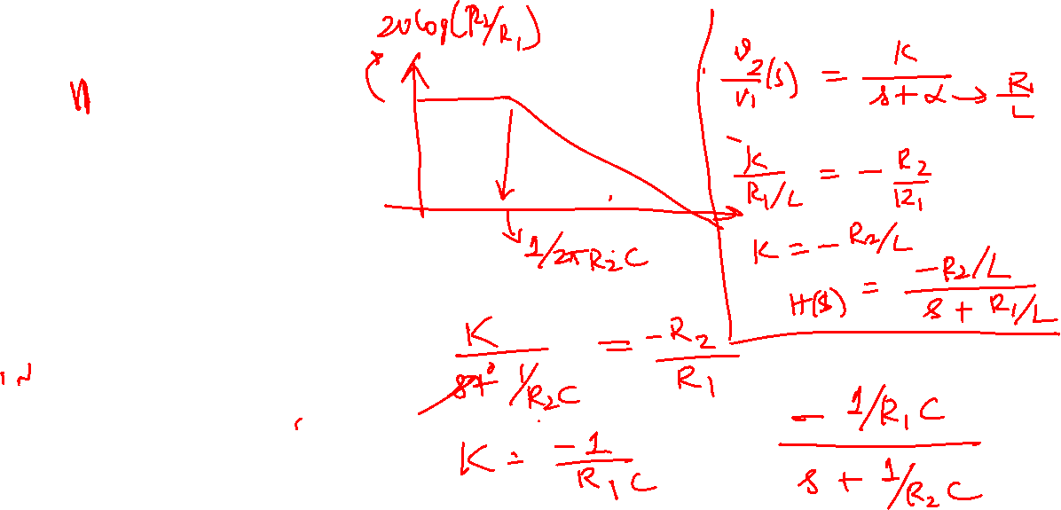

Slide 21



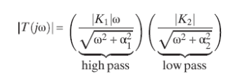


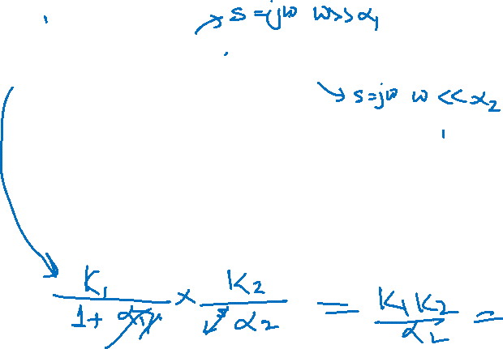
First-Order Band-Pass Response

