Slide 1

Normal Distribution
Notes:
This lecture will give an overview/review of normal distribution.

Slide 2


Types of Distribution
Frequency Distribution
Normal (Gaussian) Distribution
Probability Distribution
Poisson Distribution
Binomial Distribution
Sampling Distribution
t distribution
F distribution
Notes:
There are several types of distribution: frequency distribution, normal distribution, probability and sampling distributions. This lecture will focus on normal distribution.

Slide 3
What is Normal (Gaussian) Distribution?
The normal distribution is a descriptive model
that describes real world situations.
It is defined as a continuous frequency distribution of infinite range (can take any values not just integers as in the case of binomial and Poisson distribution).
This is the most important probability distribution in statistics and important tool in analysis of epidemiological data and management science.
Notes:
The Normal distribution is also known as the Gaussian Distribution and the curve is also known as the Gaussian Curve, named after German Mathematician-Astronomer Carl Frederich Gauss.

Slide 4
Characteristics of Normal Distribution
It links frequency distribution to probability distribution
Has a Bell Shape Curve and is Symmetric
It is Symmetric around the mean:
Two halves of the curve are the same (mirror images)

Slide 5
Characteristics of Normal Distribution Cont’d
Hence Mean = Median
The total area under the curve is 1 (or 100%)
Normal Distribution has the same shape as Standard Normal Distribution.

Slide 6
Characteristics of Normal Distribution Cont’d
In a Standard Normal Distribution:
The mean (μ ) = 0 and
Standard deviation (σ) =1

Slide 7
Z Score (Standard Score)³
Z = X - μ
Z indicates how many standard deviations away from the mean the point x lies.
Z score is calculated to 2 decimal places.
σ
Notes:
The relationship between the normal variable X and Z score is given by the Z score or standard score. Mu (μ) is the mean and sigma (σ) is the standard deviation of the population.

Slide 8
Tables
Areas under the standard normal curve
(Appendices of the textbook)
Notes:
The value of z can be calculated using the Z score. The z value can also be found in tables on standard normal curve or normal distribution curve which can be found in the appendices of most statistics or modelling textbooks.

Slide 9
Diagram of Normal Distribution Curve
(z distribution)
33.35%
13.6%
2.2%
0.15
-3 -2 -1 μ 1 2 3
Modified from Dawson-Saunders, B & Trapp, RG. Basic and Clinical Biostatistics, 2nd edition, 1994.
Notes:
This is the diagram of a normal distribution curve or z distribution. Note the bell shape of the curve and that its ends/tail don’t touch the horizontal axis below. As I mentioned earlier, the area under the curve equals 1 or 100%. Therefore, each half of the distribution from the center (that is from the mean is equal to 50%. Thus, the area from/above the mean up to 1 standard deviation is equal to 33.35%, area above +1 standard deviation is equal to 13.6%, the area above +2 standard deviation is equal to 2.2% and area above +3 standard deviations is equal to 0.1%. Since the other half is a mirror image, the percentage/proportion of area above -1 standard deviation is the same as the area above + 1 standard deviation i.e. it is 33.35%. And -2 standard deviation=+2 standard deviation and so forth….

Slide 10
Distinguishing Features
The mean ± 1 standard deviation covers 66.7% of the area under the curve
The mean ± 2 standard deviation covers 95% of the area under the curve
The mean ± 3 standard deviation covers 99.7% of the area under the curve
Notes:
Therefore, we can see that the mean +/- SD contains 66.7% of the area under the curve. i.e. total area of + 1SD and -1SD is equal to 66.7% (33.35% +33.35%). Similarly, the mean +/- 2 SD contains 95% of the area under the normal curve and the mean +/- 3 standard deviations contains 99.7% of the area under the normal curve.

Slide 11
Skewness
Positive Skewness: Mean ≥ Median
Negative Skewness: Median ≥ Mean
Pearson’s Coefficient of Skewness³:
= 3 (Mean –Median)
Standard deviation
Notes:
As I mentioned earlier the Mean = Median in the normal distribution curve. However, when the Mean is greater than the median there is a positive skewness (that is the tail is to the right) to the normal distribution curve. And when the Median is greater then the mean, the tail is skewed to the left, that there is negative skewness.
The skewness can be calculated using the Pearson’s Coefficient of Skewness.

Slide 12
Positive Skewness (Tail to Right)
Notes:
This diagram illustrates positive skewness (a move to the right).

Slide 13
Negative Skewness (Tail to Left)
Notes:
This diagram depicts negative skewness (a move to the left)

Slide 14
As a summary so far, we have covered three ideas:
Hypothesis Testing: A technique used to test a theory
Normal Distribution: An approximate representation of the data in a hypothesis test.
p-value: The probability a result at least as extreme at that observed would have occurred if the null hypothesis is true.

Slide 15
Type I & Type II Errors
Type I error is a false positive, while a Type II error is a false negative conclusion.
The probability of making a Type I error is the significance level, or alpha (α), while the probability of making a Type II error is beta (β). These risks can be minimized through careful planning in your study design

Slide 16
Example
: Type I vs Type II error You decide to get tested for COVID-19 based on mild symptoms. There are two errors that could potentially occur:
Type I error (false positive): the test result says you have coronavirus, but you actually don’t.
Type II error (false negative): the test result says you don’t have coronavirus, but you actually do.

Slide 17
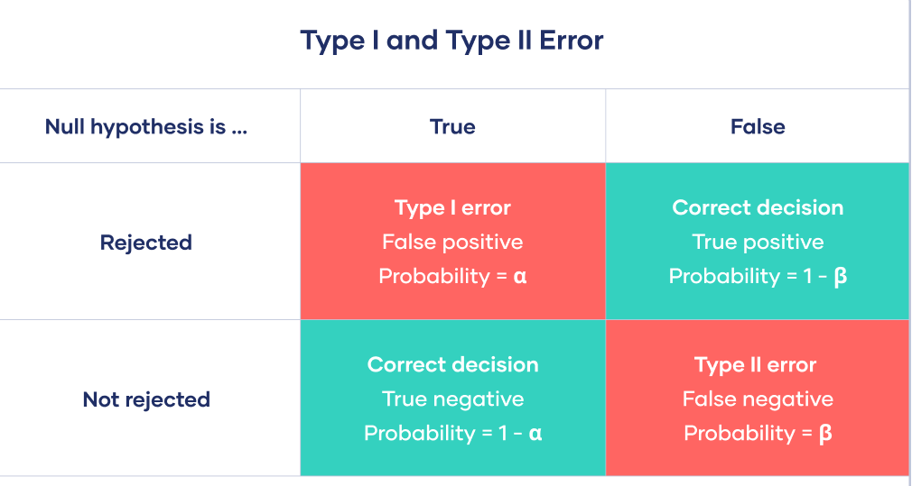
Type I & Type II Errors

Slide 18
One-tailed,Two-tailed Test
One-tailed and two-tailed test are statistical hypothesis tests to accept or reject the null hypothesis. In this article, we will briefly discuss the difference between one tail and two tail tests.

Slide 19
One-tailed Test
When we test (check) whether the Sample parameter is Higher or Lower (< or >) than the population parameter, it is known as the One-Tailed Test.
To reject the null hypothesis, the sample parameter should be either greater or less than the population parameter.
Null and Alternate Hypotheses must be established before the test.It is often use when you want to test your hypothesis in both the direction

Slide 20
One-tailed Test
It may be either:
Left-Tail: When the population parameter is lower than the assumed value.
Right-Tail: When the population parameter is greater than the assumed value.

Slide 21
Two-Tailed Test
In hypothesis testing, when we test whether the sample is greater or less than a certain range of values, it is referred to as a two-tailed test.
The region of rejection lies on both the side of the probability distribution
It is used for Null Hypothesis Testing.
The significant level is split in both directions.

Slide 22
Z-test
A z-test is a statistical test to determine whether two population means are different when the variances are known and the sample size is large.
A z-test is a hypothesis test in which the z-statistic follows a normal distribution. A z-statistic, or z-score, is a number representing the result from the z-test.

Slide 23
T- test
A t test is a statistical test that is used to compare the means of two groups.
It is often used in hypothesis testing to determine whether a process or treatment actually has an effect on the population of interest, or whether two groups are different from one another.

Slide 24
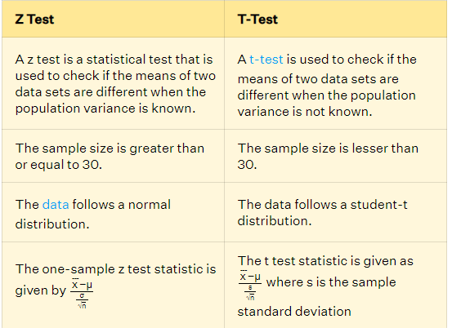
Z Test vs T-Test

Slide 25
Covariance…
Covariance measures the direction of the relationship between two variables
A positive covariance means that both variables tend to be high or low at the same time.
A negative covariance means that when one variable is high, the other tends to be low.

Slide 26
Covariance…
Covariance is a statistical tool used to determine the relationship between the movements of two random variables.
When two stocks tend to move together, they are seen as having a positive covariance; when they move inversely, the covariance is negative.

Slide 27
Covariance…
Covariance is different from the correlation coefficient, a measure of the strength of a correlative relationship.
Covariance is an important tool in modern portfolio theory for determining what securities to put in a portfolio.
Risk and volatility can be reduced in a portfolio by pairing assets that have a negative covariance.

Slide 28
Positive Covariance
Covariance between two variables indicates that these variables tend to be higher or lower at the same time.
In other words, a positive covariance between stock one and two is where stock one is higher than average at the same points that stock two is higher than average, and vice versa.
When charted on a two-dimensional graph, the data points will tend to slope upwards.

Slide 29
Negative Covariance
When the calculated covariance is less than negative, this indicates that the two variables have an inverse relationship.
In other words, a stock one value lower than average tends to be paired with a stock two value greater than average, and vice versa.

Slide 30
Pearson correlation coefficient
The Pearson correlation coefficient (r) is the most common way of measuring a linear correlation.
It is a number between –1 and 1 that measures the strength and direction of the relationship between two variables.
When one variable changes, the other variable changes in the same direction.

Slide 31
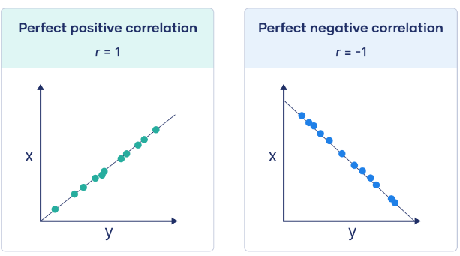
Visualizing

Slide 32
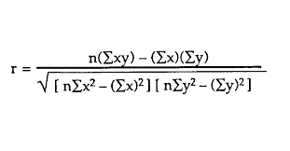
Pearson correlation coefficient

Slide 33
When to use the Pearson correlation coefficient
Both variables are quantitative
The variables are normally distributed
The data have no outliers
The relationship is linear

Slide 34
Spearman’s Rank Correlation
Spearman’s rank correlation measures the strength and direction of association between two ranked variables.
It basically gives the measure of monotonicity of the relation between two variables i.e. how well the relationship between two variables could be represented using a monotonic function.

Slide 35
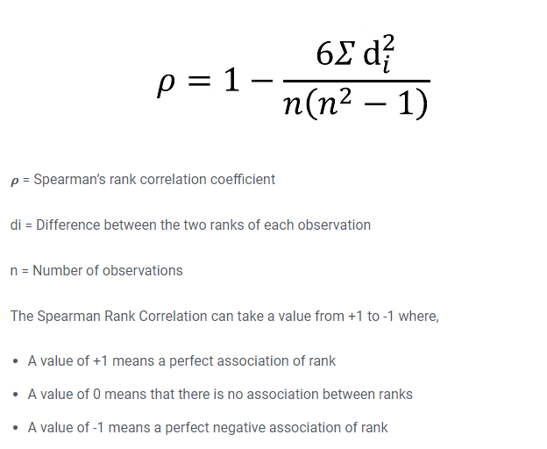
Spearman’s Rank Correlation

Slide 36
Application/Uses of Normal Distribution
It’s application goes beyond describing distributions
It is used by researchers and modelers.
The major use of normal distribution is the role it plays in statistical inference.
The z score along with the t –score, chi-square and F-statistics is important in hypothesis testing.
It helps managers/management make decisions.

