Slide 1

MICROWAVE OVEN SIMULATION Project Documentation
PRESENTED BY:
MOHAMED THASNEEM A
BIBIMARIUM MULLA
BHAVANA GAJJI
EMBEDDED SYSTEM INTERNSHIP
ES-INT-B3

Slide 2
INTERNSHIP OVERVIEW :
Embedded Internship Kickoff
Technical Orientation of the internship
C Programming resources
Microcontroller resources
WK1- C Programming
WK2 – Project Requirements & Design , Embedded Systems , Programming
WK3 – Building the Units-Peripheral Programming
WK4 – Project Integration & Testing
WK5 – DISHA WORKSHOP

Slide 3
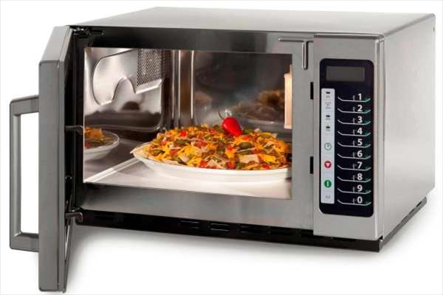
What is micro wave oven ?
A microwave oven is a cooking device that can cook or reheat food much faster than a conventional oven. Using microwave technology, water and particles within the food are heated incredibly fast, turning cold or frozen food into steaming and hot meals.
Why a Microwave oven in this internship?
This an Embedded Systems Internship, Here we are to build an Embedded System Hands-on.
Microwave oven is an Embedded System which is a best Model for Understanding how an Embedded System works , Because it is Easy for anyone to understand the mechanism.
As beginners, we found this project very interesting and we contributed our efforts in finishing this project

Slide 4
Abstract
“Microwave Oven Simulation ” is the project which is implemented on a PIC controller, it has different modes of cooking such as Micro, Grill, Convection and Start modes. As per the user requirement the user can choose whichever mode of cooking he wants to use.
Our objective is to implement all the modes and functionality of a Microwave oven on the PIC16F877A board using and test it on simulating on the PicSim lab software. The code is written in Embedded C
Key Features:
Four different cooking modes(micro ,grill, convection and start)
Count down Timer for each mode
Temperature can be set manually
Generic code
Easy to implement
Real Time Status Display

Slide 5
CONTENTS
Project Development Phases
Embedded Systems
Components of Embedded systems
Microwave Oven Components
Code Overview
Simulation overview
Challenges faced
Acknowledgment

Slide 6
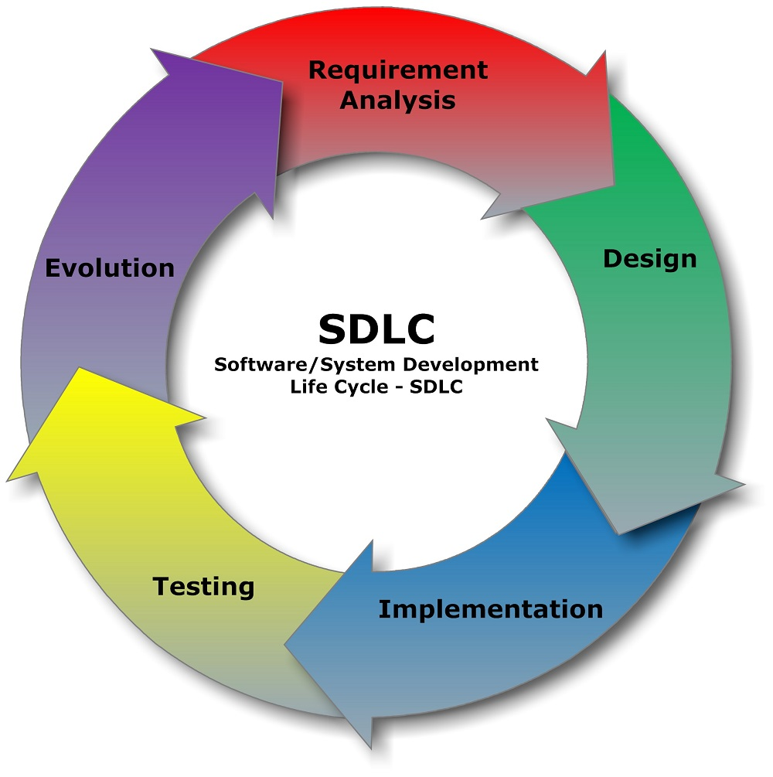
PROJECT DEVELOPMENT PHASES
The project is developed considering the Software Development Life Cycle (SDLC) phases and divided into five phases of development. Below chart explains brief about these phases,

Slide 7
EMBEDDED SYSTEMS
Embedded system:
“Any combination of Hardware and Software which is intended to do a Specific Task can be called as an Embedded System”.
Examples:
Microwave Oven
Traffic lights
Washing Machine
TV
Cameras
Refrigerator, etc.

Slide 8
Categories of embedded system:
Stand-alone
Real Time
Networked
Mobile
Requirements of Embedded system:
Reliability
Cost-effectiveness
Low Power Consumption
Efficient Usage of Processing Power
Efficient Usage of Memory
Challenges:
Efficient Inputs/Outputs
Embedding an OS
Code Optimization
Testing and debugging

Slide 9
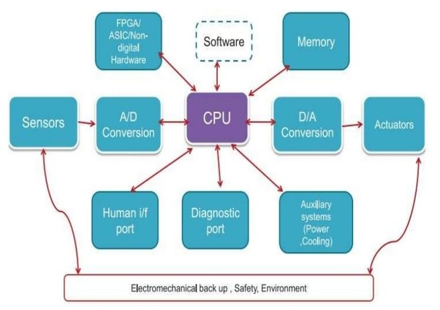
COMPONENTS OF EMBEDDED SYSTEMS:

Slide 10
What should you know about Microcontroller ?
In Our project PIC16F877A controller is used based on that some important terms can be given as,
Host:
A system which is used to develop the target. Here, Desktop, PIC16F877A
Target:
A system which is being developed for specific application. Here, Microwave Oven
Cross Compiler:
An application used to generate code for another architecture being in another architecture
Here, MPLAB xIDE

Slide 11
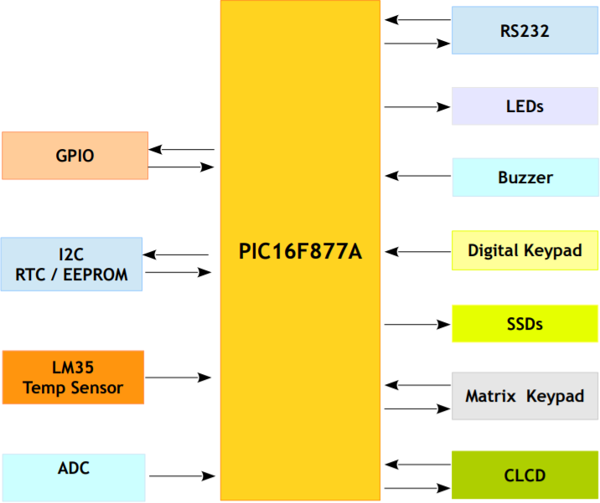
PIC16F877A Microcontroller Architecture

Slide 12
COMPONENTS OF MICROWAVE OVEN
The essential hardware components required for the project –Microwave oven simulation are as follows :
PIC16F877A
CLCD
BUZZER
MATRIX KEYPAD
SOFTWARE used:
MPLAB xIDE for building the code
PICSimLab for simulation

Slide 13
PIC16F877A:
The 16F877A is a capable microcontroller that can do many tasks because it has a large enough programming memory (large in terms of sensor and control projects) of 8k words and 368 Bytes of RAM. This is enough to do many different projects
Operating Frequency: 20 MHz
Power on reset
Flash Program Memory: 8K
Data Memory (bytes): 368
EEPROM Data Memory (bytes): 256
15 Hardware & Software Interrupts
5 I/O Ports: A, B, C, D, E
Timers: 3
2 Capture/Compare/PWM modules
USART and PSP for serial & parallel communication

Slide 14
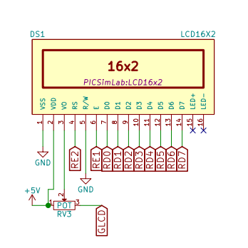
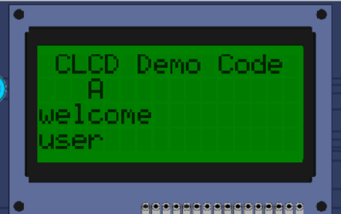
CLCD:
Most commonly used display for ASCII characters
Some customization in symbols possible
Communication Modes
8 Bit Mode
4 Bit Mode

Slide 15
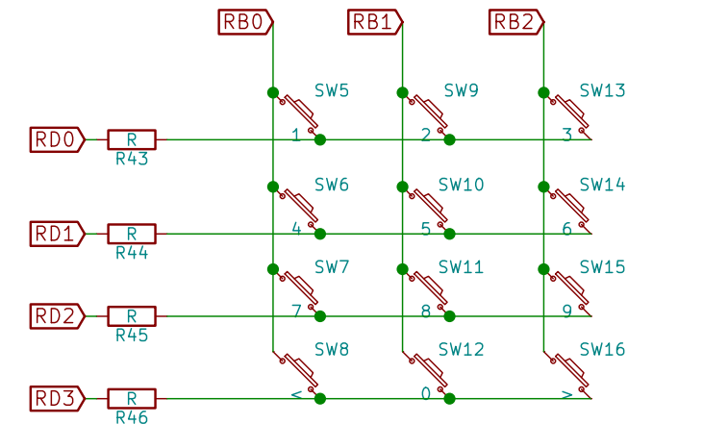
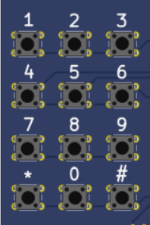
Matrix Keypad:
4 rows x 3 columns
12 Tactile Switches used
Columns -> Port B
Rows -> Port D

Slide 16
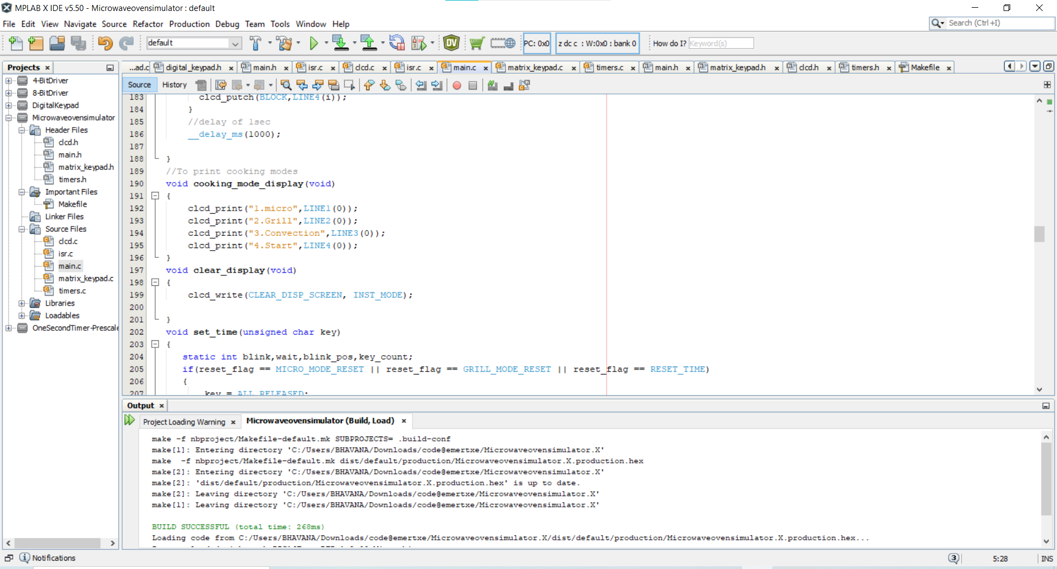
MPLAB xIDE
The MPLAB xIDE interface is where the system code is written. It supports the XC8 compiler to compile codes and generate hex files for PIC controllers by compiling C code.

Slide 17
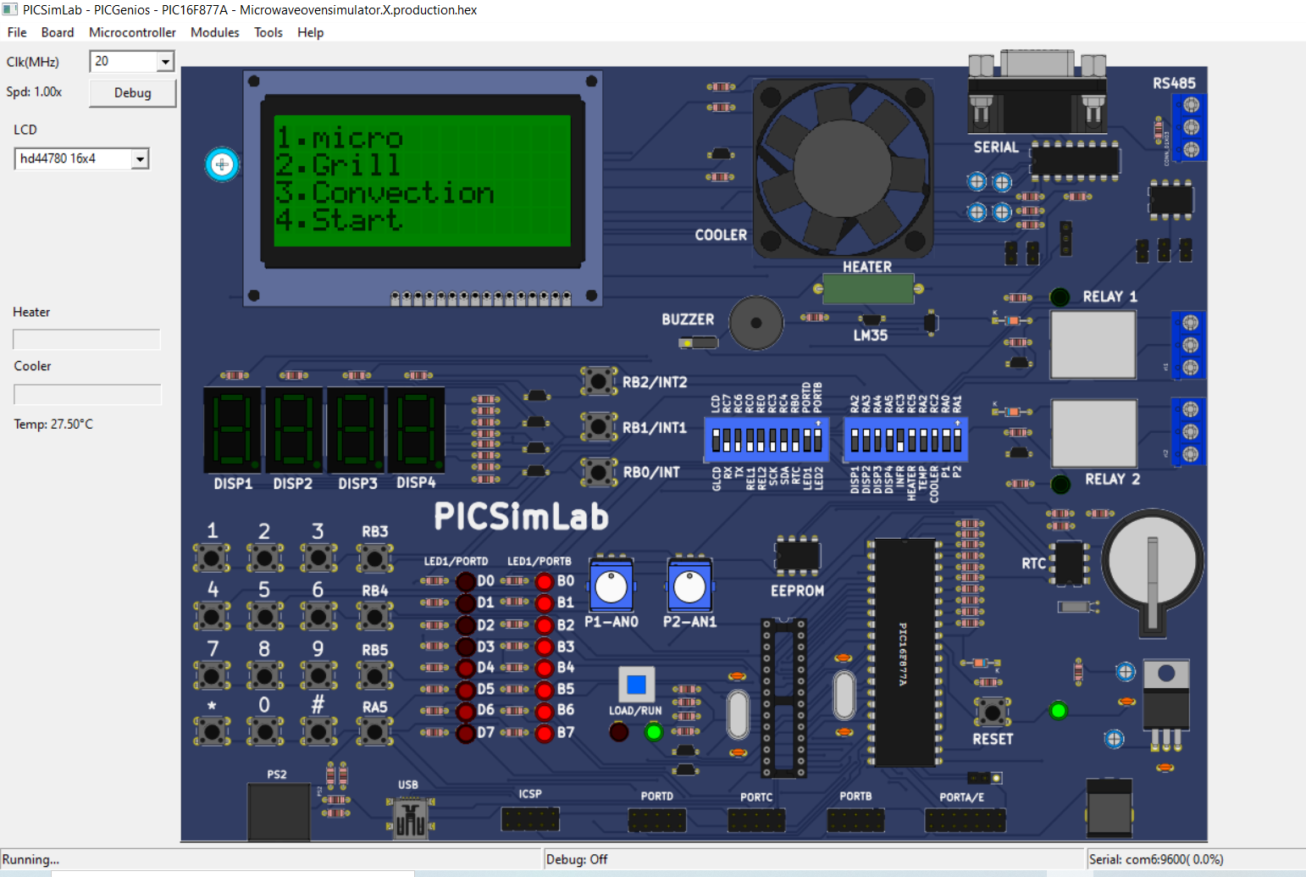
PICSim LAB
The picture shows the Picsim lab window where the Microwave Oven project is simulated by loading hex file into PIC16F877A

Slide 18
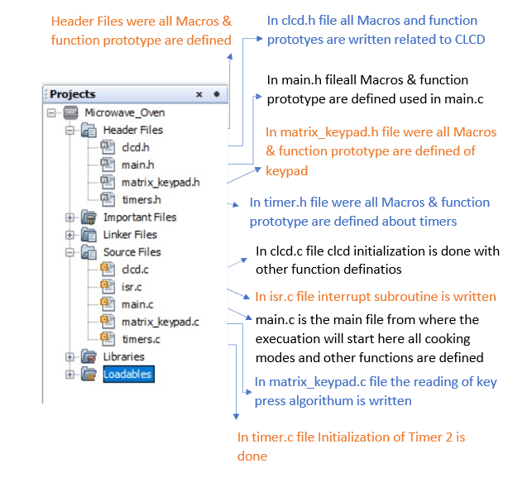
CODE OVERVIEW :
Code is written in a very generic way so that whenever there is a chance for improvement or adding any feature to system that can be easily added.

Slide 19
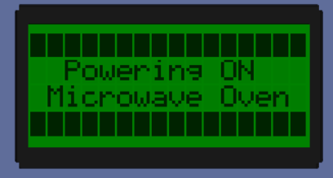
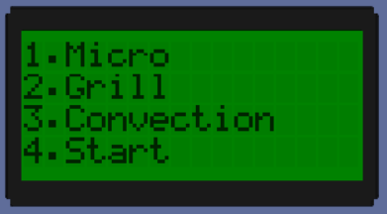
SIMULATION OVERVIEW
Microwave Oven
The whole project is categorized on the various modes and based on the CLCD Display output, will explain according to those modes only,
Power On Screen
When system is beginning power on the CLCD displays ‘Powering ON Microwave Oven’ & oven will start.
Cooking Mode Display
After turned on oven CLCD shows listed cooking modes user have to press respective key from matrix keyboard to choose the specific mode of cooking,
1.Micro mode
2.Grill mode
3.Convection mode
4.Start Mode

Slide 20
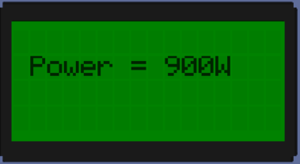
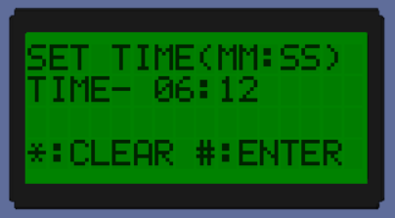
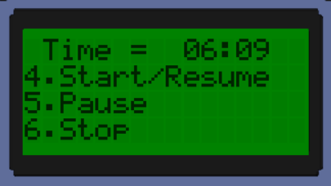
Micro Mode
If user presses ‘1’ from matrix keyboard system will enter in micro mode of operation by increasing & displaying power to 900W after that CLCD screen displays the Set Time Screen
Set Time Screen
In the set time screen user have to define for what specific time for cooking is to be done the Min:Sec are displayed as ‘00:00’ user have to set from keypad. User can clear the time by pressing ‘*’ or after setting time user have to press ‘#’ to start oven to cooking.
Time Display Screen
After pressing ‘#’ system enters in Time Display screen where Timers come in picture, Timer2 and Fan get starts and timer starts down counting the time to zero ‘0’.
In Time Display if user presses ‘4’, ‘5’ or ‘6’ then system will respond as follows,

Slide 21
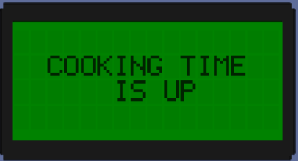
PAUSE If user presses key ‘5’ it will stop Timer and Fan and hold system in that condition unlit any response from user
START/RESUME If system is already paused by user, then by pressing key ‘4’ system will resume starting Timer and Fan on. If not paused by pressing this key the timer will increment by 30 sec for each key press.
STOP When user press key ‘6’ the system will stop every operation and come back in the cooking mode display.
Done Cooking Screen
When timer down counting reaches to 0 the interrupt will be generated leads to turning on Buzzer and turning off timer and fan also displays ‘Cooking Time Up’ on CLCD.
System stays in this for 3 sec and then will turn off buzzer and came back to cooking mode display.
Grill Mode
In the cooking mode display if user presses key ‘2’ then system will enter in grill mode and shows Set Time Screen to enter time ‘00:00’ for cooking. After that system function identical as in Micro Mode.

Slide 22
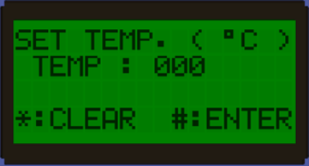
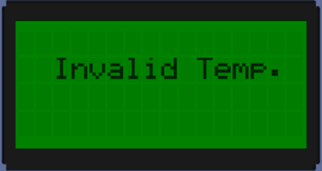
Convection Mode
System enters in Convection mode when user presses key ‘3’. In the convection mode system requires to set Temperature from user, user can enter Temp. between 0 ºC to 250 ºC.By pressing ‘*’ will clear temp to 0 and by pressing ‘#’ system will enter in Preheating mode.
If user enters temperature more than 250 ºC and presses ‘#’ to enter the system will generate an error showing ‘Invalid Temp.’ on screen and turning on buzzer for 2 sec and will again come back to set temperature

Slide 23
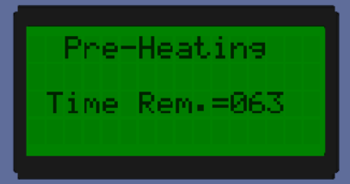
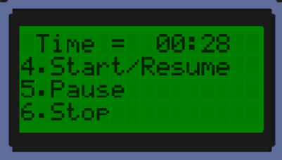
Pre-heating Mode
When ‘#’ keypress occurs and temp is below 250 ºC, system will accept the entered temperature and starts preheating to that temperature it will require 180 sec to heat,
therefore the timer will also be displayed on that screen down counting.
After Pre-Heating is done the system will go on Set Time Screen and oven will do same operation as Micro mode after time is set.
Start Mode
The start mode will be executed by pressing key “4” when system is in cooking mode display.
In the start mode time display screen will appear on CLCD and automatic timer will set to 30 sec and will operate same as Micro Mode.

Slide 24
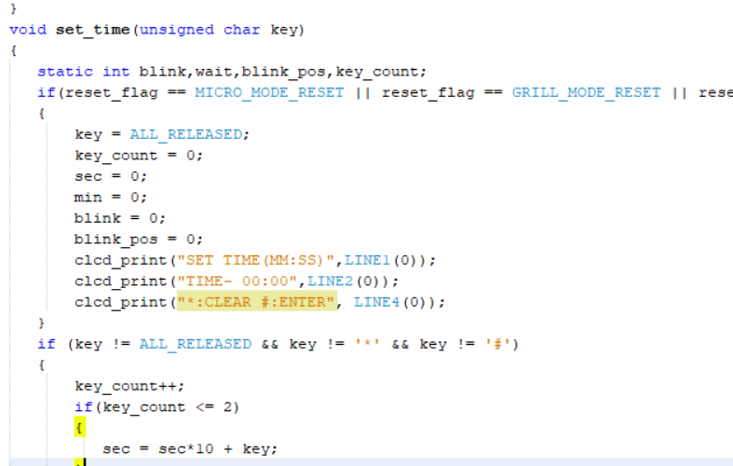
CHALLENGES FACED :
While testing and checking all processes are working correctly or not we got to know about some bugs were present in the system, and all bugs fixed by us by updating or adding some lines the in code.
In the Initial days of coding, we faced problem in the Level triggering and edge triggering part .We took each others help and resolved the problem.
In the set timer function during executing the micro mode , Blinking part took us so much time to code and after Mam explained the concept and it was Clear for us .

Slide 25
ACKNOWLEDGEMENT :
We learned the embedded C concepts and the Core concept of how to build an Embedded System
In this Internship we learnt about the PIC16F877A Microcontroller which is the main component in building this project- MICROWAVE OVEN SIMULATION.
We also learned about the Peripherals of the microcontroller like LCD , Matrix keypad,
Timers and buzzer that are used in this project.
Our Project mentor made it easy for us to understand all the concepts.
We would like to extend our gratitude to each and every one who supported us in finishing the project especially our Mentor Rajini Mam .
DISHA workshop sessions by Jayakumar sir were also very informative and we had many fun filled learning experiences.
Great learning has happened for us this year which made our 2021 special with EMERTXE internship.
We would like to build more projects on PIC microcontroller ,Gain more knowledge and increase our skillsets standard.
THANKYOU.

