Slide 1
Interfacing of Temp. Sensor DS18B20
Project:- Patient Monitoring Control System Using IoT
Group: - G2
Submitted by: -
Mohpreet Sidhu

Slide 2
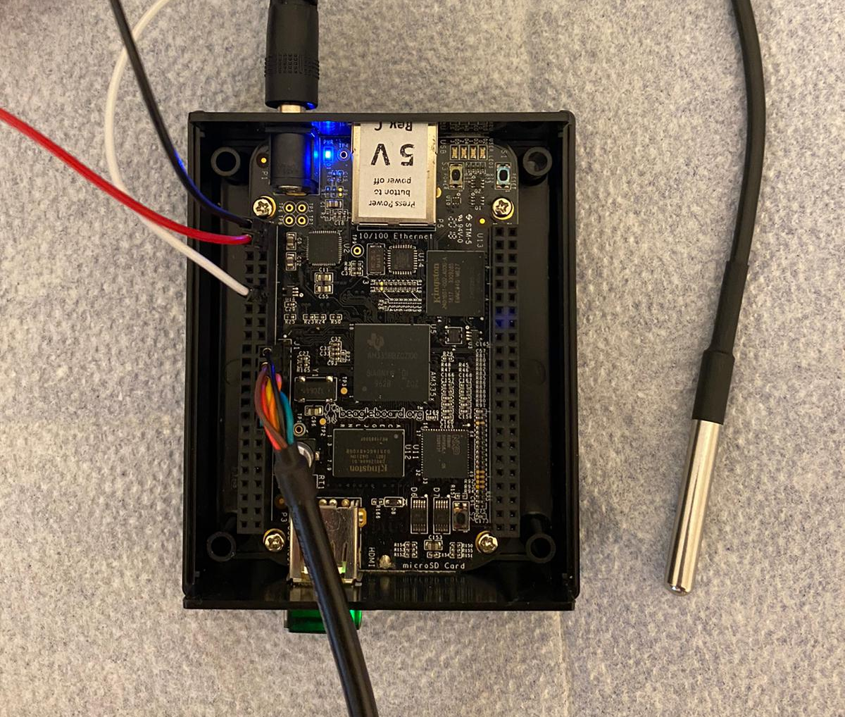
DS18B20 connection with BBB

Slide 3
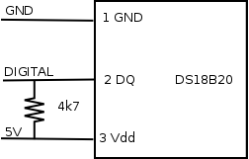
DS18B20 Connection and Pins
Pins or Wire: -
Red – 3V
White – Data
Black – GND

Slide 4
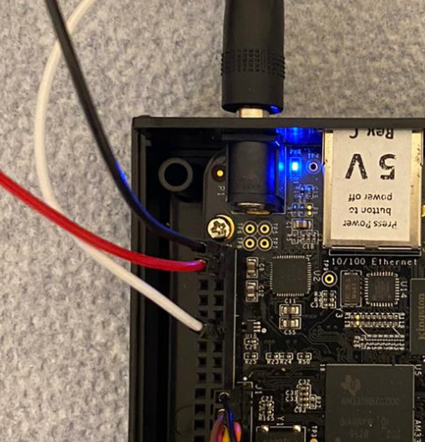
Beaglebone Pin Connections
Beaglebone black
Port :- P9
Ground:- P9.02
Vcc( 3.3 V) : - P9.04
Data Pin: - P9.12 (GPIO_60)

Slide 5
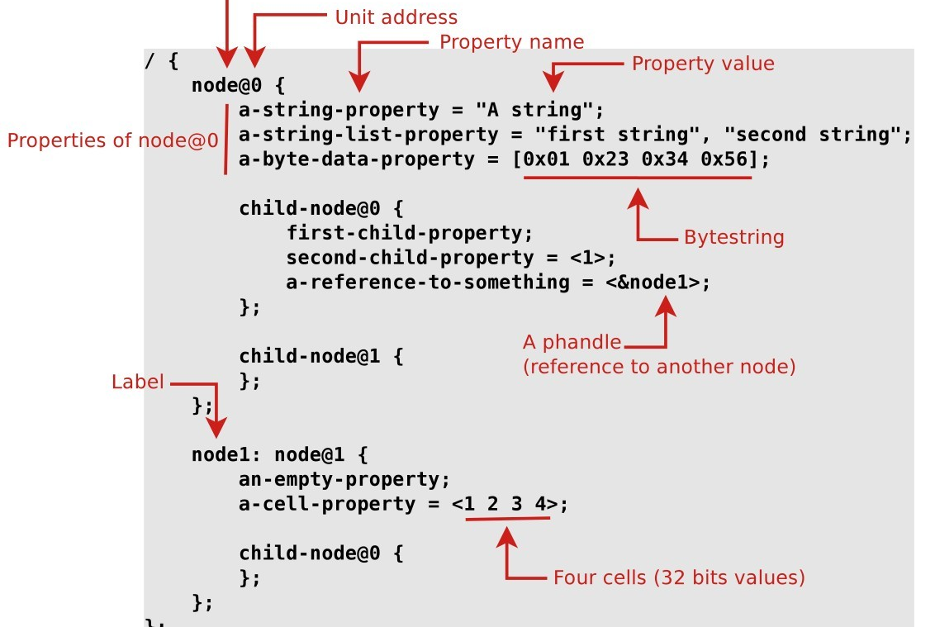
Creating the DTS_code

Slide 6
Compiling and boot file : -
1. setup: - compile the DTS code
(We have two options to compiler the DTS code)
- Using In-build dtc compiler in the linux to generate the binary code or
- Using dtb-rebuilder by Robert C.Nelson
2.Moving the file in boot/dtbo folder or lib/firware folder for boot time access.
3.Edit the uEnv.txt and add dtb_overlays so that our hardware can be detected during the boot time.
[Note if we compile the code with first method then U_boot_overlay file will be edited ]

Slide 7
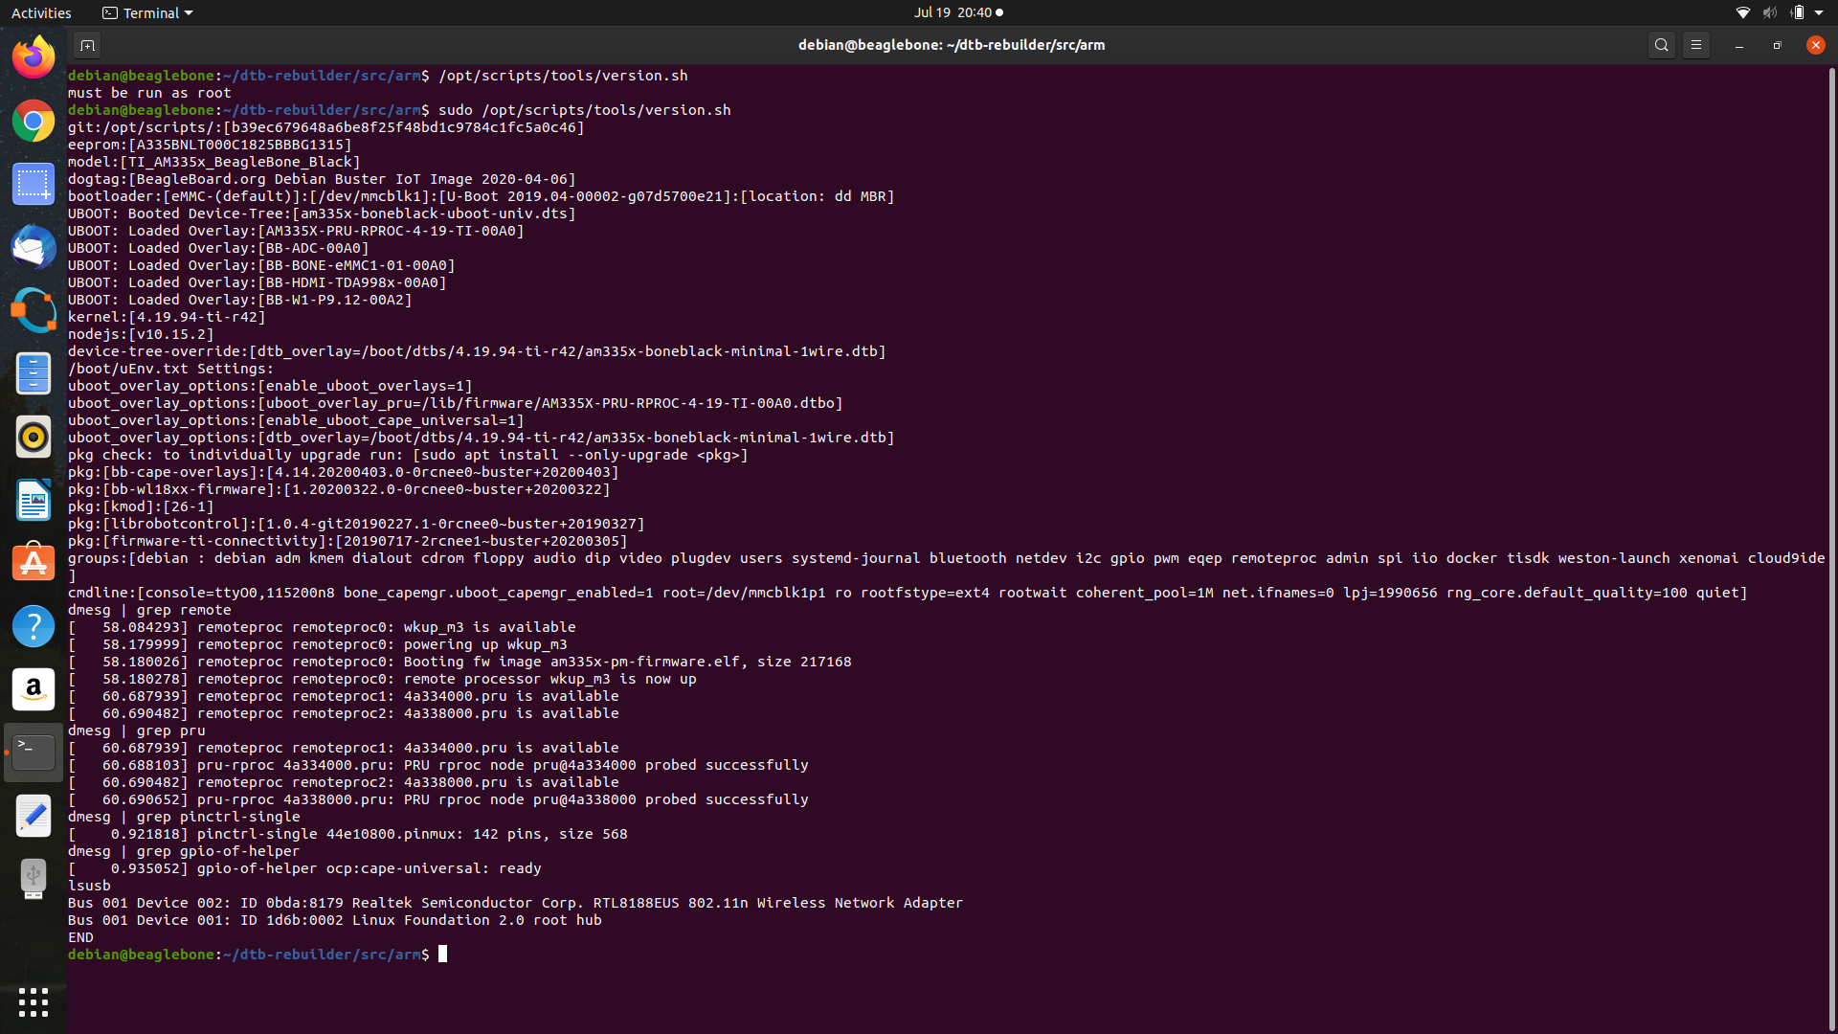


Boot Time Hardware Detection: -

Slide 8
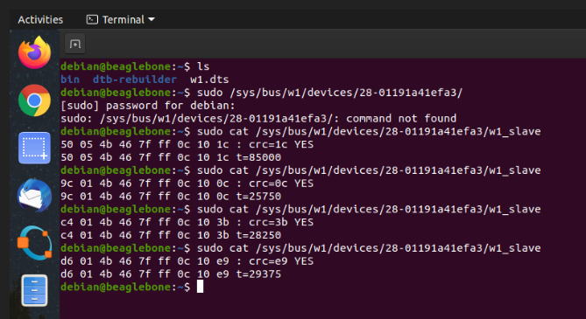

Hardware Detection and Temperature
Here as we see
: - Temp:- 29375
So
29375/1000 = 29.37 Celsius

Slide 9
References:-
1. Rebort C Nelson (2018)
: - https://github.com/RobertCNelson
2. Explore Beaglebone ( Derek Molly ) second edition
Publications : - John Wiley & Son’s Inc.

