Slide 1
Patient Monitoring and Control System using Internet of Thing
Submitted by
Group:2
Mohpreet Sidhu(C0749072)

Slide 2
Required Hardware components
BeagleBone Black
TP Link WIFI Dongle
DS18B20- Temperature Sensor
AD8232 Heart Rate Sensor
Arterial Blood Pressure sensor
GSM Module
5V Adapter
Jumper Wires

Slide 3
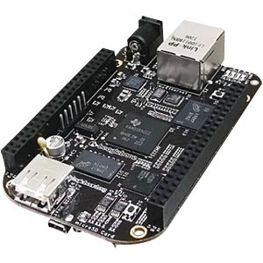
Beaglebone Black
The BeagleBone Board is a low-power open-source single-board computer.
Processor: 1GHz AM3359 Sitara ARM Cortex-A8.
DDR memory: 512 MB
USB Host
Memory: 4GB eMMC memory that’s pre-loaded with Debian GNU/Linux distribution and a microSD card slot.
Power Options: Via USB or 5V DC input
BeagleBone Black has processor speed and better flash memory and also it is lower in cost.

Slide 4
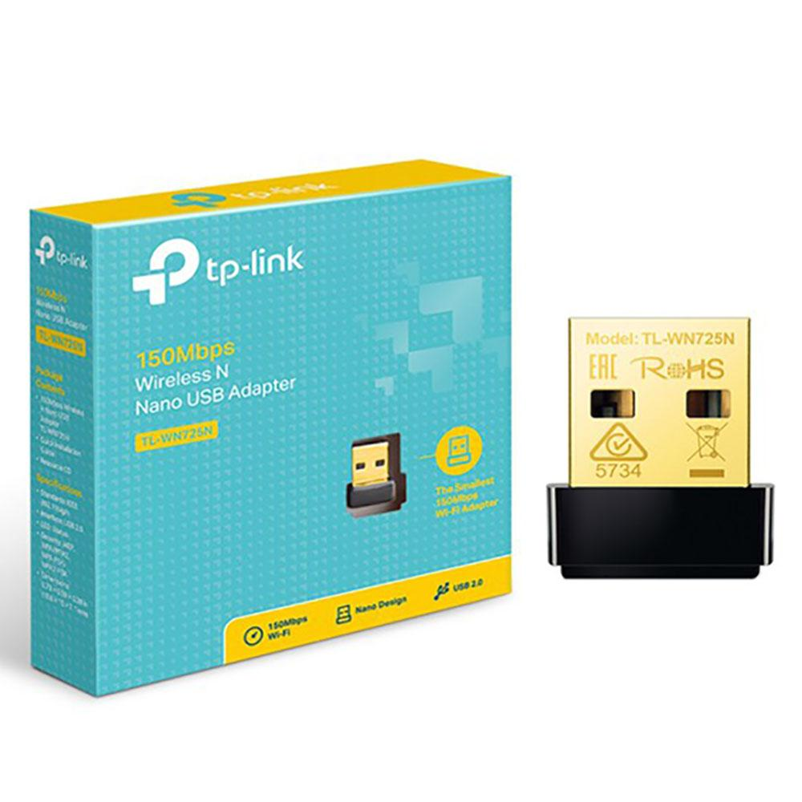
TP Link WIFI Dongle (TL-WN725N)
TP link is an USB adapter used to establish a wireless high speed internet connection to BeagleBone Black.
Speed Up to 150Mbps
TP Link uses IEEE wireless standard of 802.11.b/g/n and 2.4 GHz.
The WIFI dongle is easy to use, portable, it does not need any external power.

Slide 5
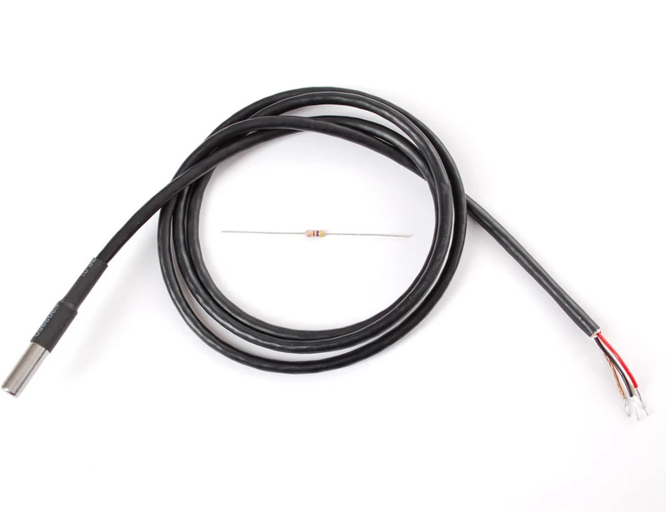
Ds18b20(temperature sensor)
Programmable Digital Temperature Sensor in order to measure temperature at multiple parts.
Communicates using 1-Wire method
Operating voltage: 3V to 5V
Temperature Range: -55°C to +125°C
Accuracy: ±0.5°C
DS18B20 has better operating voltage range compared to LM335 which has a voltage range from 4 to 30 V.

Slide 6
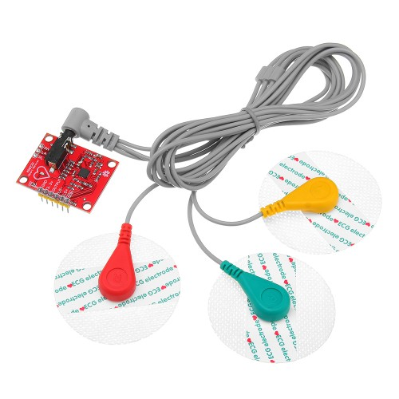
Ad8232 heart rate monitor
AD8232 is used to monitor the electrical activity of the heart
Operating Voltage is 3.3 V
3.5mm Jack for Biomedical pad connection
Analog Output
LED which pulsate with the rhythm of heart beat.
Serial Port Interface.

Slide 7
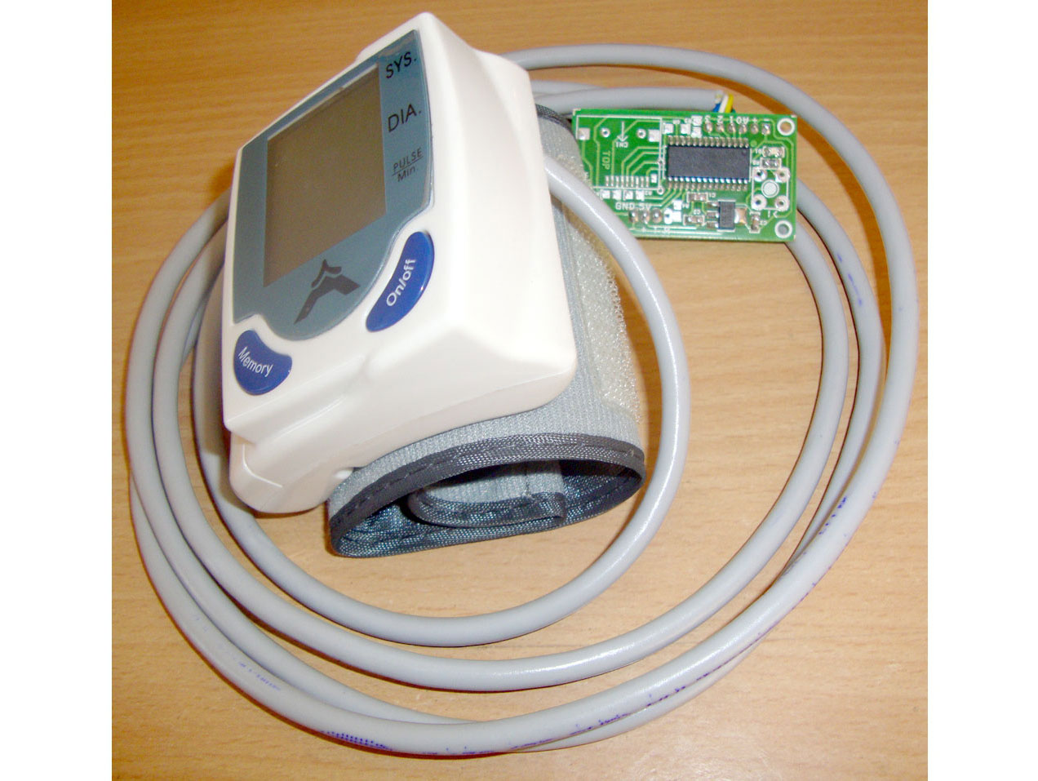
Blood pressure sensor( Sunrom 1437)
The blood pressure sensor is used to measure the pressure of blood against the arteries as the heart pump.
Automatic compression and decompression
Fully automatic and Highly accurate
Output Format: Serial data at 9600 baud rate
Working Voltage: 5 V ,200mA

Slide 8
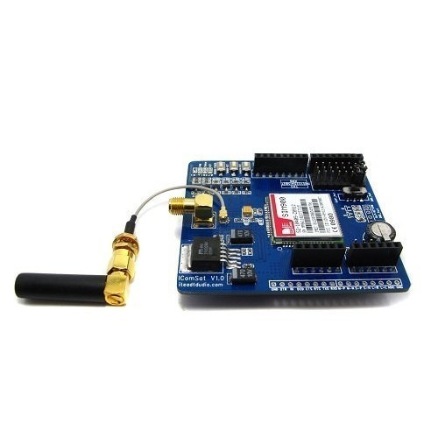
Gsm module (SIM900)
SIM900 GSM/GPRS module used to send message to the doctors phone.
Quad- Band 850/900/1800/1900 MHz
Supply Voltage ranging from 3.4 to 4.5 V
Low Power Consumption.

Slide 9
Other components
Power Adapter: 5V adapter is used to power up the system
A 4.7k ohm resistor is used between the Data and VDD pin of temperature sensor.
Jumper wires are used as connectors.

Slide 10
references
beagleboard.org, 2019 September, BeagleBone Black
https://beagleboard.org/black
USB Adapter,(N.D), 150Mbps Wireless N nano USB Adapter
https://www.tp-link.com/us/home-networking/usb-adapter/tl-wn725n/#overview
Components101,7 May 2019 DS1B20 Temperature Sensor
https://components101.com/sensors/ds18b20-temperature- sensor#:~:text=The%20DS18B20%20is%20a%201,solutions%2C%20mines%20or%20soil%20etc.&text=It%20can%20measure%20a%20wide,of%20%C2%B15%C2%B0C.
ECG Sensor Module- AD8232, (N.D)
https://5.imimg.com/data5/VP/WG/MY-1833510/ecg-sensor-module-ad8232.pdf
Sunrom, (N.D) ,Blood Pressure Sensor- Serial output
https://www.sunrom.com/p/blood-pressure-sensor-serial-output
SIM900 The GSM/GPRS Module for M2M applications,(N.D), SIM900 GSM/GPRS Module
http://www.propox.com/download/docs/SIM900.pdf

