Slide 1
Your Personal Virtual Assistant
Buddy..
Along with Real Time Image Recognition Capability
https://pixabay.com/en/metro-st-petersburg-tube-tunnel-3714290/

Slide 2

Abstract
The proposed is a virtual assistant with embedded image recognition capabilities to assist the end user through
Weather forecasting.
Launching applications.
News imparting.
Real time image Recognition with the help of TensorFlow.
Interaction can be done through a microphone or through written commands.

Slide 3
Buddy Architecture
01
Wireframes
Object Detection Overview
02
Voice Detection API Overview
03
https://pixabay.com/en/metro-st-petersburg-tube-tunnel-3714290/
https://www.pexels.com/photo/business-codes-coding-communication-360591/

Slide 4
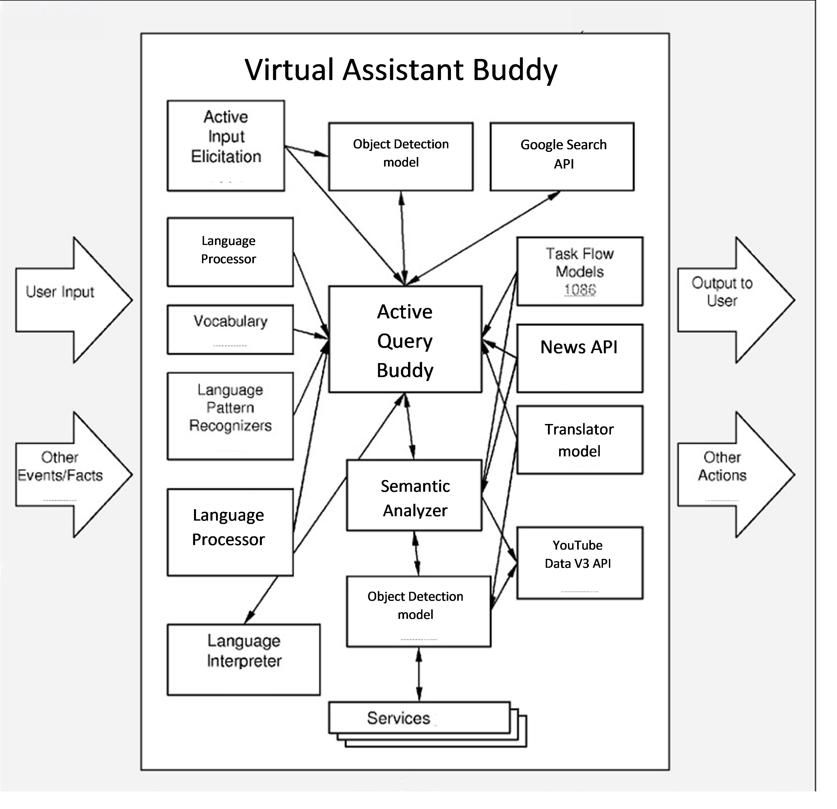
Virtual Assistant Buddy
Architectural
Overview
Donec eget viverra nisi, non luctus arcu. Sed ipsum leo, volutpat id convallis vitae, mollis ac dui. Cum sociis natoque penatibus et magnis dis parturient montes.

Slide 5
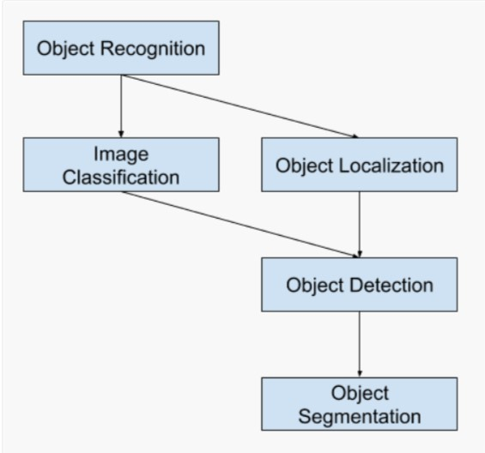
Object Detection
Overview
Donec eget viverra nisi, non luctus arcu. Sed ipsum leo, volutpat id convallis vitae, mollis ac dui. Cum sociis natoque penatibus et magnis dis parturient montes.

Slide 6
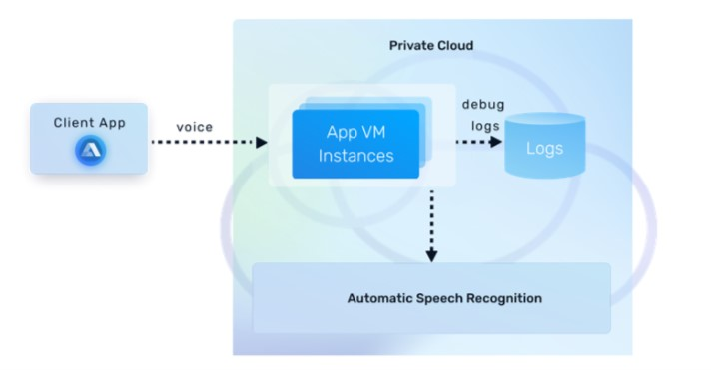
Voice Detection API
Overview
Donec eget viverra nisi, non luctus arcu. Sed ipsum leo, volutpat id convallis vitae, mollis ac dui. Cum sociis natoque penatibus et magnis dis parturient montes.

Slide 7

The Existing Model is equipped with the following features-
• Weather forecasting.
• Launching applications.
• News imparting.
• Knowledge Sources.
• Multidevice Connectivity.
• TTS(Text to Speech) and STT(Speech to Text)
Existing Model
02
https://pixabay.com/en/metro-st-petersburg-tube-tunnel-3714290/

Slide 8
The Proposed is equipped with the following features in-addition to the features of the existing model
• Character Detection.
• Language Translation.
• Real Time Image
Recognition
Proposed
Model
02

Slide 9
Working
https://pixabay.com/en/metro-st-petersburg-tube-tunnel-3714290/
https://www.pexels.com/photo/business-codes-coding-communication-360591/

Slide 10
The Speech engine has a speak function that converts text to speech.
• The speak function takes the text as an argument and then initializes the engine.
• The greeting by the system are managed through a function that greets according to the time periods.
• A command function is used to take command from the user in form of text or speech.
• The microphone captures the human speech and the recognizer recognizes the speech to give a response.
• The exception handler is used to handle the exception during the run time error and a function uses google audio to recognize the speech.

Slide 11
• The google API helps to extract information from google
• The applications are handled with the help of their respective functions.
• The object detection is done with the help of Tensorflow library. Tensorflow bundles together Machine Learning and Deep Learning models and algorithms. Tensorflow allows developers to create a graph of computations to perform.
• Detecting objects in real time is done with the help of a dependency called OpenCV and by following the YOLO Algorithm.The frames are obtained from the camera feed and then converted to Numpy arrays.Then the tensorflow API is used to detect the image in the Numpy arrays.
• Youtube is availed using the youtube data v3 API, from the google cloud developers console.
• Google translate is availed using the google translate API, from the google cloud developers console.

Slide 12
Screenshots
https://pixabay.com/en/metro-st-petersburg-tube-tunnel-3714290/
https://www.pexels.com/photo/business-codes-coding-communication-360591/

Slide 13
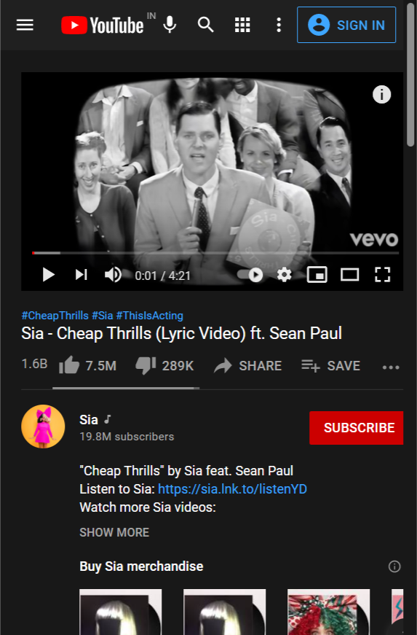
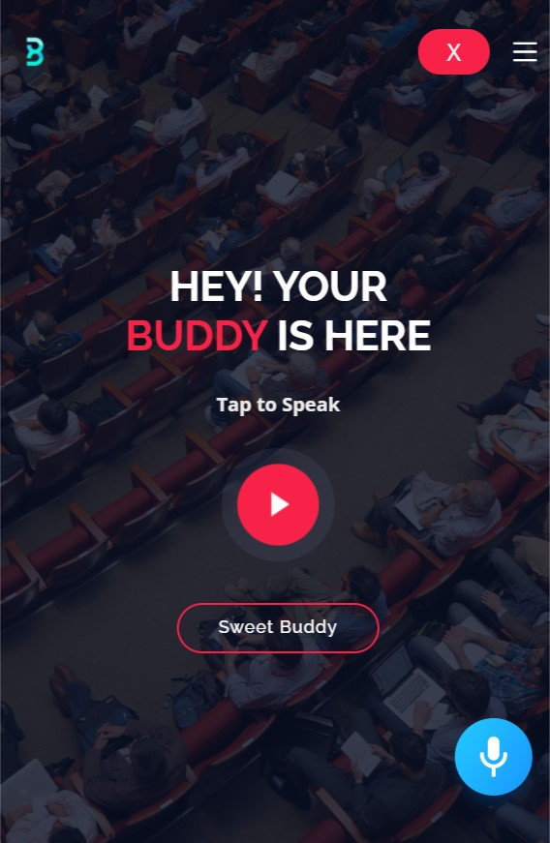

Slide 14
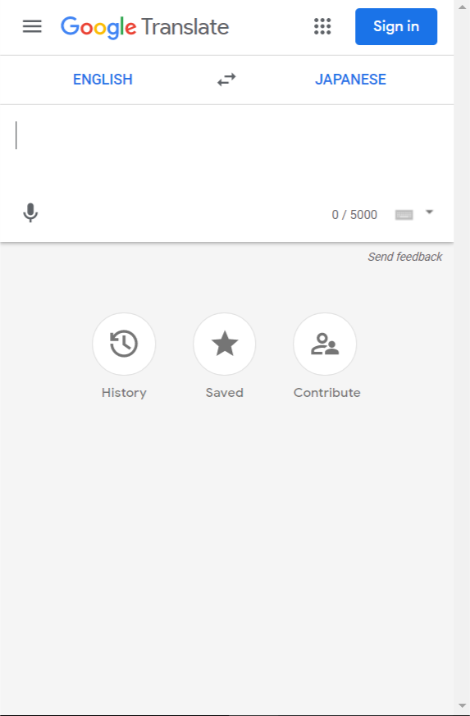
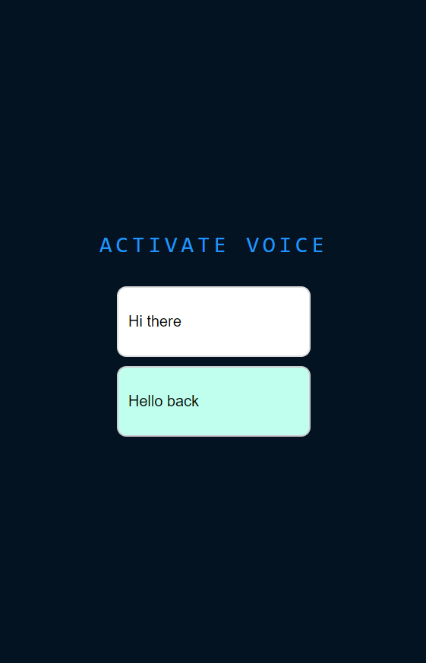

Slide 15
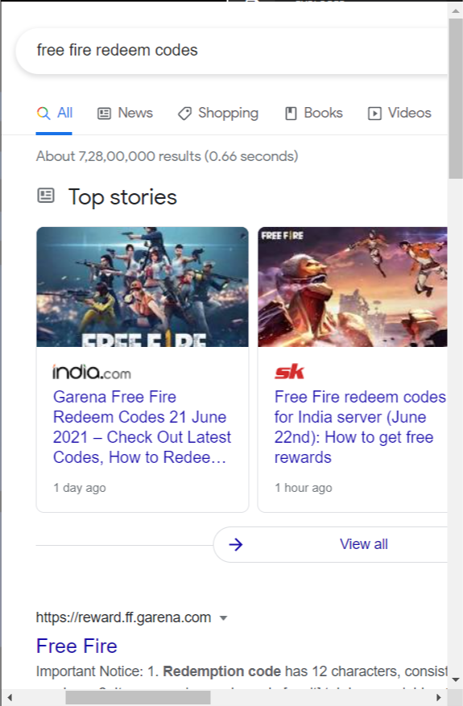
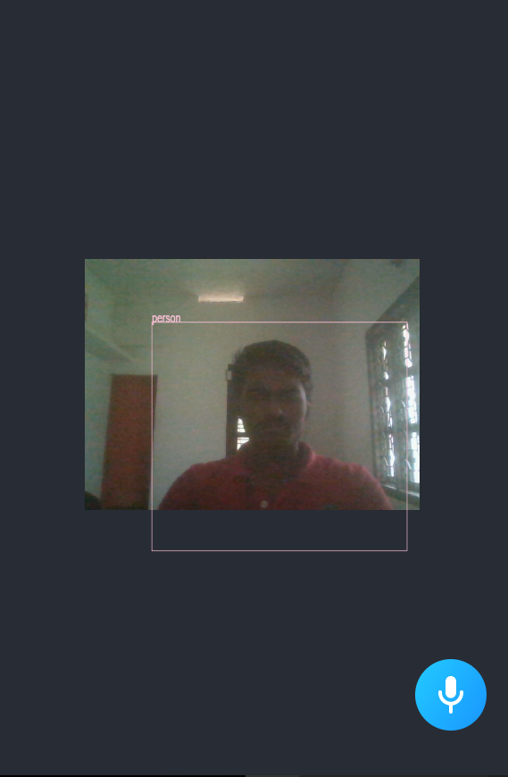

Slide 16
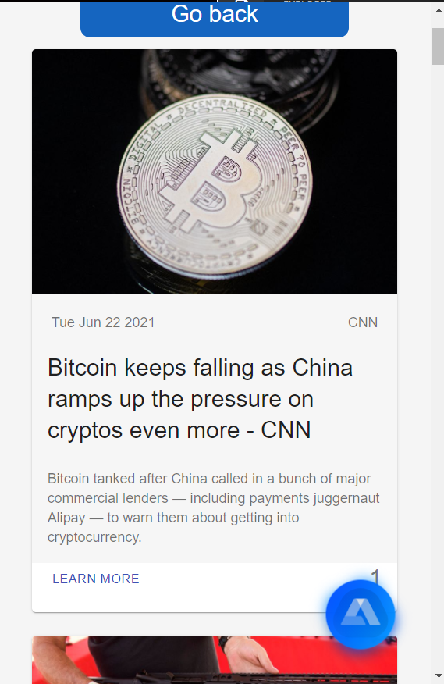
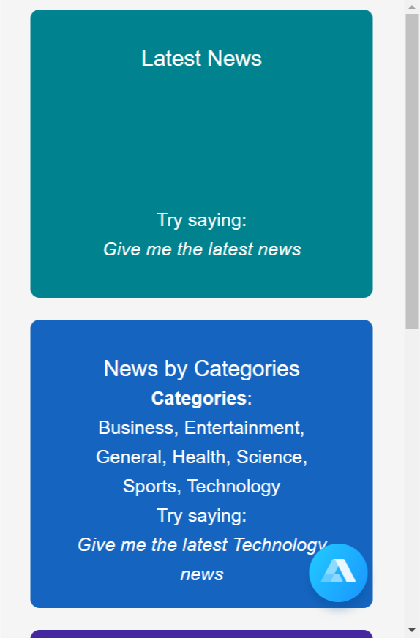

Slide 17
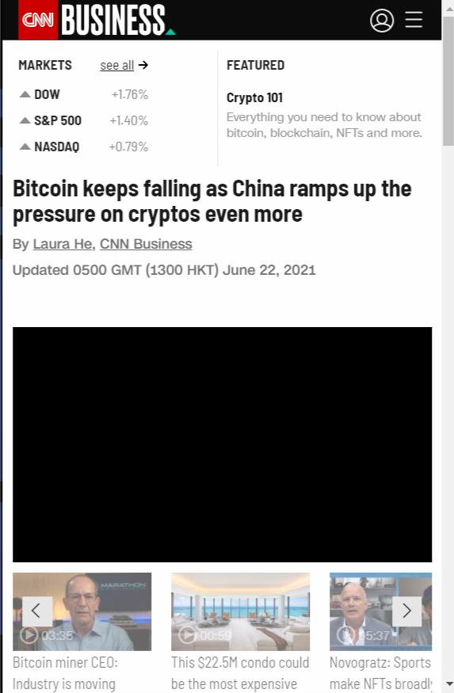
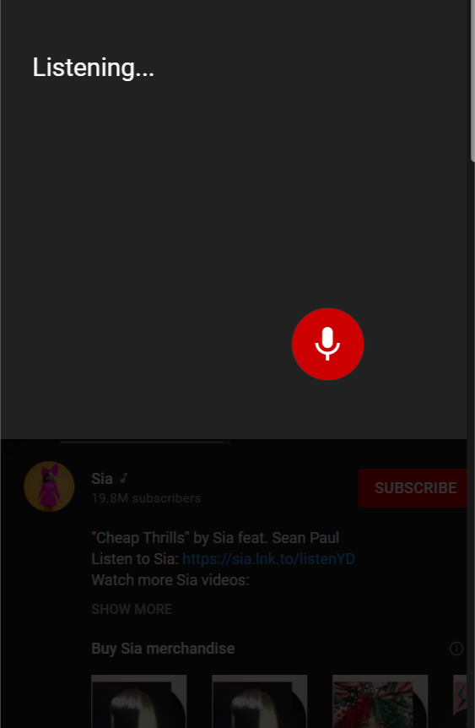

Slide 18
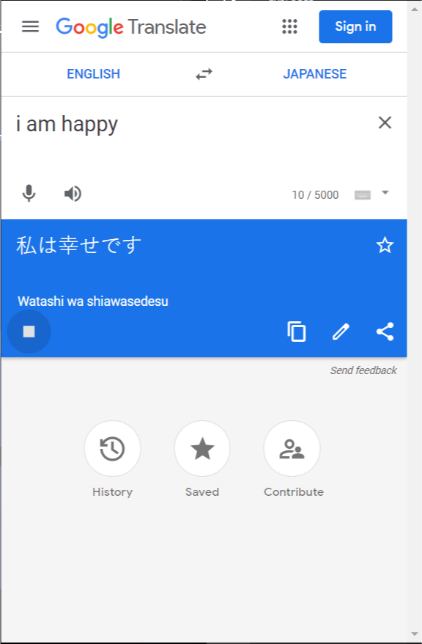
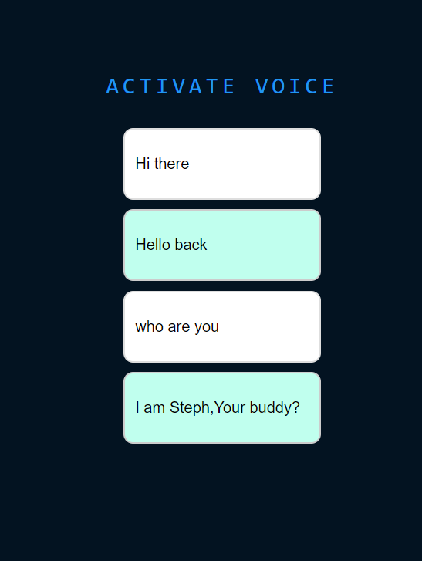

Slide 19
An initial outcome of the study indicates that the Virtual Assistant are capable of helping the user in his/her end to end activities.
• Intelligent virtual assistant increases company revenue by reducing the efforts in customer handling. It also reduces live chat volume, offers quick response, and saves time.
• By enabling real time detection enables these to unleash the true hidden potential by helping the user to understand different languages and also proves as a boon to the blind.
• In the rising age of automation and digitalization virtual assistants will play a crucial role
• Even without the TensorflowRT and CUDACNN Support,the model does not fail to
show its efficiency of a MaP=63.6% and FPS=120
Conclusion

Slide 20
https://Youtube.com/Nicolas
https://tensorflow.js/models
https://tensorflow.js/models/org/coco
References
https://openow.js/models/org/coco
https://odgfdfhdhdow.js/models/org/coco

Slide 21
Thank you
https://pixabay.com/en/metro-st-petersburg-tube-tunnel-3714290/
https://www.pexels.com/photo/business-codes-coding-communication-360591/

