Slide 1

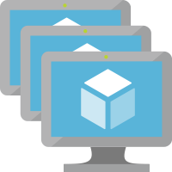

k3s master
(ingress and SSH)
k3s agents
(node pool)
/srv
storage
(SMB share)

