Slide 1
Dynamic Periodic Task
Student: Alberto Bottari

Slide 2
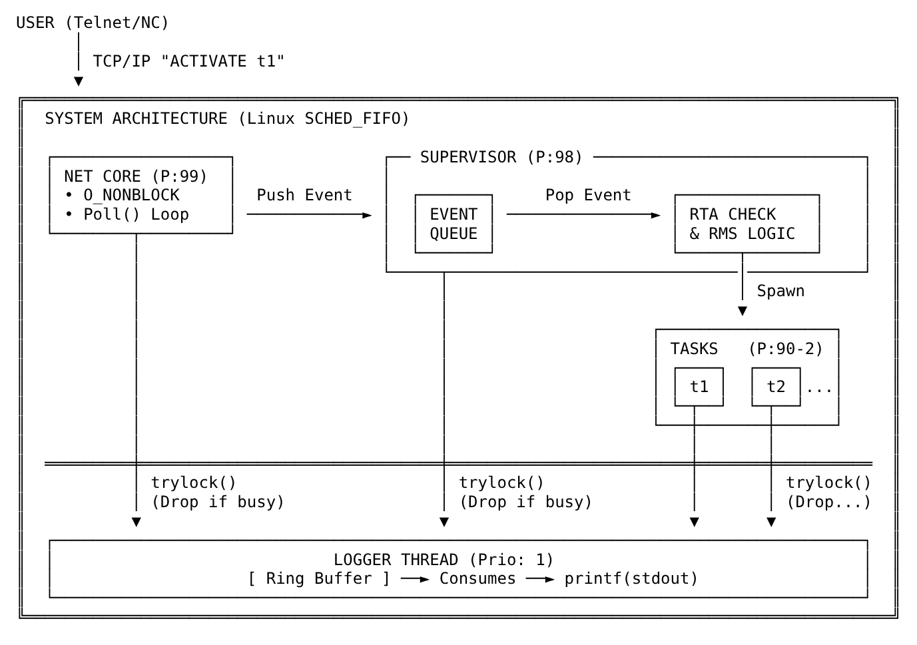
Architecture

Slide 3
Network Core
01
02
03
04
Mechanism
I/O Multiplexing via poll() on a single thread
Configuration
Sockets set to O_NONBLOCK, so one thread serves more clients
Maximum Priority
Drain sockets fast, avoid client drops
Data Integrity
Ring buffers to handle TCP fragmentation

Slide 4
Real-Time Scheduling & RTA
Policy
Admission Control
Timing Loop
Rate Monotonic Scheduling (RMS): optimal fixed-priority policy where shorter periods receive higher priority.
New tasks are reject if their worst-case response time, under higher-priority interference, exceeds deadline.
Uses clock_nanosleep with TIMER_ABSTIME to ensure zero accumulated drift
Measures execution time to detect deadline misses and task lateness

Slide 5
What if a deadline is missed?
The Problem
The Solution
If a task is delayed by seconds,
its next activation is in the past.
If next_activation <= now,
jump forward by N periods.
Task loops immediately to "catch up",
starving lower-priority tasks.
Maintains the original time grid alignment and recovers system stability instantly.

Slide 6
Why a custom Logger?
Problem
Solution
The printf() sys-call is thread-safe by using internal locking
if a lower-priority thread holds this lock, a higher-priority thread can block behind it, adding unbounded latency
Dedicate a low-priority logger thread that does the blocking printf() work.
real-time threads call pthread_mutex_trylock();
if contended, the log message is dropped (never block the producer).

Slide 7
DEMO

