Slide 1
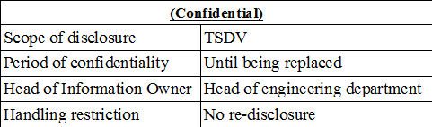
Training Material
CODING CONVENTION
TSDV Training Group

Slide 2
INTRODUCTION
Purposes
  For fresh member training or improving skill of TSDV members
Contents
  Coding convention, Using SVN, Source code Analysis tool
Trainers
  Le Huu Khoa
  Trinh Hong Hung

Slide 3
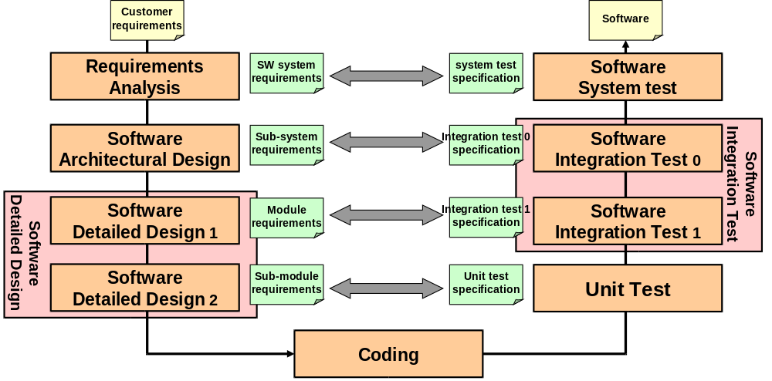
Coding phase

Slide 4
Contents
Basic C programming
Coding rules
Subversion
Code analysis
Appendix

Slide 5
Basic C programming
  Structure of a source file
  Step of compilation
  Static link & Dynamic link
  Declaration & Definition
  C array
  C pointer, Call by value & Call by reference
  Automatic, Global, Static variables

Slide 6
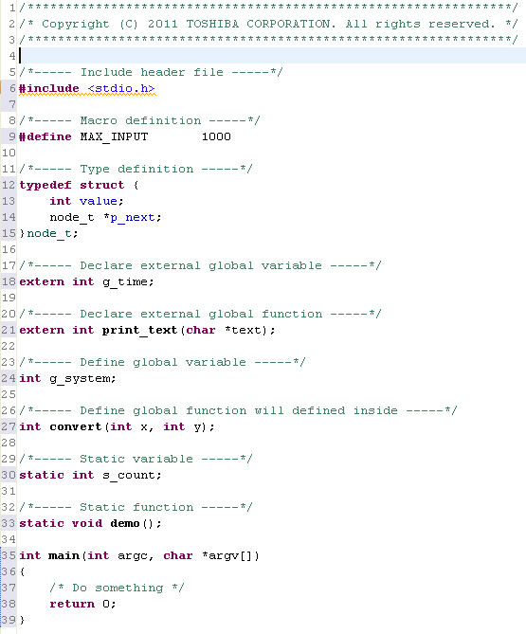
Structure of a source file

Slide 7
Steps of compilation in C language
Compiler: Borland C, CL, GCC
3 main steps
Pre-processing:
  Find all # and process it
  Perform:
    macro substitution
    conditional compilation
    inclusion of named files
We can pass flag option for each step
  Pre-processor: -I dir, -Dname,
  Compile: -ansi, -Wall, -O, -O0, -O1, -O2
  Linking: -llib, …
Sample with gcc compiler
gcc –o abc abc.c –DTEST -ansi –lpthread
Source program
Pre-processing
Source program
Compile
Object files
Linking
Executable file

Slide 8
Steps of compilation in C language
Source File
> gcc –E –P hello.c > hello.i
Source File
(after preprocessing)
⇒ hello.i
> gcc –c hello.i
Object File
⇒ hello.o
> gcc hello.o
⇒ a.exe
Executable File

Slide 9
Static link & Dynamic link
Static link: the executable file has the copy of object file
  Advantage: simple, not depend much on environment
  Disadvantage: size of executable file is big, small change of library need to compile and link all again
Dynamic link: object files will be loaded at execution time
  Advantage:
    Size of executable file is small, if have change, just compile library again
    [Windows] Multiple processes that load the same DLL at the same base address share a single copy of the DLL in physical memory. Doing this saves system memory and reduces swapping.
  Disadvantage: more complex than static link, depend on environment
Static library & shared library
  Static libraries are a collection of object files, and conventionally they end with a ".a" suffix in UNIX variants, and ".lib" in Windows. When a program is linked against a static library, the machine code from the object files for any external functions used by the program is copied from the library into the final executable.
  In contrast to static libraries, with shared libraries the library code is not bound to the executable at link time. Depending on when and how the address bindings are done, the linking process can be categorized into prelinking, load time linking, implicit run-time linking and explicit run-time linking.

Slide 10


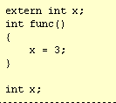
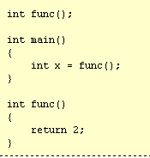
Declaration & Definition
Variable
Declare & define
Declare as a global variable
Declare & define somewhere
Function
?
What is difference between:
int func();
and
extern int func();
Answer: Same, just a declaration for a function
Notice: compile time is not need definition

Slide 11
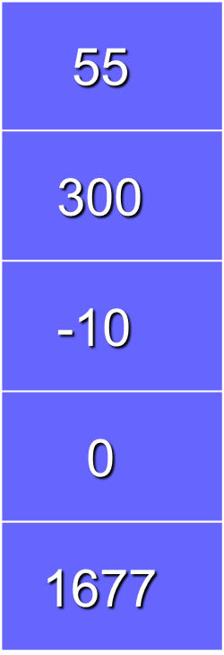
Array in C
A contiguous group of data items
Has a name which identifies the array
Each item, or element, in an array is of the same data type
An array element is selected by an index
type name [ size ] where size is an integral constant expression
(Size can be a local variable in C99)
name
0
Examples
#define SIZE 1000
int arr_val[SIZE];
1
data type
2
[Discussion]:
How to design data store if elements are not the same type?
. . .
SIZE - 1

Slide 12
Pointer
A pointer is an object that points another object
char c = 'h';
char *p_c = &c;
p_c
c
0xFF00
h
0xFF00
Value of pointer is address
[Discussion]:
What is different between pointer (*p_c) and pointer to pointer(**pp_c)?

Slide 13
Call by value & reference
void swap(int x, int y)
{
int temp;
temp = x;
x = y;
y = temp;
printf("Swapped values are a = %d and b = %d", x, y);
}
void main()
{
int a = 8, b = 4;
printf("Original values are a = %d and b = %d", a, b);
swap(a, b);
printf("The values after swap are a = %d and b = %d", a, b);
}
void swap(int *x, int *y)
{
int temp;
temp = *x;
*x = *y;
*y = temp;
printf("Swapped values are a = %d and b = %d", *x, *y);
}
void main()
{
int a = 8, b = 4;
printf("Original values are a = %d and b = %d", a, b);
swap(&a, &b);
printf("The values after swap are a = %d and b = %d", a, b);
}
Output:
Original values are a = 8 and b = 4
Swapped values are a = 4 and b = 8
The values after swap are a = 8 and b = 4
Output:
Original values are a = 8 and b = 4
Swapped values are a = 4 and b = 8
The values after swap are a = 4 and b = 8
Call by value
Call by reference

Slide 14
Call by value & reference
When a function is called, set of variables are created and copies the values of arguments into them or argument are cloned
In call by value, copied data is value of actual variable. So actual variable is not affect
In call by reference, copied data is address of actual variable
a = 10?
a
a
p_b
Call by value
*p_b = 10?
b
p_b
Call by reference

Slide 15
Automatic, Global, Static variable
Automatic: local variable
  Not automatically initialize value; we need to initialize before using
Global
  Automatically initialize value
Static variable
  Function scope: remain value after each function call
  File scope: just use in that file

Slide 16
Dynamic memory allocation
Dynamic allocation with
  malloc(): dynamic allocate without initialization
  calloc(): dynamic allocate and initialization to zero
  free(): free memory
  alloca(): allocation with automatically freed (just in POSIX)

Slide 17
Coding Convention

Slide 18
Terminology
There are many terminology in coding rules:
  Programming style
  Coding rules
  Coding style
  Coding convention
  Coding standard
  Coding practice

Slide 19
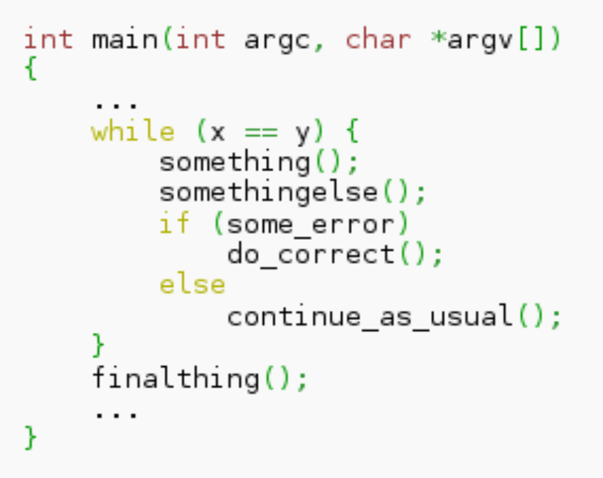
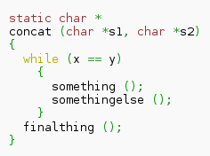
Coding Style
Coding style is just a subset of coding conventions
  Concentrate on the outside look (visual appearance) of source code: indentation, bracelets, tab, etc.
K&R Style
GNU Style

Slide 20
Coding Standard
A coding standard is a systematic description of a set of rules/conventions to write portable, robust and reliable programs.
Examples of standards:
  GNU Coding Standard (Richard Stallman)

Slide 21
Creating Coding Convention for Your Project
?
Should we make a our coding convention for our team
or using external coding convention?
Problems of following an external coding standard
  It has too many rules → hard to remember
  Some rules are not necessary for your project
  Your project needs rules that not existed in the coding standard
Steps to establish coding conventions:
  Determine a coding convention strategy
  Select rules based on the establishment strategy
  Define which rules are to be dependent on the project
  Determine procedures for making exceptions when applying rules

Slide 22
Toshiba coding practice
Document reference:
  Toshiba Coding Practice for Embedded: C_Guide_all_en.pdf
Purpose:
  Create a new coding convention
  Enhance existing coding convention
  Study material for training of programmers and self-study

Slide 23
Product Quality Attributes
Reliability | The capability of the software product to maintain a specified level of performance when used under specified conditions.
Maintainability | The capability of the software product to be modified. Modifications may include corrections, improvements or adaptation of the software to changes in environment, and in requirements and functional specifications
Portability | The capability of the software product to be transferred from one environment to another
Efficiency | The capability of the software product to provide appropriate performance, relative to the amount of resources used, under stated conditions
Functionality | The capability of the software product to provide functions which meet stated and implied needs when the software is used under specified conditions
Usability | The capability of the software product to be understood, learned, used and attractive to the user, when used under specified conditions
from ISO/IEC9126-1:2001

Slide 24
Source Code Quality Attributes
Reliability | The capability of the software product to maintain a specified level of performance when used under specified conditions.
Maintainability | The capability of the software product to be modified. Modifications may include corrections, improvements or adaptation of the software to changes in environment, and in requirements and functional specifications
Portability | The capability of the software product to be transferred from one environment to another
Efficiency | The capability of the software product to provide appropriate performance, relative to the amount of resources used, under stated conditions
Functionality | The capability of the software product to provide functions which meet stated and implied needs when the software is used under specified conditions
Usability | The capability of the software product to be understood, learned, used and attractive to the user, when used under specified conditions
from ISO/IEC9126-1:2001

Slide 25
Coding for Reliability
[Discussion] – What coding practices will contribute to reliability?
1
Initialize memory spaces and be mindful of their sizes
2
Pay attention to range, size and internal presentation when using data
3
Write in a way so as to secure behavior

Slide 26
Coding for Maintainability
[Discussion] – What coding practices will contribute to maintainability?
1
Be aware that other people are reading the program
2
Write in a way so as not to cause modification errors
3
Write program in a simple way
4
Write in a unified way
5
Write in a way that is easy to test

Slide 27
Coding for Portability
[Discussion] – What coding practices will contribute to portability?
1
Write in a way that does not rely on the compiler
2
Localize codes that have portability problems

Slide 28
Coding for Efficiency
[Discussion] – What coding practices will contribute to efficiency?
1
Write in a way that takes resource and time efficiences
Into consideration

Slide 29
Subversion

Slide 30
Subversion – rule of commit log
Source code version control: CVS, Subversion
Subversion client tool
  Command line, RapidSVN, TortoiseSVN
It is necessary to decide rule to commit & writing commit log on SVN
  Sample of commit log:
<Project>-[product type]: detail of modification
  + Project: name of project
  + Product type: if you have many product type such document, source code, unit test on subversion, you need to classify them for example: DOC, CODE, TEST
  + Detail of modification: log need to show detail as much as possible
    What is modification?
    Reason to modification?

Slide 31
Subversion – Some other common rules
Only source file & config files put on SVN
Object file, executable file, temporary or middle file should not put on SVN
Before commit, compile should be checked without error
Commit should be done frequently (at least 1 time/day); You should not wait until completed code to commit. It is not good for teamwork & reviewer

Slide 32
SOURCE CODE ANALYSIS

Slide 33
How to detect defects in source code
Review by eyes:
  Depend on member’s skill
  Take much time
Review by tool: source code analysis tool
  Some defects can detect by using tool

Slide 34
Source code analysis
Concept: source code analysis is the automated testing(or automated analysis) of source code for the purpose of debugging a computer program or application before it is distributed or sold
Two type of source code analysis:
  Dynamic analysis: analysis performed on executing programs such as Valgrind, Dmalloc, etc
  Static analysis: analysis performed without actually executing programs such as splint, QAC, etc. These tools are performed by considering the behavior of individual statements and declarations.

Slide 35
Static code analysis – QAC tool
Tutorial: refer document QAC.pdf
Sample: using QAC to check a source file

Slide 36
Appendix

Slide 37
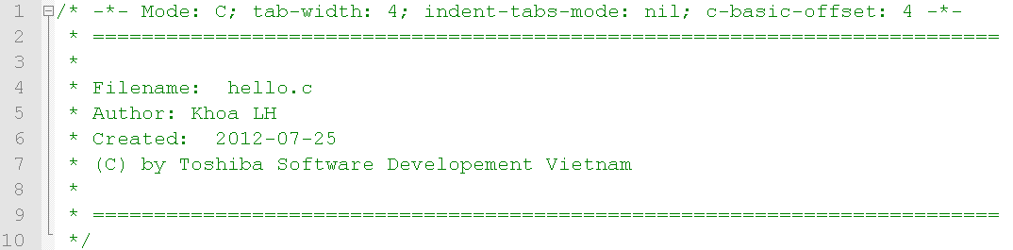
Appendix 1 – Header comment for all files

Slide 38
Appendix 2 – How to start coding phase
Step 1: Discussion to make coding rules for your team
  1. You need to use space (replace 1 tab = 4 space)
  2. You need to use prefix g_ for global variable
  3. You need to use underscore case for word boundary (get_name)
Step 2: Make review checklist base on coding rules. For example:
  1. Did you replace tab by space?
  2. Did you use prefix g_ for all global variable?
  3. Did you use underscore for word boundary in case of compound word?
Step 3: Make source code layout & build procedure
Step 4: Discuss about using subversion, commit rules, log content. For example:
  Before commit, all member need to check compile without error
  Commit log write detail of modification & should not combine many modification at the same time
Step 5: Make clear PR plan in coding phase

Slide 39
Appendix 3 – Sample of naming rules for C programming
Using abbreviation for compound word(get_name, set_win). It is better to make abbreviation list in your team.
Using underscore case to separate words in compound word identifier (get_name, g_func, etc)
Some Hungarian notation are recommended to use:
  Global variable: g_name,
  Pointer: p_name, pp_name
In case of project has many modules, it is better to define prefix for each module. This prefix should be applied for global variable & global function.
Identifier should reflect its meaning as much as possible
Using doxygen comment is recommend

Slide 40
Appendix 4 – Sample of naming style for OOP language
Use abbreviation is restriction. Full name is recommend
Camel case (upper camel case & lower camel case) is used:
  Upper camel case (Pascal case): GetName, GetWindow
  Lower camel case: getName, getWindow
Identifier should reflect its meaning as much as possible
Class name:
  Use a noun or noun phrase to name a class
  Use Pascal case
  Use abbreviations sparingly
Member of class
  Method: use Pascal case, using verb or verb phase
  Attribute: use prefix m_; Pascal case
  Local variable: Lower camel case
Using doxygen comment is recommend

Slide 41
Revision History
Version | Date | Description | Author | Reviewer | Approver
1.00 | 2013-10-21 | First official release of document | KhoaLH | TrungDV | TrungDV
1.01 | 2014-06-12 | Remove Makefile section | KhoaLH
1.02 | 2014-06-13 | Add some discussion questions (List, pointer to pointer,etc). About explanation of rules, refer to “C_Guide_all_en.pdf” then exercise. | HungTH | TrungDV | TrungDV

Slide 42


