Slide 1
Executive Summary
Adult Census Income Prediction Project
Prepared by: Nicholas Butler

Slide 2
Project Goals
- Predict likelihood of earning > $50,000
- Identify the strongest socioeconomic drivers of income
- Support equity-focused workforce and education policy

Slide 3
Dataset Overview
- 48,842 cleaned rows used for analysis and modeling
- 15 raw features expanded into encoded and engineered sets
- Demographic, educational, occupational, and financial variables
- Provides a robust foundation for socioeconomic insight

Slide 4
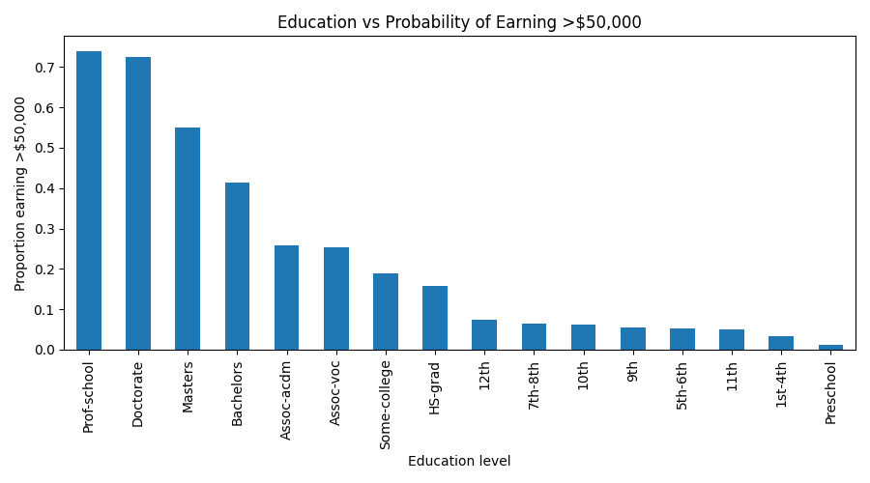
Higher Education Greatly Increases Probability of Earning > $50,000

Slide 5
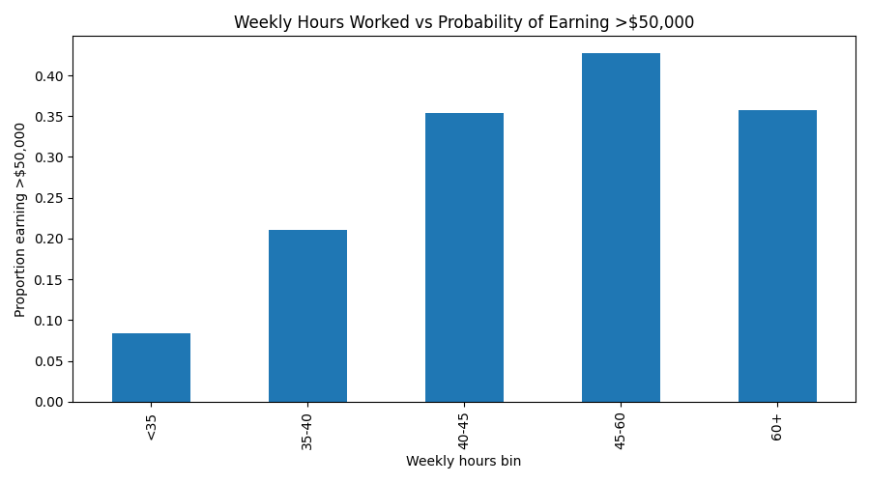
Longer Work Hours Strongly Increase the Probability of High Income

Slide 6
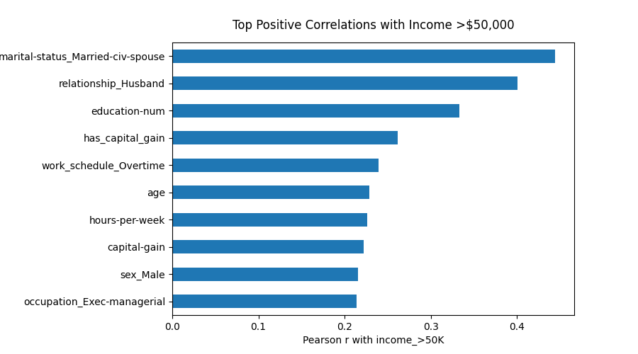
Marriage, Education, and Capital Gains Are the Strongest Positive Predictors

Slide 7
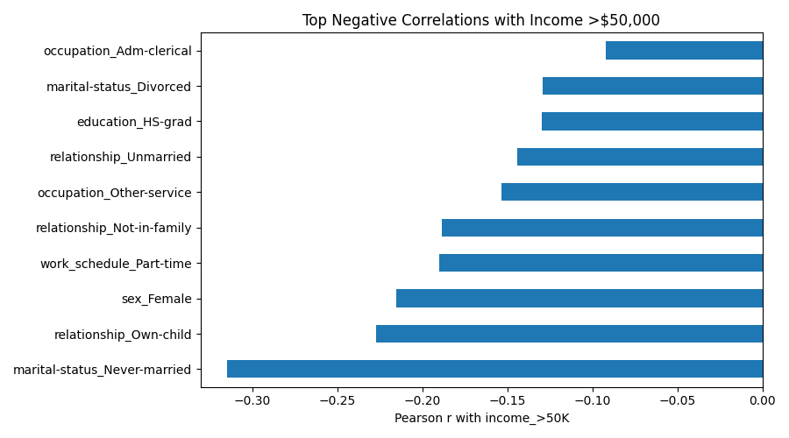
Never-Married Status, Own-Child Role, Female Indicator, and Part-Time Work Reduce Income Odds

Slide 8
Model Setup
- XGBoost and LightGBM used as core models
- Hyperparameters tuned using Optuna search
- 8 binning configurations evaluated systematically
- Stratified train/test splits to maintain class balance

Slide 9
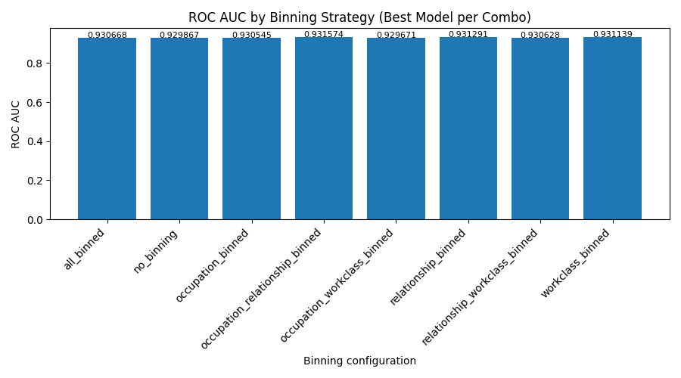
Binned XGBoost Configuration Achieves Highest ROC AUC (~0.932)

Slide 10
Rapid Policy Change Variables
- Work schedule and hours regulations
- Expanded access to training and education programs
- Targeted occupation and job classification levers
- Incentives that encourage stable full-time employment

Slide 11
Slow Policy Change Variables
- Household structure and family pattern evolution
- Long-term workforce development and reskilling cycles
- Capital gains and tax policy reforms over time
- Macro-level shifts in labor markets and industries

Slide 12
Immutable Variables
- Sex
- Race
- Age
- Native country of birth

Slide 13
Equity Improvement Strategies
- Expand pathways into higher education and advanced credentials
- Provide childcare and flexible scheduling support for caregivers
- Increase equitable access to stable full-time employment opportunities
- Assist workers transitioning into higher-mobility occupations and sectors

Slide 14
Future Research and Next Steps
- Develop fairness-aware models to diagnose and mitigate bias
- Run counterfactual simulations for key policy interventions
- Track income mobility through longitudinal data integration
- Use scenario modeling to stress-test workforce policy options

