Slide 1
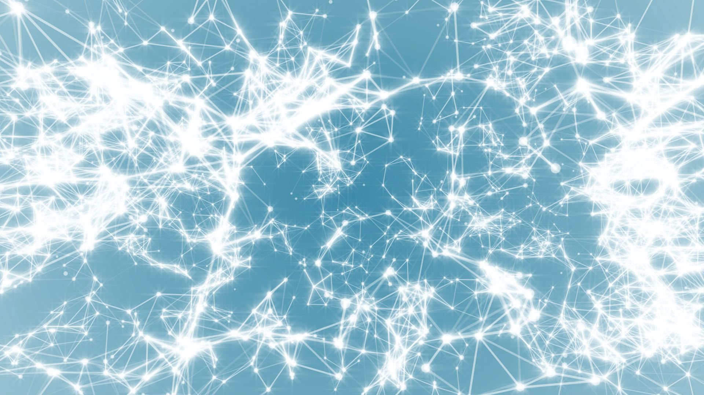
Network Science
Class 2: Graph Theory (Ch2)
Albert-László Barabási
with
Emma K. Towlson and Sean P. Cornelius
www.BarabasiLab.com
Notes:
We all have our theories of the origin of this mess. And we may also differ in the way we would like to see the solutions. But we all agree on one thing– it is the incerconnectedness of the system that is at the heart to wash away the problem with a single instruction.

Slide 2
Questions
1: The Bridges of Konisberg and mapping/defining a network.
2: Degree, degree distribution.
3: Adjacency Matrices and Sparseness.
4: Paths and distances and connectedness
5: WWW: Tell us about its characteristics relying on the
concepts we learned in Chapter 2 (synthesis).
6: Bipartite Networks/Clustering coefficient
7. Weighted networks/ Value of a network
8: Directed vs. undirected networks (synthesis).

Slide 3
Next Class Reading
For Wednesday:
Read:
Ch3
Watts and Strogatz
Milgram.

