Slide 1
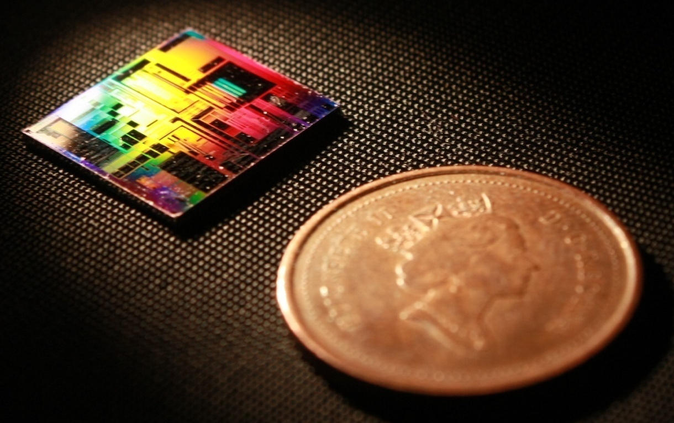
Optimizing The Contra-Directional Couplers Models March, 2019
Mustafa Hammood,
The University of British Columbia

Slide 2
Approaches
Full-length 3D FDTD Simulation
Slowest: Time and resources consuming, high risk of divergence
Accurate simulation, if your simulation converges…
EME Propagation Simulation
Fast (er?)
Difficult to simulate non-uniform grating profiles (not impossible)
Difficult to simulate unconventional perturbations (i.e. sinusoidal)
Accurate within contra-coupling wavelengths
Analytical: Coupled-mode Theory + Transfer Matrix Method
Fastest
Most accurate, can model every profile, and every band (self+contra)
Requires prior knowledge of device parameters:
Waveguides system modes
Coupling coefficients / Kappa

Slide 3
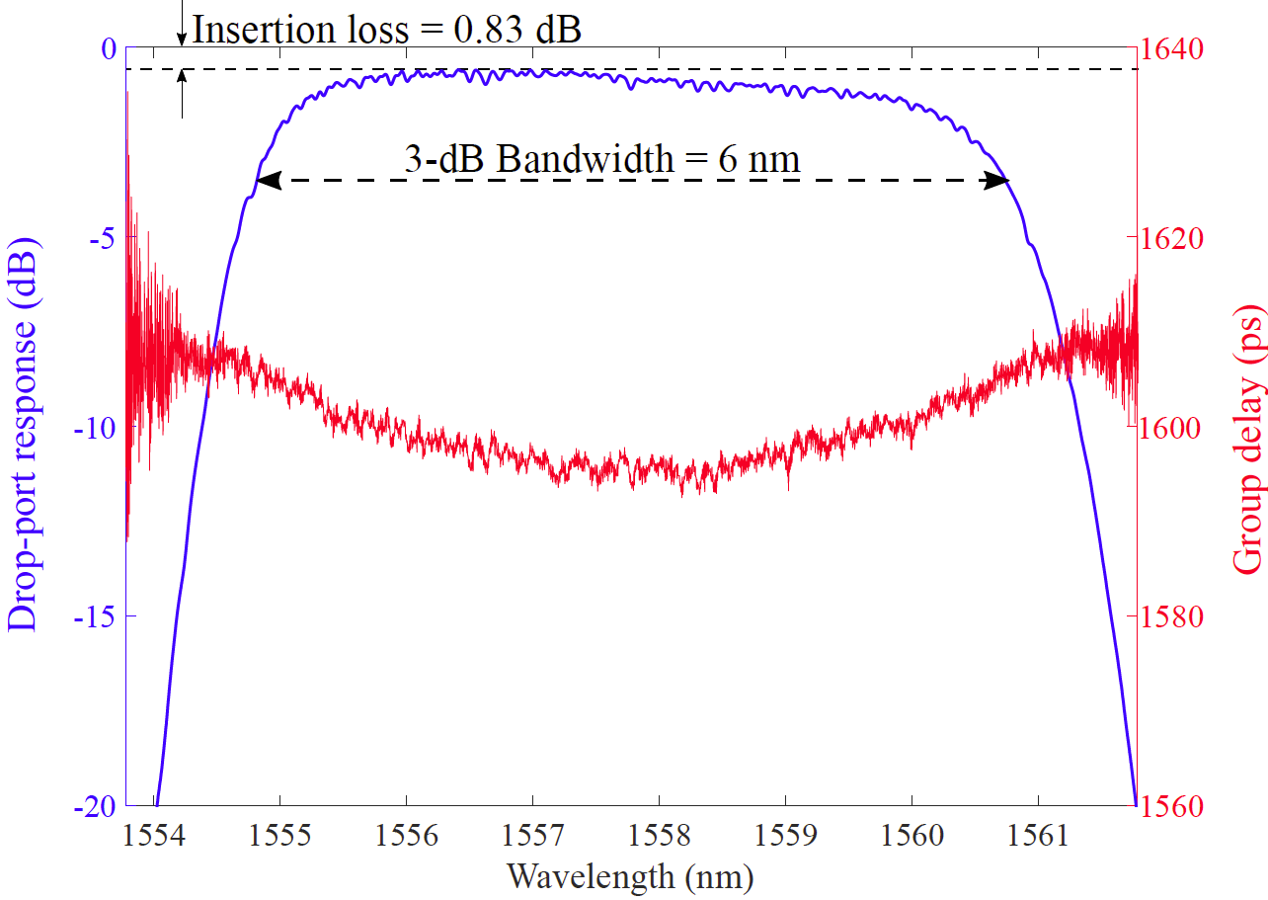
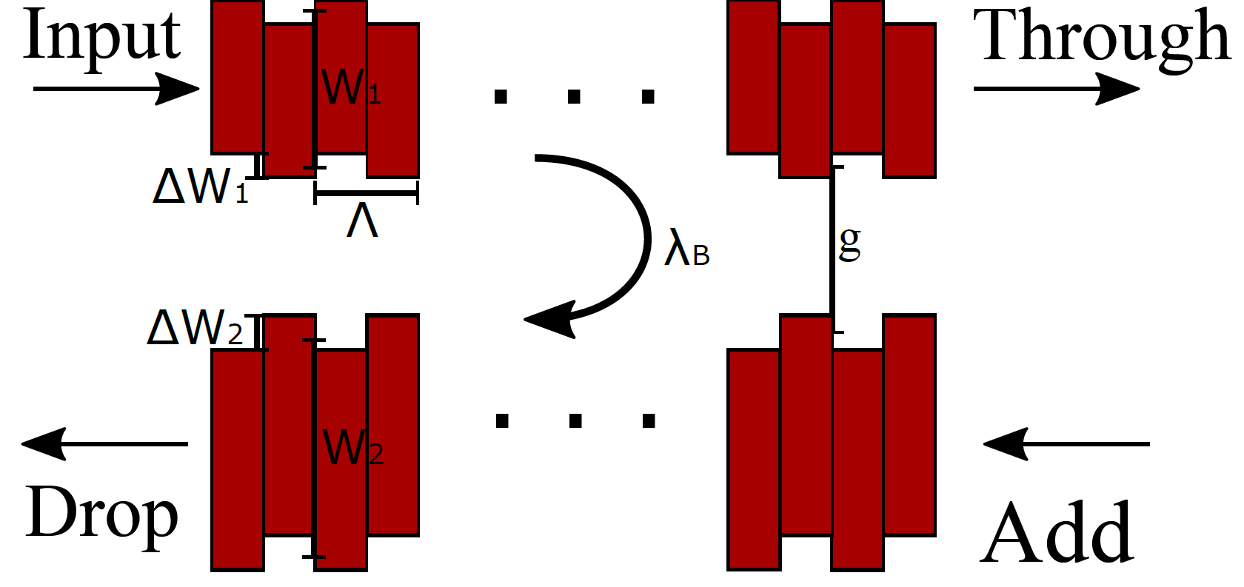
Coupling Coefficient / Kappa
Dependent on the waveguides geometry and structure of the perturbation gratings (strength/shape)
Determines the bandwidth and reflectivity of the device
The key parameter that sets coupled-mode theory model to work.

Slide 4
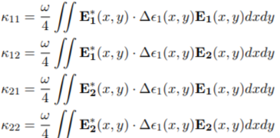

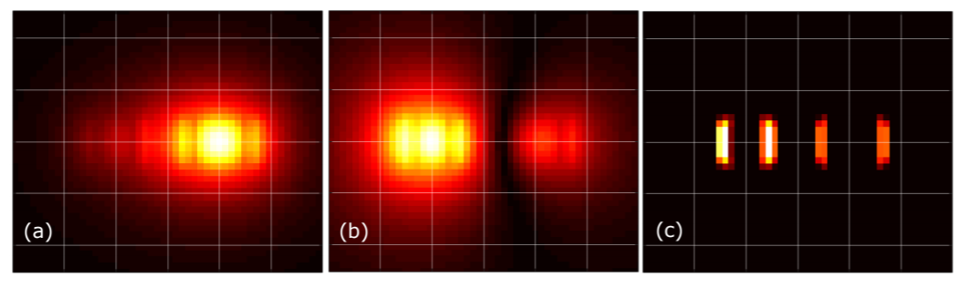
How to find Kappa? Analytically
Can be modelled analytically using:
Accurate for small perturbations
Easily implemented for simple
perturbations
Difficult to find the Fourier-expansion term (Δε) for unconventional perturbations shapes (ex: sinusoidal or litho. smoothed corrugations)
(a) (c) (b)

Slide 5

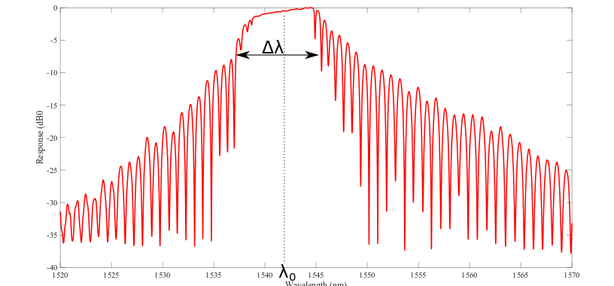
How to find Kappa? Experimentally, extracted from a response
Can be extracted from a device response/modelled experimentally using:
Given any device response (either experimental/simulation) we can find Kappa, assuming a waveguide system (to find ng).
Several means to extract from experimental data:
FWMM Method (Robi 2017)*
Nulls method*
* Not always applicable

Slide 6
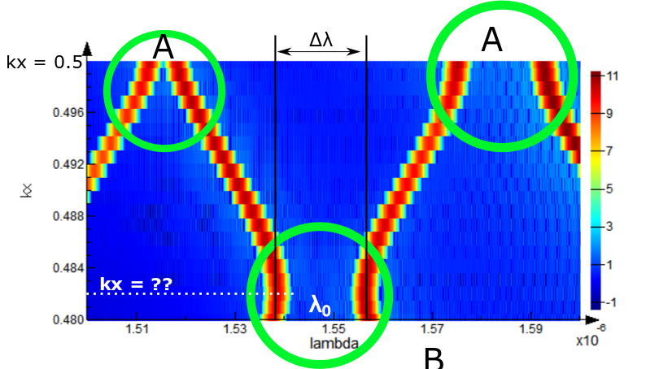
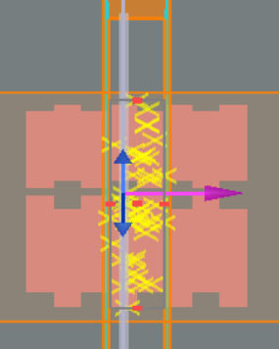
How to find Kappa? Simulation using Bloch boundary band-structure
Using an infinite length, Bloch boundary band-structure simulation, we can calculate the bandwidth and wavelength of the system’s forbidden bands
Self-Bragg bands at Kx = 0.5 – labelled (A)
Contra bands at unknown Kx – labelled (B)
Uncertainty of contra wavevector (Kx) means we have to sweep a large range to find where the contra-coupling forbidden band occurs. This is time and resource consuming. Below plot is generated from 20 points

Slide 7
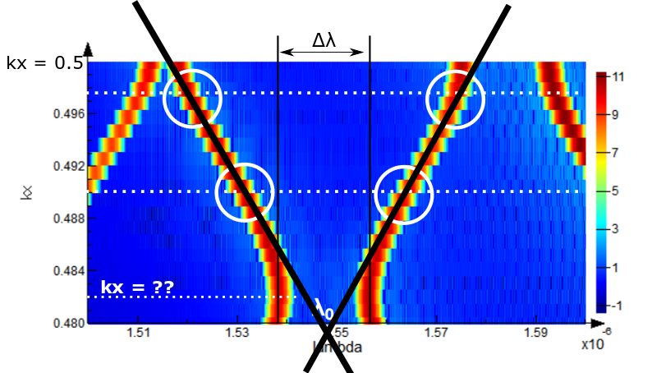
How to find Kappa? Simulation using Bloch boundary band-structure
Can we do better, simulation time and resources wise? Interpolate the system’s forbidden bands?
Can 2 simulations at two wave-vectors to predict the location of the contra-bandgap?
Test case:
 | Kx | Bandwidth (nm)
Actual | 0.4796 | 5.32
Predicted | 0.4794 | 5.88
Error <10%

Slide 8
What’s new?
Fully automated flow in Python – no need for a MATLAB engine for coupled-mode theory or the setup of any 3rd party tools (other than Lumerical)
Generates an S-parameter file (.dat) for circuit simulations
Dual polarizations: TE-TM, compact model includes two-modes support
Two new approaches to find the bandgap and Kappa – reduce FDTD simulation time from more than 5 hours to an improved, to less than a minutes. This was the simulation flow bottleneck.
Accurately predicts and simulates the waveguide’s self-reflection
Higher level of abstraction

Slide 9
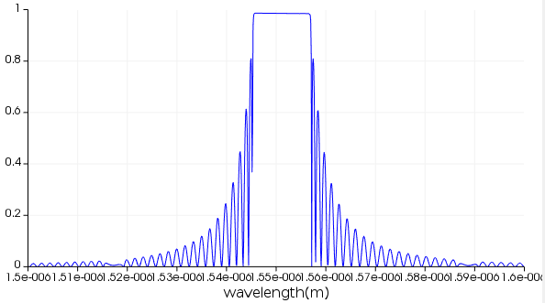
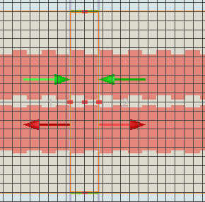
How to find Kappa? Even faster? MODE EME Simulation
Simulate a single periodic contra-DC cell in EME
Generate the uniform profile response
Extract kappa from the response using the nulls method
Feed the kappa into coupled-mode theory, transfer matrix apodized model

Slide 10
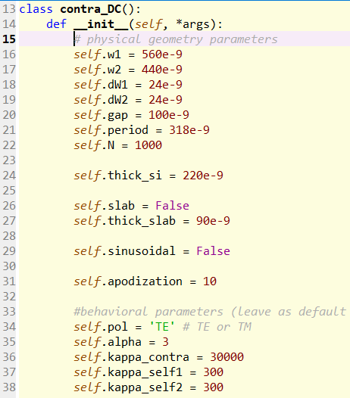
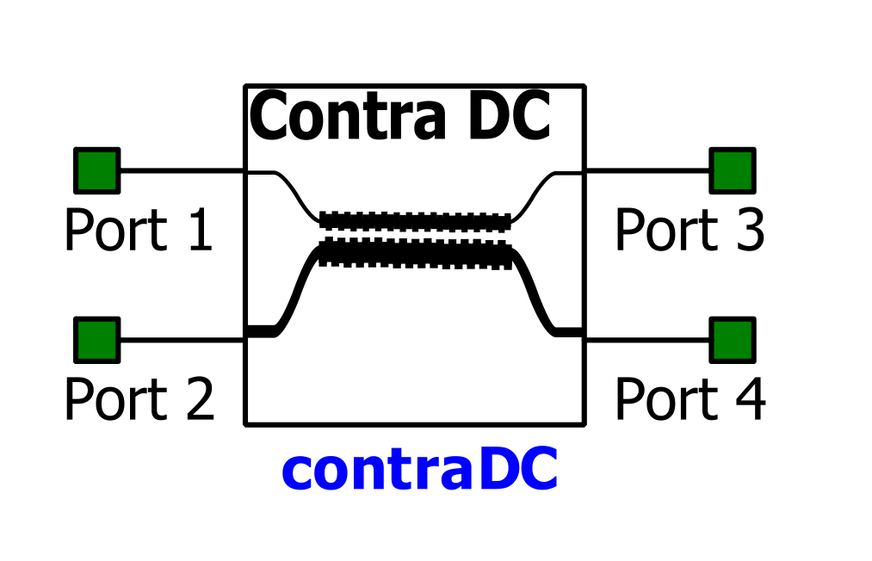
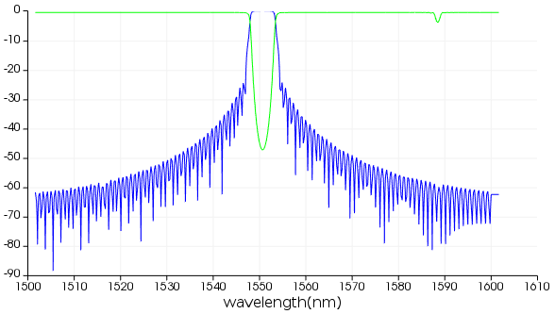
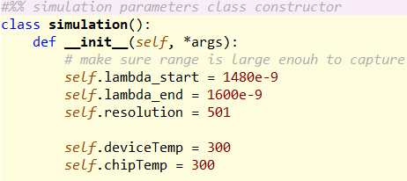
How to? Define physical parameters and simulation parameters
Feed in the design parameters
Let the script run!
Optional

Slide 11
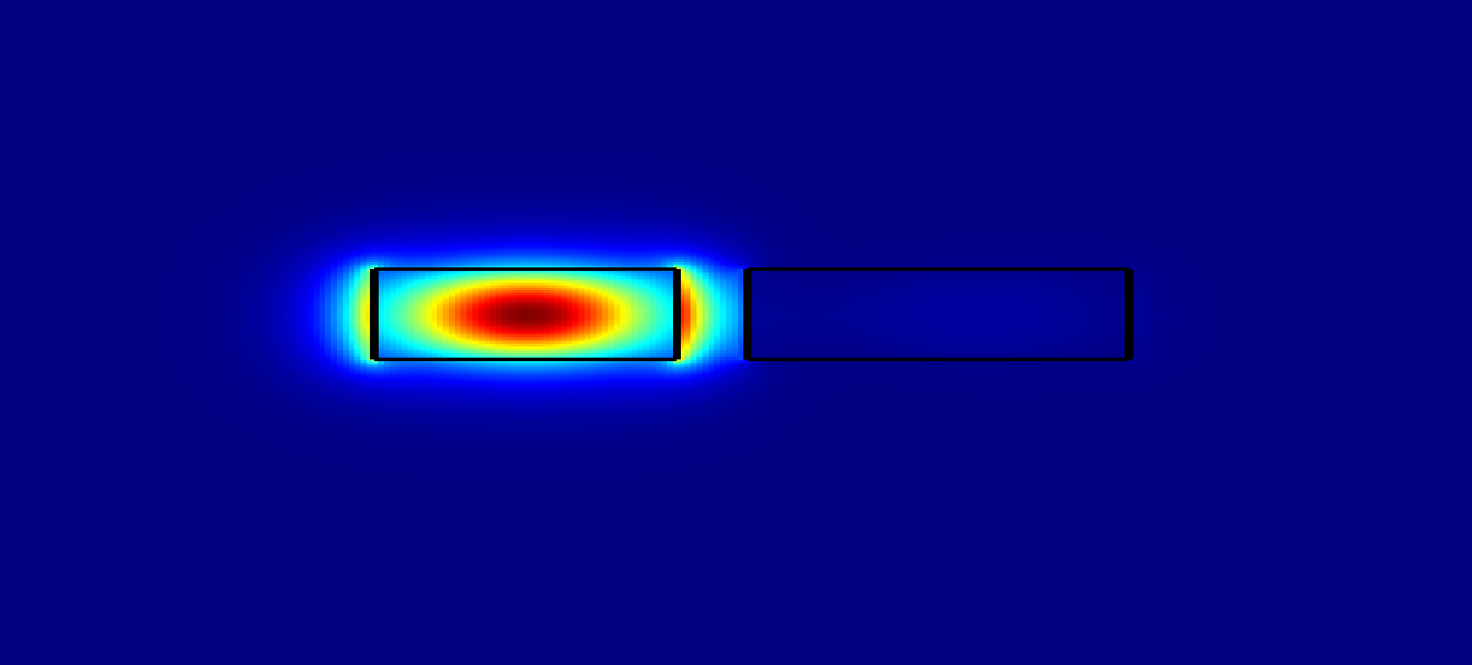
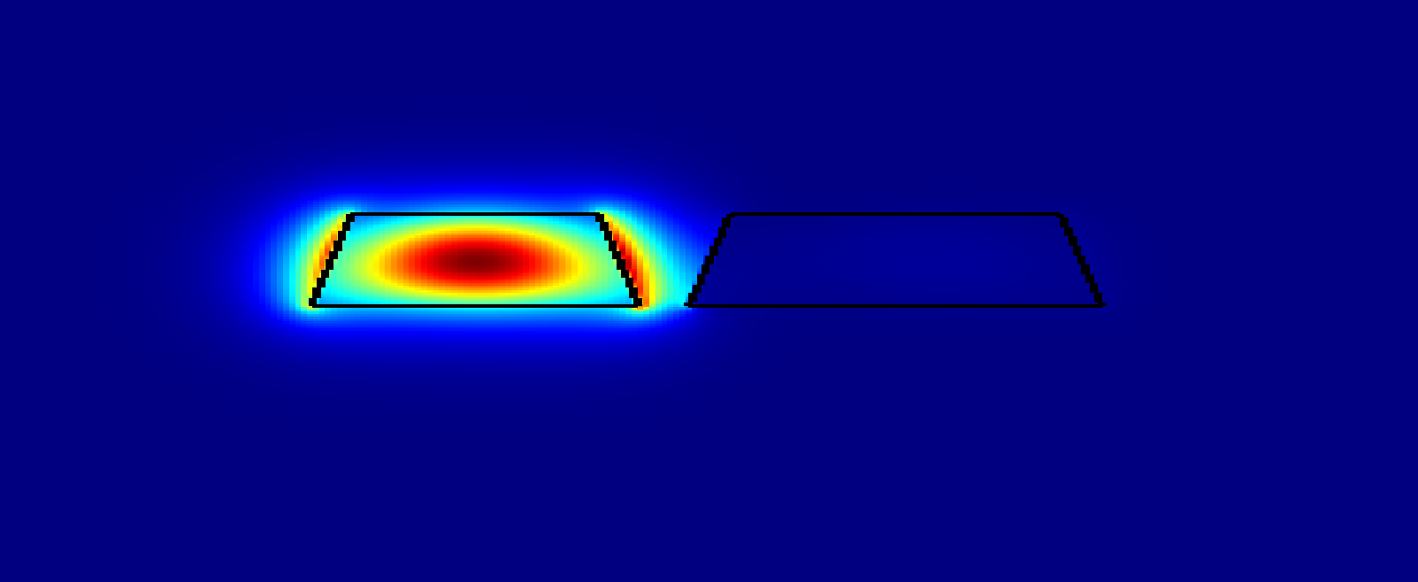
Further improvements can be done on…
Parameterized sidewall angle
Model sensitivity to process variations and corner analysis
Conclusion: bandwidth is somewhat stable, central wavelength not quite.
Segmented kappa: Wavelength-dependent coupling coefficient
𝛿(λ0)/ 𝛿(θ) = 0.63 nm/degree
𝛿(λ0)/ 𝛿(H) = 0.7 nm/nm

Slide 12
Contributors
Wei Shi
Mustafa Hammood
Jonathan St-Yves
Simon Belanger
Dominique Charron
Han Yun
Xu Wang
Ajay Mistry
Stephen Lin

