Slide 1
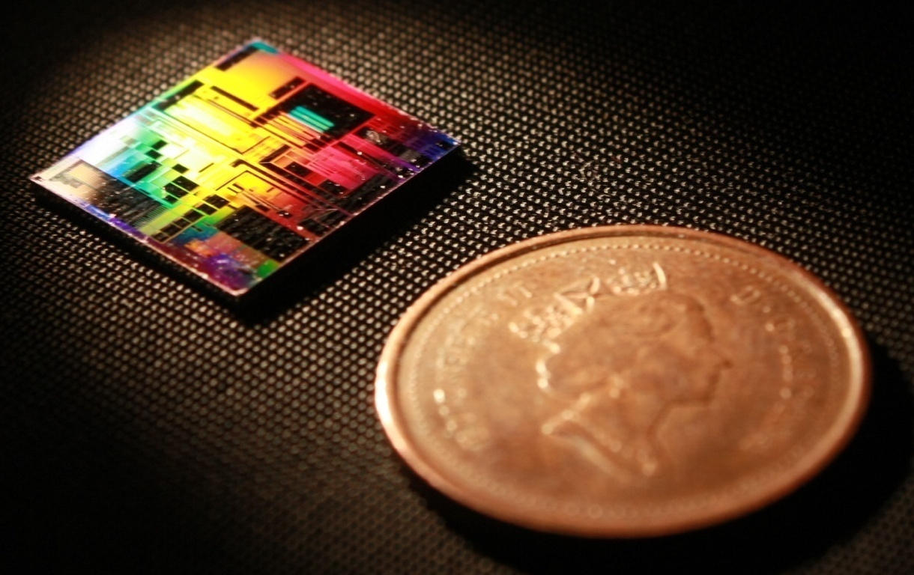
Modelling Contra-Directional Couplers March, 2019
Mustafa Hammood, Ajay Mistry, Stephen Lin
The University of British Columbia

Slide 2
Approaches
Full-length 3D FDTD Simulation
Slowest: Time and resources consuming, high risk of divergence
Accurate simulation, if your simulation converges…
EME Propagation Simulation
Fast (er?)
Difficult to simulate non-uniform grating profiles (not impossible)
Difficult to simulate unconventional perturbations (i.e. sinusoidal)
Accurate within contra-coupling wavelengths
Analytical: Coupled-mode Theory + Transfer Matrix Method
Fastest
Most accurate, can model every profile, and every band (self+contra)
Requires prior knowledge of device parameters:
Waveguides system modes
Coupling coefficients / Kappa

Slide 3
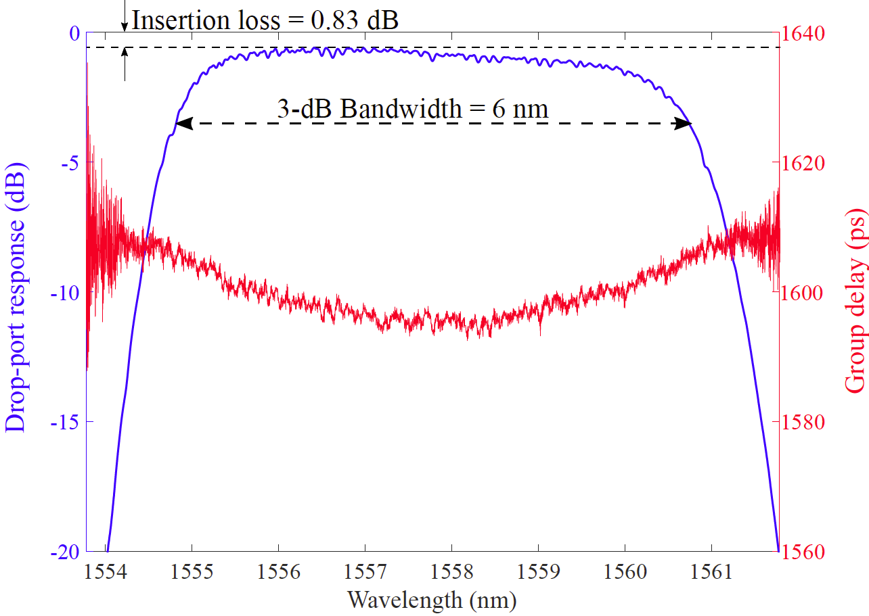
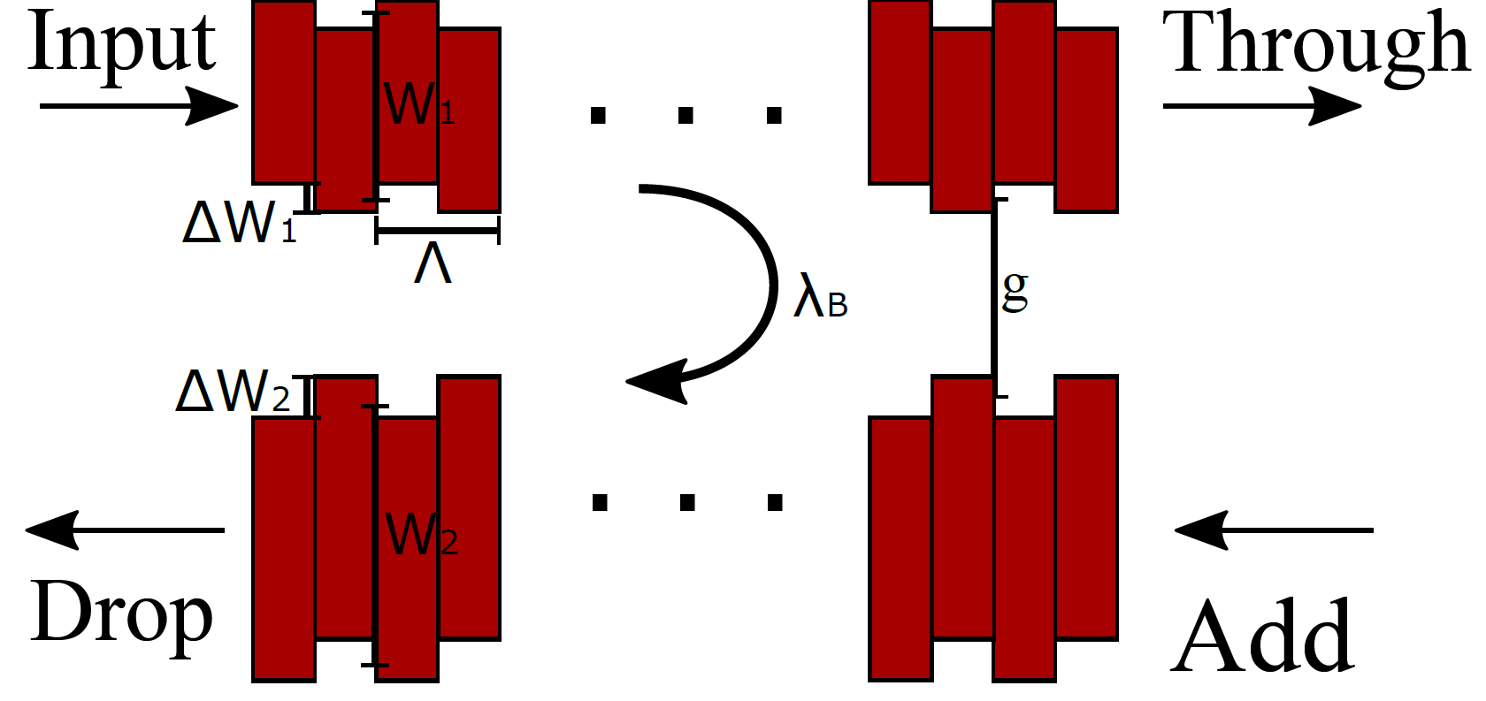
Coupling Coefficient / Kappa
Dependent on the waveguides geometry and structure of the perturbation gratings (strength/shape)
Determines the bandwidth and reflectivity of the device
The key parameter that sets coupled-mode theory model to work.

Slide 4
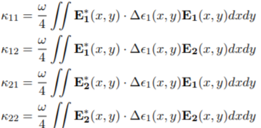

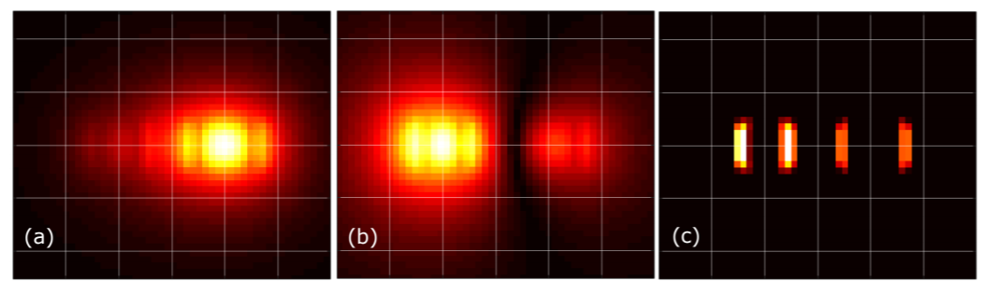
How to find Kappa? Analytically
Can be modelled analytically using:
Accurate for small perturbations
Easily implemented for simple
perturbations
Difficult to find the Fourier-expansion term (Δε) for unconventional perturbations shapes (ex: sinusoidal or litho. smoothed corrugations)
(a) (c) (b)

Slide 5

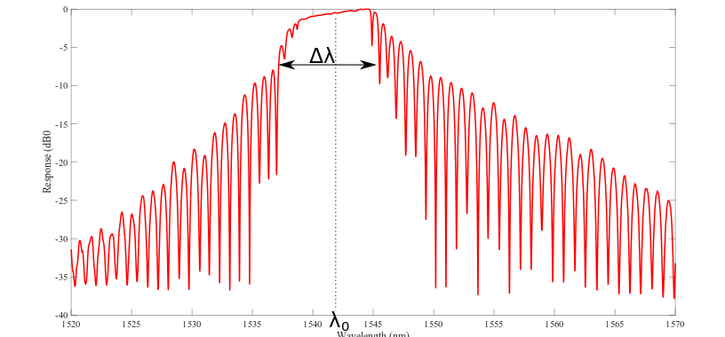
How to find Kappa? Experimentally, extracted from a response
Can be extracted from a device response/modelled experimentally using:
Given any device response (either experimental/simulation) we can find Kappa, assuming a waveguide system (to find ng).
Several means to extract from experimental data:
FWMM Method (Robi 2017)*
Nulls method*
* Not always applicable

Slide 6
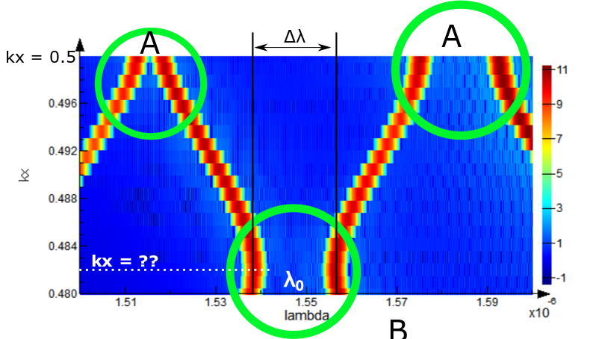
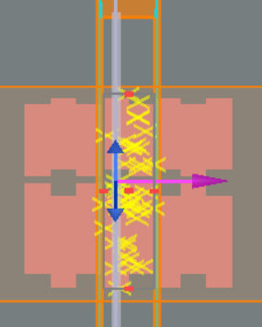
How to find Kappa? Simulation using Bloch boundary band-structure
Using an infinite length, Bloch boundary band-structure simulation, we can calculate the bandwidth and wavelength of the system’s forbidden bands
Self-Bragg bands at Kx = 0.5 – labelled (A)
Contra bands at unknown Kx – labelled (B)
Uncertainty of contra wavevector (Kx) means we have to sweep a large range to find where the contra-coupling forbidden band occurs. This is time and resource consuming.

Slide 7
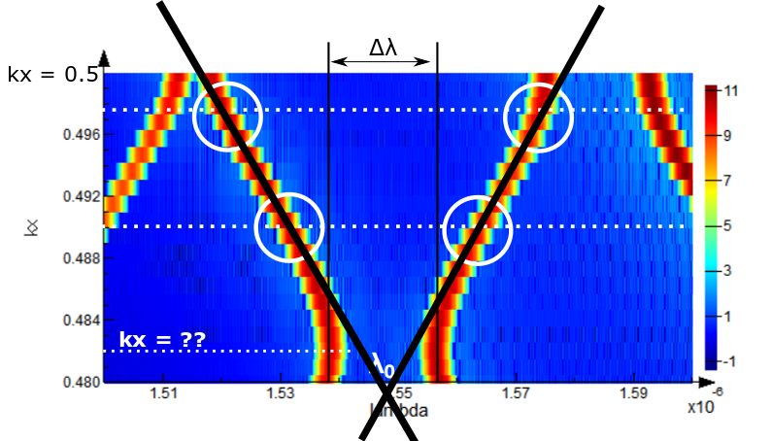
How to find Kappa? Simulation using Bloch boundary band-structure
Can we do better, simulation time and resources wise? Interpolate the system’s forbidden bands?
Can 2 simulations at two wave-vectors to predict the location of the contra-bandgap?
Test case:
 | Kx | Bandwidth (nm)
Actual | 0.4796 | 5.32
Predicted | 0.4795 | 5.36
Error 0.75%!

Slide 8
What’s new?
Fully automated flow in Python – no need for a MATLAB engine for coupled-mode theory or the setup of any 3rd party tools (other than Lumerical)
Dual polarizations: TE-TM
New approach to find the bandgap and Kappa – reduce FDTD simulation time from more than 5 hours to an improved, less than 30 minutes
Accurately predicts and simulates the waveguide’s self-reflection
Generates an S-parameter file (.dat) for circuit simulations
Higher level of abstraction

Slide 9
Next to come…
Parameterized sidewall angle
Model sensitivity to process variations and corner analysis
Conclusion: bandwidth is somewhat stable, central wavelength not quite.

Slide 10
Contributors
Wei Shi
Jonathan St-Yves
Simon Belanger
Dominique Charron
Han Yun
Xu Wang
Mustafa Hammood
Ajay Mistry
Stephen Lin

