Slide 1
2019.02.11
Level DB 진행
Key-Value Store and KVSSD
Ho Cheol Nam
nhc616@gmail.com
Dankook Univ
Department of Software
32151446

Slide 2
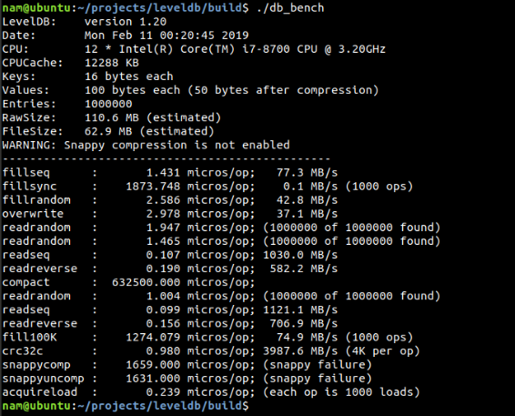
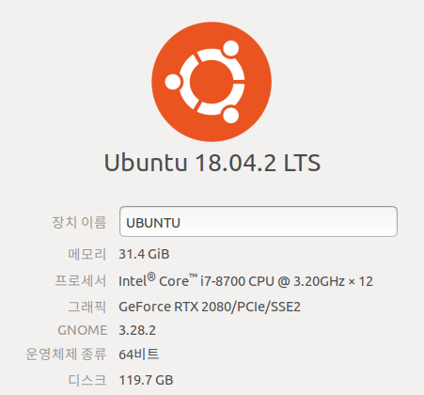
PROCESS
LevelDB ReInstall
Key-Value Store and KVSSD.
01

Slide 3
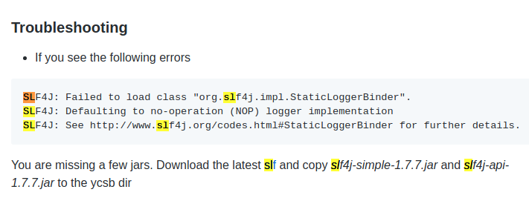
PROCESS
YCSB Install
Key-Value Store and KVSSD.
02

Slide 4
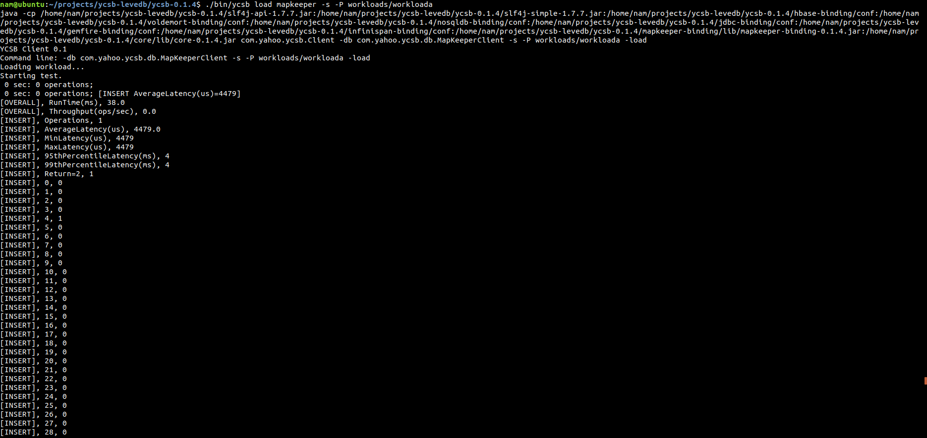
PROCESS
YCSB Install
Key-Value Store and KVSSD.
02

Slide 5
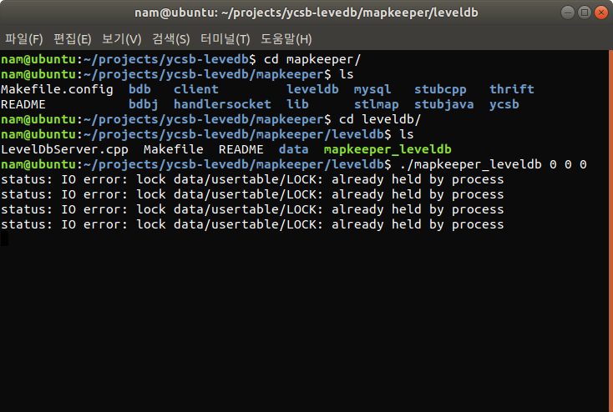
PROCESS
YCSB Install
Key-Value Store and KVSSD.
02

