Slide 1
Lottery Scheduling: Flexible Proportional-Share Resource Management
Carl A. Waldspurger William E. Weihl
MIT Laboratory for Computer Science, USENIX, 2007
2019. 10. 08
Presentation by Shin, Hojin
ghwls03s@gmail.com

Slide 2
Scheduler
Problem
Lottery Scheduling with Evaluation
Conclusions

Slide 3

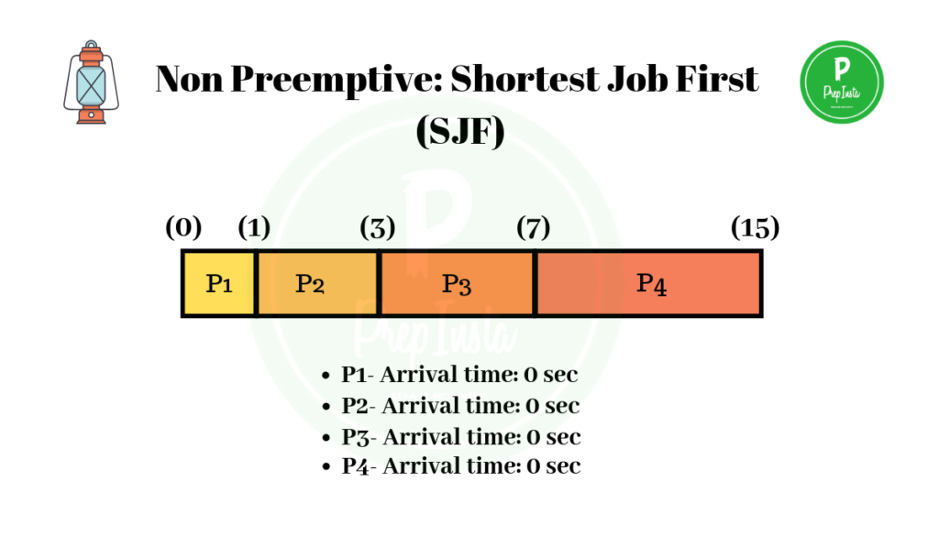
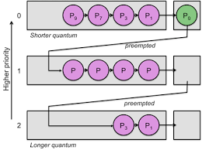


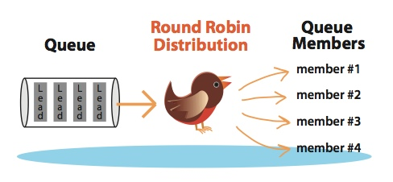
1. Scheduler

Slide 4
2. Problem
Multiplexing -> Affect on throughput, response time
Encapsulation, Modularization Properties X -> Simple notion of priority
Interactive System -> Rapid, Dynamic control over Scheduling

Slide 5
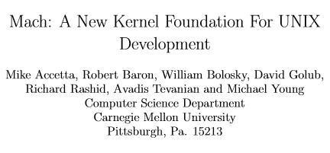
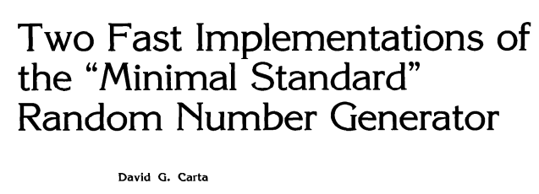

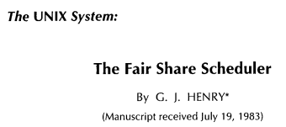
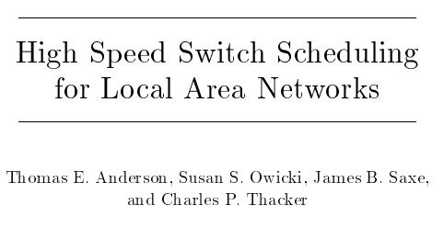
2. Problem

Slide 6
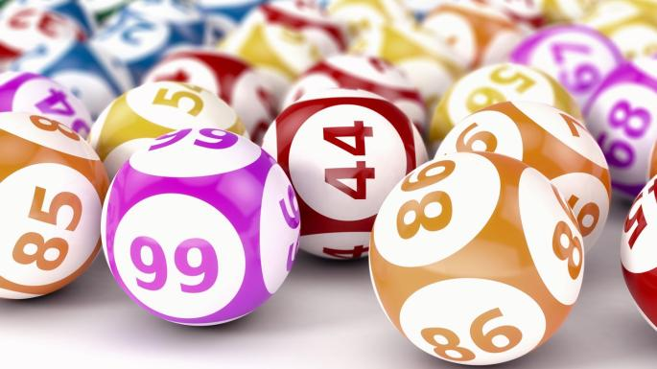
3. Lottery Scheduling
A novel randomized mechanism
Provides responsive control over the relative execution rates
Proportional-Share resource management

Slide 7
3. Lottery Scheduling
Tickets
Lotteries
Ticket Transfers
Ticket Inflation
Ticket Currencies

Slide 8

3. Lottery Scheduling - Ticket
Distribution of resources = proportional to the # of tickets
Avg. response time = inversely proportional of the # of tickets
The # of tickets != 0 Avoid Starvation state

Slide 9
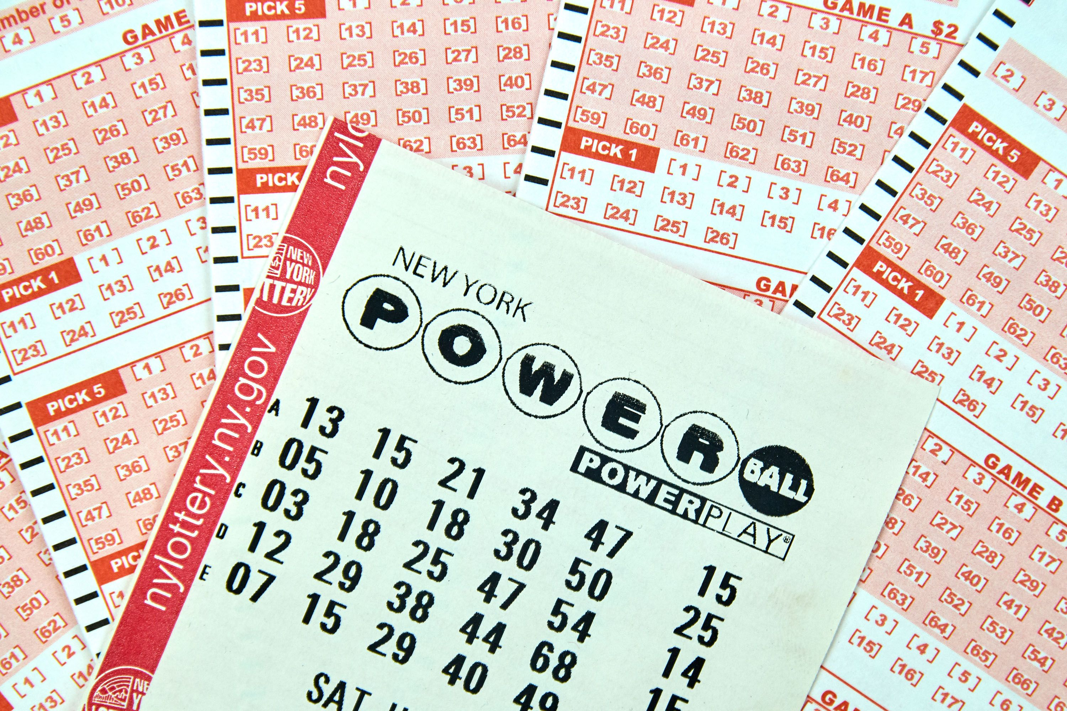
3. Lottery Scheduling - Lotteries
Priority is determined by the # of tickets each thread has
Schedular wins Random tickets
Probabilistically fair
Throughput is proportional to # of tickets
Latency is inversely proportional to # of tickets

Slide 10
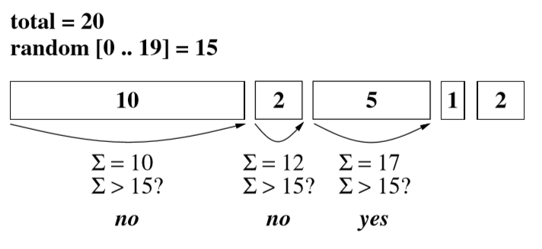
3. Lottery Scheduling - Lotteries
Requires a fast way to generate uniformly distributed random numbers -> O(n)
A running ticket sum is accumulated until the winning ticket value is reached
Sort threads by # of tickets -> improves avg search time
Create tree of partial ticket sum -> O(logn)

Slide 11
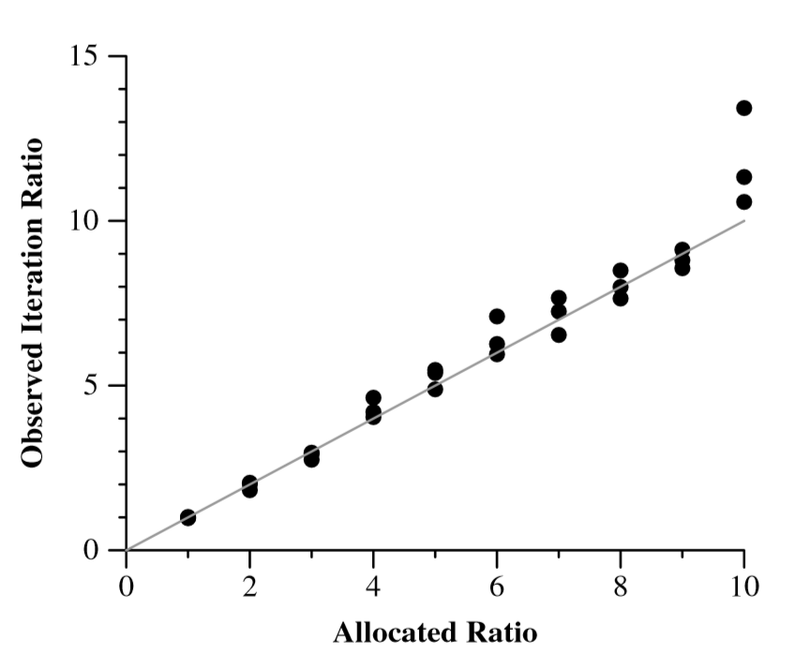
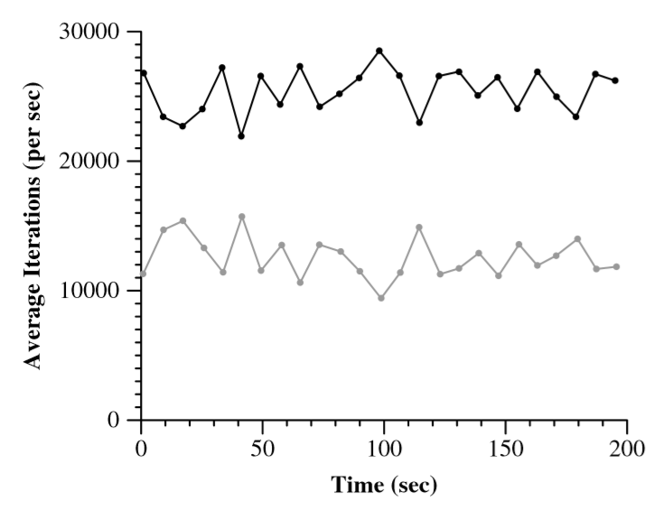
3. Lottery Scheduling - Lotteries
<Relative Rate Accuracy>
<Fairness Over Time>

Slide 12
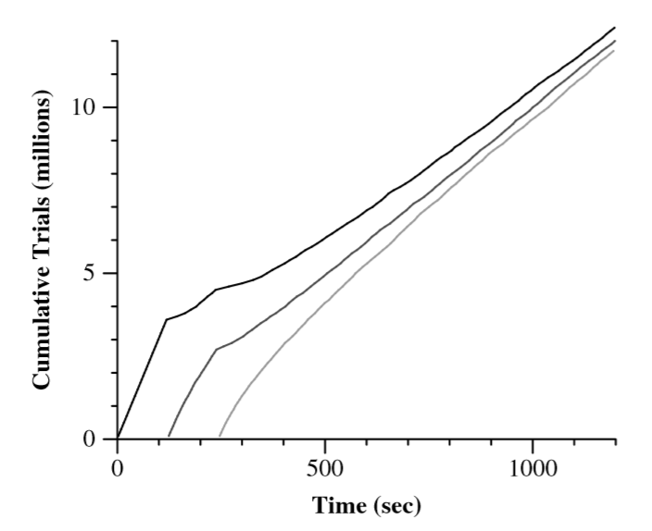

3. Lottery Scheduling - Lotteries
<Monte-Carlo Execution Rates>

Slide 13
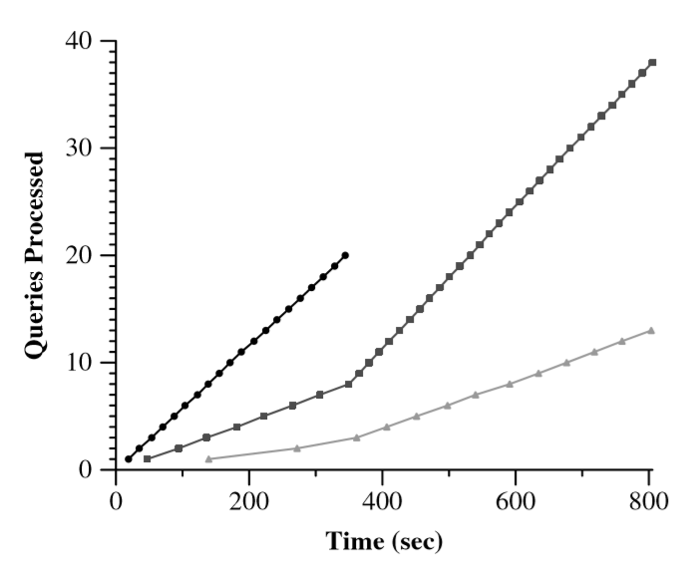
3. Lottery Scheduling – Ticket Transfer
Explicitly transfer tickets to another task
Useful when a task blocks
Solves priority inversion
<Query Processing Rates>

Slide 14

3. Lottery Scheduling – Ticket Inflation
Alternative to explicit transfers
A client can escalate its resource rights by creating more lottery tickets
But, single client could easily monopolize a resource
Inﬂation and Deﬂation can be used to adjust resource allocations without explicit communication.

Slide 15
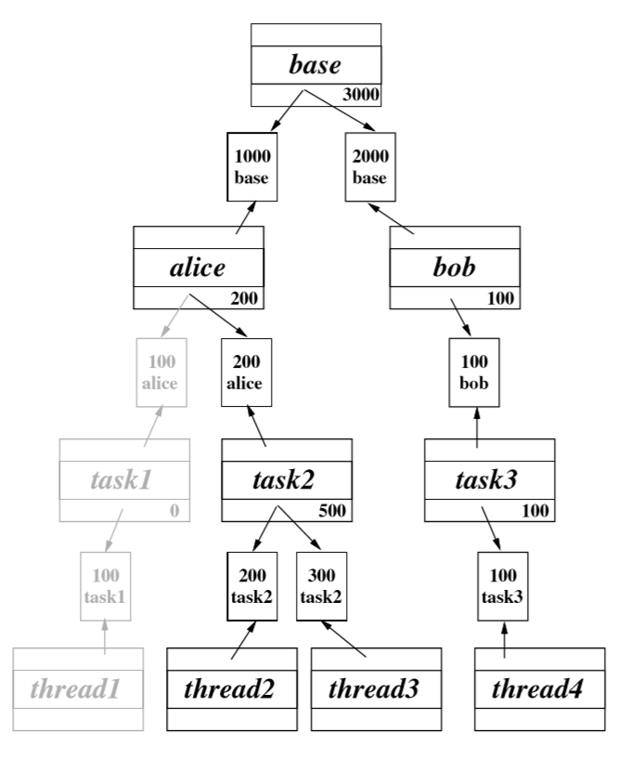
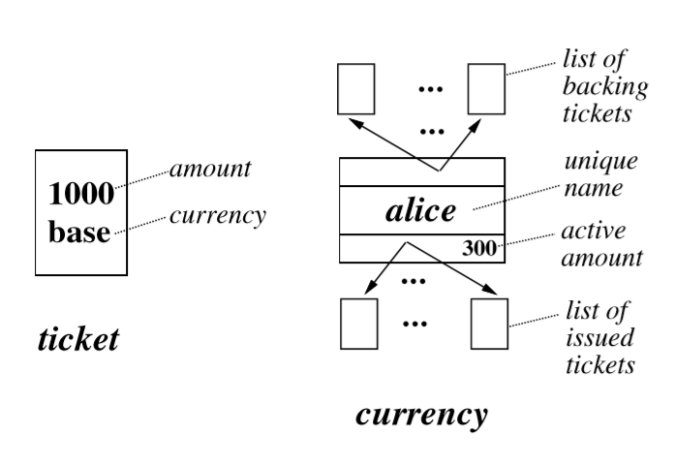
3. Lottery Scheduling – Ticket Currencies
Currencies create logical task groups
Funded by tickets in base currency
When thread removed from run queue -> deactivated
When thread rejoin run queue -> reactivated
<Example Currency Graph>

Slide 16
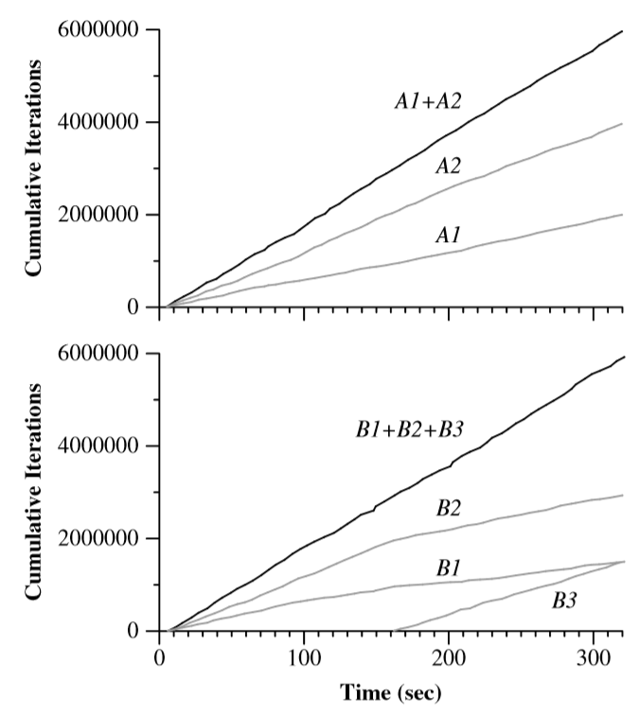


3. Lottery Scheduling – Ticket Currencies
<Currencies Insulate Loads>

Slide 17
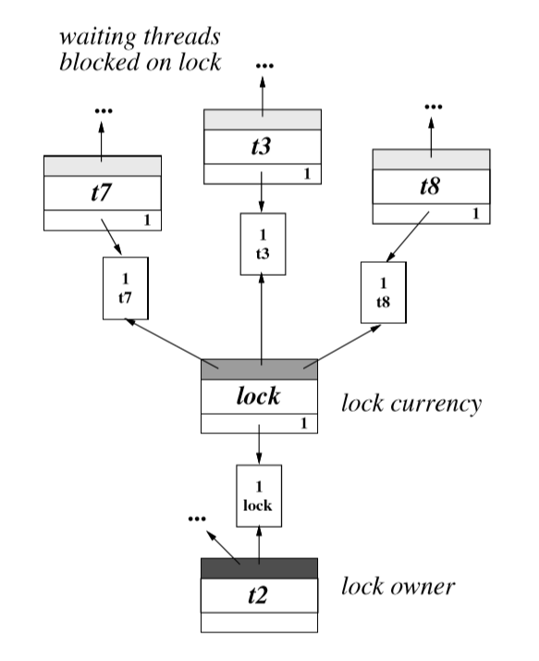
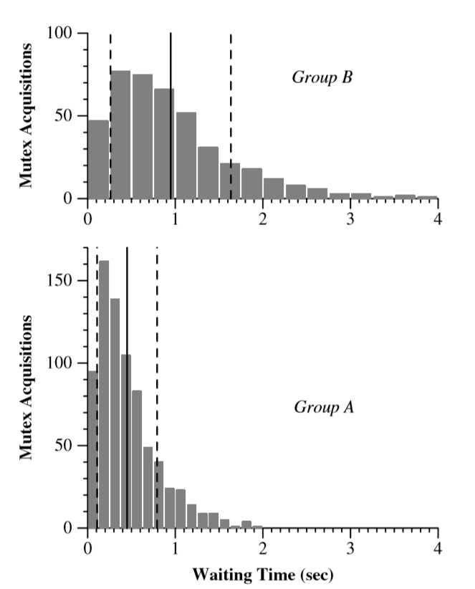
3. Lottery Scheduling – Others
<Lock Funding>
<Mutex Waiting Times>

Slide 18
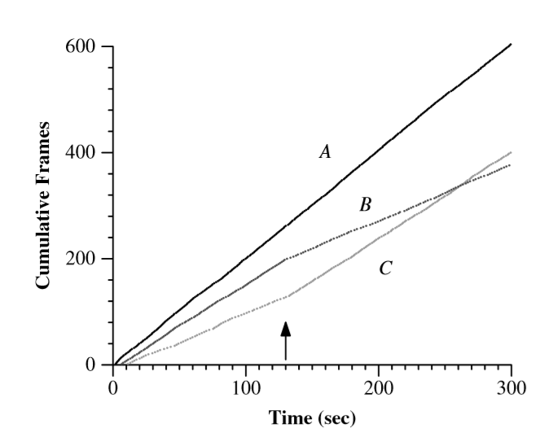
3. Lottery Scheduling – Others
<Controlling Video Rates>

Slide 19

4. Conclusion
Randomized Proportional-Share Scheduling
Fair, Flexible, Simple to Implement, Dynamic Priorities
Overhead comparable to standard Mach time-sharing policy
Added to existing operating systems -> improved control over resource consumption rates

Slide 20
Lottery Scheduling: Flexible Proportional-Share Resource Management
Carl A. Waldspurger William E. Weihl
MIT Laboratory for Computer Science, USENIX, 2007
Thank You!
2019. 10. 08
Presentation by Shin, Hojin
ghwls03s@gmail.com
Notes:
Let me begin my presentation.
Today I will give a presentation on “Fully Automatic Stream Management for Multi-Streamed SSDs Using Program Contexts”

