Slide 1

D-Tux : Dankook Univ.
DeepLearning Zero to All - 1
소프트웨어학과 15학번 신호진
2019.07.01

Slide 2

CONTENTS
Part_1
What is Machine Learning
Supervised Learning
Unsupervised Learning
Part_2
Linear Regression
Theory
Practice – source code
Part_3
Minimize cost
Theory & Gradient descent algorithm
Practice – source doe
Part_4
Make an application – amaze & 한붓그리기

Slide 3
Part 1.
What is Machine Learning

Slide 4
D-Tux : Dankook Univ.
What is DeepLearning
Motives for Deep Learning Developed
Limitation of explicit programming
Spam filter : many rules
Automatic driving : too many rules
Do Machine Learning
Kind of Machine Learning
Supervised Learning -> 지도 학습
Unsupervised Learning -> 비지도 학습
Google news grouping
Word clustering
Image Labeling
Email Spam filter
Predicting exam score

Slide 5
D-Tux : Dankook Univ.
Supervised Learning
X | Y
3, 6, 9 | 3
2, 5, 7 | 2
2, 3, 5 | 1
Training data set
Example
Predicting exam score based on time spent
Pass/non-pass based on time spent
Letter Grade based on time spent
Regression (1 ~ 100)
Binary Classification (0, 1)
Multi-labed classification (A, B, C, D, F)
X(hours) | Y(score)
10 | 90
9 | 80
3 | 50
2 | 30
X(hours) | Y(pass or fail)
10 | P
9 | P
3 | F
2 | F
X(hours) | Y(grade)
10 | A
9 | B
3 | C
2 | F

Slide 6
Part 2.
Linear Regression

Slide 7
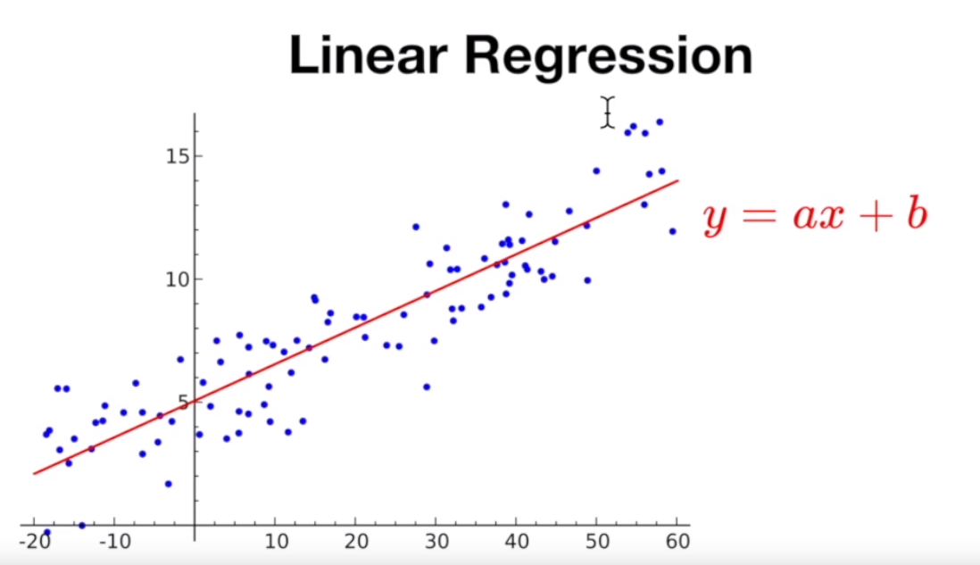
D-Tux : Dankook Univ.
Linear Regression - Theory
Regression
To find x and y relationship

Slide 8
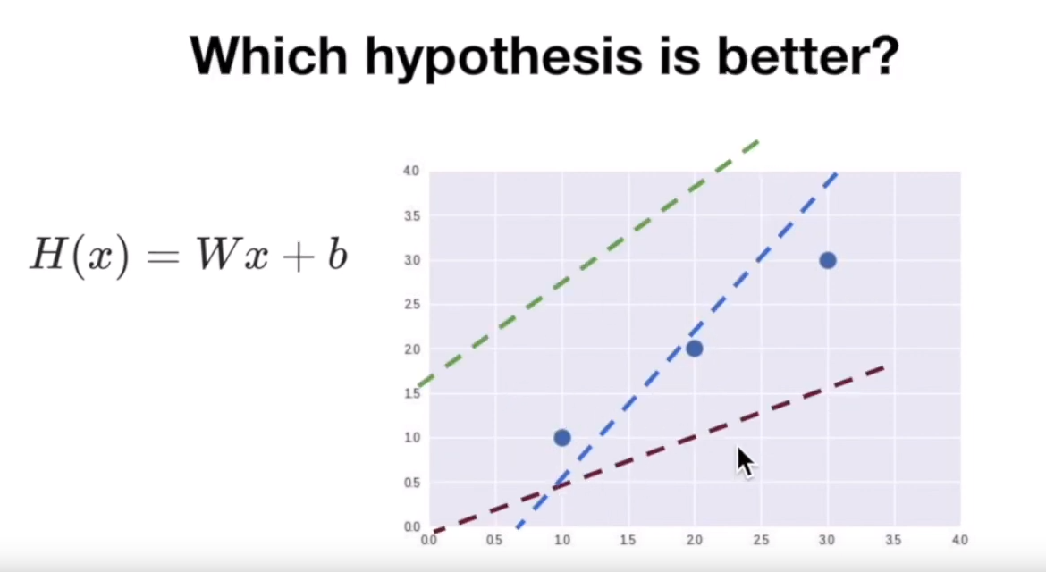
D-Tux : Dankook Univ.
Linear Regression - Theory
Hypothesis
H(x) = Wx + b
Y = ax + b

Slide 9
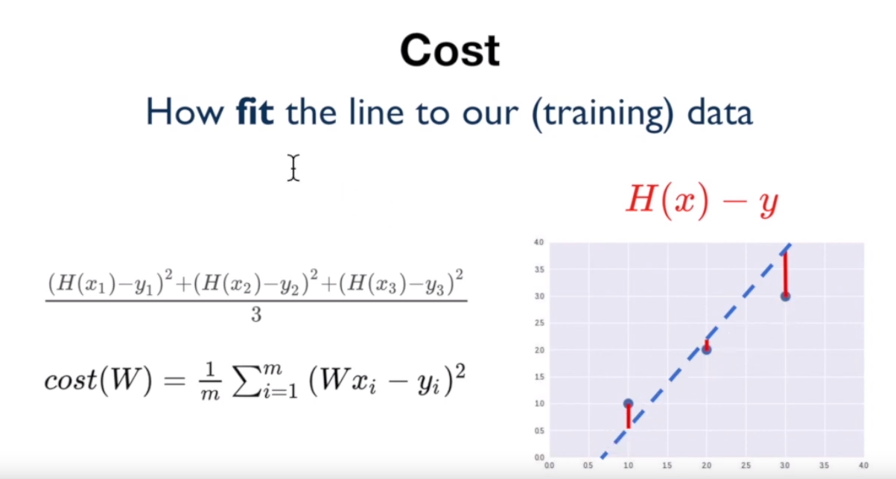
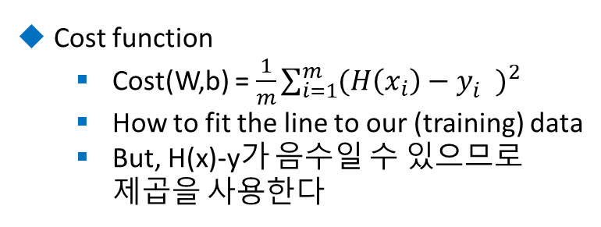
D-Tux : Dankook Univ.
Linear Regression - Theory
Cost function
Cost(W,b) = $\frac{1}{m}\sum_{i=1}^{m}{{(H\left(x_{i}\right)−y_{i}^{})}^{2}}$
How to fit the line to our (training) data
But, H(x)-y가 음수일 수 있으므로 제곱을 사용한다

Slide 10
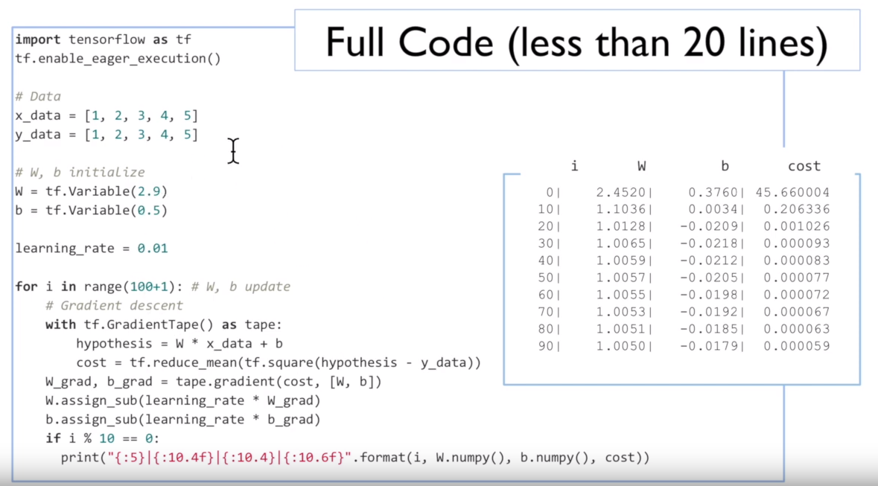
D-Tux : Dankook Univ.
Linear Regression - Pratice

Slide 11
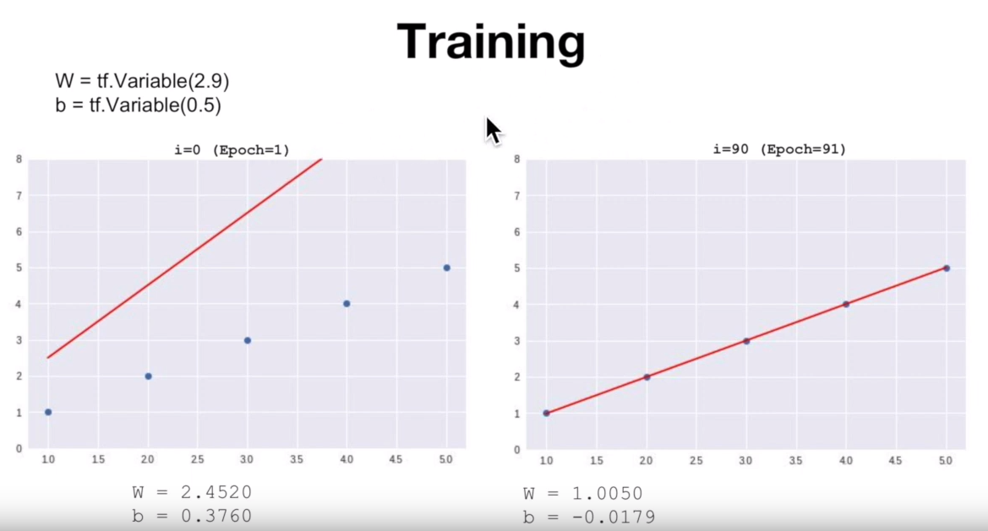
D-Tux : Dankook Univ.
Linear Regression - Pratice

Slide 12
Part 3.
Minimize cost

Slide 13
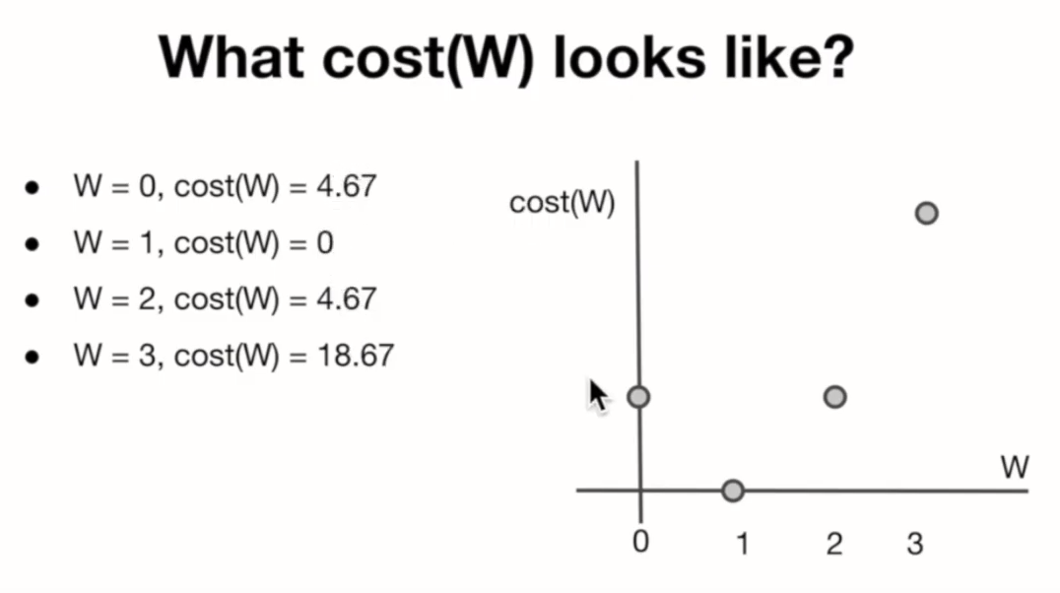
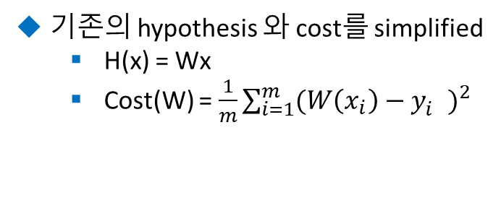
D-Tux : Dankook Univ.
Minimize cost - Theory
기존의 hypothesis 와 cost를 simplified
H(x) = Wx
Cost(W) = $\frac{1}{m}\sum_{i=1}^{m}{{(W\left(x_{i}\right)−y_{i}^{})}^{2}}$

Slide 14
D-Tux : Dankook Univ.
Gradient descent algorithm
Gradient descent algorithm
Minimize cost function
Gradient descent is used many minimization problems
For a given cost function, cost(W, b), it will find W, b to minimize cost
It can be applied to more general function: cost (w1, w2, … )
How Gradient descent algorithm works
Start with initial guesses
Start at 0,0 (or any other value)
Keeping changing W and b a little bit to try and reduce cost(W,b)
Each time you change the parameters, you select the gradient which reduces cost(W,b) the most possible
Repeat
Do so until you converge to a local minimum
Has an interesting property
Where you start can determine which minimum you end up

Slide 15
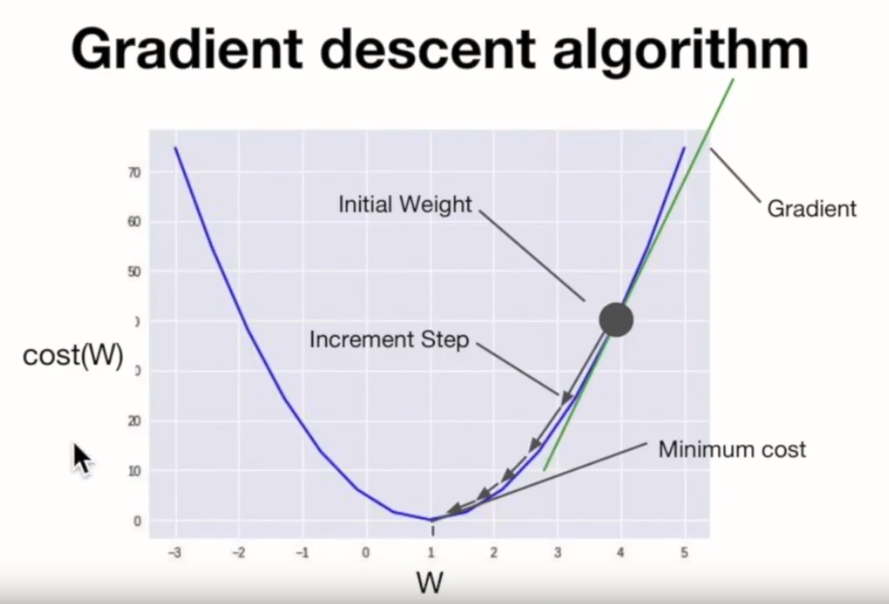
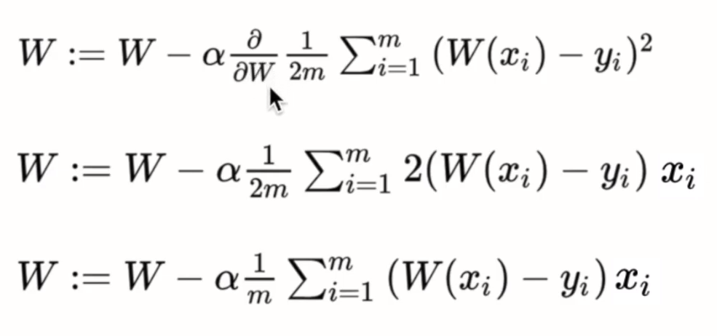
D-Tux : Dankook Univ.
Gradient descent algorithm
Gradient = function 의 미분값

Slide 16
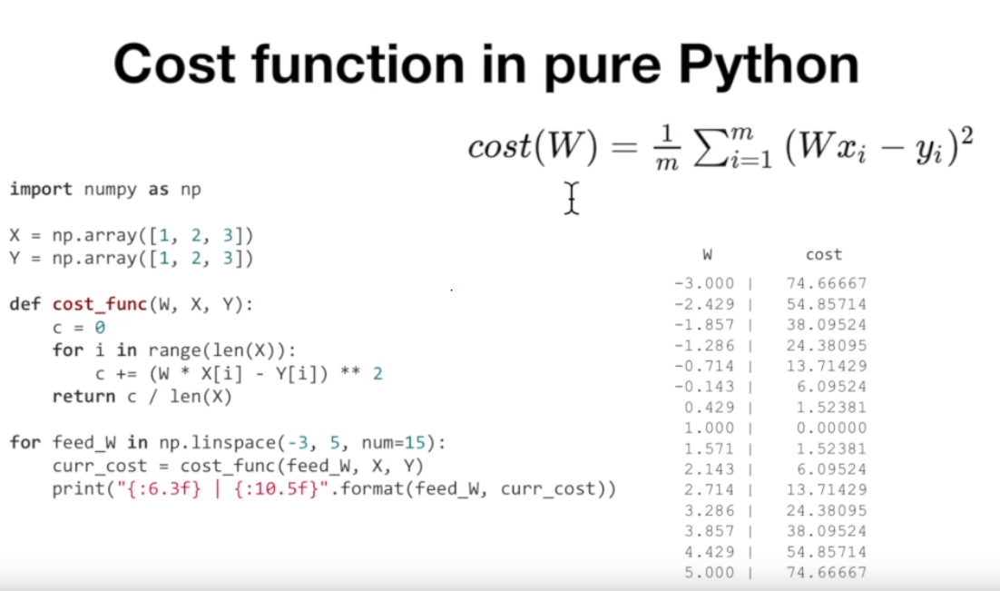
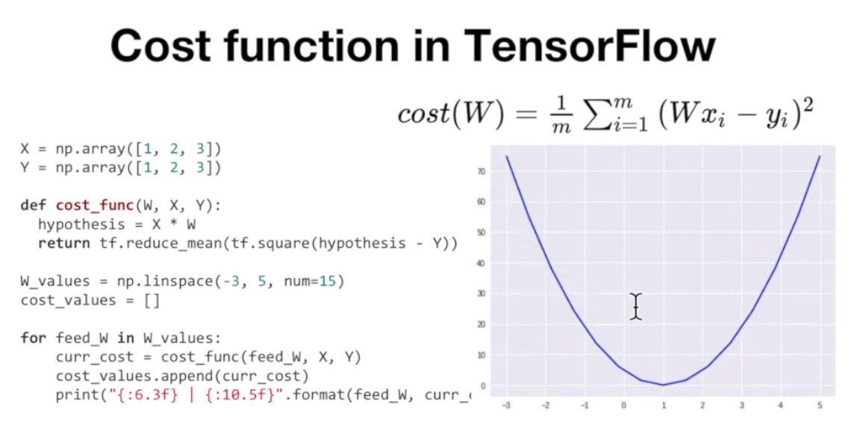
D-Tux : Dankook Univ.
Minimize cost - Pratice

Slide 17
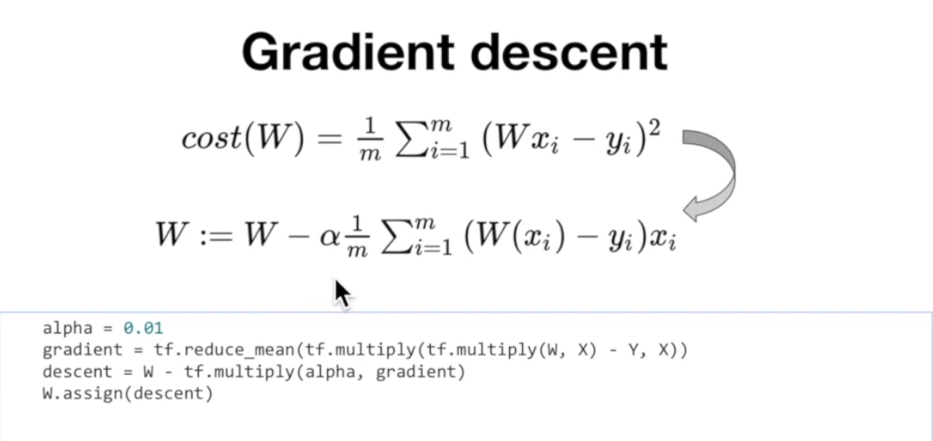
D-Tux : Dankook Univ.
Gradient Descent - Pratice

Slide 18
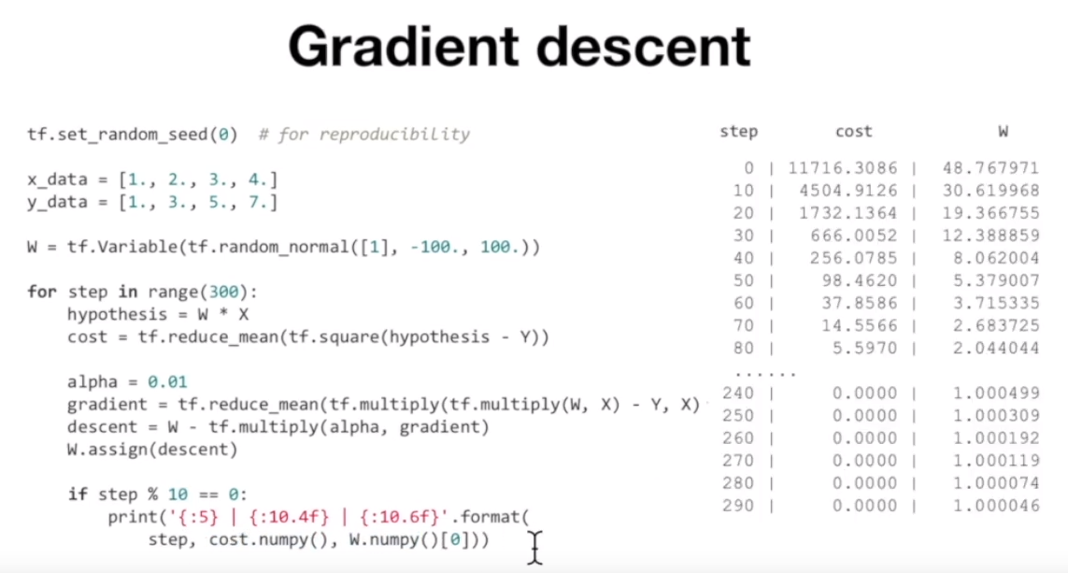
D-Tux : Dankook Univ.
Gradient Descent - Pratice

Slide 19
Part 4.
Make an application

Slide 20
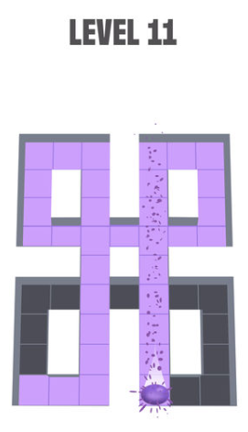
D-Tux : Dankook Univ.
Make an application
간단한 실습 프로그래밍
Mobile game – Amaze
한붓 그리기

