Slide 1

HACKATHON PROJECT
FINDING HOSPITALS
GROUP 3

Slide 2

GROUP 3
ANUSHKA PODDER(2063294)
BIDISA CHOWDHURY(2063479)
SUPRATIM MONDAL(2063529)
TOMA SAHA(2063397)
TORSHA GHOSH(2063537)

Slide 3
OBJECTIVES
Search For Hospitals
Display Top Cities
Corporate Wellness

Slide 4
DESCRIPTION
Find and Display Hospitals that are Open 24/7, has Parking facility with rating more than 3.5.
01
Go to Corporate Wellness, fill invalid details, capture the warning message from the alert and Display them
03
In Diagnostics page, pick all the top cities name , store in a List and Display them.
02

Slide 5
TECHNOLOGIES USED
Selenium
Maven
POM
Jenkins
TestNG
Apache POI
Smoke and Regression testing

Slide 6
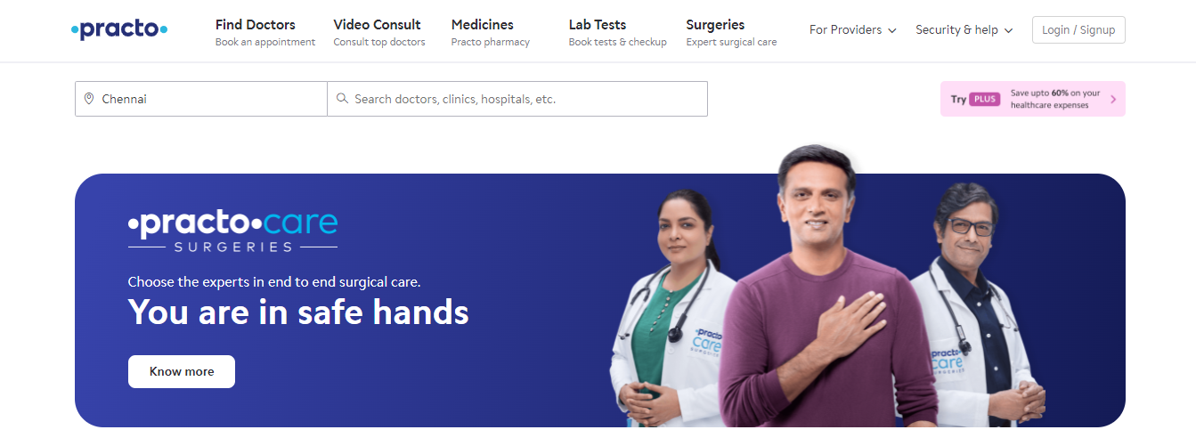
WEBSITE
https://www.practo.com/

Slide 7
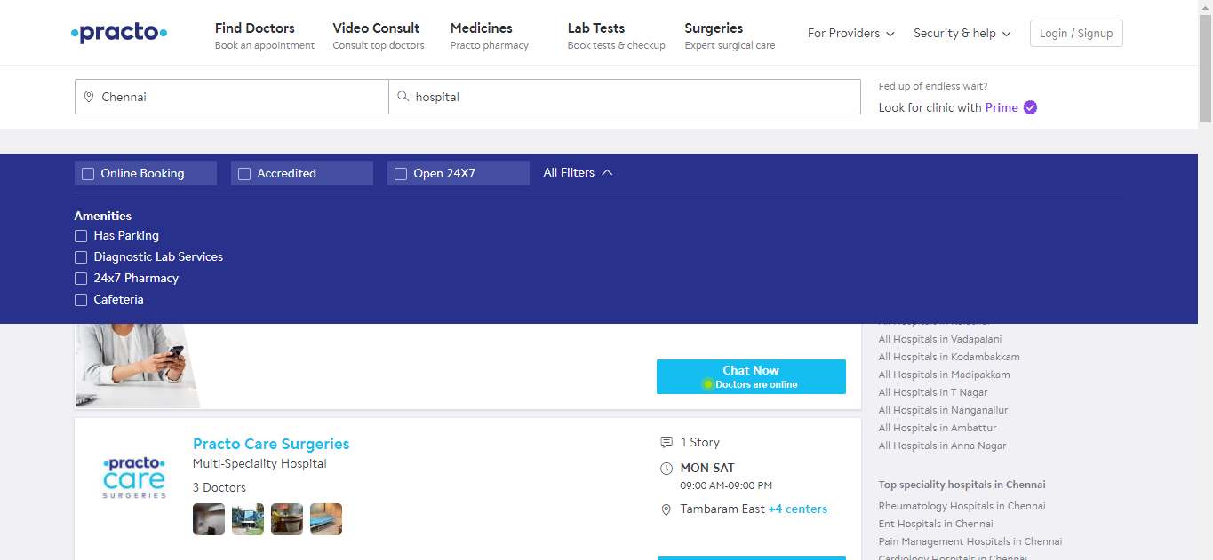
SEARCH FOR HOSPITALS

Slide 8
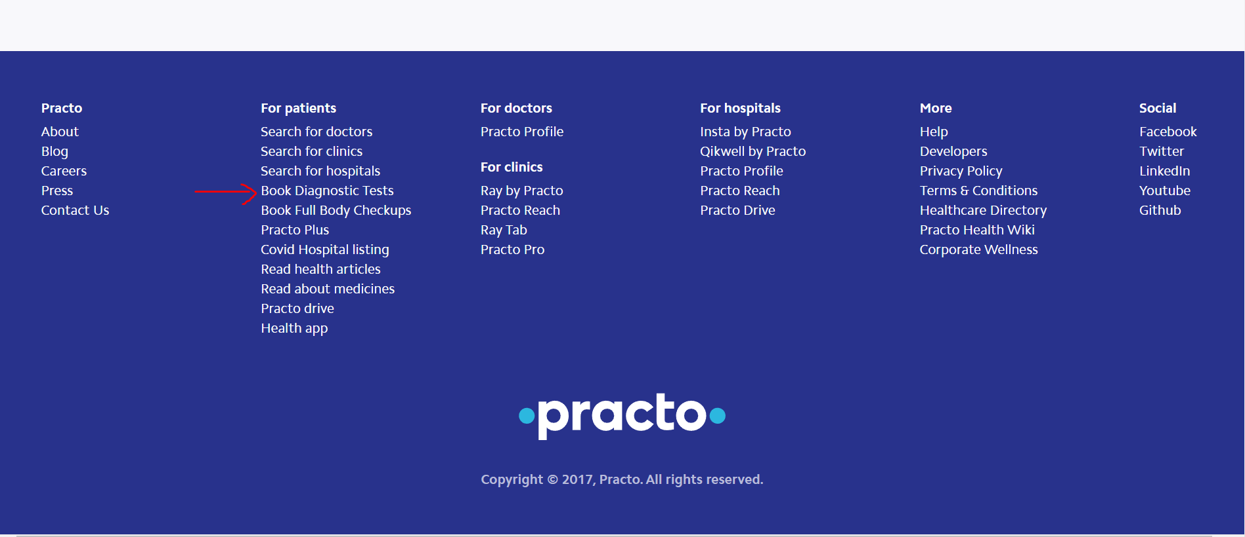
DIAGNOSTICS PAGE

Slide 9
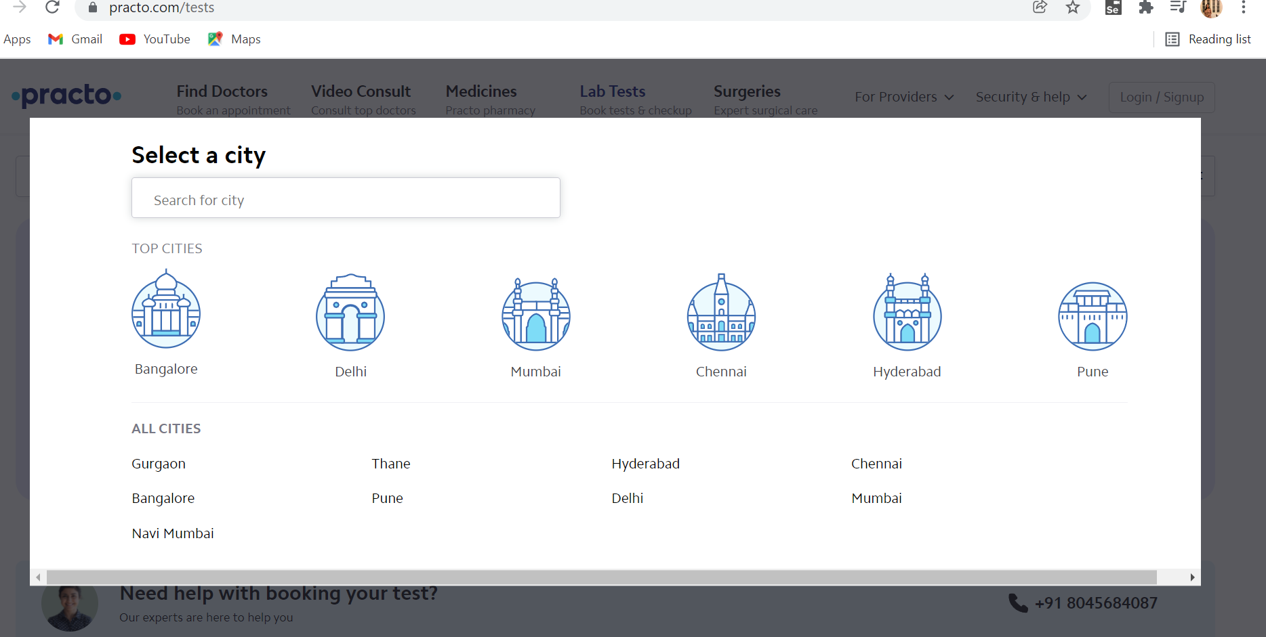
TOP CITIES

Slide 10
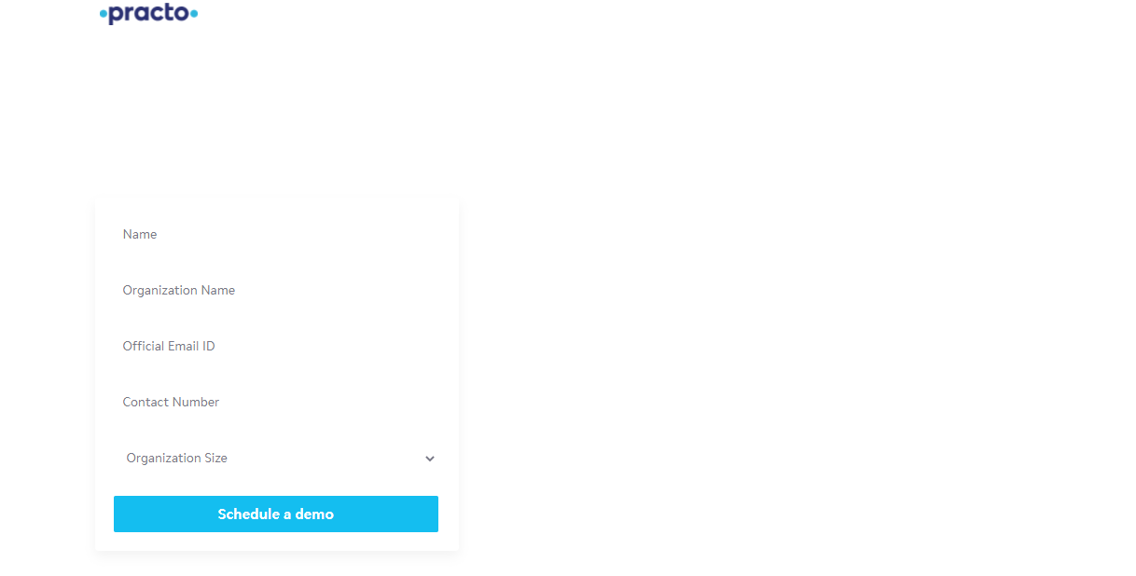
CORPORATE WELLNESS

Slide 11
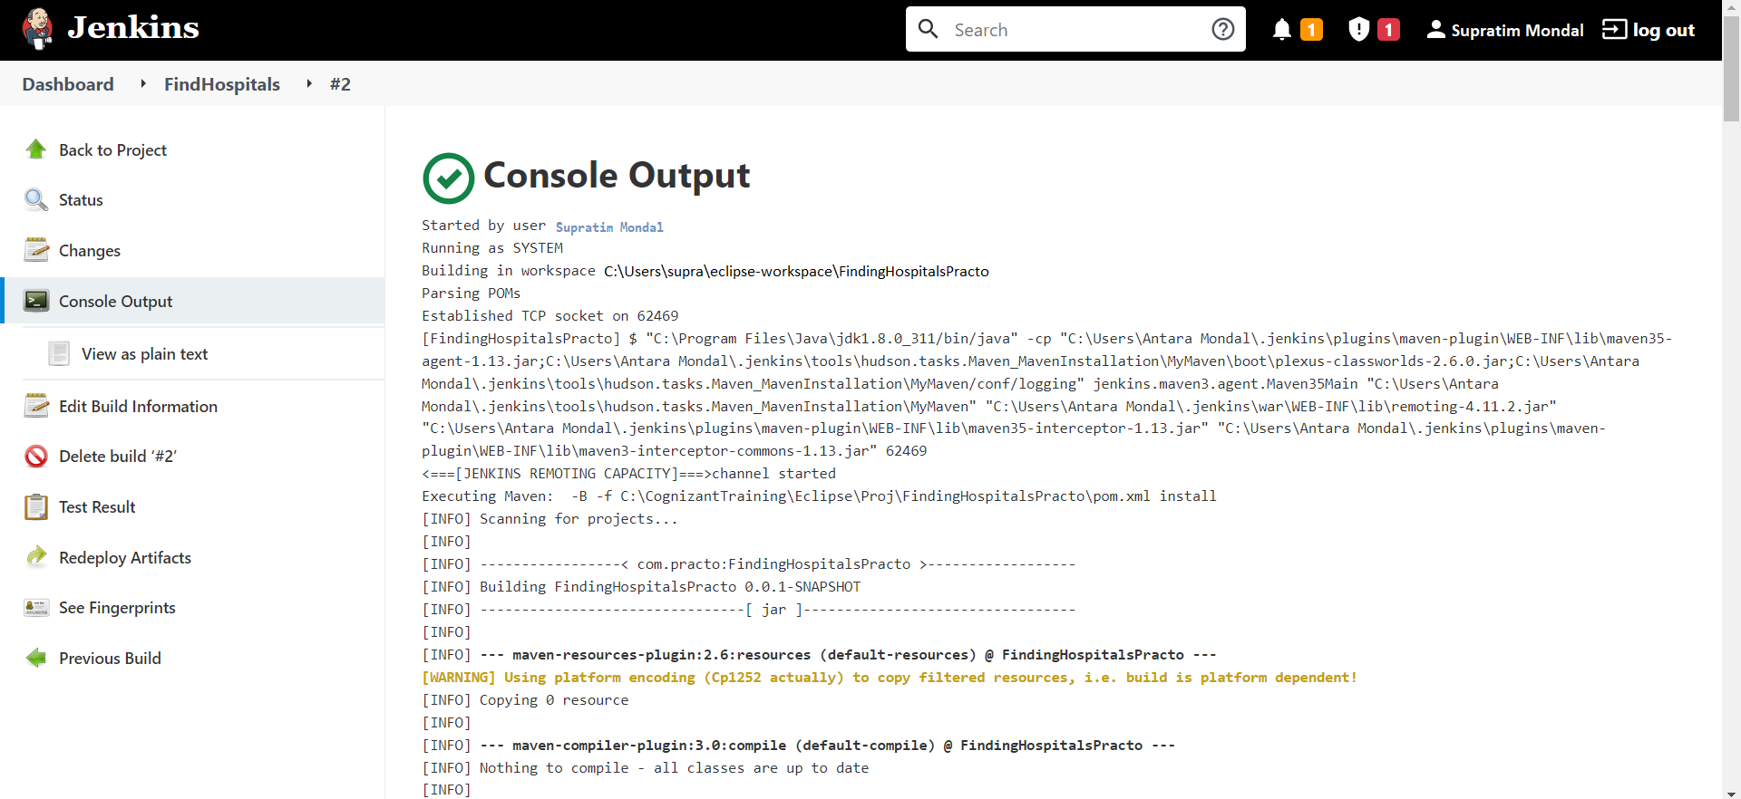
CONSOLE OUTPUT

Slide 12
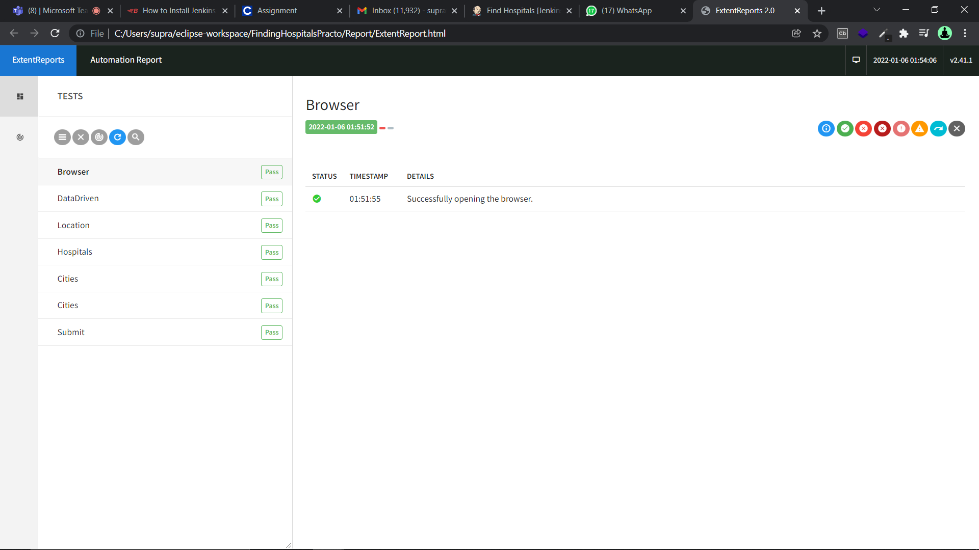
EXTENT REPORT

Slide 13

GITHUB LINK
https://github.com/supratim50/find-hospitals-selenium/tree/master/FindingHospitalsPracto

Slide 14
THANK YOU

