Slide 1
Pharmaceutical Portfolio Intelligence Report
AI-Powered Portfolio Risk Assessment, Optimization & Strategic Support
OBJECTIVE: Identify structural concentration vulnerabilities, prioritize growth vectors, neutralize risk elements, and formulate boardroom-ready insights for strategic operational execution.

Slide 2
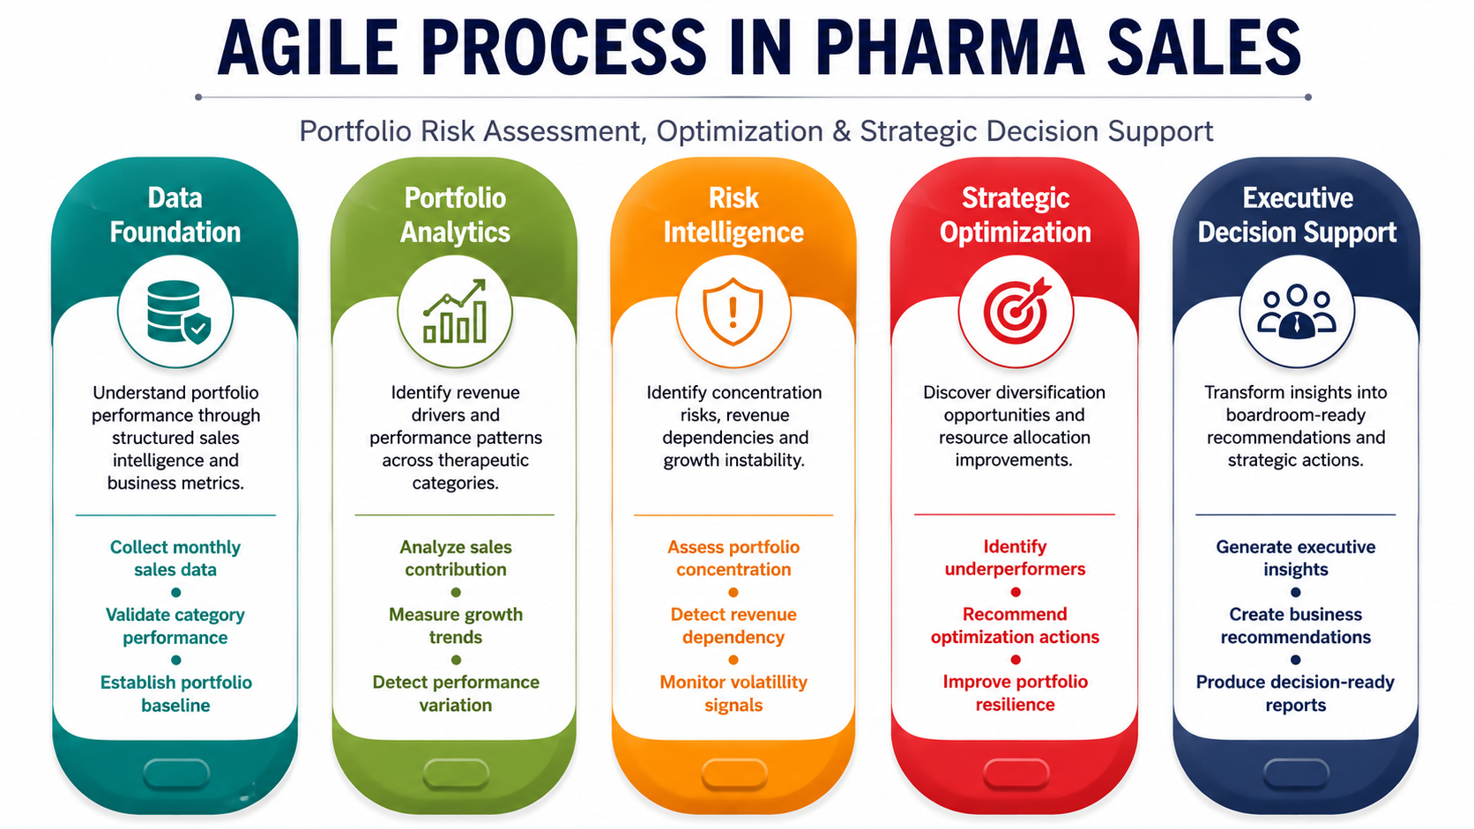

Slide 3
Executive Dashboard
127,596
Total Sales
68.27
Health Score
MEDIUM
Risk Level
N02BE
Top Category
KPI Parameters
Total Sales: Total portfolio revenue generation metrics.
Health Score: Risk-adjusted holistic operational strength metrics.
Risk Level: Overall cumulative structural portfolio vulnerability exposure.
Top Category: Primary high-volume therapeutic drug distribution matrix category.

Slide 4
Executive Summary
Revenue Dependency on N02BE
N02BE contributes 49.38% of total portfolio revenue, creating a critical dependency that limits resilience against market disruptions.
Growth Instability
Monthly sales volatility is 22.09%, indicating unstable demand patterns and forecasting challenges.
Underperforming Category
N05C contributes 0.98% of total sales, highlighting inefficiencies in resource allocation and strategic focus.
Core Portfolio Insight
Driving resilient growth through portfolio optimization, risk mitigation, and operational excellence

Slide 5
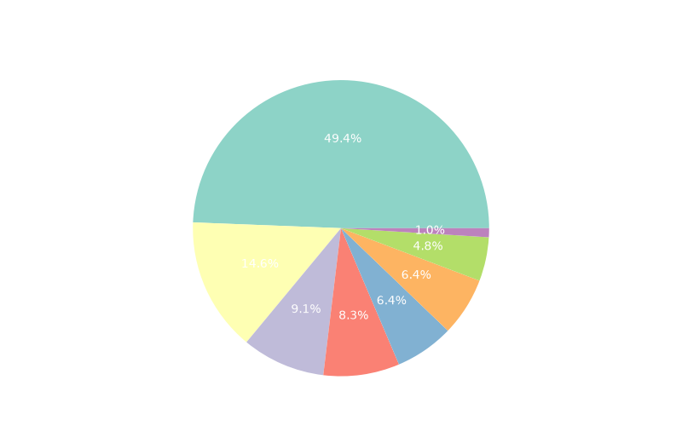
Portfolio Sales Contribution
TOP CATEGORY
N02BE
49.38%
UNDERPERFORMER
N05C
0.98%
CORE BRIEF
Monthly sales volatility is 22.09%, indicating unstable demand patterns and forecasting challenges.
STRATEGIC OUTLOOK
High concentration in N02BE increases vulnerability to market disruptions and regulatory changes.

Slide 6
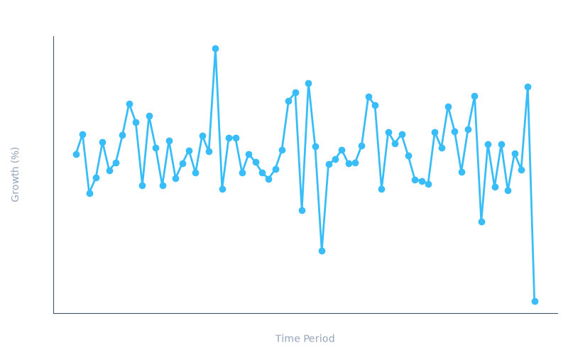
Monthly Sales Growth Trend
CORE BRIEF
N05C contributes 0.98% of total sales, highlighting inefficiencies in resource allocation and strategic focus.
STRATEGIC OUTLOOK
High concentration risk increases vulnerability to regulatory changes, competitive pressures, and pricing reforms.

Slide 7
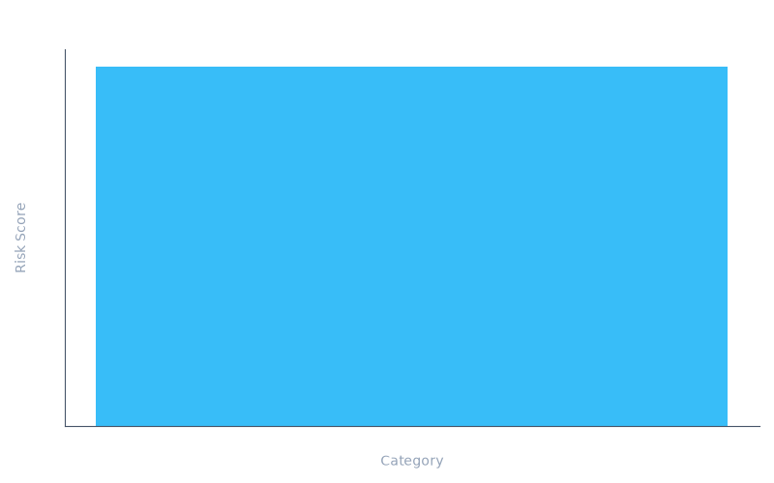
Portfolio Risk Dashboard
CORE BRIEF
Trend insights available. Please refer to the graphical interpretation.
STRATEGIC OUTLOOK
High concentration in N02BE increases vulnerability to market disruptions and regulatory changes.

Slide 8
Strategic Recommendations
Implement portfolio diversification strategies by investing in adjacent therapeutic areas to reduce dependency on N02BE.
Enhance demand forecasting and inventory optimization to stabilize sales volatility and improve operational efficiency.
Reallocate resources to high-potential categories, focusing on N05B and R03, which show higher growth potential.

Slide 9
Future Performance Outlook
The portfolio's future hinges on strategic diversification, improved forecasting, and efficient resource allocation. By addressing concentration risks and optimizing underperforming categories, the portfolio can achieve greater resilience and long-term growth potential. Continuous monitoring and agile adjustments will be critical to navigating market dynamics and maintaining competitive advantage.
MODERATE
Risk Outlook Profile
STABLE
Revenue Stability Forecast
MODERATE
Portfolio Resiliency Index

Slide 10

Thank You
Strategic Planning & Executive Advisory Operations

