Slide 1


The Complete 2020 Web Development Bootcamp/ Deep Learning A-Z: Hands-on Artificial Neural Networks
Industrial Training Presentation
Presented by:
BIDISHA BORGOHAIN (201700349.), 7th Sem/Sec B
Department of Computer Science and Engineering
Sikkim Manipal Institute of Technology

Slide 2
Contents
1. Introduction – Web Development
2. Front End – HTML, CSS, Bootstrap, React and JavaScript
3. Back End – NodeJS and MongoDB
4. To-Do List
5. Grocery List
6. Introduction-Deep Learning
7. Artificial Neural Network
8. Convolutional Neural Network
9. Recurrent Neural Network
10. Churn Rate Prediction using ANN

Slide 3
Introduction – WEB DEVELOPMENT
Web development refers to building, creating, and maintaining websites.
It includes aspects such as web design, web publishing, web programming, and database management.
Web development can range from developing a simple single static page of plain text to complex Web-based Internet applications (Web apps), electronic businesses, and social network services.
Front-end web development is done using HTML, CSS and JavaScript. The backend of the web consists of the server that hosts the website, an application for running it and a database to contain the data.

Slide 4
Front end
HTML – It’s a mark-up language
CSS – Used to style Web pages.
Bootstrap - A free and open source CSS framework
JavaScript – Light weight and is used to make websites dynamic
React - Open-source JavaScript library for building user interfaces or UI components.

Slide 5
back end
NodeJS – An open-source, cross-platform, JavaScript runtime environment (Framework) that executes JavaScript code outside a web browser .
MongoDB - MongoDB is a cross-platform document-oriented database program. Classified as a NoSQL database program, MongoDB uses JSON-like documents with optional schemas.

Slide 6
to-do list app
The front-end of this to-do app is made using HTML,CSS and Bootstrap. The backend scripting is done using NodeJS , the database is maintained using mongoDB and the data modeling is done using Mongoose .Passport.js is used for adding cookies and sessions for Authentication.

Slide 7
The functionalities are:
> User registers to the to-do app
> User logins to to-do app through registered userID and password
> Add items to to-do list
> Delete items from to-do list

Slide 8
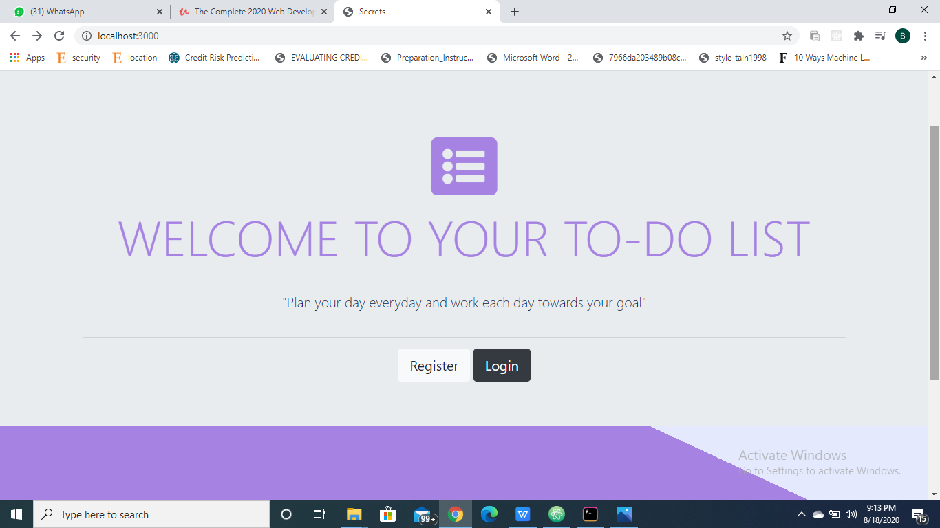
The home page. Unregistered users can register ,registered users can login.

Slide 9
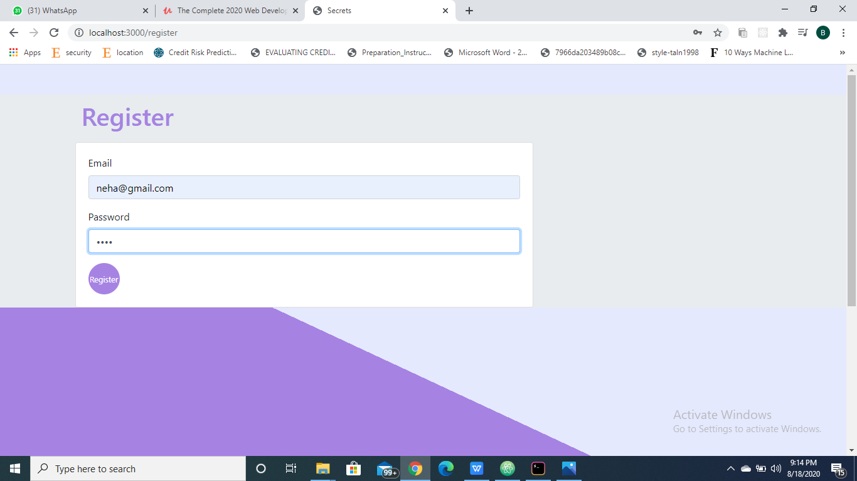
The registration page where the user has to provide his/her email and a password.

Slide 10
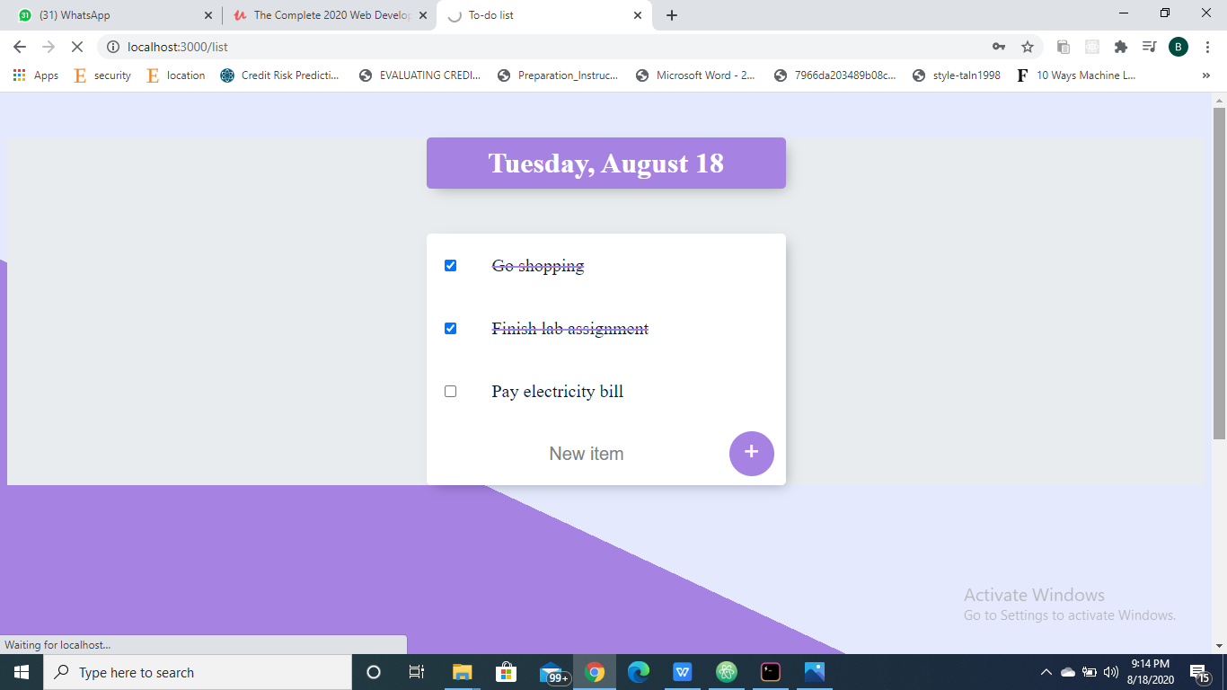
The current date gets displayed and the user can add items to the list as well as delete the items when it is done.

Slide 11
When a new user registers, a new entry gets created in the database along with his/her details. The details get stored as normal text however the password gets stored as encrypted text in the database.

Slide 12
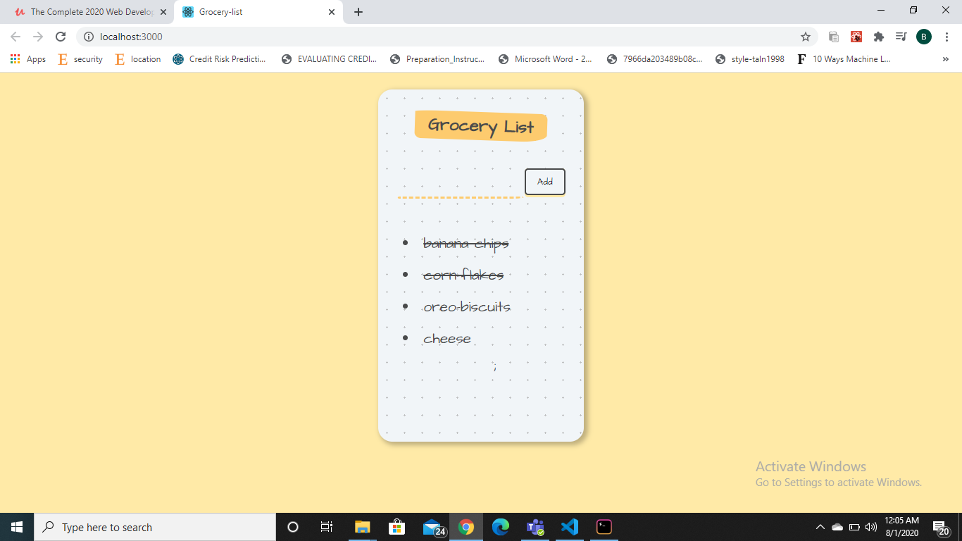
Grocery List App
A Grocery list app for adding and deleting items using the React framework and JavaScript.

Slide 13
Introduction – DEEP LEARNING
Deep Learning is a subfield of machine learning concerned with algorithms inspired by the structure and function of the brain called artificial neural networks.
Deep learning is an artificial intelligence (AI) function that imitates the workings of the human brain in processing data and creating patterns for use in decision making.
It unravels huge amounts of unstructured data that would normally take humans decades to understand and process.

Slide 14
Artifial Neural Network: Artificial neural networks (ANNs) are computing systems vaguely inspired by the biological neural networks that constitute animal brains.
Convolutional Neural Network: Class of deep neural networks, most commonly applied to analyzing visual imagery.
Recurrent Neural Network: RNNs can take one or more input vectors and produce one or more output vectors and the output(s) are influenced not just by weights applied on inputs like a regular NN, but also by a “hidden” state vector representing the context based on prior input(s)/output(s).

Slide 15
Churn Rate prediction using Artificial Neural Network abstract
1.The churn rate, also known as the rate of attrition or customer churn, is the rate at which customers stop doing business with an entity. In case of banking, it is the rate at which customers discontinue their subscriptions within a given time period.
2.A bank or company can compare its churn and growth rates to determine if there was overall growth or loss.
3.A high churn rate could adversely affect profits and impede growth. Churn rate is an important factor in banking because most banks and credit unions pour a lot of effort into marketing to lure people in, but it is of no good or profitable if the customers don't stick around.

Slide 16
Introduction
My project “Churn Rate Prediction using ANN’ analyse customer behaviour
and predict accordingly whether they will stay with the bank or leave it. Bank can use this information to identify the loyal customers and also make necessary precautions to decrease the churn rate.
The model outputs either 0 or 1. 1 means the customer has a high chance of staying with the bank and 0 means the customer has a low chance of staying with the bank.

Slide 17
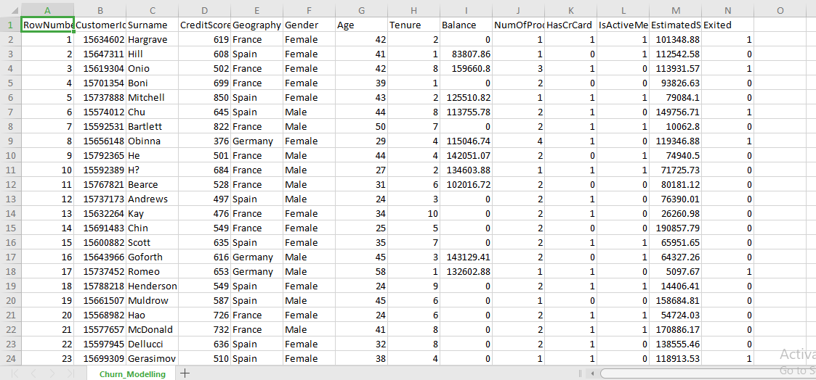
implementation
Exited is the dependent feature,i.e, the target outputs.
There are no null features.
A brief look at the dataset

Slide 18
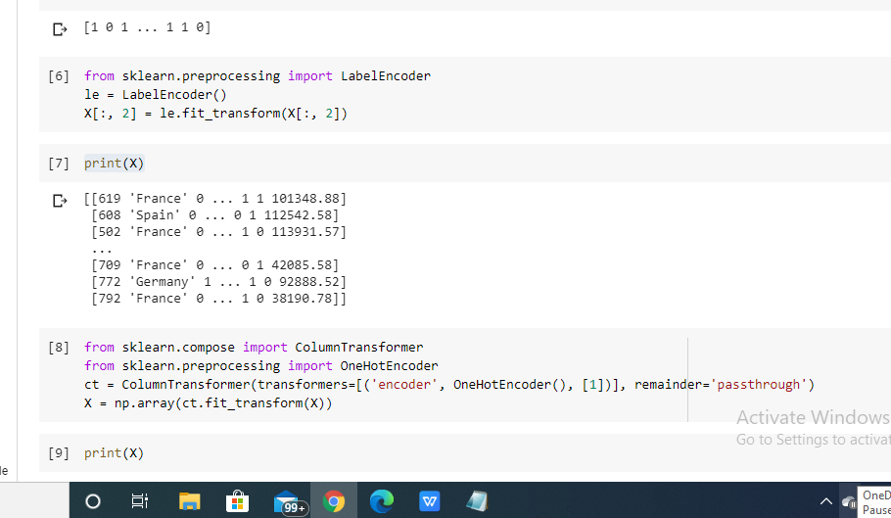
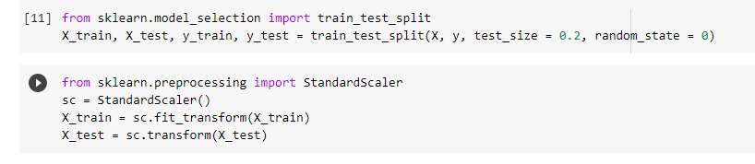
Handling categorical data:
LabelEncoder is used for label encoding the gender column.
OneHotEncoding is done on the geography column.
We split the data set in 8:2 ratio. 80% data is used for training and rest 20% or testing.
Then we import StandardScaler or feature scaling.

Slide 19
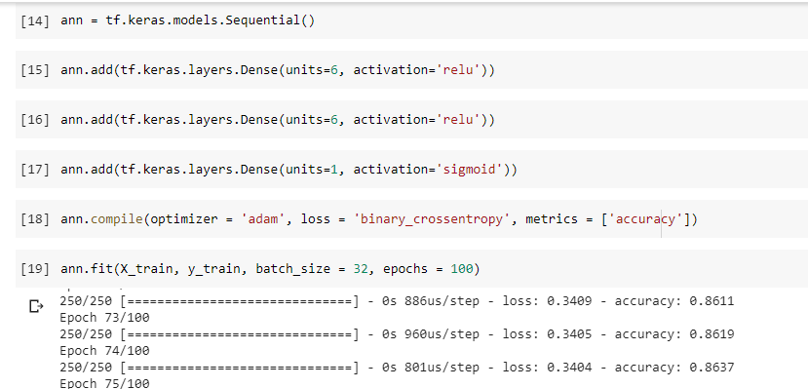
We then build the ANN . We build a Sequential model.
The activation function used in the hidden layers: relu.
Number of hidden layers: 2
Number of neurons per hidden layer: 6
Number of neurons in the output layer: 1
Activation function in the output layer: sigmoid
We then train the model.
Optimizer used: Adam
Loss function used: Binary Cross Entropy
Batch size: 32
Number of epochs: 100

Slide 20
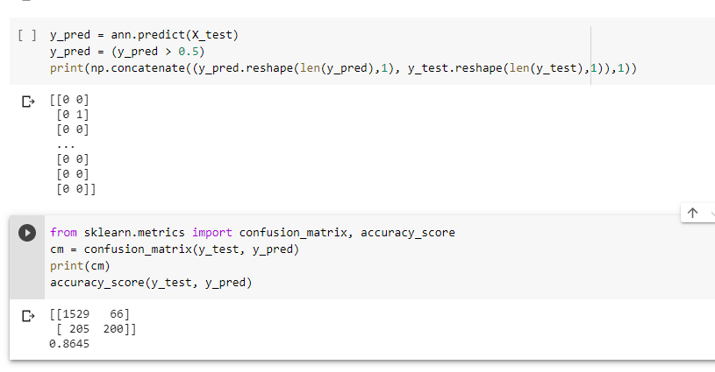
Predicting the Test set results:
We keep the threshold as 0.5 which means >0.5 will give the output as 1 and <=0.5 will give the output as 0.
We use a confusion matrix to visualize the performance of our model. We then compute the accuracy of our model on the test dataset and the accuracy comes out to be 86%.

Slide 21
SUMMARY
Nowadays almost everything happens online - Online transactions, online banking, online shopping etc.Every company needs to maintain their website inorder to maintain communication between them and their potential clients, sell their products or services, generate leads for the business, and increase the popularity of the company and much more.Therefore a full stack web developer has become much in demand in recent years.
In a world generating millions of data on a daily basis, deep learning can help utilise those data, learn from them and effectively use that knowledge for prediction, image classiication, speech recognition and much more.
Both these courses introduced me to new technologies and helped to develop my skills which will be helpul in my work life.

Slide 22
THANK YOU

