Slide 1
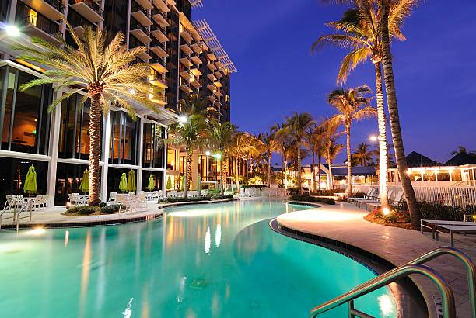
Hotel Booking Data Analysis
By Bidisha Pal

Slide 2
Content
Introduction & Objective
Steps Of Project
Loading Data
Data Cleaning
Exploratory Data Analysis
Hypothesis Testing
Model Building
Model Evaluation
Model Validation
Operational Insights
Conclusion

Slide 3
Introduction and Objective
Introduction:
This project delves into the booking data of a city hotel and a resort hotel collected between 2015 and 2017 to identify the key factors contributing to high cancellation rates. The dataset, stripped of any personally identifiable information, encompasses a wide range of comprehensive booking details, including "Reservation_date", "Length_of_stay", "Room_Type", "Stay_on_weekday_and_weekend","ADR","Guest Demographics" and other amenities like "Parking Availability" etc.
Objective:
In recent years, both the City and Resort hotels have experienced a concerning surge in cancellation rate, negatively impacting revenue generation and leading to underutilized room capacity. By meticulously analysing cancellation patterns and associated variables, this project aims to provide insights and recommendations to reduce cancellation, boost revenue and optimize hotel operations, improving the financial performance.

Slide 4






Steps Of The Project
Loading
Dataset
Data
Pre-Processing
Exploratory Data Analysis
Model
Building
Model
Evaluation
Model
Validation

Slide 5
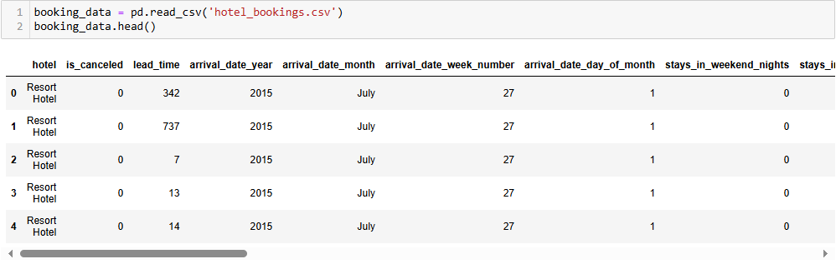
Data Description
The given dataset contains 32 columns and 119390 rows.
The target variable ‘is_cancelled” has two categories, 0 (Not Cancelled), 1 (Cancelled)
A snapshot of the raw data is given below –

Slide 6
Data Cleaning
1. Imputing Missing Values :
There were missing values in 4 columns - ‘children’, ’country’, ’agent’ and ‘company’ .
‘company’ column has been dropped due to high missing values (~94%).
13% missing values in ‘country’ column has been imputed with ‘others’.
Missing values in ‘children’ and ‘agent’ column has been filled with ‘0.0’ .
2. Converting Data Types :
Datatype of ‘reservation_status_date’ has been changed to ‘datetime’ from ‘object’ type.
‘children’ and ‘agent’ columns are converted to ‘int’ datatype from ‘float’.
3. Creating New Features from the Existing Features :
A new feature “total_guests” has been created by adding up the values of “adults", “children“ , “babies” and all the observations with ‘total_guests” = 0 has been dropped.

Slide 7
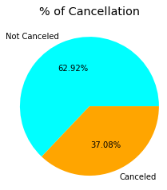
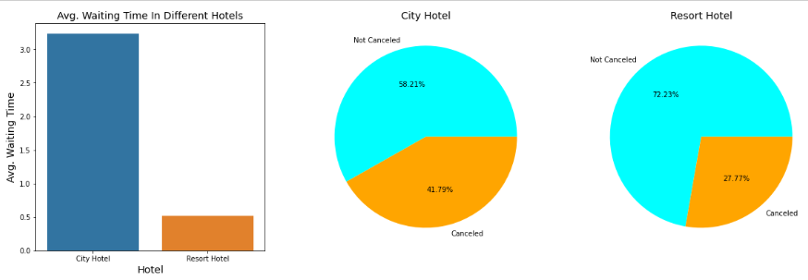
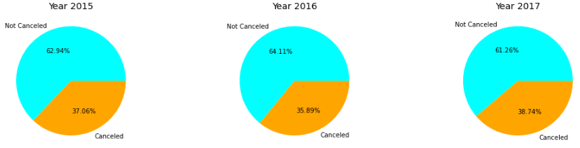
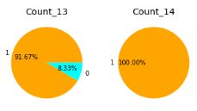
Cancellation Rate, Pattern & Influencing Factors

Slide 8
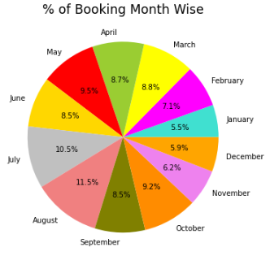
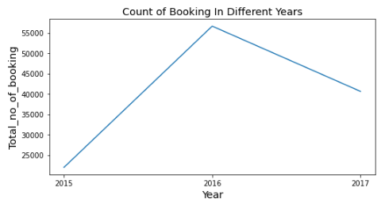
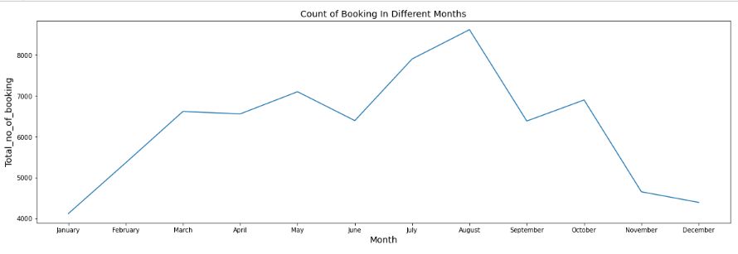
Booking Trends & Seasonality in Booking

Slide 9
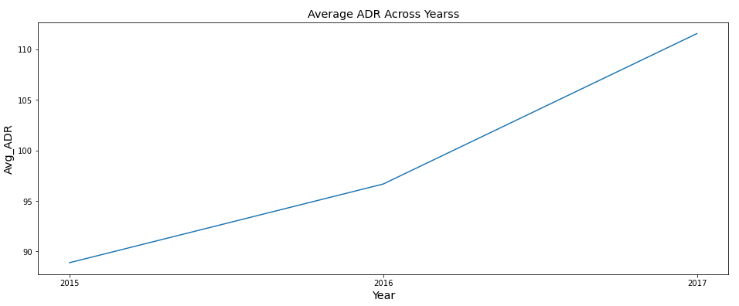
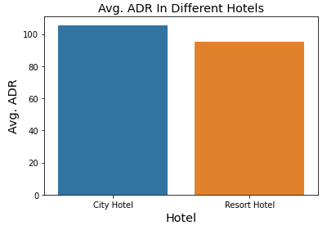
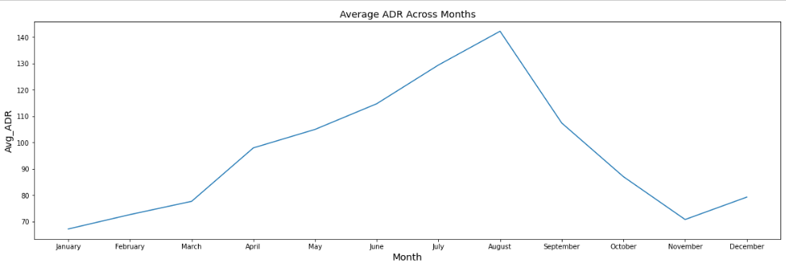
Average Daily Rate (ADR) Trend

Slide 10
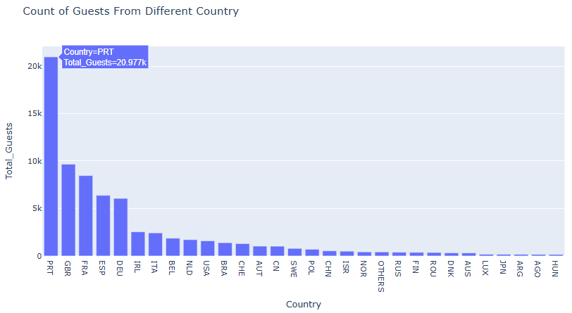
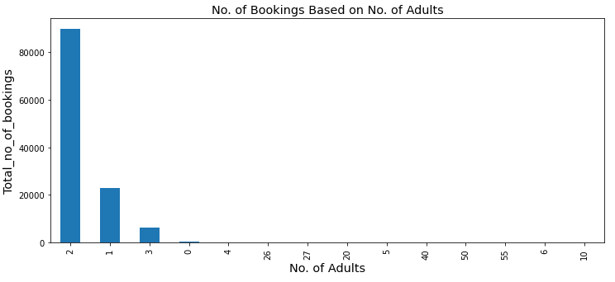
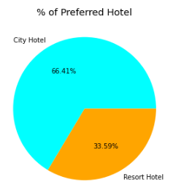
Customer Demographics

Slide 11
Findings From EDA
Out of all the bookings 37% were cancelled.
Most of the guests are from PTR followed by GBR and FRA.
No. of booking is maximum when there is no children, babies and number of adults are 2.
August was the busiest month of the year as no. of booking was highest and ADR is higher in August compared to other months of the year.
The year 2016 received the maximum no of bookings(~64%).
The cancellation rate was max in the year 2017 approximately 39%, yet ADR in 2017 is higher.
The guests prefer City Hotels over Resort Hotels and this trend has maintained across years resulting a higher ADR for City Hotels in comparison to Resort Hotels.
% of cancellation for City Hotels are higher ~41% and the longer waiting time can be a potential cause for this.
Out of all the guests only 3.15% were repeated guests which indicates a low retention rate.
Most of the bookings (~80%) has been done through Travel Agents/Travel Operators.
Guests who has a record of cancelling more than 13 previous bookings has a very high probability of cancelling the current booking.

Slide 12
Hypothesis Testing
Here hypothesis testing has been performed on 2 statements :
Hypothesis_1 : "Customers booking more than 6 months in advance are more likely to cancel.“
As both the variable are Categorical "Chi-Square Contingency" test has been used to test significant statistical relation between both the variables.
Result : p-value = 0 ; Reject Null Hypothesis
Hypoyhesis_2 : "Weekday bookings have a higher average daily rate than weekend bookings.“
Here we need to compare mean of 'ADR' between two features "Weekday_booking" and "Weekend_booking".
In this case we can apply Two Sample t-Test or Independent t-test if both the feature ‘ADR’ is normally distributed or we can apply Mann-Whitney U Test if it is not normally distributed and "Shapiro-Wilk" test has been applied to check the normality of distribution.
Result : p-value = 0 ; Reject Null Hypothesis

Slide 13

Predictive Modelling - Data Preparation
Step 1 : Encoding Categorical Variables :
Label Encoding has been applied for Binary Categorical Variables.
One-Hot Encoding has been applied for Multi-class Categorical Variables.
Step 2 : Splitting Data into Dependent and Independent Variables :
Step 3 : Handling Multicollinearity :
All the columns with correlation coefficient > 0.8 is dropped.
Step 4 : Feature Scaling :
Values of a lot of the numerical columns vary over a very wide range. Hence, to avoid unwanted biasness in result we have scaled/normalize the independent variables with MinMaxScaler

Slide 14
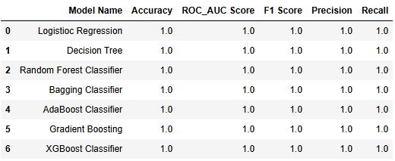
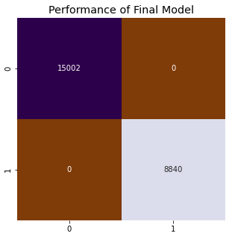
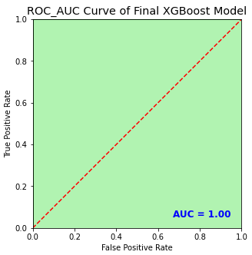
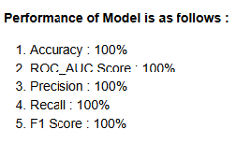
Predictive Modelling - Performance of Models
a
Performance of all the models are same using both Stratified k Fold and Simple Train Test Split method.
We have checked for Over Fitting problem using
both Cross Validation and Train Test Split approach and in both the cases accuracy is consistent.
So Logistic Regression is chosen as the final model as the model provide same performance as others with lesser complexity, computational cost and high interpretability.

Slide 15
Operational Insights
1. Targeted Marketing : Segment customers and tailor marketing campaign with incentives, loyalty programs and family packages.
2. Focus on Direct Booking : Prioritize direct bookings and run seasonal campaigns to reduce dependencies on high-cancellation channels.
3. Operational Improvements : Balance flexible cancellation policies with protective measures and proactively engage with long-load-time bookings.
4. Dynamic Pricing : Implement a flexible pricing strategy based on demand, lead_time and guest loyalty.

Slide 16
Conclusion
We have successfully train our model to predict cancellation of a booking with an accuracy 100%. We proceeded step by step analysing, cleaning and modelling the data. We have performed extensive Exploratory Data Analysis to find out the potential cause of increasing cancellation rate. Simultaneously we have applied various machine learning algorithm to achieve the desired result and finally we are able to build a model with a quiet good accuracy, precision and recall.

Slide 17


