Slide 1


The effect of the interbank network structure on contagion and common shocks
Co-Pierre Georg
Presented By:
Hemant Bidasaria
Notes:
Contagion and common shocks are important concepts that help us understand how problems can spread in the financial system

Slide 2


TABLE OF CONTENTS
1
Overview of Industry
2
Introduction
3
Model Formation
4
Network Theory
5
Figures and Observations
6
Conclusion
7
Some Other Readings

Slide 3
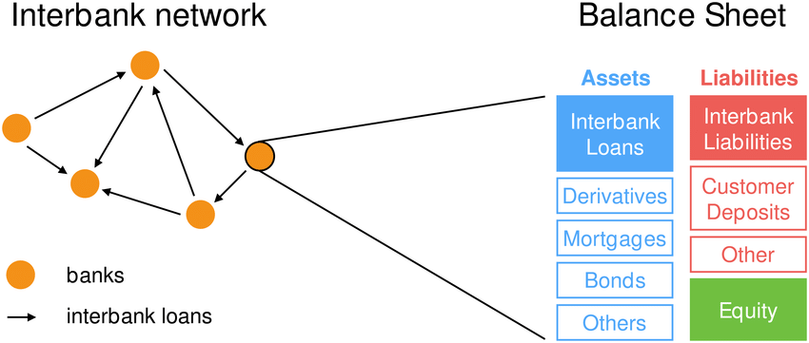
Interbank Network
Through the interbank market, banks which suffer liquidity shortages can borrow from banks with liquidity surpluses. Thus, the interbank market can have a stabilizing effect on the financial system by redistributing funds in an effective way among banks, however, at the same time it can make the system prone to financial contagion through the existing interbank linkages.
According to Pericoli and Sbracia (2003), a country’s banking system can contribute to the transmission of contagion due to moral hazard caused by the presence of institutionally enforced guarantees on deposits and by fluctuations in asset values used as collateral by banks.
Notes:
In such network structure, every node represents a bank and the connections between banks are represented by edge

Slide 4
Contagion and Common Shocks Effect
Contagion and Common Shocks are concepts to understand the spread of problems in the financial system.
Contagion Effect | Common Shock Effect
Refers to the way financial problems in one bank or financial institution can spread to others | Events that affect many banks simultaneously, rather than spreading from one to another
If Bank A has a lot of loans from Bank B and Bank A starts to fail, Bank B might also face problems because it won’t get its money back | A sudden economic downturn, like a recession, where many banks lose money because their customers can’t pay back loans
Previous papers focussed on risk-free investment options and deposits as residual, but here the author allows the possibility of risky investments and deposit fluctuations. Other paper focusses on impact of individual bank to overall systemic risks while this paper analyze the impact of interbank network structure on financial stability.

Slide 5
Purpose of the Paper: The idea
The paper introduces a dynamic multi-agent model of a banking system that includes the central bank, focusing on how banks manage their portfolios of risky investments and riskless excess reserves based on their preferences for risk, return, and liquidity
It highlights the interconnectedness of banks through interbank loans which leads to fluctuations in liquidity
The research compares different interbank network structures, revealing that money-centre networks are more stable than random networks. This finding suggests that the structure of interbank connections plays a crucial role in financial stability
Additionally, the paper discusses systemic risk, contrasting contagion effects with common shocks. It concludes that these two forms of systemic risk necessitate different optimal policy responses, indicating the complexity of managing financial stability in varying conditions

Slide 6
Introduction
Interbank network exhibits robust yet fragile property, showing contrasting impacts during normal times (leading to enhanced liquidity allocation and risk sharing) as compared to times of distress (Insolvency issue: Lehman Brother)
The Contagion and common shocks as systemic risks lead to search for a network structure that are more resilient to financial distress.
Counterparty Externality: When a bank lends to a number of other banks it is oblivious to any links between those banks and might underestimate its portfolio correlation.
Correlation Externality: Arises when a bank is oblivious to the asset holdings of other banks.
Banks face a stochastic supply of household deposits and stochastic returns from risky investments. This gives rise to liquidity fluctuations and initiates the dynamic formation of an interbank loan network.

Slide 7


Model Formation
A dynamic model of a banking system that can be used to analyze the impact of the interbank network structure on financial stability
1) Deposit Fluctuations are included
2) Fluctuations in investment returns have to be compensated by banking capital, risky investments are a major cause of bank insolvencies. Thus, The balance sheet of the bank k looks like:
A constant relative risk aversion (CRRA) utility function is assumed to model the bank’s preferences:
Notes:
it has to hold a certain fraction rDk of required reserves at the central bank, fixed banking capital BCk (which is as summed to be held in a highly liquid form), interbank loans Lk and cen tral bank loans LCk.
Lambda k is the fraction of the risky part of the portfolio. Mu k is the expected return, (sigma k)2 the expected variance of the portfolio and theta k is the banks risk aversion parameter. Vk t = Ik t + Ek t denotes the bank’s portfolio volume.

Slide 8
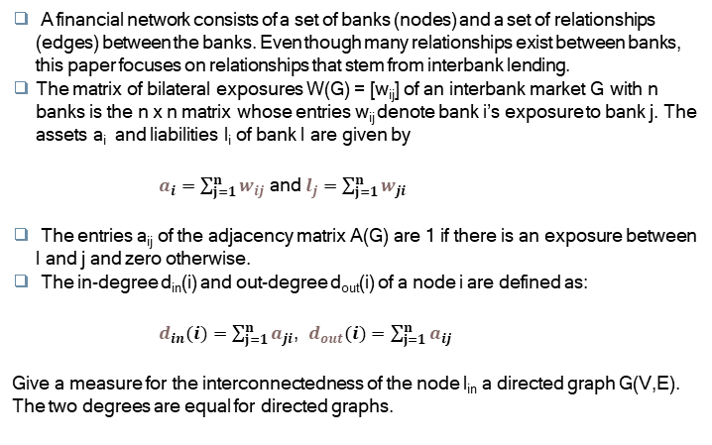
Network Theory
A financial network consists of a set of banks (nodes) and a set of relationships (edges) between the banks. Even though many relationships exist between banks, this paper focuses on relationships that stem from interbank lending.
The matrix of bilateral exposures W(G) = [w_{ij}] of an interbank market G with n banks is the n x n matrix whose entries w_{ij} denote bank i’s exposure to bank j. The assets a_{i} and liabilities l_{i} of bank I are given by
$a_{i}=\sum_{j=1}^{n}{w_{ij}}$ and $l_{j}=\sum_{j=1}^{n}{w_{ji}}$
The entries a_{ij} of the adjacency matrix A(G) are 1 if there is an exposure between I and j and zero otherwise.
The in-degree d_{in}(i) and out-degree d_{out}(i) of a node i are defined as:
$d_{in}(i)=\sum_{j=1}^{n}{a_{ji}}$, $d_{out}(i)=\sum_{j=1}^{n}{a_{ij}}$
Give a measure for the interconnectedness of the node I_{in} a directed graph G(V,E). The two degrees are equal for directed graphs.

Slide 9
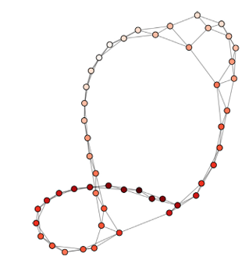
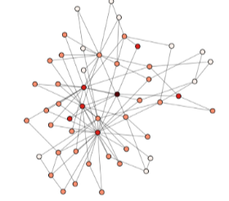
Figures and Observations
Fig. 1 shows a small-world network
N=50 , k = 4, β = 0.05
(A value of 0.05 means less chance that connections can be randomly rewired)
Note: Small-world networks are known for having a high degree of clustering and short average path lengths
Fig. 2 shows a scale free network
N=50 , m = 2
(each new node added to the network connects to 2 existing nodes. This process leads to some nodes becoming very well-connected (hubs), while others have fewer connections)
Notes:
To characterize a network, average path lengths and degree of clustering is used. Network topology refers to the arrangement of different elements (like banks) and how they are connected to each other.

Slide 10
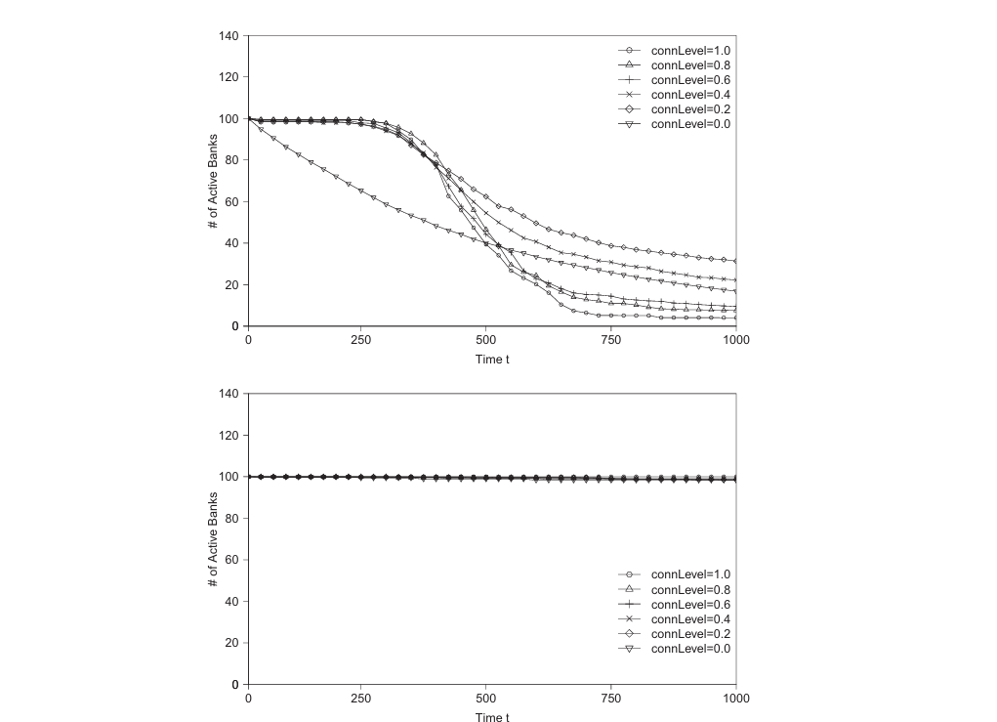
Figures and Observations
Fig 3 shows the effect of different network topologies on financial stability.
Top: crisis scenario and random topology.
Bottom: normal scenario and random topology.
Connection levels of connLevel = 0.0,0.2,0.4,0.6,0.8,1.0 were used.
Notes:
a "random topology" is used, meaning that the connections between banks are made randomly rather than following a specific pattern.
The study aims to understand how different connection levels in a random topology affect financial stability during both crisis and normal scenarios.
if banks are too isolated (0.0), they may not be able to support each other during a crisis. Conversely, if they are too interconnected (1.0), a problem in one bank could quickly spread to others, leading to a larger crisis.
In tranquil times, liquidity demand-driven interbank lending is low and cascading defaults are thus contained.

Slide 11
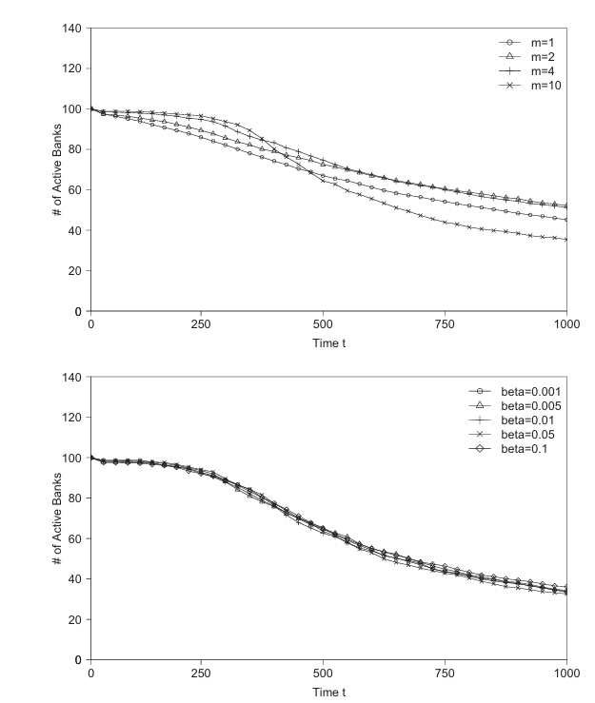
Figures and Observations
Network Structures affecting the stability of financial market
Fig 4: Top: crisis scenario and scale-free (BA) network with m = 1, 2, 4, 10.
Bottom: crisis scenario and small world (WS) network with b=0.001, 0.005, 0.01, 0.05, 0.1.

Slide 12
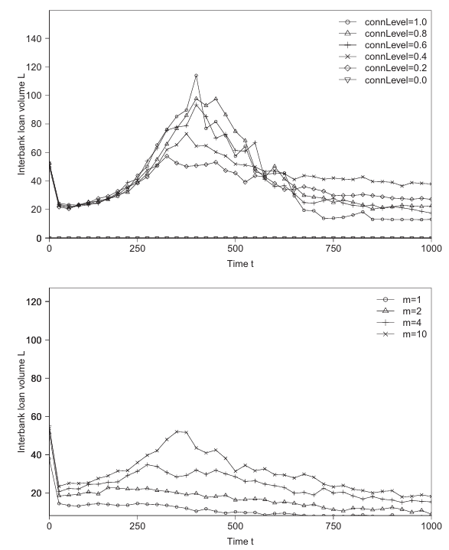
Figures and Observations
A visual representation showing how different types of connections (called "network topologies") between banks affect the amount of money they lend to each other
Top: Crisis scenario and random topology, with connection levels of connLevel = 0.0, 0.2, 0.4, 0.6,0.8, 1.0.
Bottom: Crisis scenario and scale-free network with m =1,2,4,10.

Slide 13
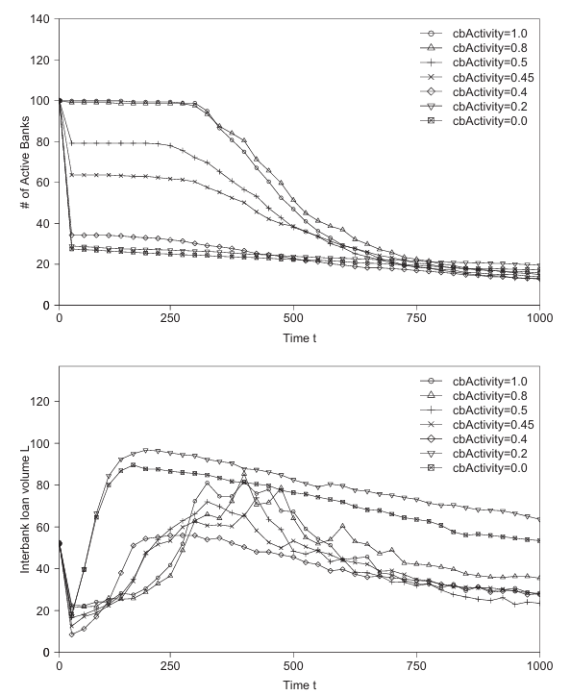
Figures and Observations
The effect of central bank activity for different scenarios.
Top: Number of active banks over simulation time for a random network with connectivity of 0.2.
Bottom: Interbank loan volume over simulation time for a random network with connectivity of 0.2. The central bank activity a^{k} varied between a^{k} = 0.0 and a^{k} = 1.0

Slide 14
Results: Regime Switching Property
Financial Systems changes its behavior based on different conditions.
In tranquil times, liquidity demand-driven interbank lending is low and cascading defaults are thus contained.
In times of distress, money centre networks (which are typically found in reality) are seen to be more stable than purely random networks.
In times of crisis, individual banks suffer larger liquidity fluctuations and engage in higher liquidity-driven interbank lending. This drives the financial system into a contagious regime. When exactly the regime-switching behavior occurs depends on the interbank network structure.
Central banks can stabilize the financial system in the short run. In the long run, however, the system always converges to a steady state which depends, amongst other things, on the interbank network structure. Central bank liquidity provision helps banks to withstand liquidity shocks for a longer time. This, however, allows banks that would otherwise be insolvent to engage in liquidity demand-driven interbank borrowing. The result is that the financial system as a whole is more highly interconnected and more likely to enter the contagious regime
Notes:
during these calm times, the way banks are connected (the interbank network structure) does not significantly change how stable the financial system is. In calm times, banks don’t need to borrow much money from each other. This means that even if one bank has problems, it doesn’t lead to a chain reaction affecting other banks.

Slide 15
Some Other Readings
Simulating financial contagion dynamics in random interbank networks by John et al
The study assesses the resilience of financial systems to exogenous shocks using techniques drawn from the theory of complex networks
They trigger a series of banking crises by exogenously failing each bank in the system and observe the propagation mechanisms that take effect within the system under different scenarios.
Analyzed the interplay of several crucial drivers of interbank contagion, such as network topology, leverage interconnectedness, heterogeneity and homogeneity across bank sizes and interbank exposures.
Considers the role of financial interconnectedness between the United States Subprime Mortgage crisis in 2008 as well as European sovereign debt crisis in 2009.

Slide 16
Thank You

