Slide 1
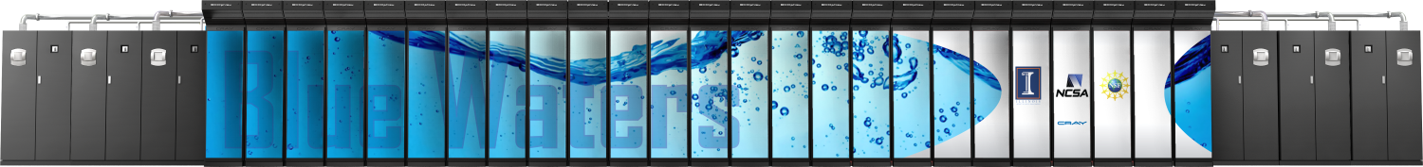
Account Management on a Large-Scale HPC Resource
Brett Bode, Tim Bouvet, Sharif Islam and Jeremy Enos
National Center for Supercomputing Applications
University of Illinois

Slide 2
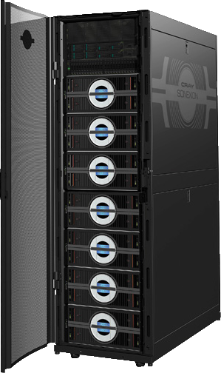
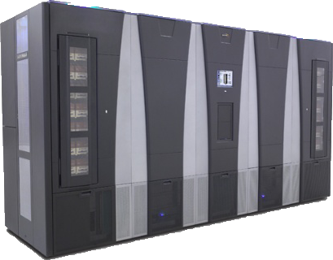
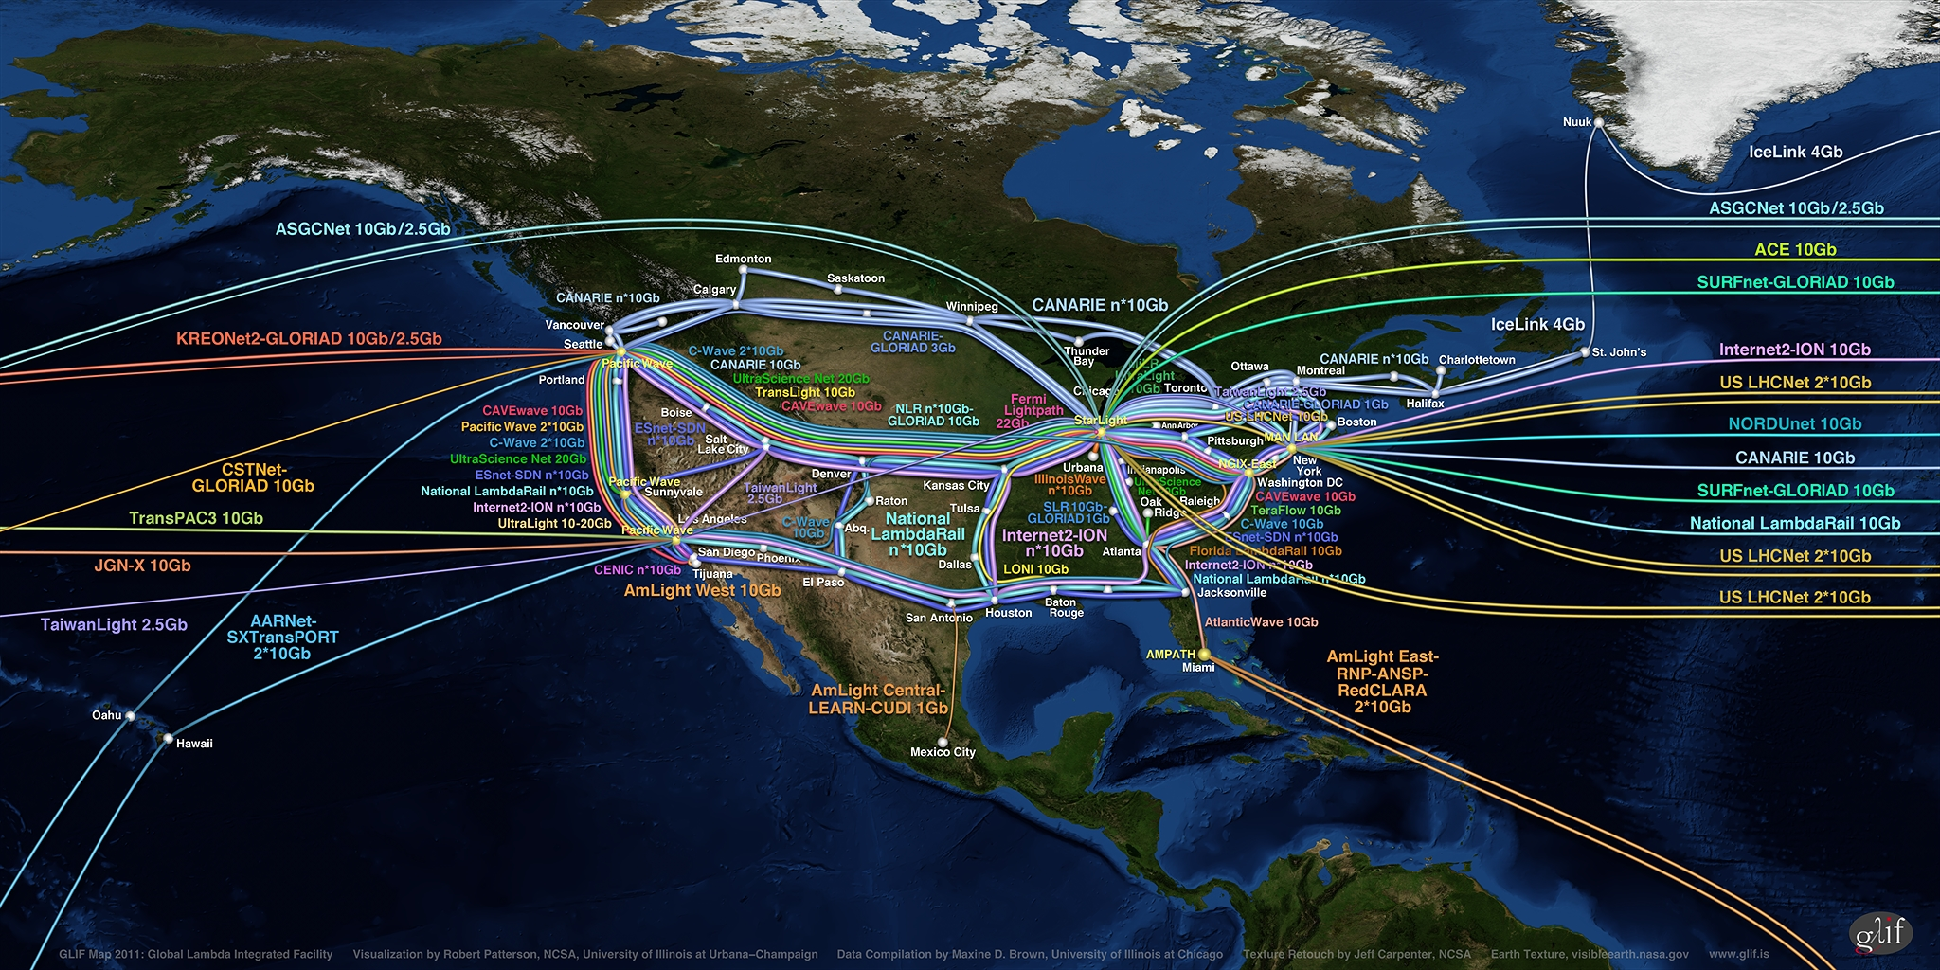
Blue Waters Computing System
Aggregate Memory – 1.66 PB
Scuba Subsystem - Storage Configuration for User Best Access
External Servers
IB Switch
>1 TB/sec
10/40/100 Gb
Ethernet Switch
66 GB/sec
120+ GB/sec
300+ Gbps WAN
Spectra Logic: 200 usable PB
Sonexion: 26 usable PB

Slide 3
g
Gemini Fabric (HSN)
Cray XE6/XK7 - 288 Cabinets
DSL
48 Nodes
XE6 Compute Nodes - 5,659 Blades – 22,636 Nodes –
362,176 FP (bulldozer) Cores – 724,352 Integer Cores
XK7 GPU Nodes
1057 Blades – 4,228 Nodes
33,824 FP Cores – 4,228 GPUs
Resource Manager (MOM)
64 Nodes
BOOT
2 Nodes
SDB
2 Nodes
RSIP
12Nodes
Network GW
8 Nodes
Unassigned
74 Nodes
LNET Routers
582 Nodes
SMW
esLogin
4 Nodes
Boot RAID
InfiniBand fabric
Boot Cabinet
Import/Export
Nodes
10/40/100 Gb
Ethernet Switch
HPSS Data Mover
Nodes
Sonexion
25+ usable PB online storage
36 racks
Cyber Protection IDPS
Management Node
NCSAnet
Near-Line Storage
200+ usable PB
esServers Cabinets
NPCF
Supporting systems: LDAP, RSA, Portal, JIRA, Globus CA, Bro, test systems, Accounts/Allocations, Wiki
Notes:
Blue Waters supersystem, Need to emphasize the unprecedented scale. Largest Cray, IE, HPSS, Lustre, Network. Hold performance discussion to later slides. Note all storage sizes are usable storage.

Slide 4
Security Strategy
Separate user and administrative login points
Eliminate privilege escalation on user accessible hosts
Limit administrative access to originate on a small number of administrative hosts
Administrative access must be one way!
Layout and get buy in on a policy for critical security issues!
On Blue Waters user exploitable privilege escalation issues warrant emergency maintenance and possible user immediate lockout.

Slide 5
Authentication
Historically compromised passwords have been the top vector for intrusions on NCSA HPC systems.
If using passwords make sure you have a reasonable policy and that default passwords are not used or are expired quickly.
For Blue Waters two-factor One Time Passwords were specified for both admin and user access.
Largely solves the compromised account problem, but does add cost and significant overhead.

Slide 6
Network Design
NCSA operates a very high-bandwidth open network environment
Currently 370 Gbps
No firewalls – active intrusion detection using Bro
Even on a firewalled network administrative hosts should be isolated from user networks.
Blue Waters has four separate administrative domains!

Slide 7
Logical Network Design

Slide 8
Bastion Hosts
The Blue Waters bastion hosts provide (the only) login route to the multiple administrative domains.
Admins login using their regular accounts and OTP
Host based access used internally to the administrative servers – restricted through LDAP groups.
sudo used to escalate privs on the admin servers, also restricted by LDAP groups
pfsense firewalls do allow very limited egress to allow “normal” software update tools to function.

Slide 9
Administrative Access
Escalation is only allowed on the administrative hosts.
From there keybased access for root is used within that administrative domain.
One-way access. Administrative hosts do not allow user or admin access from a user accessible host, and bastions do not allow reverse path from administrative hosts
Root can not cross administrative domains.
Allows granting admin rights on a subset of the overall system.

Slide 10
User Access Management
Potentially separate groups have access to logins, lustre data transfer and nearline data transfer.
Access is granted based on group membership and the standard linux /etc/security/access.conf file.
+ : TRAIN_aaaa TRAIN_bbbb : 141.142.xxx.xx/32
: ALL EXCEPT root crayadm globus bw_staff PRAC_cccc ILL_dddd … : ALL
What about maintenance? Desirable to have a fast way to restrict access to all nodes in a service class.
Blue Waters has a centralized monitoring and control workstation (ISC). Using a web portal admins can quickly add/remove projects from the access list or switch to a restricted maintenance access list.
Clients pull a new access.conf file once per minute. (motd and ssh.banner are done the same way)

Slide 11
Account and Group Management
Managing projects and adding/removing users is performed using an external database and web portal – outside the scope of this talk.
Changes need to be pushed to 27,000+ clients quickly and efficiently!
Our solution was to build our own LDAP infrastructure emphasizing scalability and fault tolerance.
All changes are made on an external host that is the LDAP master (LDAP is not writable from anywhere else)
LDAP replicaservers are setup in redundant pairs both externally to BWs and inside the high-speed fabric, with presence on each separate network (administrative, HSN, user private, user public)
No clients pull from the master directly.
SSL is used, though LDAP is not used for passwords.

Slide 12
Extending LDAP
LDAP provides support for standard account and group information. However, it is also quite easy to extend LDAP to provide additional features.
BWs extends the LDAP schema to include storage quotas, project PI information and gridmap information.
All are set at project/user creation on the LDAP master.
On login a PAM module checks and creates the home and scratch directory if needed. Quotas are also checked and changed if needed.
The gridFTP daemon was modified to call out to LDAP to lookup the gridmap entry rather than relying on the traditional file.

Slide 13
Account/Project removal
PIs are provided the ability to add and remove users via a web portal so accounts can be removed at anytime.
When projects end they are provided a 90 day grace period and then are removed.
Home and project data are permanently removed!
Nearline access can be extended up to one year, but is also eventually closed and data removed.

Slide 14
Education/Training Projects
The use of BWs for Education and training projects is encouraged, but required an alternative account setup and distribution process.
Some training projects may use hundreds of accounts spread across multiple remote sites making the distribution of OTP tokens impractical.
The BWs solution is to allow limited single-factor logins for certain, short-duration projects.
These accounts are generic – instr*… train* and get recycled.
All access is required to go through a single bounce host.
Each account is assigned a unique password on the bounce host and a self-signed certificate granting access from the bounce host to a regular login node for only the duration of the project.
The passwords are included in a generated pdf that is encrypted prior to distribution to the instructors for the event. A separate channel is used to distribute the encryption key.
An admin enables the group for access to the logins (from the bounce host) at the beginning of the course and disables at the end of the course.
Since these accounts are not two-factor they may be disabled without notice in the event of a known security issue.

Slide 15
Conclusions
A carefully planned administrative network provides secure and effective system administrative access.
The Blue Waters use of LDAP has enabled very efficient and resilient account and project management changes with a very large client count.
LDAP has also proven to be very extensible for helping manage a range of quotas and project information.
The use of OTP can be carefully mixed with limited non-OTP accounts for special purposes.

Slide 16
Questions
Acknowledgements
Mark Klein
Jason Alt
NCSA security team
Supported by:
The National Science Foundation through awards OCI-0725070 and ACI-1238993
The State and University of Illinois

