Slide 1

Blue Waters Resource Management and Job Scheduling Best Practices
Brett Bode, Sharif Islam and Jeremy Enos
National Center for Supercomputing Applications
University of Illinois

Slide 2

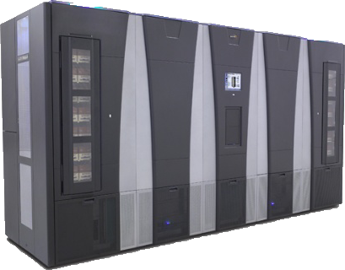
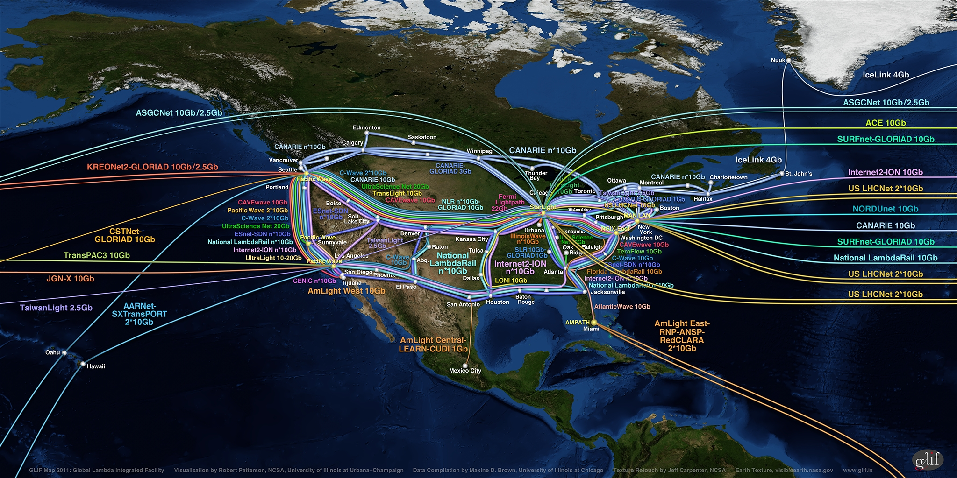
Blue Waters Computing System
Aggregate Memory – 1.66 PB
Scuba Subsystem - Storage Configuration for User Best Access
External Servers
IB Switch
>1 TB/sec
10/40/100 Gb
Ethernet Switch
66 GB/sec
120+ GB/sec
300+ Gbps WAN
Spectra Logic: 200 usable PB
Sonexion: 26 usable PB

Slide 3
g
Gemini Fabric (HSN)
Cray XE6/XK7 - 288 Cabinets
DSL
48 Nodes
XE6 Compute Nodes - 5,659 Blades – 22,636 Nodes –
362,176 FP (bulldozer) Cores – 724,352 Integer Cores
XK7 GPU Nodes
1057 Blades – 4,228 Nodes
33,824 FP Cores – 4,228 GPUs
Resource Manager (MOM)
64 Nodes
BOOT
2 Nodes
SDB
2 Nodes
RSIP
12Nodes
Network GW
8 Nodes
Unassigned
74 Nodes
LNET Routers
582 Nodes
SMW
esLogin
4 Nodes
Boot RAID
InfiniBand fabric
Boot Cabinet
Import/Export
Nodes
10/40/100 Gb
Ethernet Switch
HPSS Data Mover
Nodes
Sonexion
25+ usable PB online storage
36 racks
Cyber Protection IDPS
Management Node
NCSAnet
Near-Line Storage
200+ usable PB
esServers Cabinets
NPCF
Supporting systems: LDAP, RSA, Portal, JIRA, Globus CA, Bro, test systems, Accounts/Allocations, Wiki
Notes:
Blue Waters supersystem, Need to emphasize the unprecedented scale. Largest Cray, IE, HPSS, Lustre, Network. Hold performance discussion to later slides. Note all storage sizes are usable storage.

Slide 4
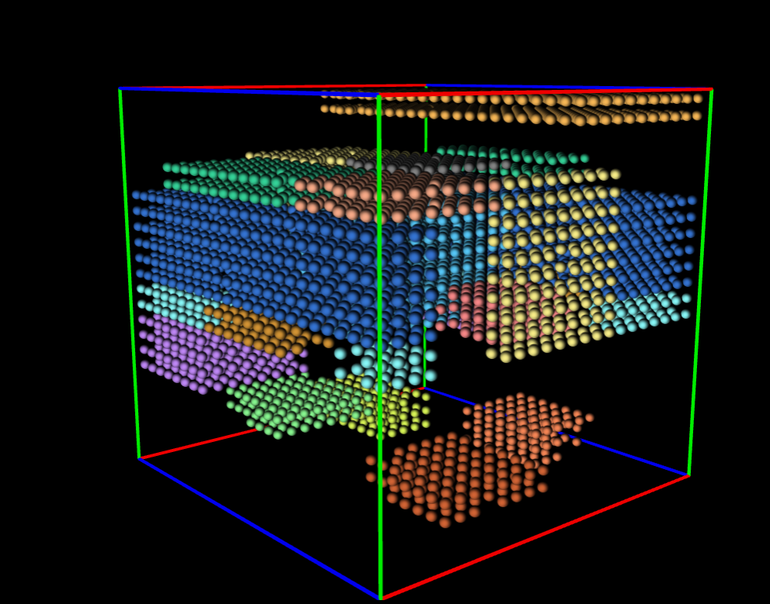
Overview
Moab/Torque used
Modified for Topology Aware Placement for 3D torus net
Job counts ~2k R, 3k Q
Job size range: 1-22k (up to 27k) nodes
Policy prioritizes large jobs
3D placement adds additional constraint, but only changes degree of already existing scheduling challenges

Slide 5
Scheduler Configuration
Heterogenous resource distinguished by Torque node feature (more efficient than Moab for this)
Default feature “xe” applied (“xk” is minority)
#Include modular breakout for configuration (organized, portable)
Changes vetted on test machine and through bi-weekly change control review *
Maintain change log and older revs
* Exceptions for urgent conditions or pre-approved tunables

Slide 6
Scheduler Policy - Overview
Goals
Perfectly fair, perfectly utilized, zero wait times, zero restrictions, responsive interaction, large job favor
Large jobs prioritized
Can be overridden to some degree by queue: high/normal/low/debug
Queue charge factors differ: 2/1/.5/1 respectively
Can be overridden by aged priority growth
Priority calculation and tuning evaluated with spreadsheet (sample jobs show resultant priority)

Slide 7
Scheduler Policy - Discounts
Good utilization can be assisted greatly with cooperative job characteristics
Incentivize cooperation with charge discounts
Compounding charge discounts provided for:
Accurate wallclock specification
Did the job run as backfill? (backfill opportunities are continually polled and plotted visually on user portal)
Was job preemptible or startable with less than requested walltime?

Slide 8
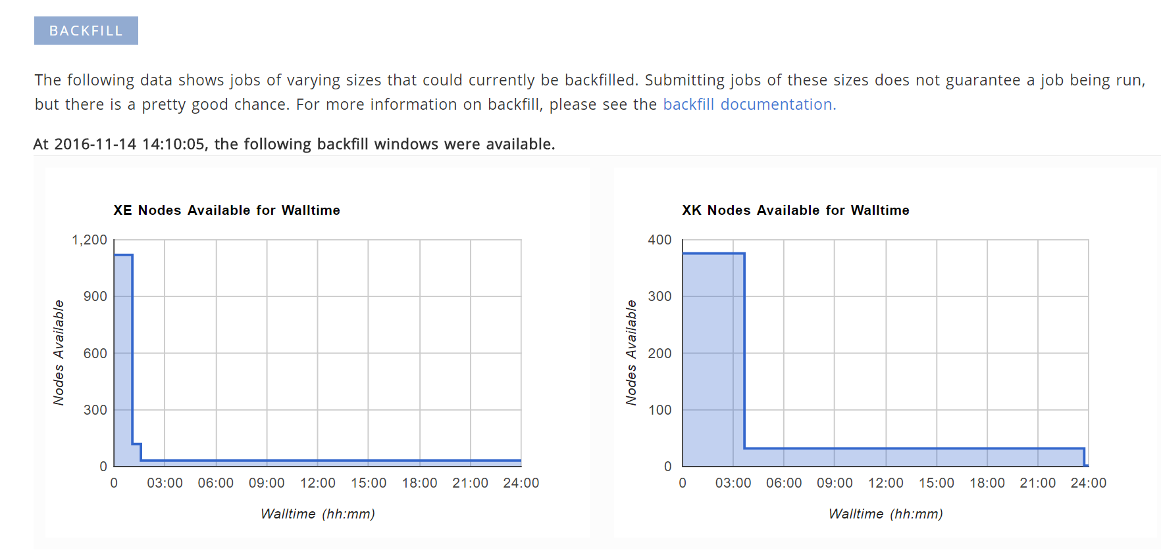
Backfill Plots on User Portal

Slide 9
Scheduler Policy - Throttling
Scheduler performance
MAXIJOB (per user, per project)
Fairness
MAXIJOB (per user, per project)
MAXINODE (per user, per project)
Fairshare
Policy defined when it was needed – sometimes best not to be too prescriptive/presumptive before a problem exists to solve

Slide 10
Job Dependency Trains
Priority accrual while ineligible (disabled)
Single global setting
Good for large jobs (newly eligible dependency makes efficient use of idle nodes left by previous job)
Bad for small jobs (surrounding drain cost perturbation when eligibility status changes)
Workaround solution:
Manual reservations for qualifying workloads
Must be monitored for use and blocking other workload
Must be managed for torus placement consolidation

Slide 11
Submit Filter & Submit Wrapper
One called by qsub, one calls qsub
Wrapper required to override command line
Applies default options if not present
Validates parameters provided for syntax or policy
Verifies the allocation is valid, not expired or exhausted (can reject submission)

Slide 12
Reservation Depth
Determines how many priority jobs in future Moab calculates placement for each iteration
RESDEPTH = 10 (per feature, xe & xk)
Keeps policy true – prevents priority dilution (aka ~100% backfill)
Goal should be deep enough to cover at least 1 full wall clock interval into future (varies by jobs submitted)
Improves prediction for job start time for users
Look at reservations, not showstart!
Drastic impact on scheduler iteration computation requirement

Slide 13
Job Templates
Transparent in function – modifying job attributes
Used to apply utilization-beneficial shape consolidation for Topology Aware logic
Used to manage logical torus placement separation fence, when needed, between conflicting job geometries “long & narrow” vs. “wide/large”

Slide 14
Scheduler Monitoring
Jenkins used to launch and record historical results
Command responsiveness
Scheduler state
Other Jenkins hosted regression tests rely on workload manager to launch test
Moab log monitored for key errors or known problem signatures, job reservation sliding, etc
Iteration time continually tracked and plotted

Slide 15
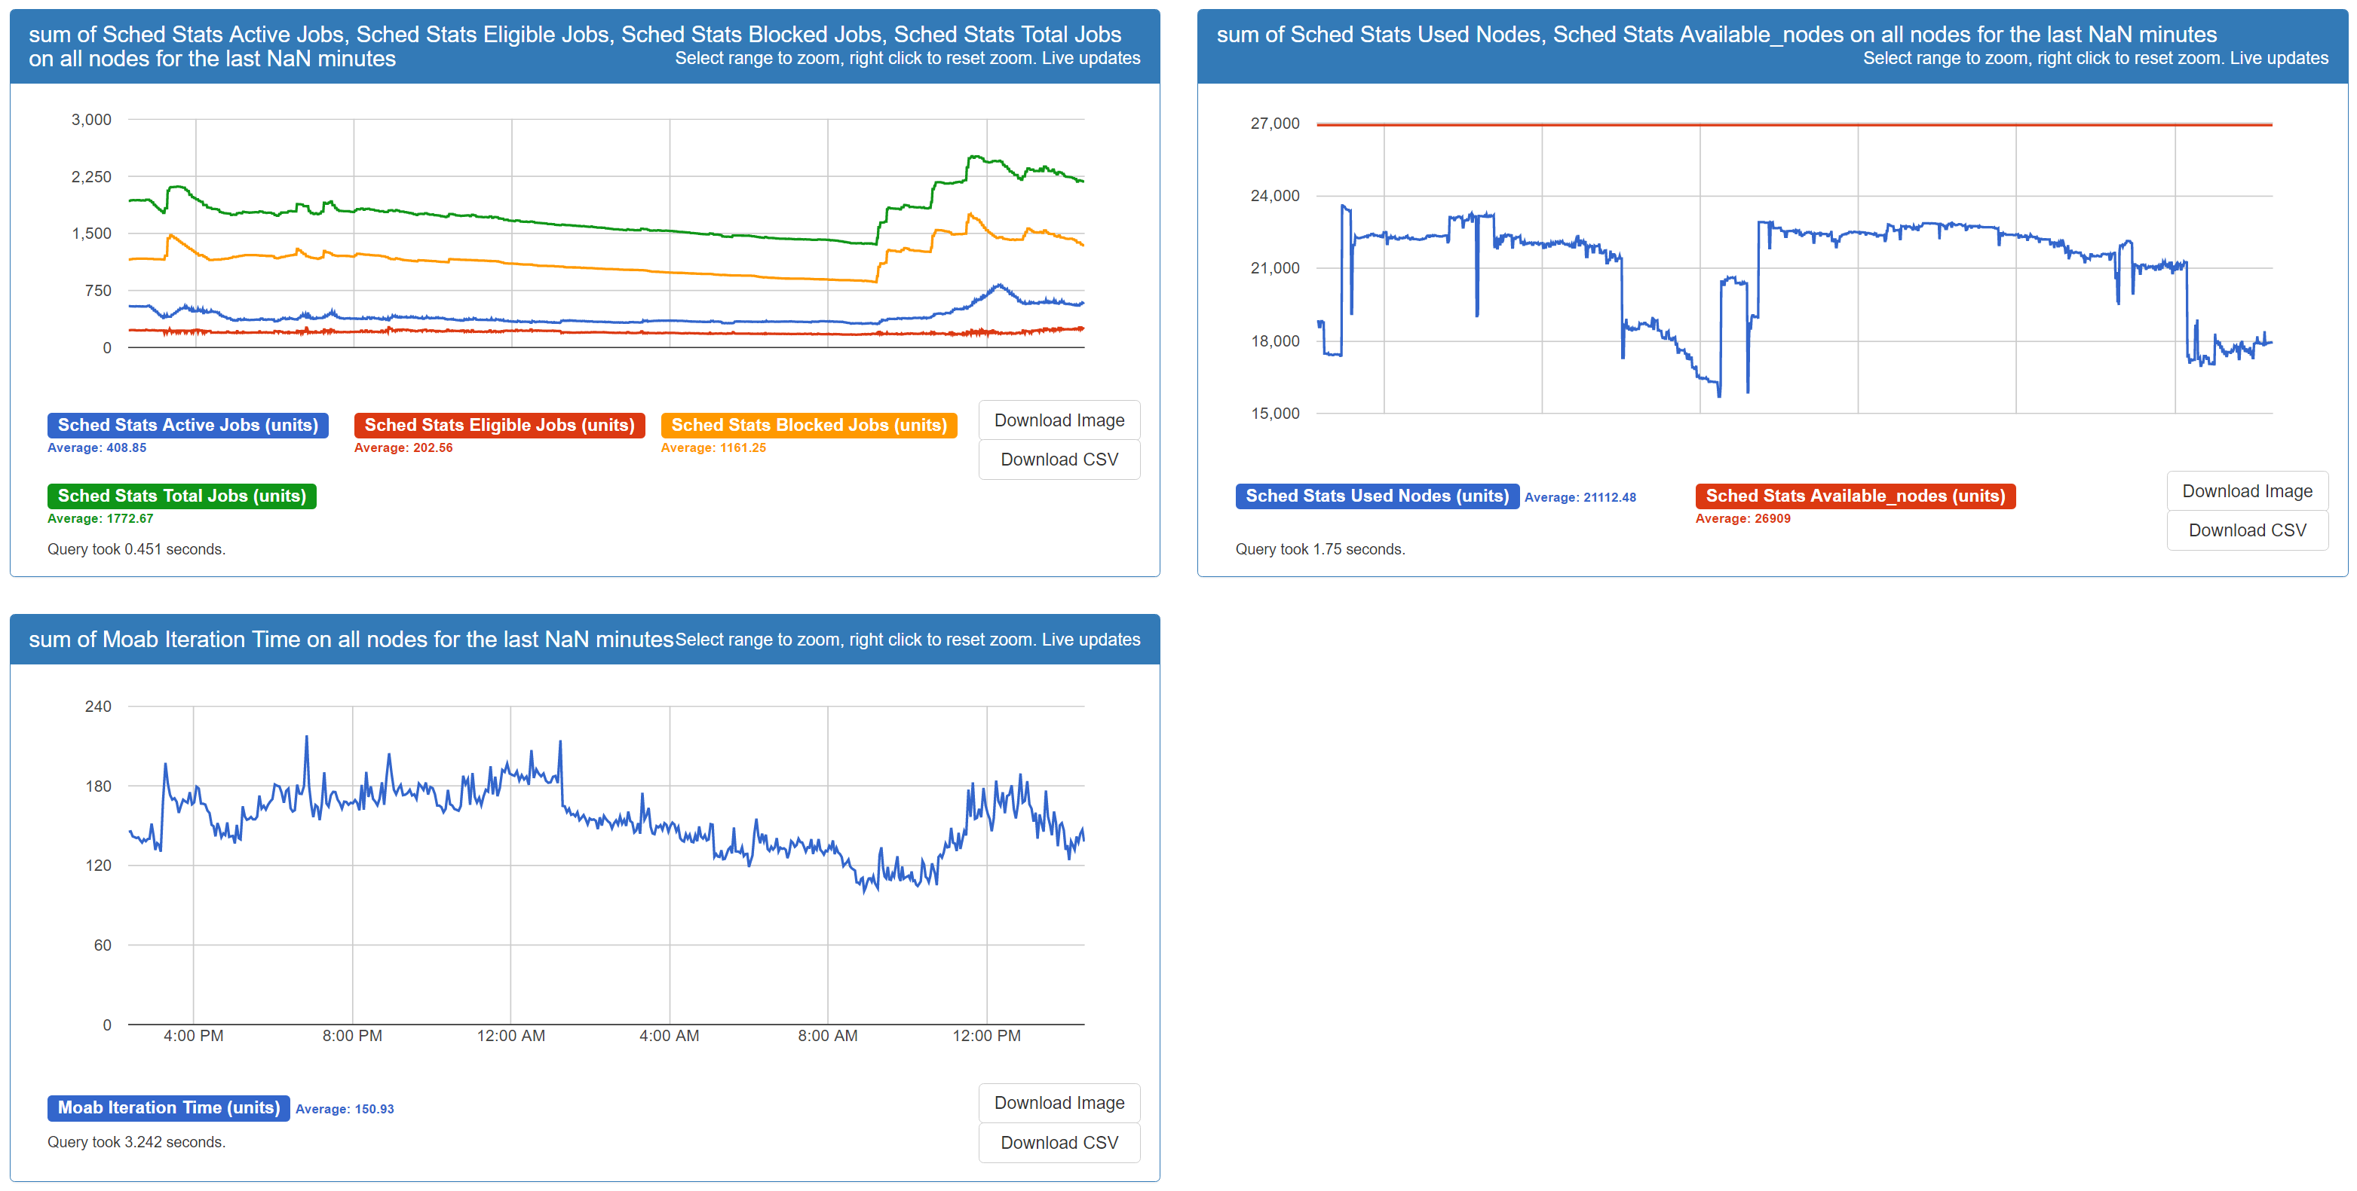
Custom Dashboard from Collected Stats

Slide 16
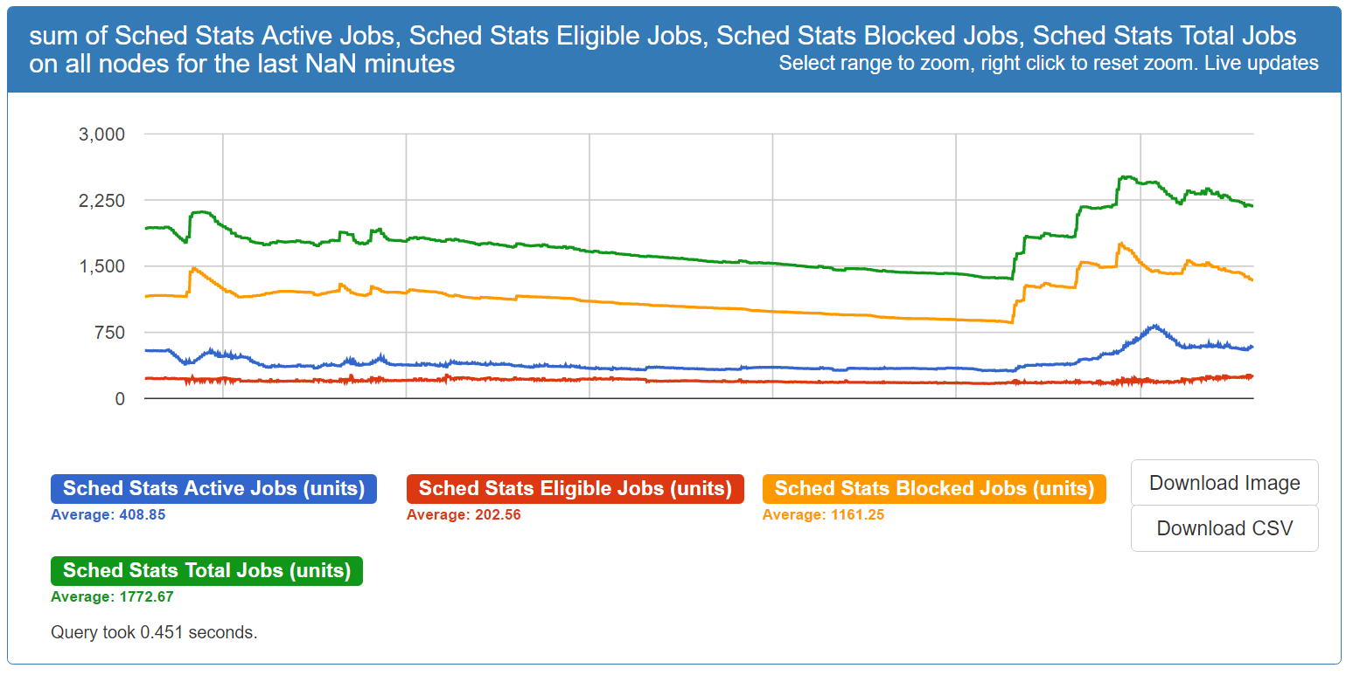
Job View

Slide 17
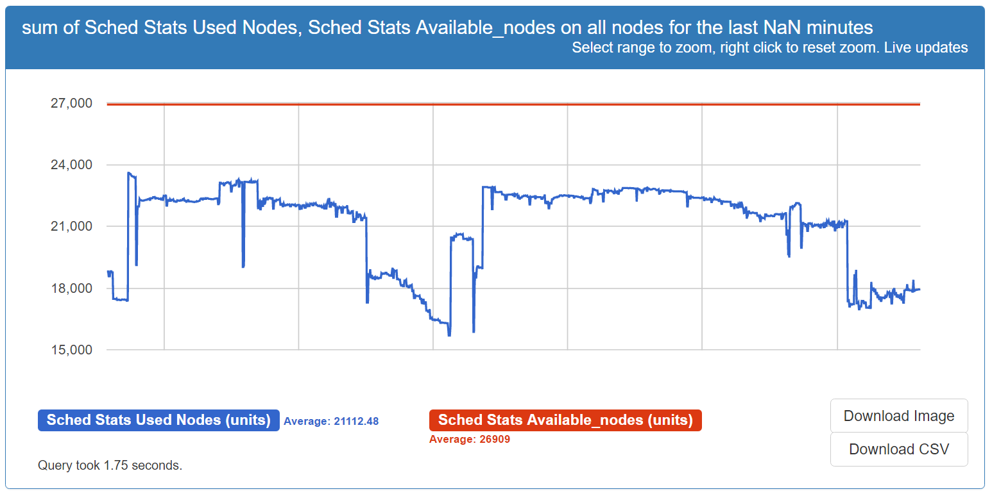
Node Utilization

Slide 18
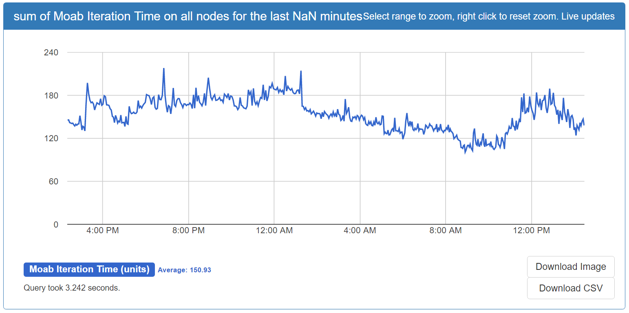
Scheduler Iteration Time

Slide 19
Accounting
Node level charging
Torque and Moab bisect community efforts by offering accounting options in both
Each has advantages and historical issues
Using Torque accounting now, moving to Moab
Moab should be superset of information (e.g. reservations)
We still must augment with additional job metadata we parse from other streams (e.g. backfill status of job)

Slide 20
Testing and Simulation
Simulators exist at multiple levels
ALPS/Torque/Moab
No customer access to Cray ALPS simulator
Torque Simulator (NativeRM) is not performant for *many* job testing, but works well for validation of real Moab policy or fixes against a many node scenario (Blue Waters configuration can be faked to Moab)
Moab simulator refactored, not mature yet (show stopping bugs)

Slide 21
Policy and Bug Review Meetings
Weekly review of scheduler policy, it’s impact, users reported issues, resource management efficiency
Semi-weekly review of bugs, workarounds, and resolution progress with vendors

Slide 22
Documentation & Communication
Users frequently reminded of best practices, discount incentives, documentation location
Expose policy enough to set expectations; stop shy of exposing so much it’s game-vulnerable
Internal documentation for administering the machine and policy goals – constantly growing admin knowledge base

Slide 23
Conclusion
Large scale and Topology Aware scheduling present unique challenges – many are common though and simply magnified
Determining scheduling policy is a complex game of balancing tradeoffs between goals
Policy goals are mostly common (be perfect in all aspects), but vary in emphasis
Jobs are an uncontrolled variable in a complex equation – but desired behavior can be incentivized

