Slide 1
Stateless Provisioning: Modern Practice in HPC
Leveraging Systemd, Ansible, and CI practices to provide policy compliant OS images for computational clusters
John Blaas
University of Colorado Boulder
John Roberts
Argonne National Laboratory

Slide 2
Where we started
OS image/directories as git repos
Worked well but can lead to fairly unwieldy git repos
Can’t be shared with others
Secrets in the repo
Used chroot to apply updates and configuration against the image directories
For some updates this also required us to bind mount certain filesystems from the host OS as well
Very little testing after an image had been built - relied on deploying an image to staging hardware first to reveal any issues.

Slide 3
Motivation
Incorporate tests to verify the ultimate state of an image, strictly define our computing environment through these tests
Provide stakeholders with better reports and audits of the environment we provide to users
Lower barrier of entry for new system administrators in being able to contribute to the code base, configuration changes

Slide 4
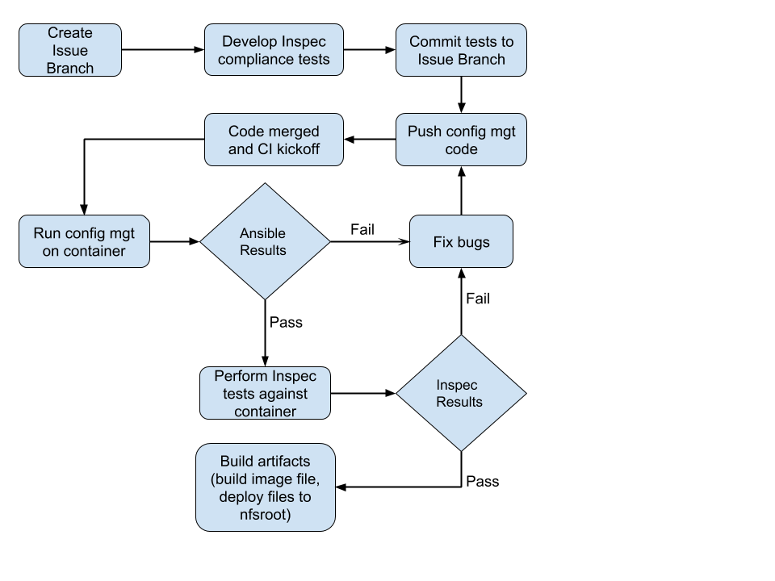

Slide 5
What is systemd-nspawn?
Improved chroot, no need to bind mount the usual suspects
Tool that spawns unique namespaces
Designed with building, testing, and debugging in mind
Incredibly simple to get started with
> rpm -i --root=/tmp/centos7 centos7-release.rpm
> yum --installroot=/tmp/centos7 groupinstall Base
> systemd-nspawn -bD /tmp/centos7

Slide 6
What is Inspec?
Compliance testing framework based on Serverspec
Designed to have clear syntax and be platform agnostic
Describes tests as a collection of controls which can be grouped into compliance profiles
Allows you to define policy for the state of a node
Tests can be run locally or with SSH
Originally developed by the Chef team

Slide 7
Future Work
Developing tests that can be used to train new system administrators in configuration management and where/how to define variables
Publish Inspec compliance profiles that help define our computing environment
Expose group_vars to condo node users so that they can have the option to self-manage their environment
Notes:
These are the immediate items I want to get accomplished in the next 1-2 years with this project/workflow

Slide 8
Why not use X instead?
You can substitute out the initial provisioning element to something else such as xCat, Warewulf, or your own custom provisioning framework.
You can also use many other tools such as Cobbler, Foreman,etc to help you with managing DHCP,PXE,DNS
You can even substitute out Inspec for another testing framework ( Molecule, Testinfra, Goss )
Notes:
Adding this for if we get questions on why another technology wasn’t used by us…

Slide 9
Software we use
OS: Centos7 or RHEL7
Resource Manager: Slurm
Node Health Check: NHC
Git Repos: Gitlab-ce
Gitlabrunner: CI Runner
Config Mgmt: Ansible
Compliance Tests: Inspec
Notes:
Additionally if folks want to know what software we would suggest running to fulfill the workflow we have proposed

