Slide 1




Ahsanullah University of Science and Technology
Final Project
Presentation
Presentation by
Group - 2
07 February 2024
Spring | 2023

Slide 2









Group Introduction
Bidyarthi Paul
20200104023
Dipta Biswas
SM Musfiqur Rahman
20200104013
20200104002
Ziaul Hassan
20200104004

Slide 3


Submitted To
Mr. Faisal Muhammad Shah
Associate Professor
Dept. of CSE
Mr. Md. Zahid Hossain
Lecturer Grade-II
Dept. of CSE

Slide 4

Title
Methodology
Introduction
Experimental Result
Overview
Literature Review
Limitations and Future Works
Dataset
Conclusion
Group 4502

Slide 5

Title
BanglaHeartbeat: Mapping Emotional Echoes in
Social Media Texts

Slide 6



Introduction
What
Why
How

Slide 7

Paper Title | Model | Approach | Accuracy
Comparison of classical machine learning approaches on bangla textual emotion analysis.[1] | 1. Naive Bayes 2.Decision Tree 3. KNN 4. SVM 5. K-Means Clustering | 1.Machine learning approach | SVM achieve highest accuracy 52.98%
A hybrid model for automatic emotion recognition in suicide notes[2] | 1. NB 2. SVM 3. ME | 1.Machine learning approach | 53%
Automatic Detecting of Insulting Sentences in Conversation[3] | 1. Multi-Layer Neural Network 2.SVM 3. Naive Bayes 4. Decision Tree | 1.Machine learning approach | SVM achieve highest 76.9%
SemEval-2007 Task 14: Affective Text [4] | 1.UPAR7 2.SICS 3.CLaC 4.SWAT 5.CLaC-N | 1. Linguistic approach 2. unsupervised approach 3. Supervised approach | UPAR7 achieve 93% accuracy for anger
Literature Review
Table :01

Slide 8
Paper Title | Model | Approach | Accuracy
A Dataset for Analyzing Fine-Grained Emotions on Noisy Bangla Texts [5] | 1. Bi-LSTM 2. linear SVM | 1. Machine learning approach | Bi-LSTM + Attn. (FastText) 57.13%
Bangla Text Emotion Classification using LR, MNB, and MLP with TF-IDF & CountVectorizer. [6] | 1.Multi-Layer Perceptron 2.Multinomial Naive Bayes 3.Logistic Regression | 1. supervised machine learning approach | Multinomial Naive Bayes achieve 43%
An annotated dataset for emotional analysis of Bengali short stories.[7] | 1.Logistic Regression 2.Linear SVM 3.K Nearest Neighbors 4.CNN 5.Random Forest Classifier | 1.Machine learning approach | Logistic Regression 73%
Literature Review
Table :02

Slide 9






Dataset
EmoNoBa
22,698 public comments in Bangla from various social platform
Content
Labels: love, joy, surprise, anger, sadness, fear.
Purpose
Rich and diverse resource

Slide 10
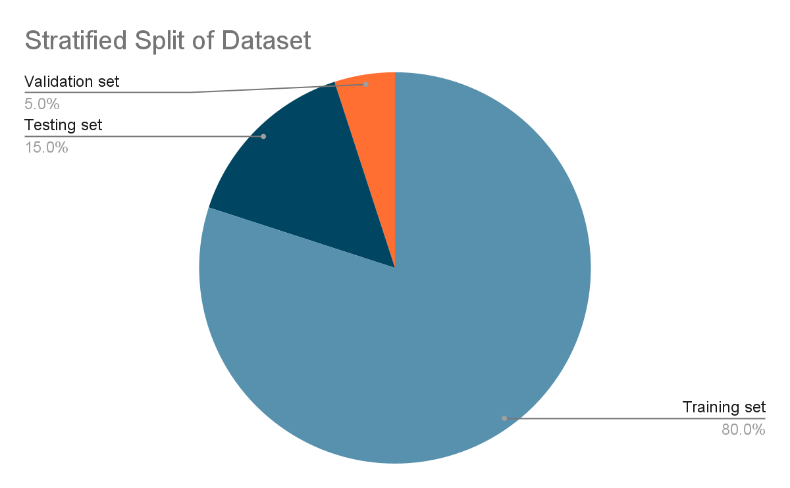
Dataset

Slide 11

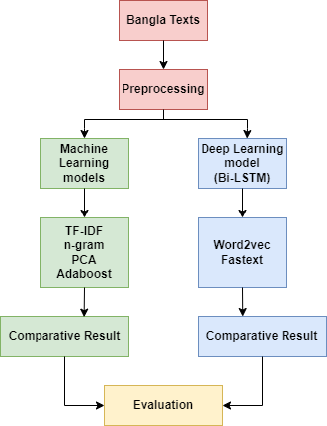
Proposed Methodology
Machine Learning models
Deep learning models
Figure: 01

Slide 12
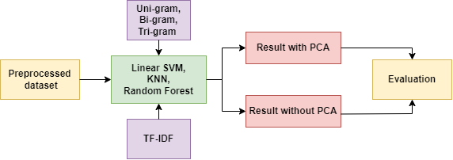
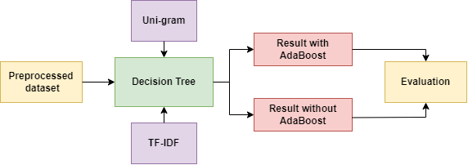
Proposed Methodology
Machine Learning models
Linear SVM
KNN
Random Forest
Figure: 02
Figure: 03

Slide 13
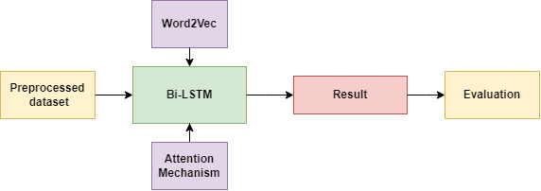
Proposed Methodology
Deep Learning models
Bi-LSTM
Word2vec
Figure: 04

Slide 14
Model | n-Gram | PCA | AdaBoost | F1-score
SVM | Uni-gram | No | No | 0.63
KNN | Uni-gram | No | No | 0.57
Random Forest | Uni-gram | No | No | 0.57
Decision Tree | Uni-gram | No | Yes | 78.6
Bi-LSTM | No | No | No | 23.73
Experimental Result
Table :03

Slide 15
Limitations
Data Limitation
Emotional Imbalance
Analytical Tool Limitations
Variance in the occurrence of different emotions in the dataset.
Use of traditional tools like n-grams.
Data came only from social media.
Limited scope in capturing everyday and contextual usage of Bangla.
Potential bias in the analysis results.
Inability to capture all linguistic nuances.

Slide 16
Future Work
Future Research Directions
Incorporate diverse text sources for a comprehensive understanding of Bangla usage.
Ensure balanced representation of all emotions in the data.
Explore advanced technologies such as BERT or GPT for improved contextual understanding.
Enhance text preprocessing techniques to refine analysis.
Investigate novel approaches for integrating multiple models to gain deeper insights into Bangla emotions.

Slide 17
Conclusion
Linear SVM model with unigram analysis proved most effective in understanding emotions in Bangla text from social media comments, suggesting promising avenues for future research in sentiment analysis enhancement.

Slide 18


Ahsanullah University of Science and Technology
Thank You
Presentation by
Group 2
Spring | 2023

Slide 19

Reference
[1] Md Rahman, Md Seddiqui, et al. 2019. Comparison of classical machine learning approaches on bangla textual emotion analysis. arXiv preprint arXiv:1907.07826.
[2] Hui Yang, Alistair Willis, Anne De Roeck, and Bashar Nuseibeh. 2012. A hybrid model for automatic emotion recognition in suicide notes. Biomedical informatics insights, 5:BII–S8948. Journal, Year.
[3] Merav Allouch, Amos Azaria, Rina Azoulay, Ester Ben-Izchak, Moti Zwilling, and Ditza A Zachor. 2018. Automatic detection of insulting sentences in conversation. In 2018 IEEE International Conference on the Science of Electrical Engineering in Israel (ICSEE), pages 1–4. IEEE.. Journal, Year.
[4] Carlo Strapparava and Rada Mihalcea. 2007. Semeval-2007 task 14: Affective text. In Proceedings of the Fourth International Workshop on Semantic Evaluations (SemEval-2007), pages 70–74.

Slide 20
Reference
[5] Islam, Khondoker & Yuvraz, Tanvir & Hassan, Enamul & Islam, Md Saiful. (2022). EmoNoBa: A Dataset for Analyzing Fine-Grained Emotions on Noisy Bangla Texts.
[6] Ahmed, Tamal & Mukta, Shawly & Mahmud, Tamim & Hasan, Sakib & Hussain, Md Gulzar. (2022). Bangla Text Emotion Classification using LR, MNB, and MLP with TF-IDF & CountVectorizer. 10.1109/ICSEC56337.2022.10049341.
[7] Pal, Aditya & Karn, Bhaskar. (2020). Anubhuti -- An annotated dataset for emotional analysis of Bengali short stories.

