Slide 1
Machine Vision
Convolutional neural networks

Slide 2
Image classification
https://towardsdatascience.com/the-most-intuitive-and-easiest-guide-for-convolutional-neural-network-3607be47480

Slide 3

Image recognition in tic-tac-toe game
for example, a graphic tablet.
the player can start and draw either O or X...
...so the program must recognize what the 'computer player' is playing.
https://www.youtube.com/watch?v=HGwBXDKFk9I Neural Networks Part 8: Image Classification with Convolutional Neural Networks (CNNs); StatQuest with Josh Starmer

Slide 4
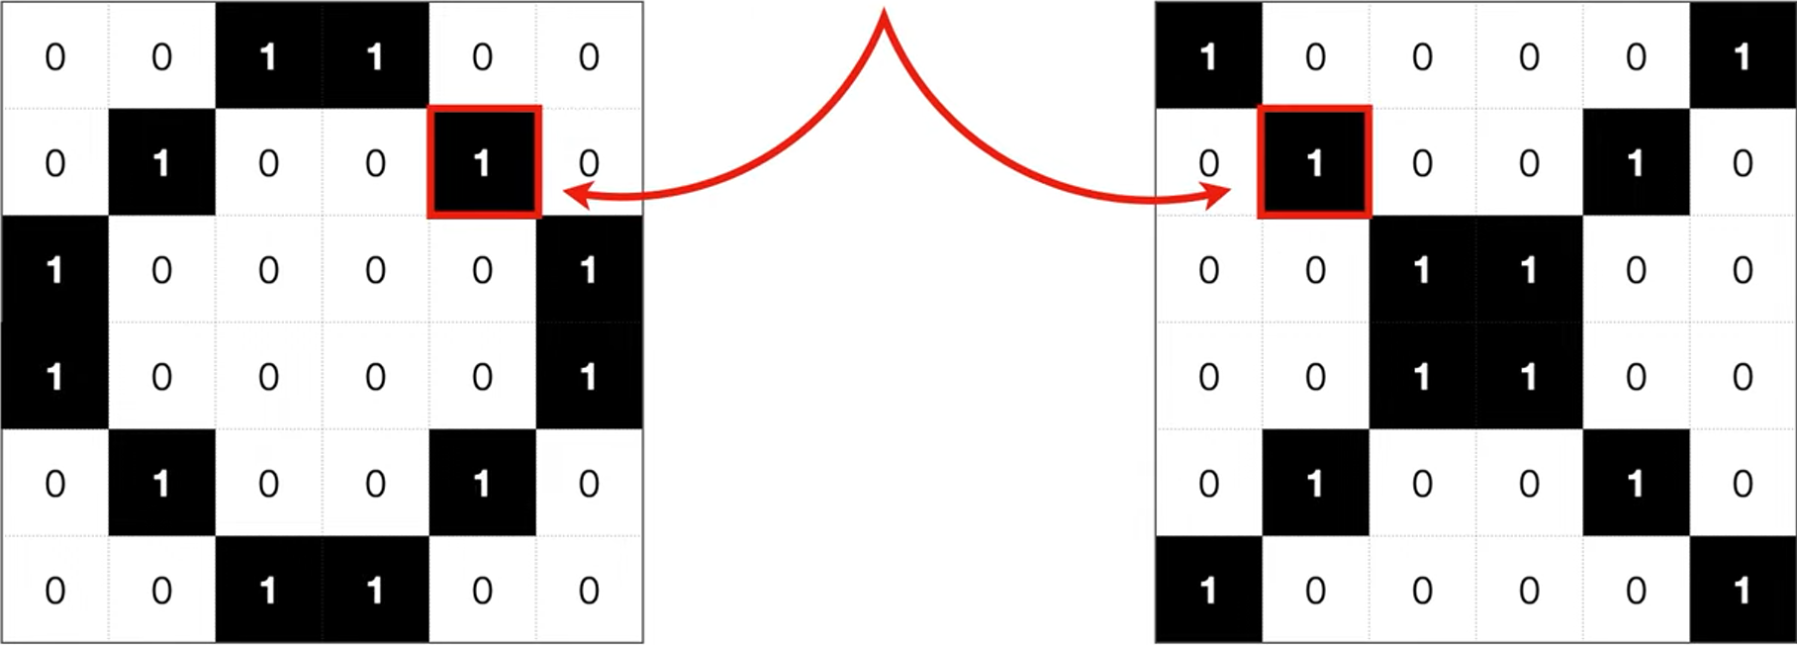
Image recognition in tic-tac-toe game
for example, a graphic tablet.
the player can start and draw either O or X...
...so the program must recognize what the 'computer player' is playing.
The image of 'O' and 'X' takes the form of a binary matrix.
https://www.youtube.com/watch?v=HGwBXDKFk9I Neural Networks Part 8: Image Classification with Convolutional Neural Networks (CNNs); StatQuest with Josh Starmer

Slide 5
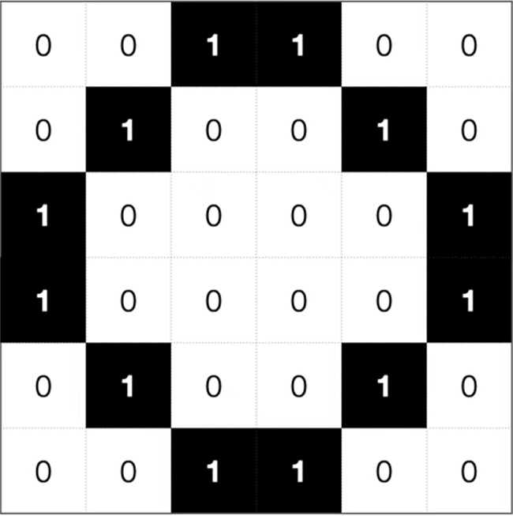
Image recognition - a regular neural network
The player drew this:
6 px
6 px
https://www.youtube.com/watch?v=HGwBXDKFk9I Neural Networks Part 8: Image Classification with Convolutional Neural Networks (CNNs); StatQuest with Josh Starmer

Slide 6
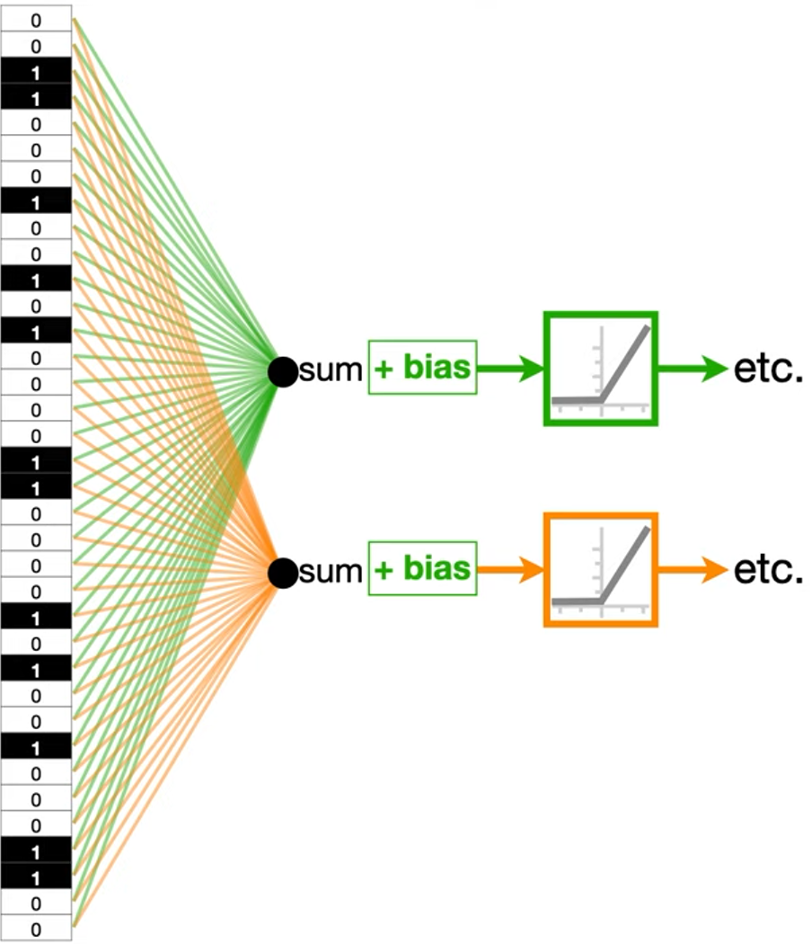
Image recognition - a regular neural network
The player drew this:
6 px
Why a regular neural network is a bad idea?
1. It doesn't scale well.
2. It doesn't account for shifts.
3. It doesn't leverage correlations observed in the image.
6 px
https://www.youtube.com/watch?v=HGwBXDKFk9I Neural Networks Part 8: Image Classification with Convolutional Neural Networks (CNNs); StatQuest with Josh Starmer

Slide 7
Image recognition - a regular neural network
The player drew this:
6 px
6px * 6px = 36 input nodes
Why a regular neural network is a bad idea?
1. It doesn't scale well.
100px * 100px = 10 000!
6 px
https://www.youtube.com/watch?v=HGwBXDKFk9I Neural Networks Part 8: Image Classification with Convolutional Neural Networks (CNNs); StatQuest with Josh Starmer

Slide 8
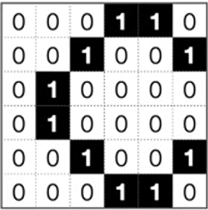
Image recognition - a regular neural network
The player drew this:
6 px
6px * 6px = 36 input nodes
Why a regular neural network is a bad idea?
1. It doesn't scale well.
2. It doesn't account for shifts.
3. It doesn't leverage correlations observed in the image.
100px * 100px = 10 000!
6 px
A shift of 1 pixel to the right.
https://www.youtube.com/watch?v=HGwBXDKFk9I Neural Networks Part 8: Image Classification with Convolutional Neural Networks (CNNs); StatQuest with Josh Starmer

Slide 9
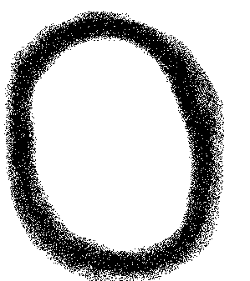
Image recognition - a regular neural network
The player drew this:
6 px
6px * 6px = 36 input nodes
Why a regular neural network is a bad idea?
1. It doesn't scale well.
2. It doesn't account for shifts.
3. It doesn't leverage correlations observed in the image.
100px * 100px = 10 000!
6 px
A shift of 1 pixel to the right.
https://www.youtube.com/watch?v=HGwBXDKFk9I Neural Networks Part 8: Image Classification with Convolutional Neural Networks (CNNs); StatQuest with Josh Starmer

Slide 10
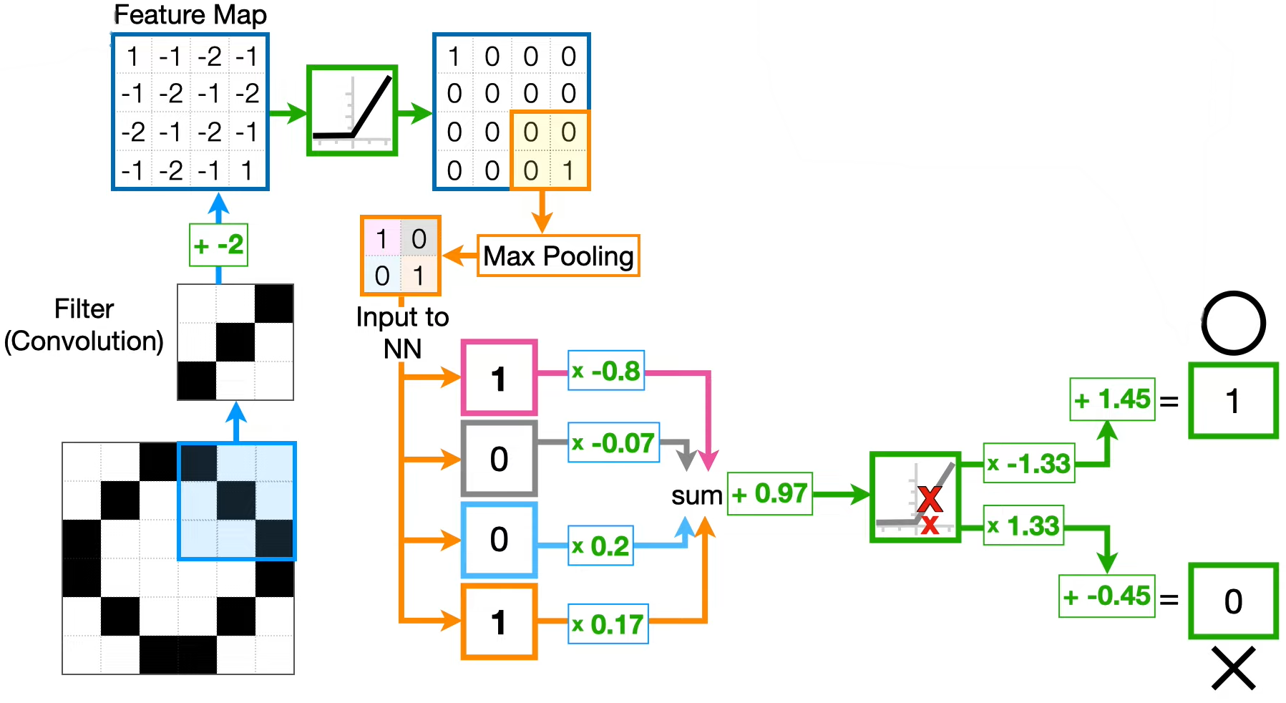
Convolutional Neural Network:
https://www.youtube.com/watch?v=HGwBXDKFk9I Neural Networks Part 8: Image Classification with Convolutional Neural Networks (CNNs); StatQuest with Josh Starmer

Slide 11
Convolutional Neural Network: 1. Convolution 2. Max pooling 3. Regular neural network
https://www.youtube.com/watch?v=HGwBXDKFk9I Neural Networks Part 8: Image Classification with Convolutional Neural Networks (CNNs); StatQuest with Josh Starmer

Slide 12
Convolutional Neural Network: 1. Convolution 2. Max pooling 3. Regular neural network
https://www.youtube.com/watch?v=HGwBXDKFk9I Neural Networks Part 8: Image Classification with Convolutional Neural Networks (CNNs); StatQuest with Josh Starmer

Slide 13
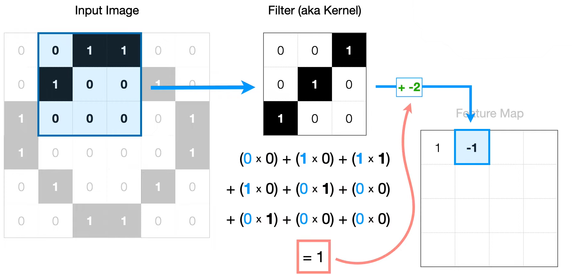
Convolutional Neural Network: 1. Convolution
https://www.youtube.com/watch?v=HGwBXDKFk9I Neural Networks Part 8: Image Classification with Convolutional Neural Networks (CNNs); StatQuest with Josh Starmer

Slide 14
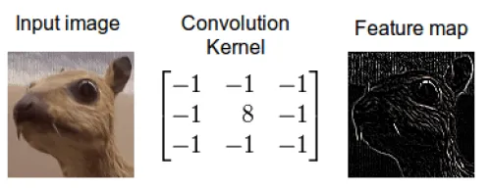
Convolutional Neural Network: 1. Convolution
https://www.youtube.com/watch?v=HGwBXDKFk9I Neural Networks Part 8: Image Classification with Convolutional Neural Networks (CNNs); StatQuest with Josh Starmer

Slide 15
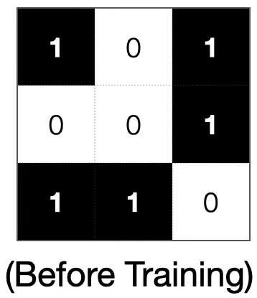
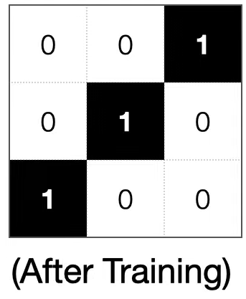
Convolutional Neural Network: 1. Convolution
Backpropagation
https://www.youtube.com/watch?v=HGwBXDKFk9I Neural Networks Part 8: Image Classification with Convolutional Neural Networks (CNNs); StatQuest with Josh Starmer

Slide 16
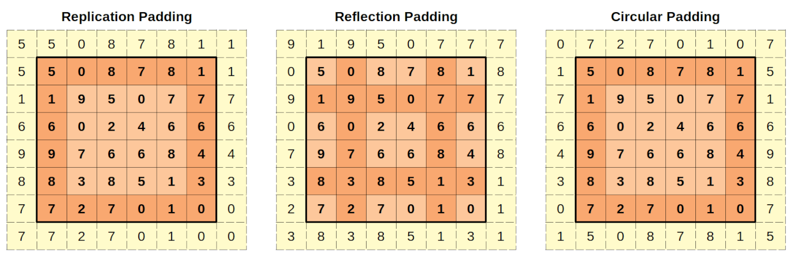
Convolutional Neural Network: 1. Convolution
Same padding (maintains size)
Stride length = 1px
Padding techniques:
Zero padding
Reflective/mirror padding
Replicate padding
Circular padding (periodic)
No padding / valid padding stride length =1px
https://towardsdatascience.com/the-most-intuitive-and-easiest-guide-for-convolutional-neural-network-3607be47480

Slide 17
Convolutional Neural Network: 1. Convolution
stride length =1px
stride length =2px
https://towardsdatascience.com/a-comprehensive-guide-to-convolutional-neural-networks-the-eli5-way-3bd2b1164a53

Slide 18
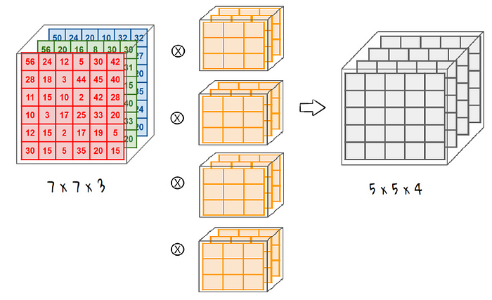
Convolutional Neural Network: 1. Convolution
Input image,
Red Green Blue color space,
7x7 px resolution
4 filters with 3 channels each,
of size 3x3
https://towardsdatascience.com/the-most-intuitive-and-easiest-guide-for-convolutional-neural-network-3607be47480

Slide 19
Convolutional Neural Network: 1. Convolution
https://www.youtube.com/watch?v=HGwBXDKFk9I Neural Networks Part 8: Image Classification with Convolutional Neural Networks (CNNs); StatQuest with Josh Starmer

Slide 20
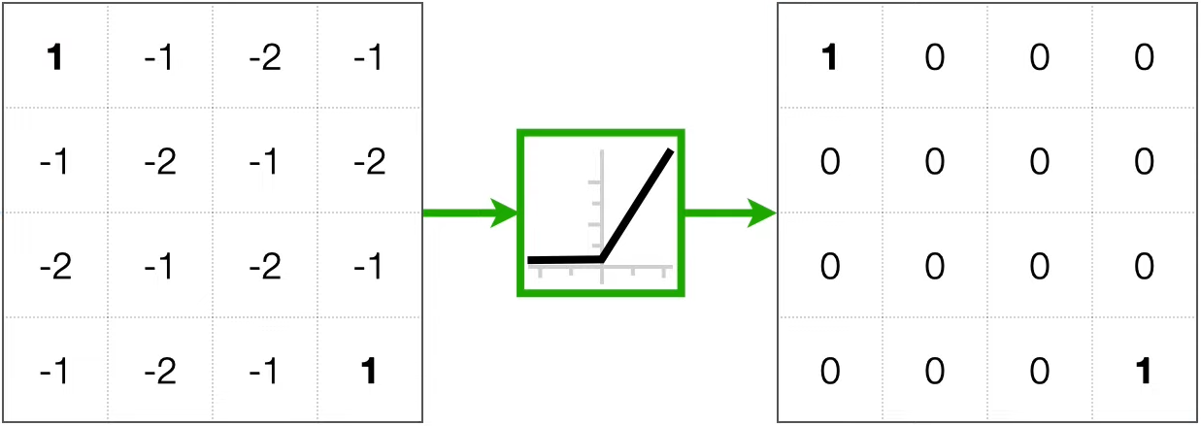
Convolutional Neural Network: 1. Convolution
Feature map
Feature map, post ReLU
ReLU = max(0,x)
https://www.youtube.com/watch?v=HGwBXDKFk9I Neural Networks Part 8: Image Classification with Convolutional Neural Networks (CNNs); StatQuest with Josh Starmer

Slide 21
Convolutional Neural Network: 1. Convolution 2. Max pooling 3. Regular neural network
https://www.youtube.com/watch?v=HGwBXDKFk9I Neural Networks Part 8: Image Classification with Convolutional Neural Networks (CNNs); StatQuest with Josh Starmer

Slide 22
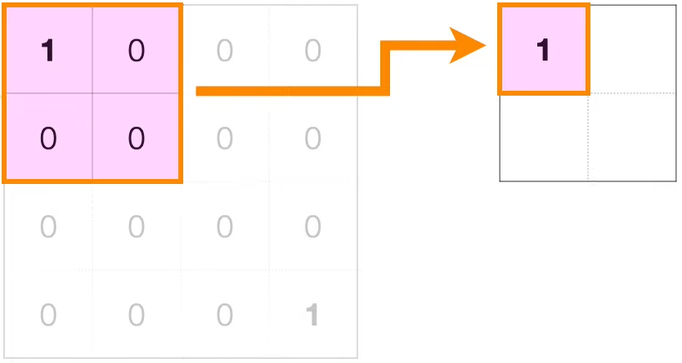
Convolutional Neural Network: 2. Max pooling
Feature map
Feature map, post ReLU
Max Pooled
ReLU
It could be seen like losing information at the first glimpse, but it’s rather getting more ‘meaningful’ data than losing. By removing some noise in the data and extracting only the significant one, we can reduce overfitting and speed up the computation.
https://towardsdatascience.com/the-most-intuitive-and-easiest-guide-for-convolutional-neural-network-3607be47480

Slide 23
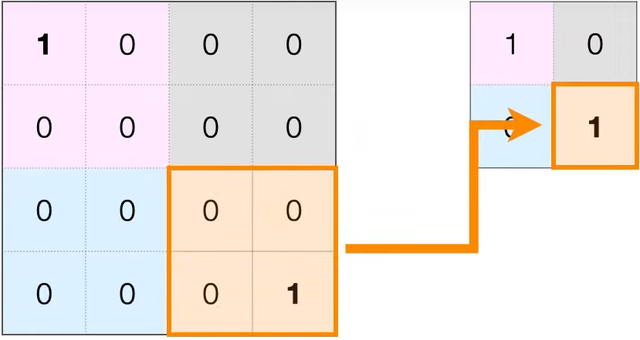
Convolutional Neural Network: 2. Max pooling
Feature map
Feature map, post ReLU
Max Pooled
ReLU
https://www.youtube.com/watch?v=HGwBXDKFk9I Neural Networks Part 8: Image Classification with Convolutional Neural Networks (CNNs); StatQuest with Josh Starmer

Slide 24
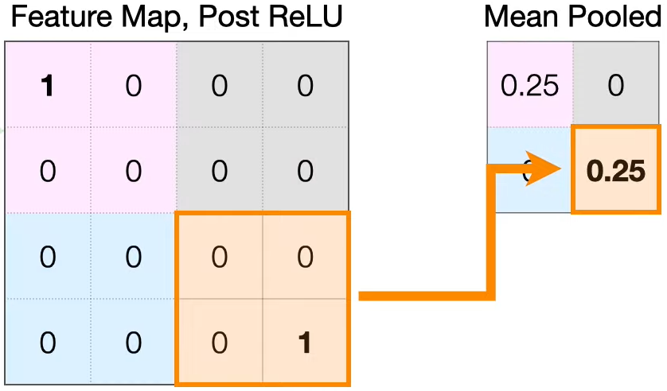
Alternatively
Feature map
Feature map, post ReLU
Mean Pooled
ReLU
https://www.youtube.com/watch?v=HGwBXDKFk9I Neural Networks Part 8: Image Classification with Convolutional Neural Networks (CNNs); StatQuest with Josh Starmer

Slide 25
Convolutional Neural Network: 2. Max pooling
Feature map
Feature map, post ReLU
Max Pooled
ReLU
https://www.youtube.com/watch?v=HGwBXDKFk9I Neural Networks Part 8: Image Classification with Convolutional Neural Networks (CNNs); StatQuest with Josh Starmer

Slide 26
Convolutional Neural Network: > 3x3 filter, stride 1 + Relu > Max Pooling 2x2, stride 2 > 2x2 -> 1x4 flatten > Dense layer 1 node + Relu > Output layer, 2 nodes
https://www.youtube.com/watch?v=HGwBXDKFk9I Neural Networks Part 8: Image Classification with Convolutional Neural Networks (CNNs); StatQuest with Josh Starmer

Slide 27
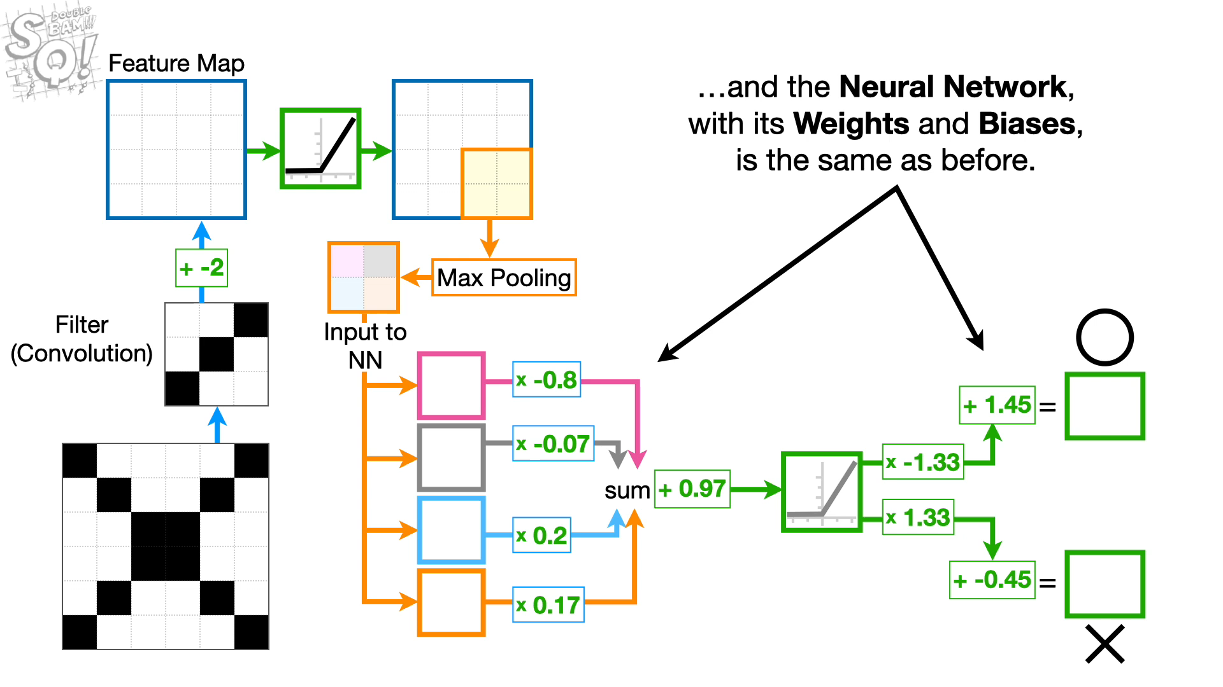
https://www.youtube.com/watch?v=HGwBXDKFk9I Neural Networks Part 8: Image Classification with Convolutional Neural Networks (CNNs); StatQuest with Josh Starmer

Slide 28
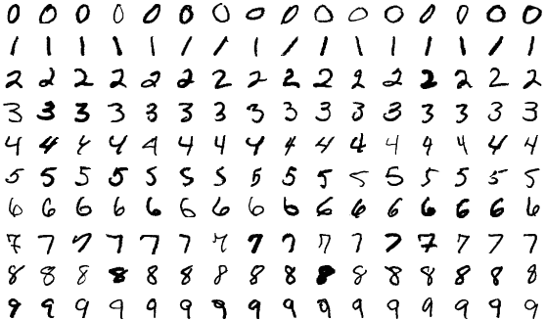


Code
Sources of inspiration: https://keras.io/examples/vision/ https://keras.io/api/datasets/
00_mnist.py
inputs = Input(shape=input_shape)
x = Conv2D(4, kernel_size=(3, 3), activ='relu')(inputs)
x = MaxPooling2D(pool_size=(2, 2))(x)
x = Flatten()(x)
x = Dense(64, activation='relu’)(x)
outputs = Dense(num_classes,activ='softmax')(x)

Slide 29
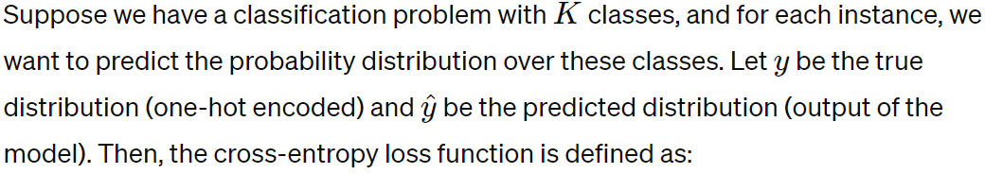

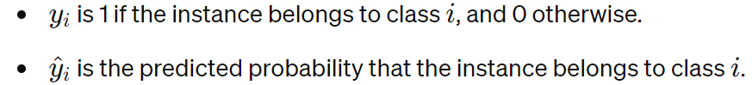

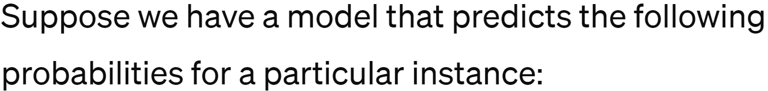
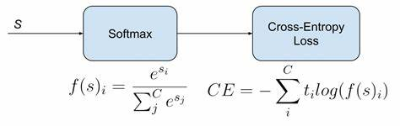
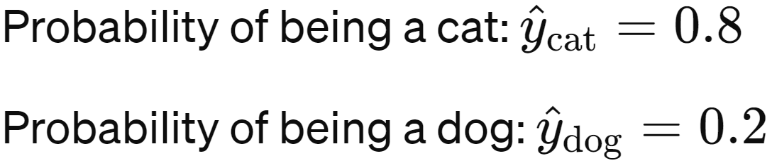
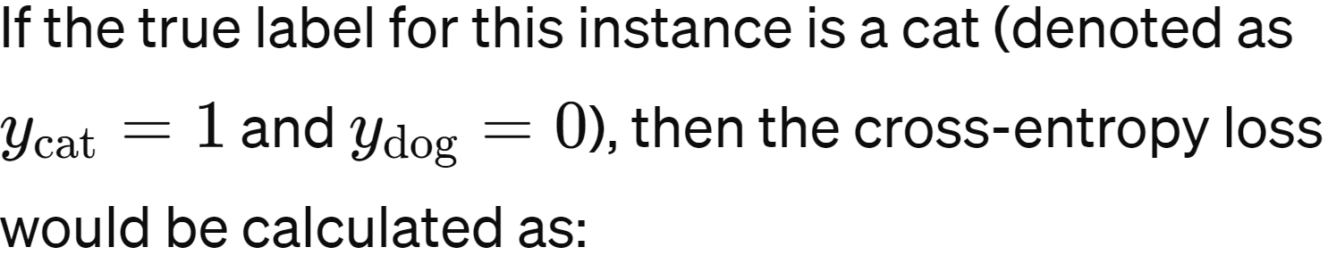

Cross-entropy loss function

Slide 30
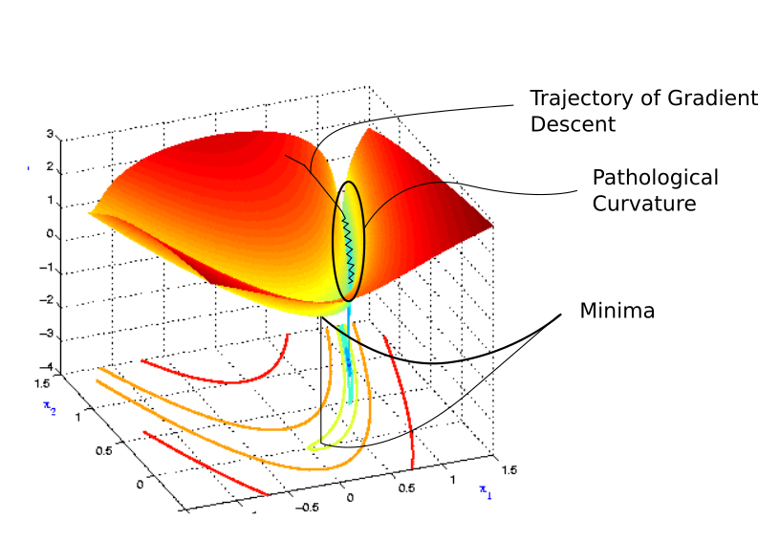
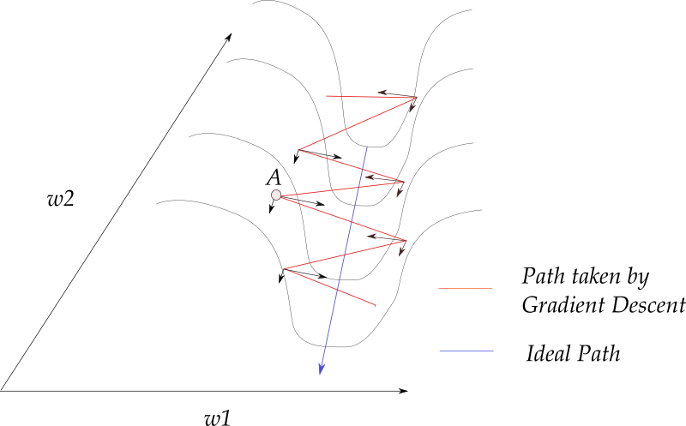
Optymizator ADAM - Adaptive Moment Estimation
ADAM accumulates gradients from previous steps to determine the direction in which to move.
https://blog.paperspace.com/intro-to-optimization-momentum-rmsprop-adam/

Slide 31
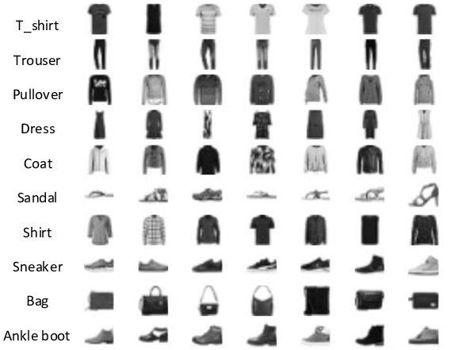
Code
01_a_fashion_mnist_training 01_b_fashion_mnist_import_completed
inputs = Input(shape=input_shape)
x = Conv2D(32, kernel_size=(3, 3), padding='same',activation='relu')(inputs)
x = Conv2D(32, kernel_size=(3, 3), padding='same',activation='relu')(x)
x = MaxPooling2D(pool_size=(2, 2))(x)
x = Dropout(0.5)(x)
x = Flatten()(x)
x = Dense(256, activation='relu')(x)
x = Dropout(0.25)(x)
outputs = Dense(num_classes, activation='softmax')(x)

Slide 32
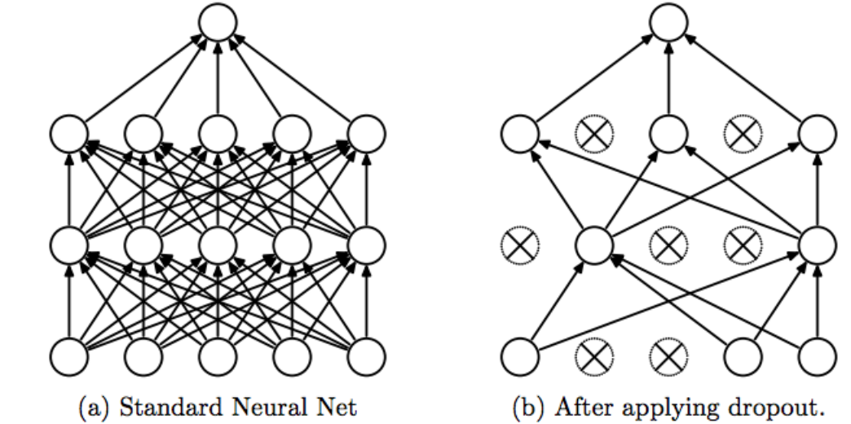
Dropout layer
https://keras.io/api/layers/regularization_layers/dropout/
Dropout layer prevents overfitting by randomly deactivating certain neurons during training.
Random neuron deactivation: During training, in each iteration, a certain number of neurons in the layer are randomly selected and deactivated (set to 0). This means their output is not passed to the next layers. This action is performed for each training sample and in each training epoch. Inputs that are not set to 0 are scaled up by 1 / (1 - rate), ensuring that the sum of all inputs remains unchanged.
Reducing interdependence between neurons: Deactivating random neurons forces the remaining neurons to function without their assistance, which can lead to better generalization.
Application only during training: The Dropout layer is applied only during training. During testing or model evaluation, all neurons are activated, and their outputs are normalized.

Slide 33
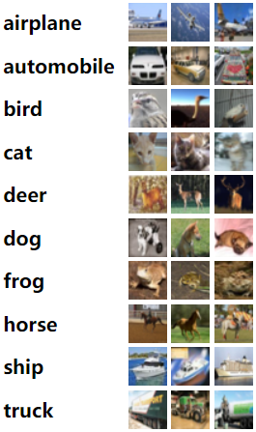
Project 4 (14 points)
Your task is to implement and test a neural network model for classifying the CIFAR-10 dataset.
CIFAR-10 is a popular dataset containing 60,000 color images of 32x32 pixels, divided into 10 classes. Each class represents different objects, such as cars, dogs, ships, etc.
Suggested layers to use: Conv2D, Dropout, Dense, MaxPooling2D, Flatten.
Note: If the number of layers exceeds 10, add a kernel_initializer to improve the CNN's performance and prevent the vanishing gradient problem.
The results of the network should be presented in a report including:
Network visualization
Export the network as .keras
Confusion Matrix
Training history plot
Final accuracy on the test data
Source code

Slide 34
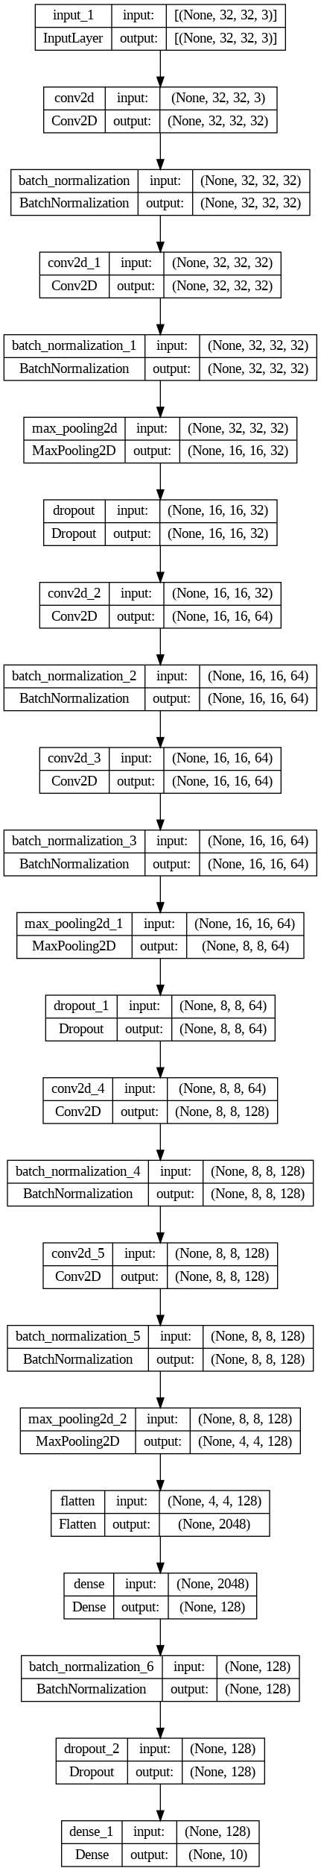
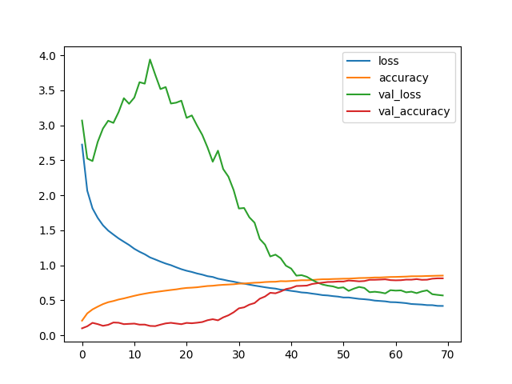
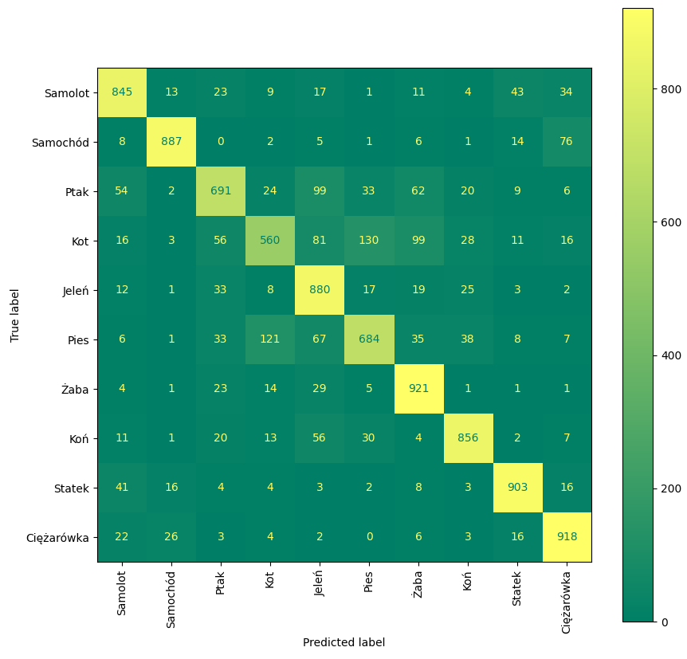
Project 4
Network visualization
Training history plot
Confusion Matrix
….
Final accuracy on the test data 0. 81

Slide 35
Project 4
Grading criteria:
- Accuracy < 0.599 → 0 points
- 0.600 < Accuracy < 0.699 → 7 points
- 0.700 < Accuracy > 0.779 → 9 points
- 0.78 < Accuracy > 0.799 → 12 points
- Accuracy > 0.800 → 14 points
https://franky07724-57962.medium.com/once-upon-a-time-in-cifar-10-c26bb056b4ce https://www.kaggle.com/code/kedarsai/cifar-10-88-accuracy-using-keras/ https://machinelearningmastery.com/how-to-develop-a-cnn-from-scratch-for-cifar-10-photo-classification/

Slide 36
Addendum: the initialized kernel weights in a given layer.
The `kernel_initializer` in the Keras library is a parameter of a layer that allows defining the weight initialization strategy in neural network layers:
`random_uniform`: Initializes weights according to a uniform distribution.
`random_normal`: Initializes weights according to a normal distribution.
`glorot_uniform` (also known as Xavier): Initializes weights according to the strategy proposed by Glorot and Bengio, which handles the vanishing gradient problem better in deep neural networks.
`glorot_normal`: Similar to `glorot_uniform`, but initializes weights according to a normal distribution.
Other initialization strategies, such as `he_uniform`, `he_normal`, `lecun_uniform`, `lecun_normal`, which have also been proposed to improve the performance of neural networks in various scenarios.

Slide 37
Addendum: layer normalization
BatchNormalization() is a technique for normalizing input data for each mini-batch during the training of a neural network. The normalization of input data involves scaling activations (e.g., output values from activation functions) to have a mean close to 0 and a variance close to 1. This is achieved by computing the mean and standard deviation for each batch of training data and applying a linear transformation to each activation. This transformation normalizes activations by subtracting the mean and dividing by the standard deviation.
The benefits of using BatchNormalization include:
1. Reduction of the vanishing/exploding gradient problem.
2. Faster learning.
3. Regularization.
4. Increased ability to use larger learning rates.
https://keras.io/api/layers/normalization_layers/batch_normalization/

