Slide 1

THE BRAND
Doddy.
Your mate in your pocket.
CHARACTER FIRST. PRODUCT SECOND.
Doddy / Brand Guidelines v1.3
01

Slide 2

STRATEGY
Contents
One character. Many places.
Identity / Character / Typography / Colour / Motion / Product / Social / Handoff
Doddy / Brand Guidelines v1.3
02

Slide 3

STRATEGY
Brand idea
A capable mate, not a know-it-all.
Doddy turns practical intelligence into a recognisable, accessible companion. Friendly and lively when appropriate; precise, careful and clear when it matters.
Doddy / Brand Guidelines v1.3
03

Slide 4

STRATEGY
Promise
Useful first. Memorable always.
The character creates familiarity through content. The product earns repeat use through clear value, speed, honesty and follow-through.
Doddy / Brand Guidelines v1.3
04

Slide 5

STRATEGY
The character-first route
Meet Doddy. Like Doddy. Use Doddy.
Short-form storytelling → recognition → product invitation → repeated useful moments. The brand never promises capabilities the app cannot deliver.
Doddy / Brand Guidelines v1.3
05

Slide 6

STRATEGY
Five personality traits
Friendly. Capable. Playful. Curious. Reliable.
Cheeky is an accent, never the default. The interaction always prioritises the user’s context, consent and task.
Doddy / Brand Guidelines v1.3
06

Slide 7

STRATEGY
What Doddy is / is not
A mate with judgment. Not a mascot with opinions.
YES: energetic, considerate, witty, helpful. NO: intrusive, childish, overconfident, sarcastic in sensitive situations.
Doddy / Brand Guidelines v1.3
07

Slide 8
VOICE
Voice and tone
“Oi, what’s happening?”
Casual opening when appropriate. “Got it. Here’s what I found.” for competence. “That didn’t work. Want me to try another way?” when recovering from a failure.
Doddy / Brand Guidelines v1.3
08

Slide 9

VOICE
Context sets the tone
Humour is optional. Clarity is not.
In health, legal, financial, distress and safety contexts: calm, accurate, respectful; no jokes, false certainty or invented action confirmations.
Doddy / Brand Guidelines v1.3
09

Slide 10
IDENTITY
Primary colour palette
Doddy Orange
Ink Black
Warm Paper
Night
Paper White
#FF7A00
#0B0B0B
#F7F2E9
#151515
#FFFDF7
Doddy / Brand Guidelines v1.3
10

Slide 11

IDENTITY
Accessible contrast
Ink for words. Orange for energy.
On warm paper, use near-black for body copy. Orange is for distinctive marks, emphasis and sufficiently large display elements—not small text.
Doddy / Brand Guidelines v1.3
11

Slide 12
IDENTITY
Typography system
Your mate in your pocket.
Inter Display Bold / Headline
Inter / interface • body • labels
Custom hand-inked display lettering is an art direction, not a license-free font asset.
Doddy / Brand Guidelines v1.3
12

Slide 13
IDENTITY
Type scale
One expressive voice. One readable system.
Hero 60/62 • H1 40/44 • H2 32/36 • H3 24/30 • Body 16/24 • Label 13/18. Illustration-like headlines should remain hand-crafted.
Doddy / Brand Guidelines v1.3
13

Slide 14



IDENTITY
Logo system
Primary
Secondary
Reversed
Doddy / Brand Guidelines v1.3
14

Slide 15

IDENTITY
Logo integrity
A marker, not a paragraph.
Use sufficient clear space equal to the character eye width. Never distort, add glow/shadows, set tiny slogans, or redraw the eyes inconsistently.
Doddy / Brand Guidelines v1.3
15

Slide 16
CHARACTER
Character anatomy
Head
Organic, near-round; recognisable in tiny avatar.
Eyes
Two filled vertical ovals with deliberate asymmetry.
Smile
One curved, slightly off-centre stroke.
Body
Flexible ink line; minimal anatomy.
Accessories
Oversized trainers + backpack. Basketball optional.
Doddy / Brand Guidelines v1.3
16

Slide 17
CHARACTER
Proportions and stroke
3 head-heights. One unmistakable face.
Character canvas: 420 × 580 units. Head ~185 units wide, core outlines 8–14 units. Rounded ink ends; imperfect but intentional geometry.
Doddy / Brand Guidelines v1.3
17

Slide 18


CHARACTER
Turnaround
Front
Three-Quarter Draft
Side
Back
Doddy / Brand Guidelines v1.3
18

Slide 19








CHARACTER
Expressions / 01–10
Happy
Excited
Curious
Thinking
Confused
Cheeky
Laughing
Surprised
Proud
Focused
Doddy / Brand Guidelines v1.3
19

Slide 20









CHARACTER
Expressions / 11–20
Concerned
Relaxed
Tired
Determined
Impressed
Sceptical
Embarrassed
Celebrating
Sad
Supportive
Doddy / Brand Guidelines v1.3
20

Slide 21





CHARACTER
Expressions / 21–30
Listening
Explaining
Neutral
Joyful
Love
Disappointed
Impatient
Questioning
Confident
Flattered
Doddy / Brand Guidelines v1.3
21

Slide 22




CHARACTER
Pose library / 01–09
Neutral
Waving
Pointing
Using Phone
Thinking
Celebrating
Walking
Running
Dribbling
Doddy / Brand Guidelines v1.3
22

Slide 23






CHARACTER
Pose library / 10–18
Jumping
Sitting
Listening
Explaining
Reading
Working
Resting
Greeting
Holding Ball
Doddy / Brand Guidelines v1.3
23

Slide 24





CHARACTER
Pose library / 19–25
Shooting Ball
Dancing
Curious
Supporting
Confident
Searching
Thumbs Up
Doddy / Brand Guidelines v1.3
24

Slide 25


CHARACTER
Signature accessories
Basketball
Orange Backpack
Doddy / Brand Guidelines v1.3
25

Slide 26
CHARACTER
Character must-haves
Keep the face. Keep the shoes.
Round ivory head; black oval eyes; asymmetric smile; expressive three-stroke tuft; orange pack; oversized orange/white trainers. Hand-made energy at every scale.
Doddy / Brand Guidelines v1.3
26

Slide 27
CHARACTER
Character restrictions
Never generic. Never shiny.
No 3D robots, polished gradients, detailed fingers, realistic hair, fluctuating head geometry or unapproved pupils. Orange supports identity, not every pixel.
Doddy / Brand Guidelines v1.3
27

Slide 28
CHARACTER
Adaptive assets
Full character → head → simplified glyph.
≥128 px: full body. 64–127 px: head and orange badge. 32–63 px: simplified head. <32 px: tested monochrome glyph. Validate actual pixel size.
Doddy / Brand Guidelines v1.3
28

Slide 29





VISUAL LANGUAGE
Supporting graphic elements
Lightning
Arrow
Swoosh
Star
Crown
Doddy / Brand Guidelines v1.3
29

Slide 30
VISUAL LANGUAGE
Light and dark environments
The same mate. Different light.
Warm Paper supports illustration and content. Night Ink supports voice, ambience and cinematic moments. Preserve colour semantics in both.
Doddy / Brand Guidelines v1.3
30

Slide 31



PRODUCT
App icon directions
Orange
Dark
Paper
Doddy / Brand Guidelines v1.3
31

Slide 32
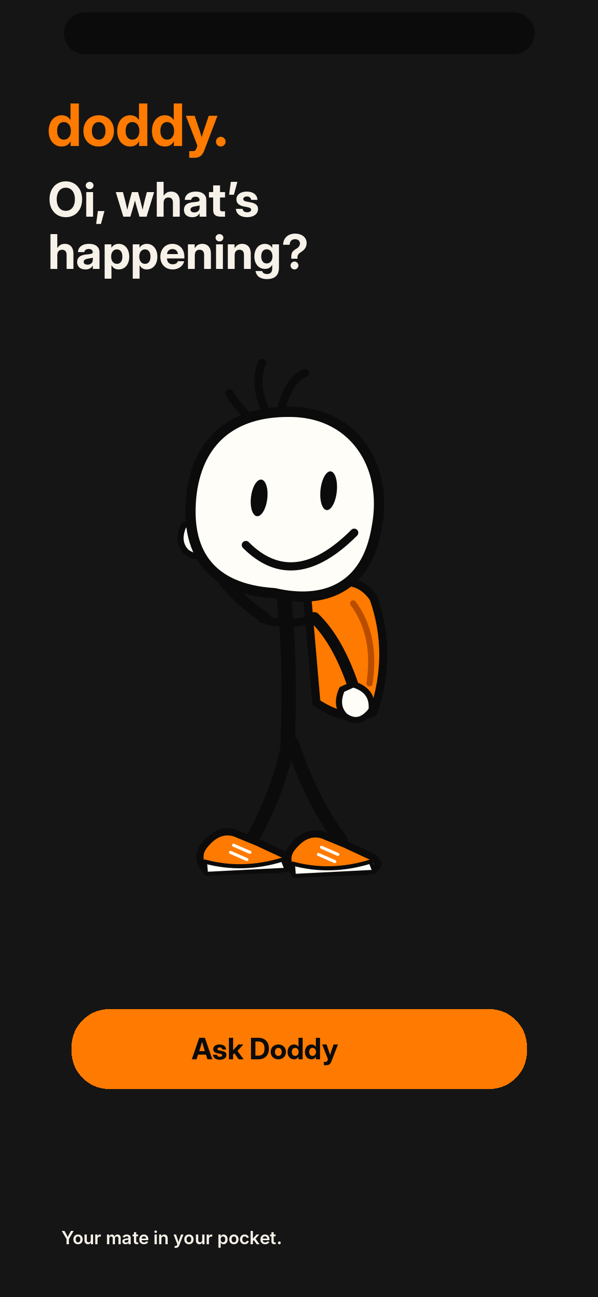
PRODUCT
App state / Home
Ready when you are.
A branded illustration supports the interface. Accessible labels and actual system state remain essential.
Doddy / Brand Guidelines v1.3
32

Slide 33
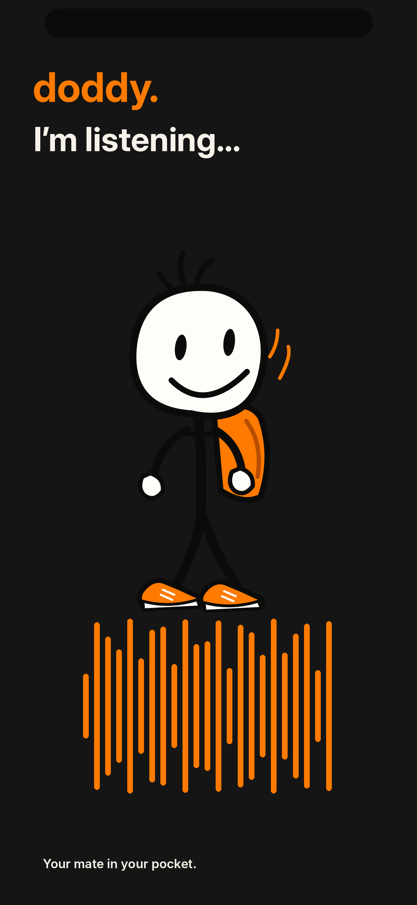
PRODUCT
App state / Listening
Signal reflects real audio.
A branded illustration supports the interface. Accessible labels and actual system state remain essential.
Doddy / Brand Guidelines v1.3
33

Slide 34
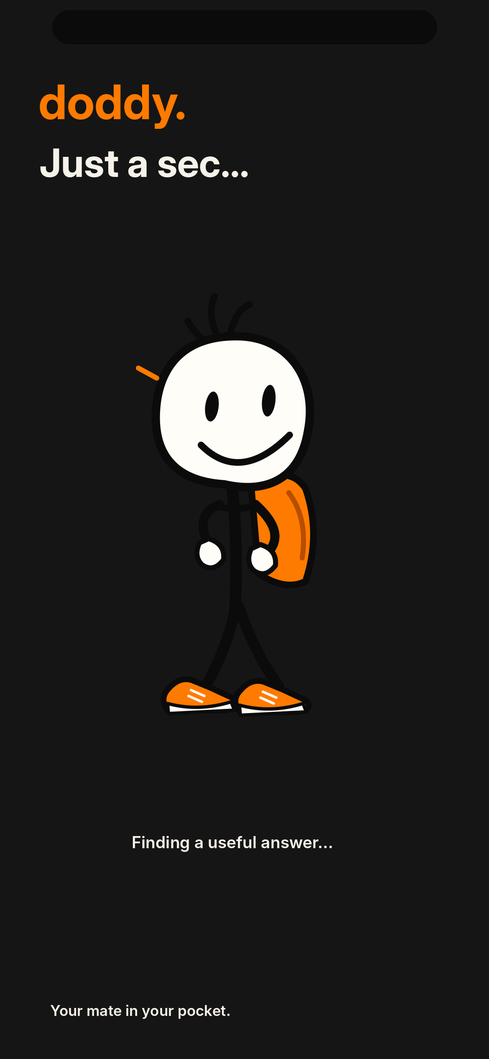
PRODUCT
App state / Thinking
Visible progress, not spinner theatre.
A branded illustration supports the interface. Accessible labels and actual system state remain essential.
Doddy / Brand Guidelines v1.3
34

Slide 35
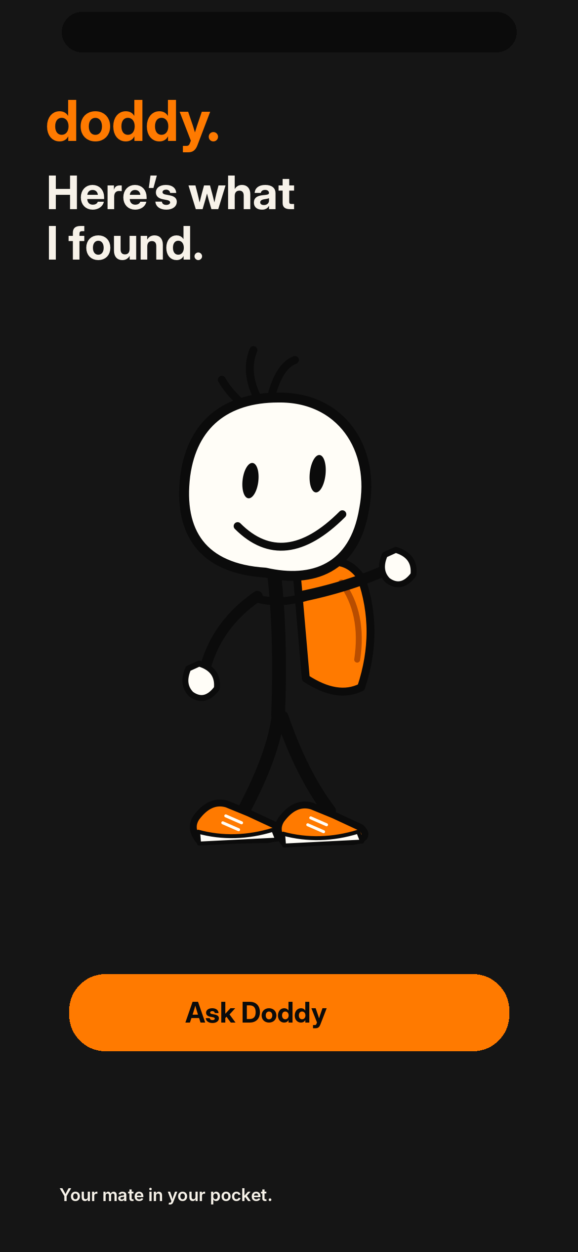
PRODUCT
App state / Speaking
The answer is the hero.
A branded illustration supports the interface. Accessible labels and actual system state remain essential.
Doddy / Brand Guidelines v1.3
35

Slide 36
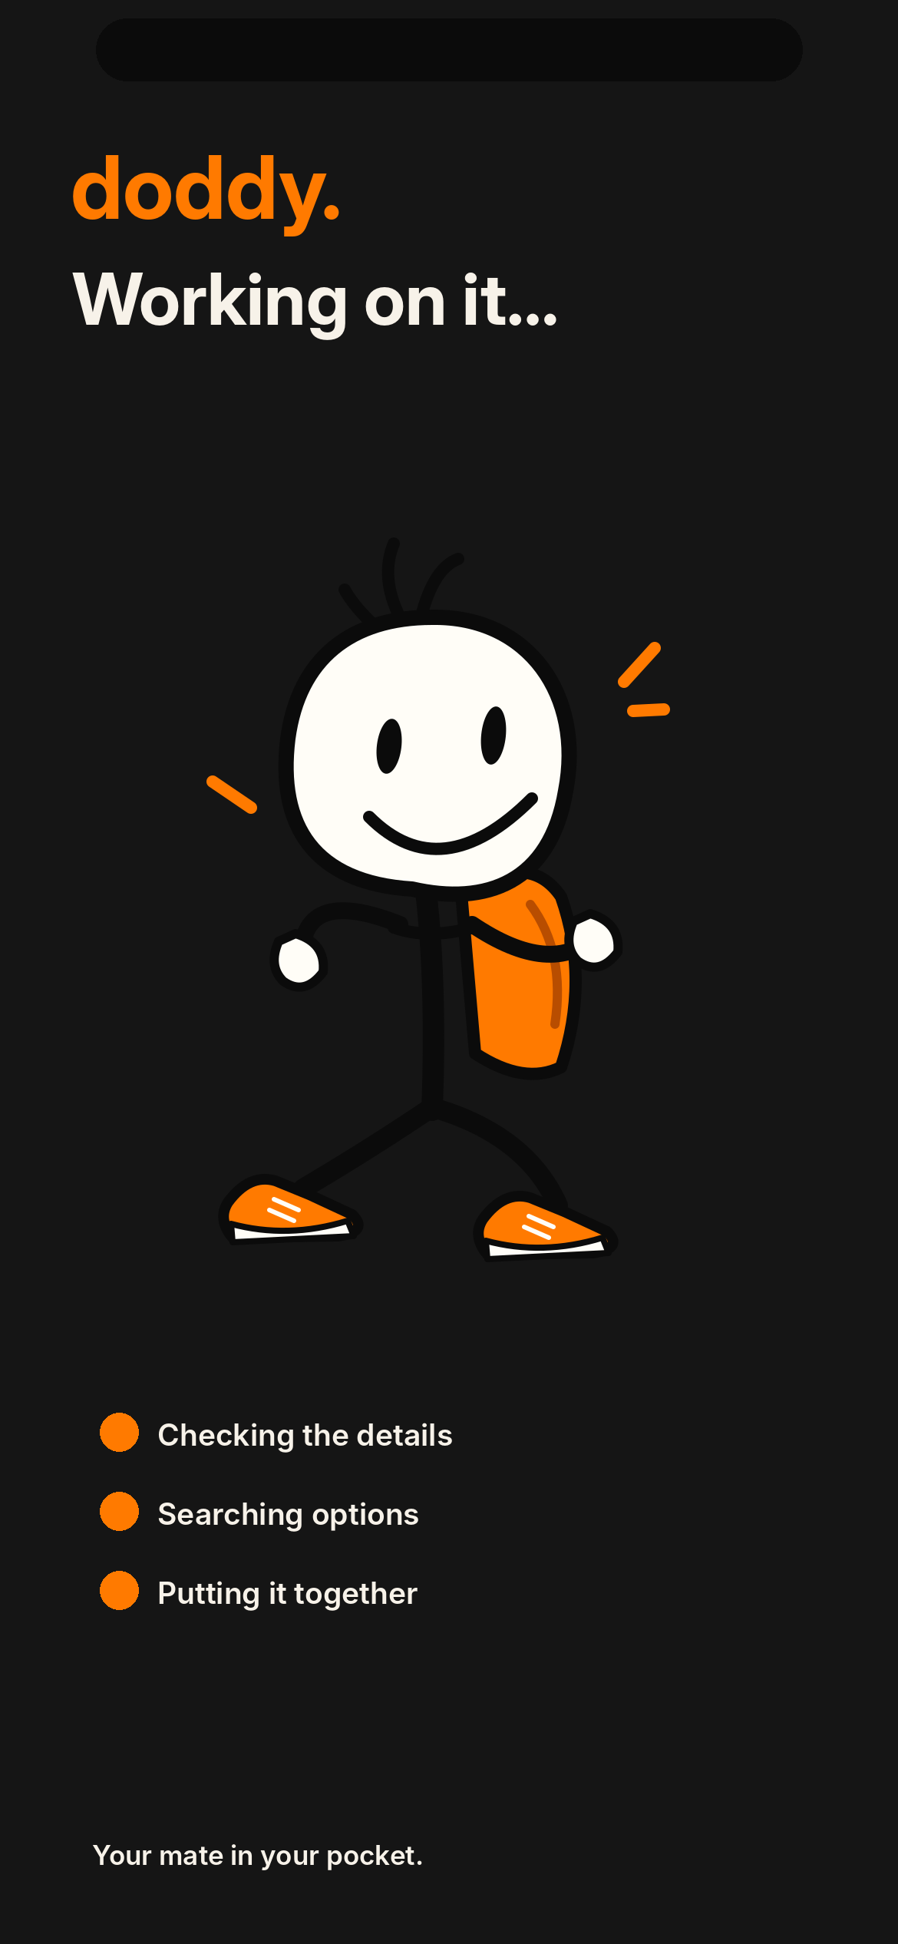
PRODUCT
App state / Action
Show the action stage accurately.
A branded illustration supports the interface. Accessible labels and actual system state remain essential.
Doddy / Brand Guidelines v1.3
36

Slide 37
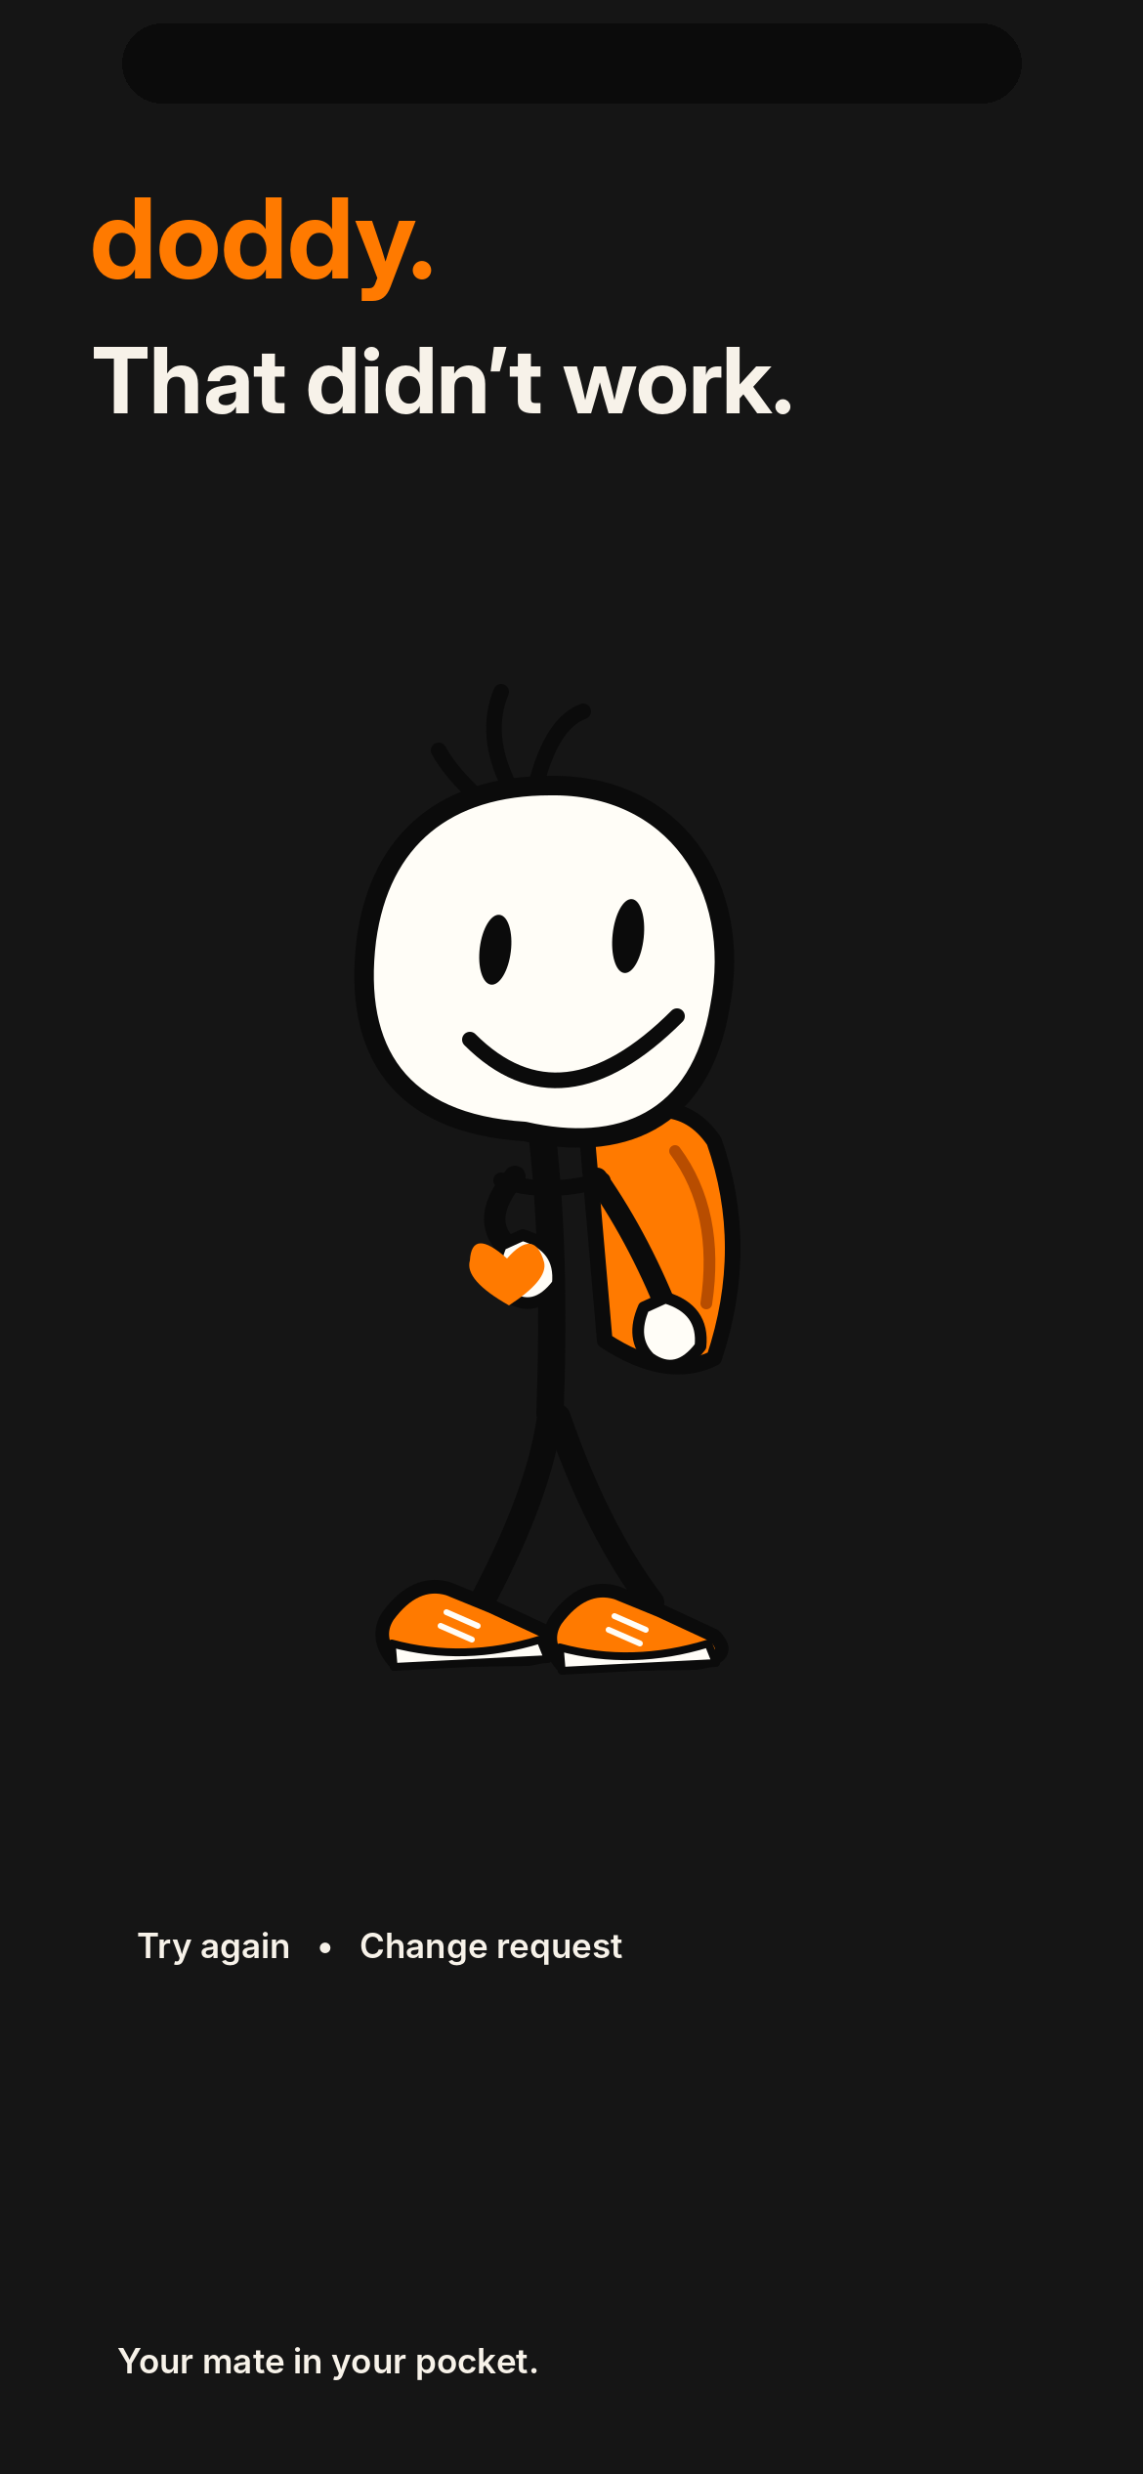
PRODUCT
App state / Error
Recover without blame or nonsense.
A branded illustration supports the interface. Accessible labels and actual system state remain essential.
Doddy / Brand Guidelines v1.3
37

Slide 38
PRODUCT
Onboarding and permissions
Earn trust before asking for access.
Explain what Doddy can do and what he cannot read automatically. Back Tap requires user setup. Provide clear voice/memory/data controls.
Doddy / Brand Guidelines v1.3
38

Slide 39
PRODUCT
System integration boundaries
Helpful within iOS rules.
Dynamic Island and Live Activities are system- and activity-scoped. Neither provides a permanent free-running mascot. Do not depict unsupported automation as shipped functionality.
Doddy / Brand Guidelines v1.3
39

Slide 40
MOTION
Motion principles
Never teleport. Always explain state.
Invoke instantly; keep spatial continuity; listen to actual microphone data; allow interruptions; distinguish proposed versus completed actions.
Doddy / Brand Guidelines v1.3
40

Slide 41
MOTION
Motion tokens
ACKNOWLEDGE
100–140 ms
Input received
ENTER
240–320 ms
Character arrival
THINK
220–320 ms
Processing/hand-off
SUCCESS
260–450 ms
Action completed
EXIT
180–260 ms
Surface recedes
Doddy / Brand Guidelines v1.3
41

Slide 42
MOTION
State loop
Listen → understand → do → confirm.
An illustration is never proof of successful action. A task must explicitly move from intent to confirmation to verified result or recovery.
Doddy / Brand Guidelines v1.3
42

Slide 43
MOTION
Reduce Motion
Meaning survives without movement.
Use short fades and explicit text labels when iOS Reduce Motion is enabled. No indefinite flashing, forced audio, or animated state-only signalling.
Doddy / Brand Guidelines v1.3
43

Slide 44
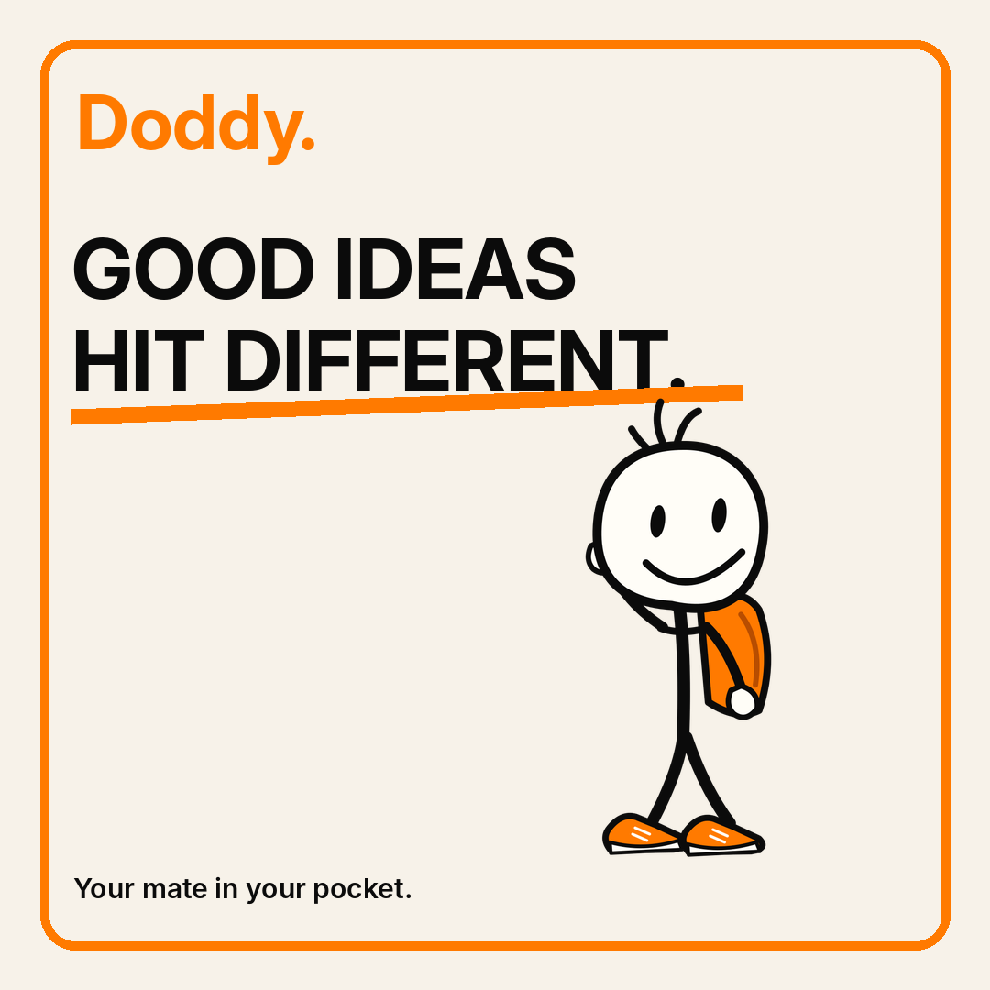
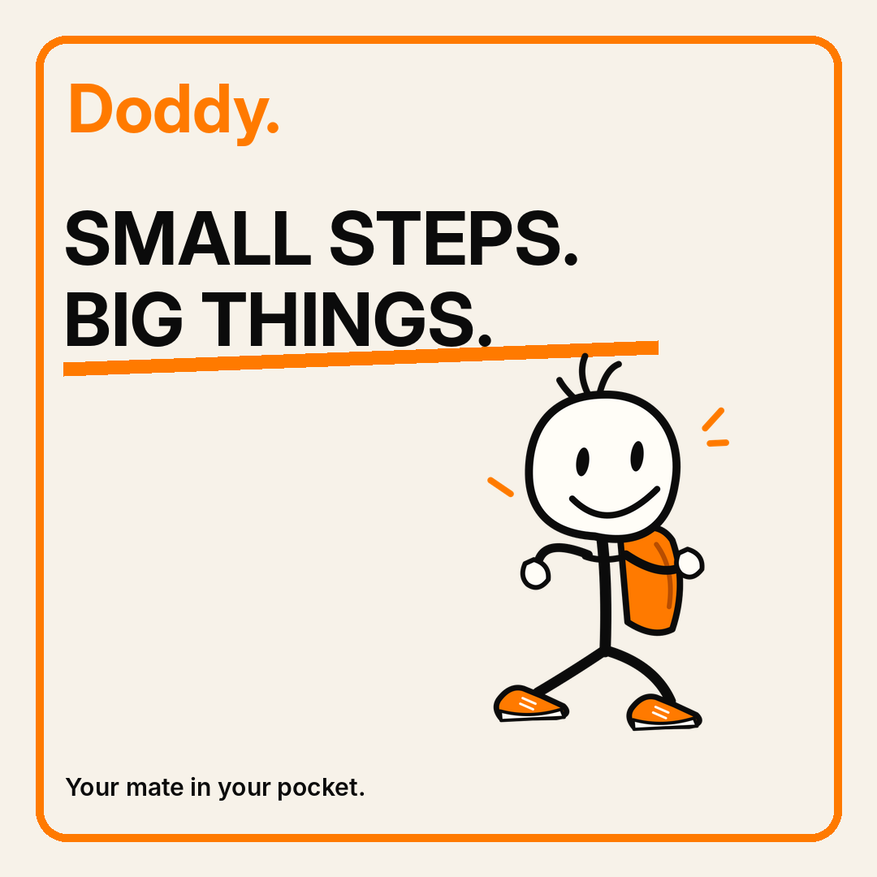
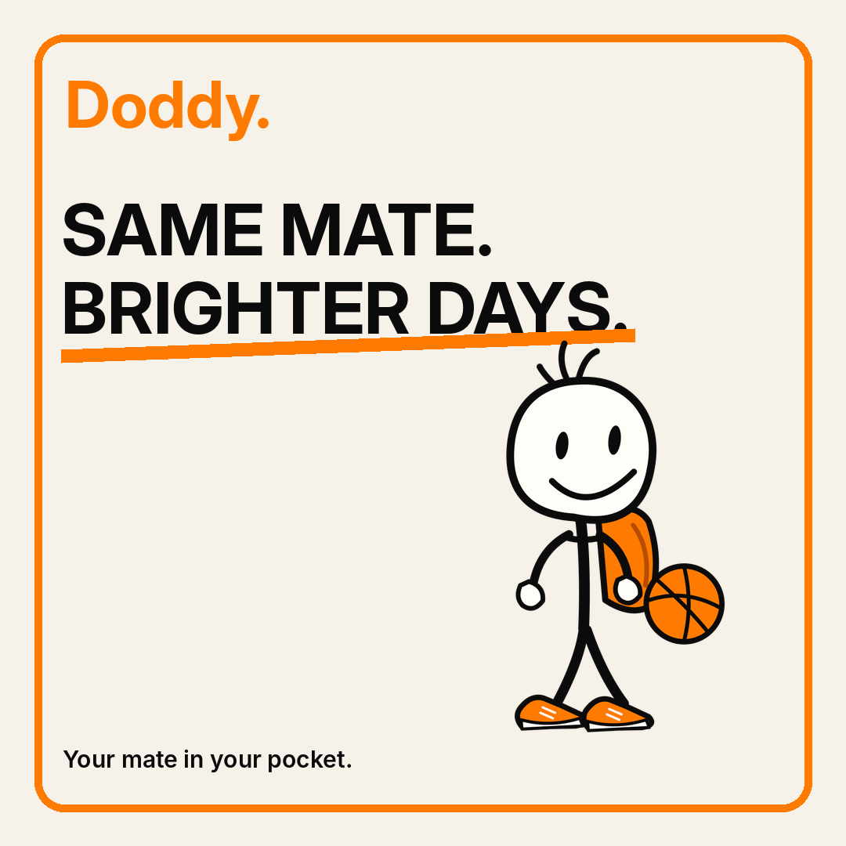
SOCIAL
Instagram editorial templates
Repeatable editorial grid: headline + attitude + character behaviour + one clear idea.
Doddy / Brand Guidelines v1.3
44

Slide 45
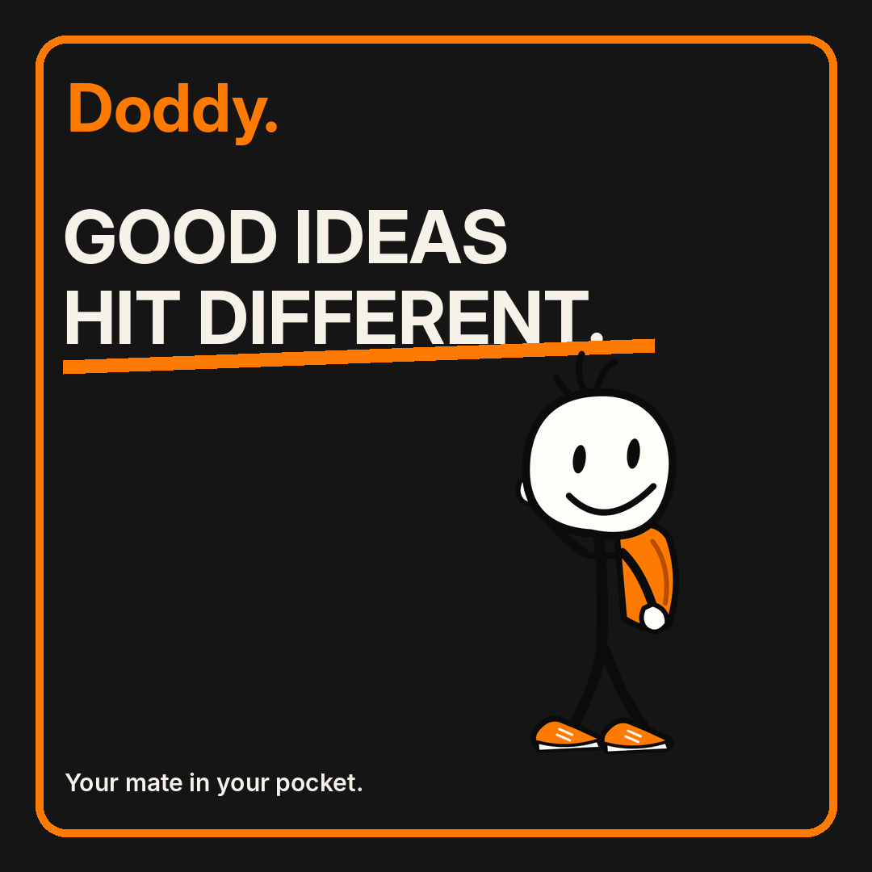
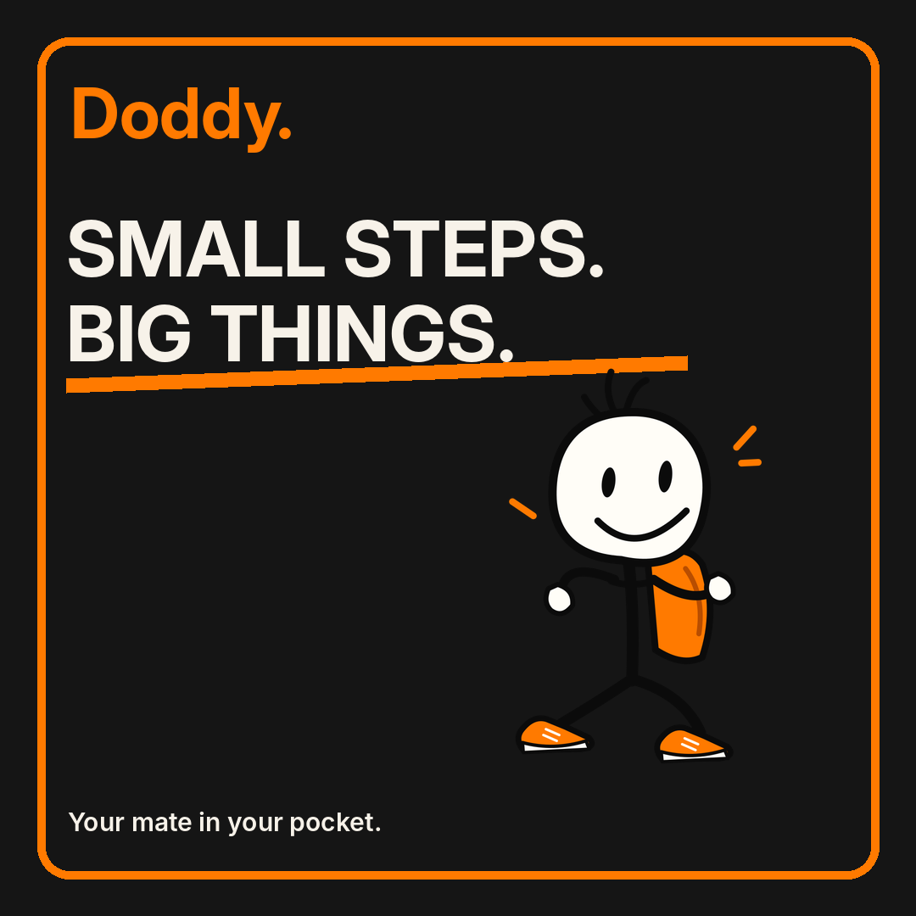
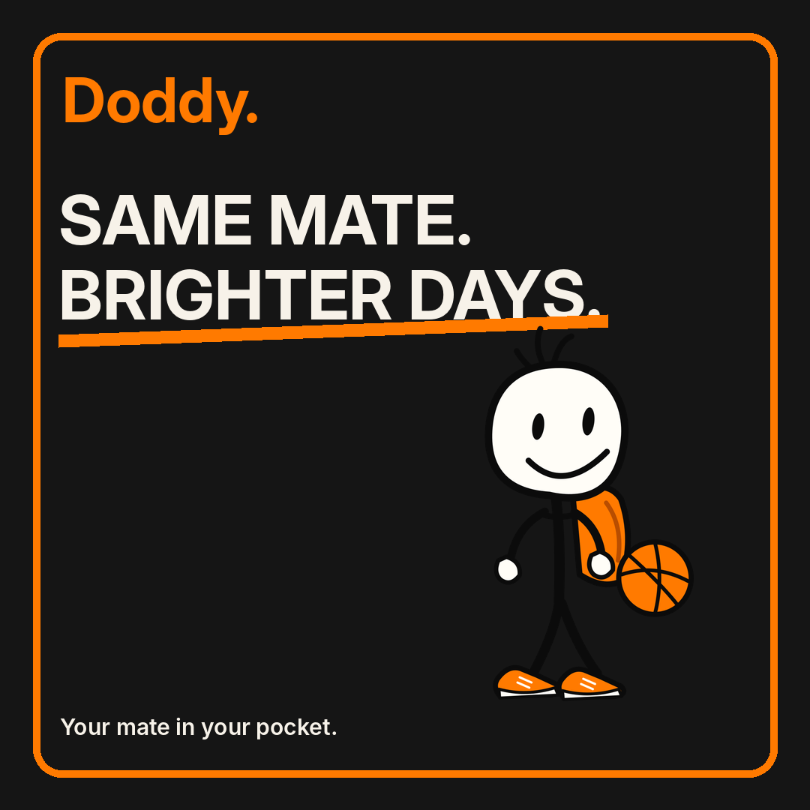
SOCIAL
Social at night
The same visual vocabulary, ready for nighttime storytelling and app launch moments.
Doddy / Brand Guidelines v1.3
45

Slide 46
SOCIAL
Character storytelling
Let everyday problems carry the plot.
Set-up → minor problem → Doddy response → human moment → optional useful app moment. Keep stories worth watching before any product CTA.
Doddy / Brand Guidelines v1.3
46

Slide 47
SOCIAL
Content-to-product conversion
Recognition is not retention.
Content introduces the mate. The app has to win on repeat tasks, memory consent, quick invocation and verified utility. Never use views alone as product proof.
Doddy / Brand Guidelines v1.3
47

Slide 48
HANDOFF
Accessibility
Personality must remain legible.
Interface copy ≥16 pt default, reliable contrast, readable transcript, VoiceOver alternative labels, reduced motion, and no colour-only statuses.
Doddy / Brand Guidelines v1.3
48

Slide 49
HANDOFF
Developer tokens
One JSON source of truth.
Brand swatches, radii, spacing and default motion durations ship as machine-readable JSON. Resolve semantic contrast at component level.
Doddy / Brand Guidelines v1.3
49

Slide 50
HANDOFF
Export rules
Source SVG + practical PNG.
Source SVGs are editable vector geometry. PPTX copy and components are editable; raster illustration previews link to companion SVGs. Do not treat image previews as masters.
Doddy / Brand Guidelines v1.3
50

Slide 51
HANDOFF
Naming and inventory
Make it easy to find the right Doddy.
Assets follow Doddy_<category>_<state>_<theme> naming. Every delivered asset is indexed in ASSET_INVENTORY.csv with SHA-256 and file size.
Doddy / Brand Guidelines v1.3
51

Slide 52
HANDOFF
Release QA
Check actual assets. Not just mockups.
Verify consistent eyes, shoes, pack, background transparency, readable type, generated SVG parsing, GIF playback and PDF/PPTX page counts.
Doddy / Brand Guidelines v1.3
52

Slide 53
HANDOFF
Approvals before brand freeze
The final artist pass matters.
3/4 character view, custom outlined wordmark, organic line-work and finished rig animations require specialist review. This v1.3 package is real and usable, not an unsupported claim of final sign-off.
Doddy / Brand Guidelines v1.3
53

Slide 54

END
Doddy.
Your mate in your pocket.
Doddy / Brand Guidelines v1.3
54

